Slide 1
Data & Graphing

Slide 2
Types of data
Quantitative
Continuous, discrete
Qualitative
Categorical, Ordinal
Notes:
Continuous variable: Continuous variables are numeric measurements or observations that can include any number of values within a certain range. (E.g. temperature, time, weight, and concentration).
Discrete variable: Discrete variables are measured as whole units. (E.g. number of birds in a population, number of students in a class).
Categorical variable: Categorical variables describe a quality or a characteristic (E.g. Colour, species, sex, blood type)

Slide 3
Types of data
Continuous variables: numeric measurements or observations that can include any number of values within a certain range. (E.g. temperature, time, albedo, energy, weight, and concentration).
Notes:
Continuous variable: Continuous variables are numeric measurements or observations that can include any number of values within a certain range. (E.g. temperature, time, weight, and concentration).
Discrete variable: Discrete variables are measured as whole units. (E.g. number of birds in a population, number of students in a class).
Categorical variable: Categorical variables describe a quality or a characteristic (E.g. Colour, species, sex, blood type)

Slide 4
Types of data
Continuous variables: numeric measurements or observations that can include any number of values within a certain range. (E.g. temperature, time, albedo, energy, weight, and concentration).
Discrete variable: Discrete variables are measured as whole units. (E.g. number of birds in a population, number of students in a class).
Notes:
Continuous variable: Continuous variables are numeric measurements or observations that can include any number of values within a certain range. (E.g. temperature, time, weight, and concentration).
Discrete variable: Discrete variables are measured as whole units. (E.g. number of birds in a population, number of students in a class).
Categorical variable: Categorical variables describe a quality or a characteristic (E.g. Colour, species, sex, blood type)

Slide 5
Types of data
Categorical variable: describe a quality or a characteristic (E.g. Color, species, sex, blood type, location a tick is found)
Notes:
Continuous variable: Continuous variables are numeric measurements or observations that can include any number of values within a certain range. (E.g. temperature, time, weight, and concentration).
Discrete variable: Discrete variables are measured as whole units. (E.g. number of birds in a population, number of students in a class).
Categorical variable: Categorical variables describe a quality or a characteristic (E.g. Colour, species, sex, blood type)

Slide 6
 | State | zipcode | Family_size | Annual_income
1 | Florida | 32716 | 8 | 20000
2 | Alabama | 35236 | 5 | 80000
3 | Florida | 32116 | 6 | 1350000
4 | Florida | 33679 | 5 | 2100000
5 | Alabama | 36374 | 4 | 2100000
6 | California | 94565 | 1 | 2300000
Notes:
Zip code, categorical
Family size – quantative
Annual income - quantitative

Slide 7
Consumer Reports analyzed a dataset of 77 breakfast cereals. Here is a part of the dataset.

Slide 8
Graphing

Slide 9
Independent value on x-axis
Dependent value on y-axis
Not always clear
TIME *always* on x-axis

Slide 10
Before you make a graph, consider:
Do I need a graph?
Will a sentence or table suffice?
What types of variables do I have?
Determines which type of graph and what statistics I might run.
What is my message?
What do you want your graph to show?

Slide 11
Before you make a graph, consider:
Do I need a graph?
Will a sentence or table suffice?
What types of variables do I have?
Determines which type of graph and what statistics I might run.
What is my message?
What do you want your graph to show?

Slide 12
Before you make a graph, consider:
Do I need a graph?
Will a sentence or table suffice?
What types of variables do I have?
Determines which type of graph and what statistics I might run.
What is my message?
What do you want your graph to show?

Slide 13
Scatter (XY) plots – Scatter plots are used for examining relationships between two types of data. The dots are not normally connected in a scatter plot, though a ‘best-fit’ or regression line may be drawn through the points to illustrate the relationship.
Add a trendline! (R²)
Notes:
Line Charts are generally used to depict a trend of data over time.
The leaner and much more elegant alternative to the pie chart is the bar chart, that is able to express all that the pie says and much more, without making a mess of labels and legends.
Line charts can display continuous data over time, set against a common scale, and are therefore ideal for showing trends in data at equal intervals or over time. In a line chart, category data is distributed evenly along the horizontal axis, and all value data is distributed evenly along the vertical axis.
Scatter charts are commonly used for displaying and comparing numeric values, such as scientific, statistical, and engineering data. These charts are useful to show the relationships among the values in several data series, and they can plot two groups of numbers as one series of xy coordinates.

Slide 14
R-squared values range from 0 to 1 and are commonly stated as percentages
R-squared = Explained variation / Total variation
0% indicates that the model explains none of the variability of the response data around its mean.
100% indicates that the model explains all the variability of the response data around its mean.

Slide 15
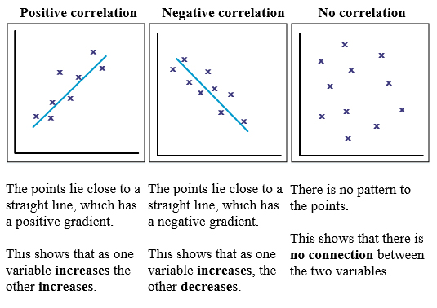
Notes:
R-squared values range from 0 to 1 and are commonly stated as percentages from 0% to 100%.
R-squared = Explained variation / Total variation
0% indicates that the model explains none of the variability of the response data around its mean.
100% indicates that the model explains all the variability of the response data around its mean.

Slide 16
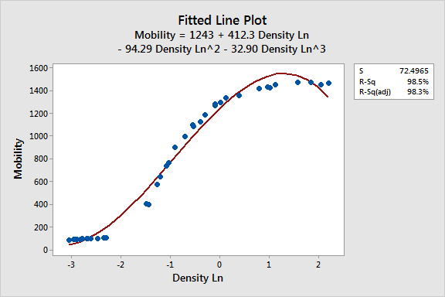
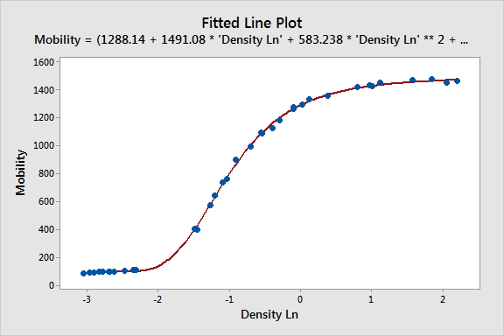

Slide 17
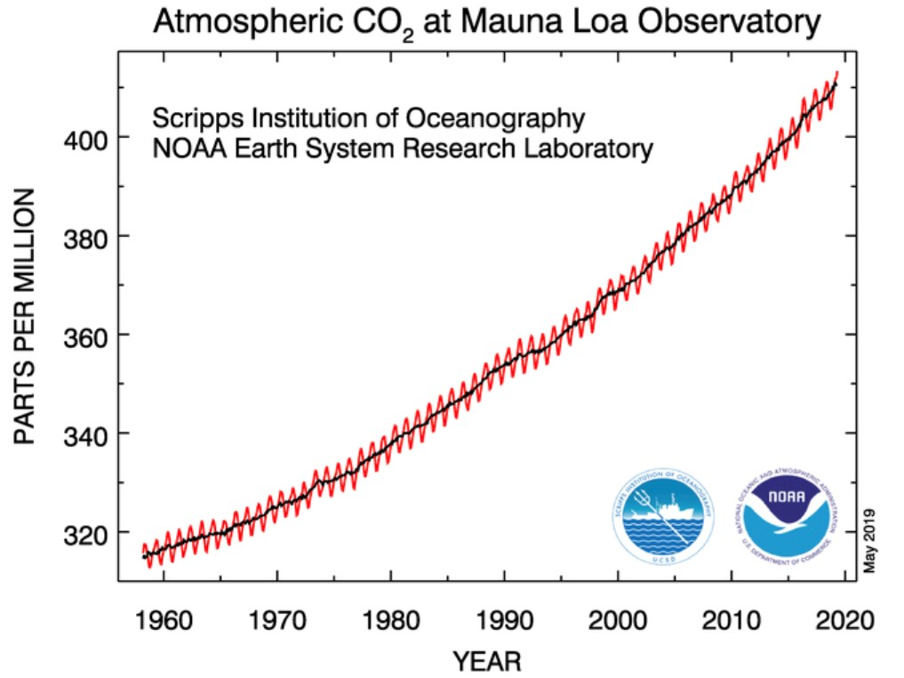
Line Graphs – are generally used to depict a trend of data over time.
**OR In a line chart, category data is distributed evenly along the horizontal axis, and all value data is distributed evenly along the vertical axis.
Notes:
Line Charts are generally used to depict a trend of data over time.
The leaner and much more elegant alternative to the pie chart is the bar chart, that is able to express all that the pie says and much more, without making a mess of labels and legends.
Line charts can display continuous data over time, set against a common scale, and are therefore ideal for showing trends in data at equal intervals or over time. In a line chart, category data is distributed evenly along the horizontal axis, and all value data is distributed evenly along the vertical axis.
Scatter charts are commonly used for displaying and comparing numeric values, such as scientific, statistical, and engineering data. These charts are useful to show the relationships among the values in several data series, and they can plot two groups of numbers as one series of xy coordinates.

Slide 18
Bar Graphs (Columns) – Bar graphs are used for making comparisons between discrete cases or to look for trends, such as over space or time. Bar graphs are appropriately used when one of the axes — usually the X — is discontinuous, evenly spaced (e.g., dates) or non-numeric (e.g., station codes).
Notes:
Line Charts are generally used to depict a trend of data over time.
The leaner and much more elegant alternative to the pie chart is the bar chart, that is able to express all that the pie says and much more, without making a mess of labels and legends.
Line charts can display continuous data over time, set against a common scale, and are therefore ideal for showing trends in data at equal intervals or over time. In a line chart, category data is distributed evenly along the horizontal axis, and all value data is distributed evenly along the vertical axis.
Scatter charts are commonly used for displaying and comparing numeric values, such as scientific, statistical, and engineering data. These charts are useful to show the relationships among the values in several data series, and they can plot two groups of numbers as one series of xy coordinates.

Slide 19
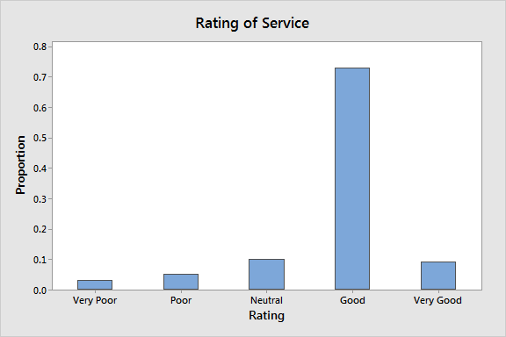
Bar Graphs (Columns) – Bar graphs are used for making comparisons between categories or to look for trends, such as over space or time. Bar graphs are appropriately used when one of the axes — usually the X — is discontinuous, evenly spaced (e.g., dates) or categorical.
Notes:
Line Charts are generally used to depict a trend of data over time.
The leaner and much more elegant alternative to the pie chart is the bar chart, that is able to express all that the pie says and much more, without making a mess of labels and legends.
Line charts can display continuous data over time, set against a common scale, and are therefore ideal for showing trends in data at equal intervals or over time. In a line chart, category data is distributed evenly along the horizontal axis, and all value data is distributed evenly along the vertical axis.
Scatter charts are commonly used for displaying and comparing numeric values, such as scientific, statistical, and engineering data. These charts are useful to show the relationships among the values in several data series, and they can plot two groups of numbers as one series of xy coordinates.

Slide 20
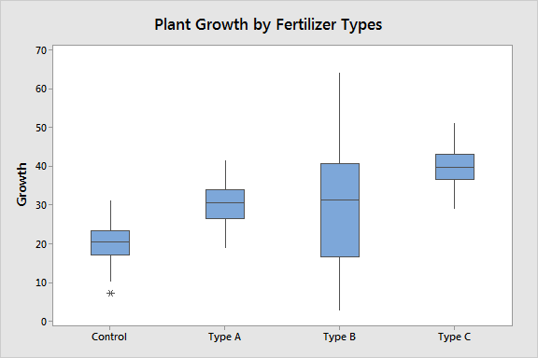
Box plots (and t-test)
*continuous data broken into categories

Slide 21
T-test
A statistical test that determines whether there is a statistically significant difference between the means in two unrelated groups.
A t-test’s statistical significance indicates whether or not the difference between two groups’ averages most likely reflects a “real” difference in the population from which the groups were sampled.

Slide 22
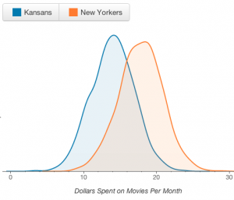
T-test
Interested in whether the average New Yorker spends more than the average Kansan per month on movies.
Notes:
You ask a sample of 3 people from each state about their movie spending. You might observe a difference in those averages (like $14 for the average Kansan and $18 for the average New Yorker). But that difference is not statistically significant; it could easily just be random luck of which 3 people you randomly sampled that makes one group appear to spend more money than the other. If instead you ask 300 New Yorkers and 300 Kansans and still see a big difference, that difference is less likely to be caused by the sample being unrepresentative.

Slide 23
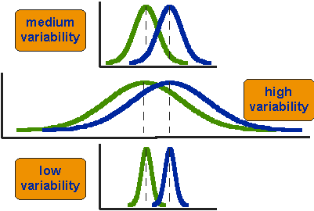
T-test
Notes:
You ask a sample of 3 people from each state about their movie spending. You might observe a difference in those averages (like $14 for the average Kansan and $18 for the average New Yorker). But that difference is not statistically significant; it could easily just be random luck of which 3 people you randomly sampled that makes one group appear to spend more money than the other. If instead you ask 300 New Yorkers and 300 Kansans and still see a big difference, that difference is less likely to be caused by the sample being unrepresentative.

Slide 24
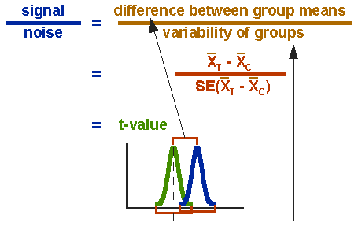
T-test
Notes:
The t-value will be positive if the first mean is larger than the second and negative if it is smaller. Once you compute the t-value you have to look it up in a table of significance to test whether the ratio is large enough to say that the difference between the groups is not likely to have been a chance finding.
The t-value will be positive if the first mean is larger than the second and negative if it is smaller. Once you compute the t-value you have to look it up in a table of significance to test whether the ratio is large enough to say that the difference between the groups is not likely to have been a chance finding.

Slide 26
On making ‘good’ graphs
1. Label everything
https://hackerspace.kinja.com/5-rules-for-making-graphs-1605706367
Notes:
Or well, not everything, but everything not obvious. So label every axis, as clearly as possible and include units when plotting something that has them, like time, temperature, calories.
The x axis doesn't get labeled because the tick marks clearly indicate that these are dates. The figure title alludes to the relationship/pattern the graph is attempting to describe. Never title a graph something like views vs. uniques vs. dates-that's what labels are for. Explain the big picture in the title. And, when labeling all your data, don't let your labels obscure information. Or well, not everything, but everything not obvious. So label every axis, as clearly as possible and include units when plotting something that has them, like time, temperature, calories.
The x axis doesn't get labeled because the tick marks clearly indicate that these are dates. The figure title alludes to the relationship/pattern the graph is attempting to describe. Never title a graph something like views vs. uniques vs. dates-that's what labels are for. Explain the big picture in the title. And, when labeling all your data, don't let your labels obscure information.

Slide 27
On making ‘good’ graphs
1. Label everything
https://hackerspace.kinja.com/5-rules-for-making-graphs-1605706367
Notes:
Or well, not everything, but everything not obvious. So label every axis, as clearly as possible and include units when plotting something that has them, like time, temperature, calories.
The x axis doesn't get labeled because the tick marks clearly indicate that these are dates. The figure title alludes to the relationship/pattern the graph is attempting to describe. Never title a graph something like views vs. uniques vs. dates-that's what labels are for. Explain the big picture in the title. And, when labeling all your data, don't let your labels obscure information. Or well, not everything, but everything not obvious. So label every axis, as clearly as possible and include units when plotting something that has them, like time, temperature, calories.
The x axis doesn't get labeled because the tick marks clearly indicate that these are dates. The figure title alludes to the relationship/pattern the graph is attempting to describe. Never title a graph something like views vs. uniques vs. dates-that's what labels are for. Explain the big picture in the title. And, when labeling all your data, don't let your labels obscure information.

Slide 28
2. Work with the numbers

Slide 29
2. Work with the numbers

Slide 30
3. Choose colors carefully
Notes:
Sequential data use colors in the same family (so pale red to dark red or yellows to oranges to reds or the like) and arrange them from lightest/mildest color to most vivid in the order that matches your data. So large value in your data is important? That's red. Small value important? Than that's red.
Divergent data if your data centers around some neutral central value-like hot and cold temperatures-make that central value a neutral color (like white) and use opposing colors on each side of the neutral (like shades of red for hot and shades of blue for cold).
Qualitive data such as whether a town is rural, urban, or suburban, use a map where the shades are different enough from each other that it is really clear that the data points are somewhat independent.

Slide 31
3. Choose colors carefully
Notes:
Sequential data use colors in the same family (so pale red to dark red or yellows to oranges to reds or the like) and arrange them from lightest/mildest color to most vivid in the order that matches your data. So large value in your data is important? That's red. Small value important? Than that's red.
Divergent data if your data centers around some neutral central value-like hot and cold temperatures-make that central value a neutral color (like white) and use opposing colors on each side of the neutral (like shades of red for hot and shades of blue for cold).
Qualitive data such as whether a town is rural, urban, or suburban, use a map where the shades are different enough from each other that it is really clear that the data points are somewhat independent.

Slide 32
3. Choose colors carefully
Notes:
Sequential data use colors in the same family (so pale red to dark red or yellows to oranges to reds or the like) and arrange them from lightest/mildest color to most vivid in the order that matches your data. So large value in your data is important? That's red. Small value important? Than that's red.
Divergent data if your data centers around some neutral central value-like hot and cold temperatures-make that central value a neutral color (like white) and use opposing colors on each side of the neutral (like shades of red for hot and shades of blue for cold).
Qualitive data such as whether a town is rural, urban, or suburban, use a map where the shades are different enough from each other that it is really clear that the data points are somewhat independent.

Slide 33
4. Use the Correct ‘Graph’ Type
Notes:
There's no hard and fast rule for choosing the correct type. My adviser's suggestion is to think about the questions the visualization is supposed to answer and then work backward from there.

Slide 34
4. Use the Correct ‘Graph’ Type
Notes:
There's no hard and fast rule for choosing the correct type. My adviser's suggestion is to think about the questions the visualization is supposed to answer and then work backward from there.

Slide 35
4. Use the Correct ‘Graph’ Type
Notes:
There's no hard and fast rule for choosing the correct type. My adviser's suggestion is to think about the questions the visualization is supposed to answer and then work backward from there.
Pie charts are rarely used in scientific articles, but they can be useful when communicating with the public. You should check the requirements of your assignment with your lecturer for guidance on how to display your data.

Slide 36
Notes:
https://extremepresentation.typepad.com/files/choosing-a-good-chart-09.pdf
http://labs.juiceanalytics.com/chartchooser/index.html
https://blog.datawrapper.de/dualaxis/

Slide 39
@michellerial

Slide 40
@michellerial

Slide 41
@michellerial

Slide 42
What type of graph?
Graph between albedo & variable of interest?
Graph of albedo and temperature?
Graph of energy emitted and albedo?

