Slide 1
Remote sensing data processing – NEON airborne data

Slide 2
Learning objectives
Understand remote sensing approaches that monitor the environment
Know NEON and the data sources
Apply coding skills to remote sensing data processing to address relevant questions
Collaborate to design a case study based on a simple scientific question
Communicate data analysis results using graphs, writing and verbal ways
Agenda/Activities
Lecture (30 min)
R code demonstration and practice (50 min)
Group discussion (30 min)
Case study practice (50 min)

Slide 3
Lecture outline
Concepts of remote sensing
Remote sensing data logistics and structure
Satellite remote sensing data sources
Introduction to National Ecological Observatory Network (NEON)
NEON airborne data

Slide 4
Remote sensing is the measurement or acquisition of information of some property of an object or phenomenon by a recording device that is not in physical or intimate contact with the object or phenomenon under study.
Remote Sensing
NASA satellites orbiting the earth

Slide 5
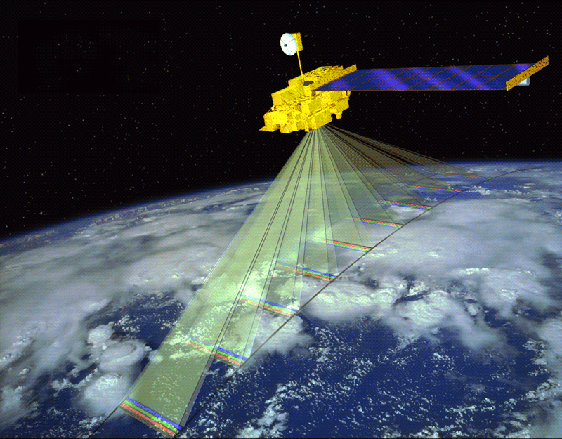
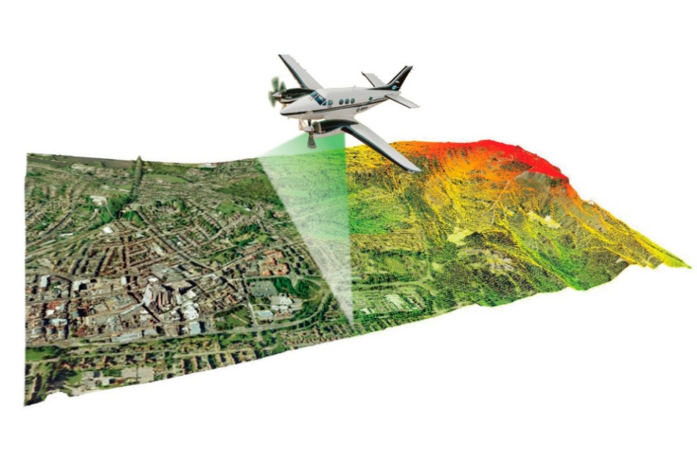
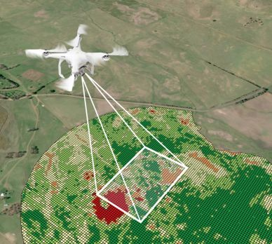
Remote sensing
Remote sensing is the measurement or acquisition of information of some property of an object or phenomenon by a recording device that is not in physical or intimate contact with the object or phenomenon under study.
Instruments:
Cameras
Multispectral and hyperspectral scanners
Thermal-infrared detectors
Radio Detection and Ranging (RADAR) sensors
Light Detection and Ranging (LiDAR) sensors
Platforms:
Satellites
Airplanes
Helicopters
Unmanned aerial vehicles (UAVs)

Slide 6
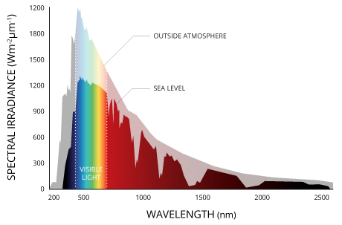
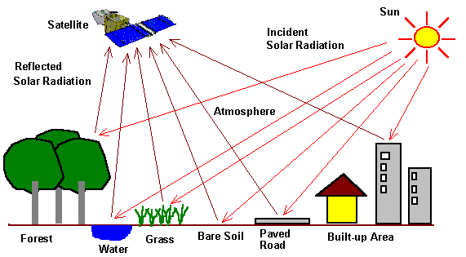
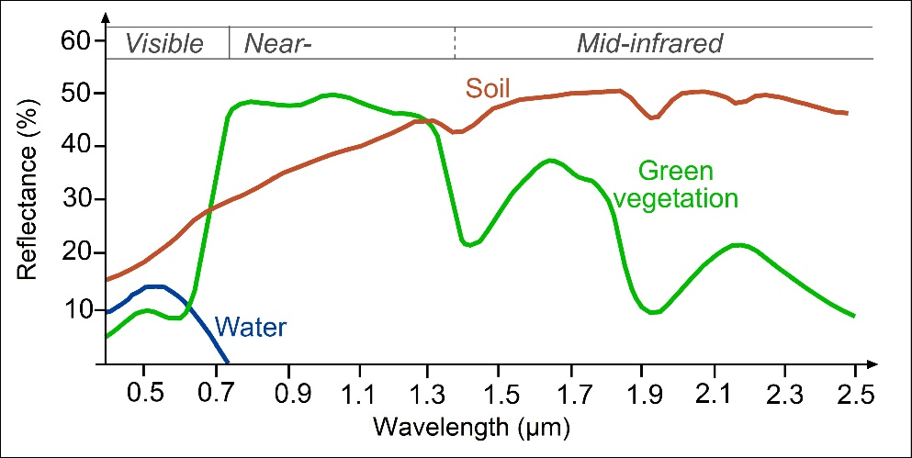
Remote sensing components
The proportion of reflected to incident energy is an object's spectral reflectance.
Solar Radiation
200 1000 1800 2500 (nm)

Slide 7
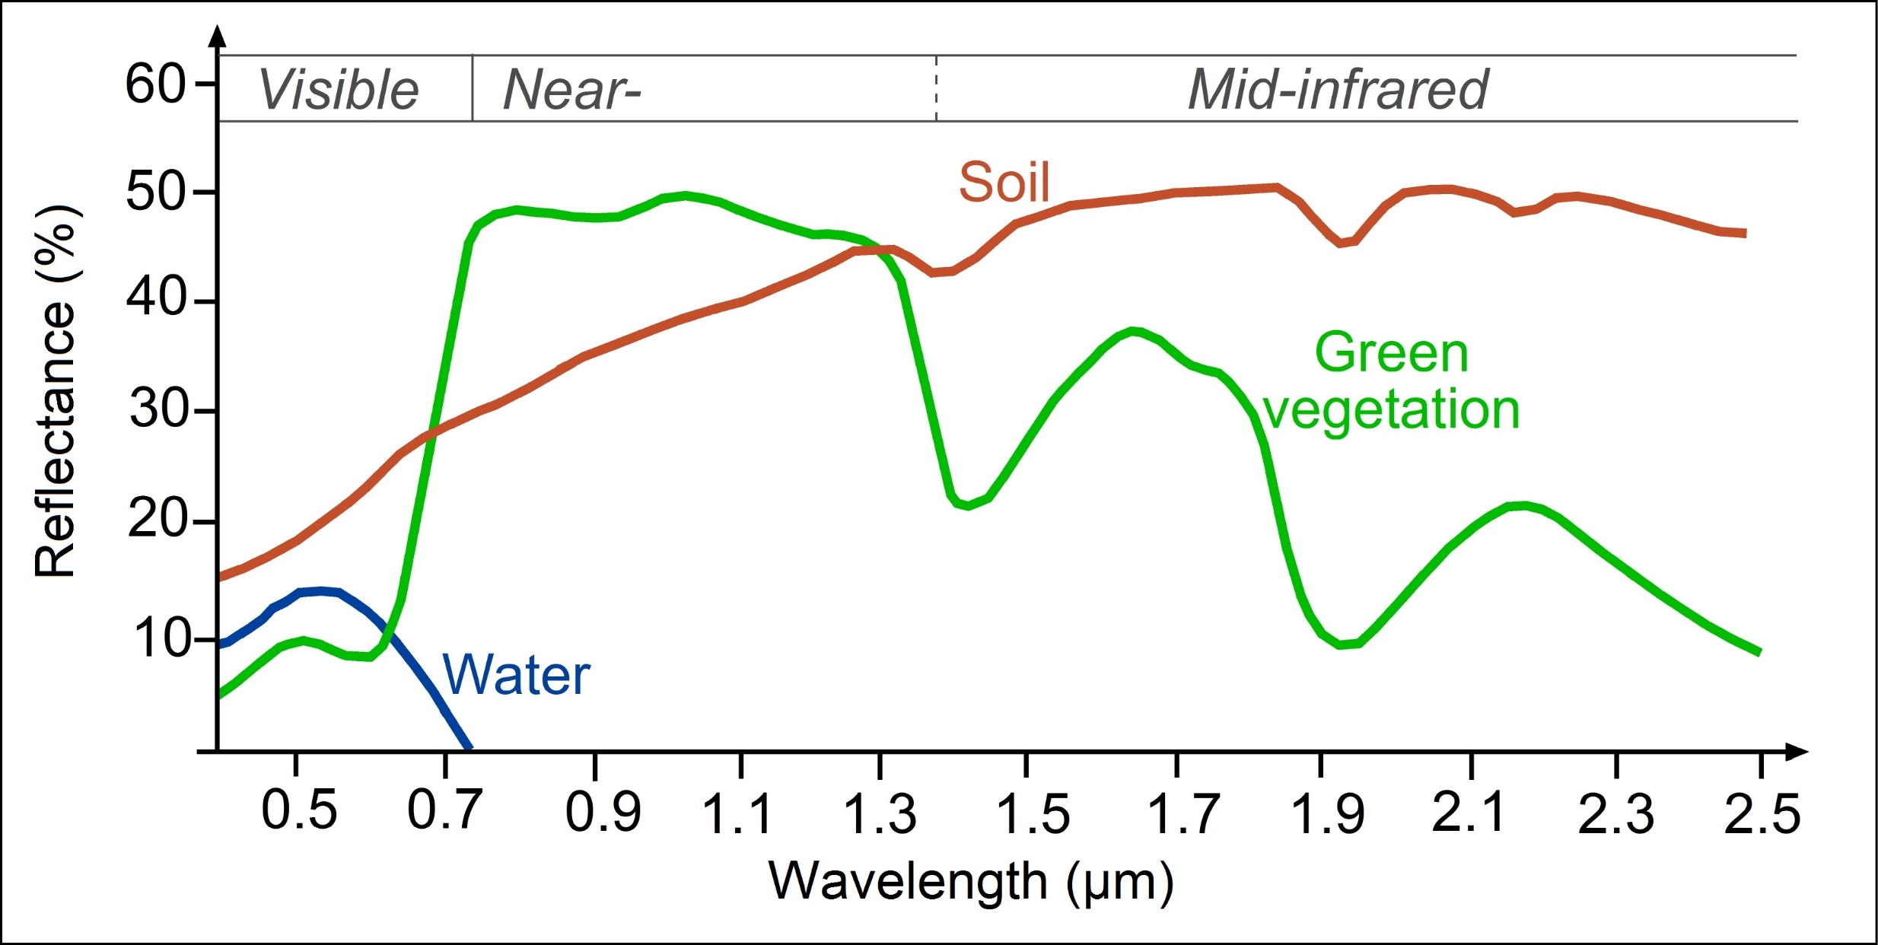
Spectral reflectance curves
Soil
Green vegetation
Water
Notes:
a curve plot that measures energy reflected from an object across a spectrum of wavelength
Remote sensing is based on the measurement of reflected or emitted radiation from different bodies. Objects having different surface features reflect or absorb the sun's radiation in different ways.

Slide 8
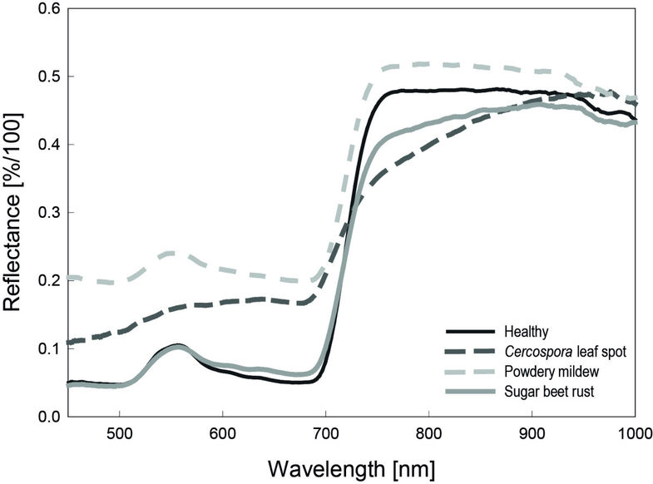
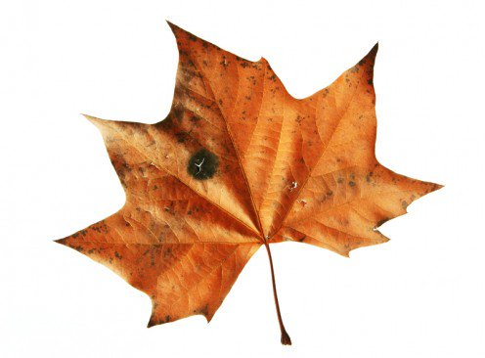
Question
Match leaves with spectral reflectance curves
A
B
C
Green
Brown
Red

Slide 9
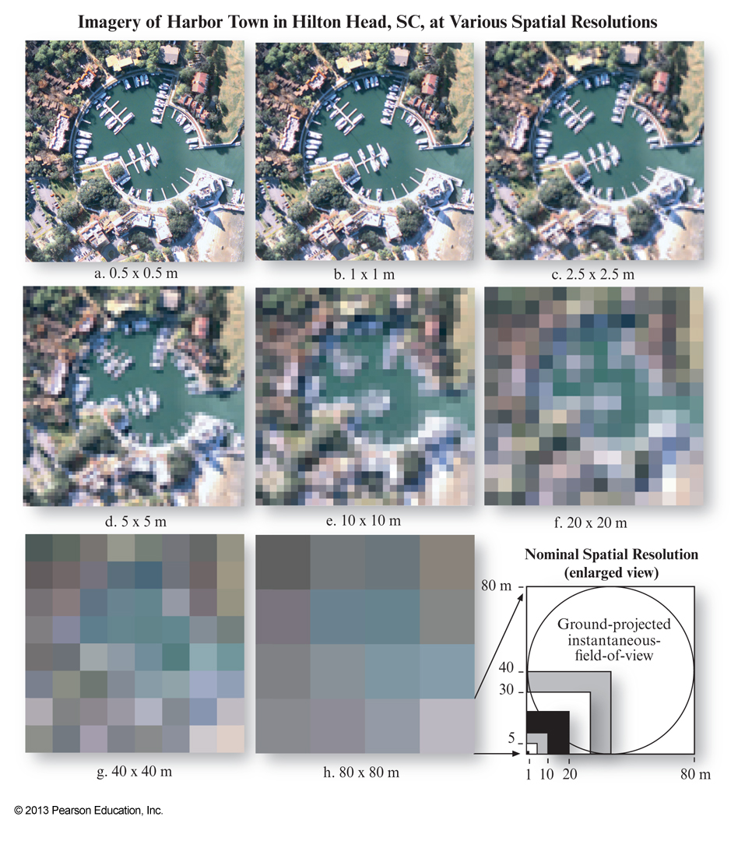
Spatial resolution
Spatial resolution is a measure of the area or size of one satellite images pixel covering the Earth’s surface.
The higher the resolution and the finer the grid is, the larger is the degree of recognizable details on the earth's surface.
Q: Which resolution is the best?
Notes:
Resolution Trade-Off
The different spatial, temporal and spectral resolutions are the limiting factor for the utilization of the satellite image data for different applications.
Unfortunately, because of technical constraints, satellite remote sensing systems can only offer the following relationship between spatial and spectral resolution: a high spatial resolution is associated with a low spectral resolution and vice versa.

Slide 10
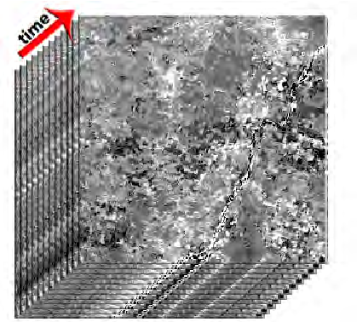
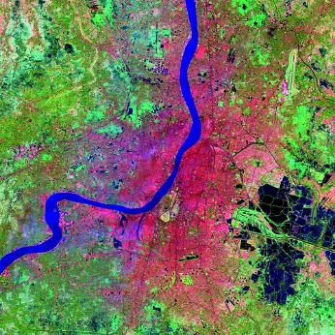
Temporal resolution
Temporal resolution describes how often data are obtained for the same area or object
time
It depends on the revisit period, which refers to the length of time it takes for a satellite to complete one entire orbit cycle
Mar 6, 2018
Mar 22, 2018
Apr 7, 2018
Apr 23, 2018
16 days

Slide 11
Temporal resolution
Mar 6, 2018
Mar 22, 2018
Apr 7, 2018
Apr 23, 2018
16 days
16 days
1 day

Slide 12
Spectral reflectance curves/bands
Soil
Green vegetation
Water

Slide 13
Spectral resolution - Hyperspectral vs. Multispectral
Continuous reflectance curves
Discontinuous reflectance bands

Slide 14
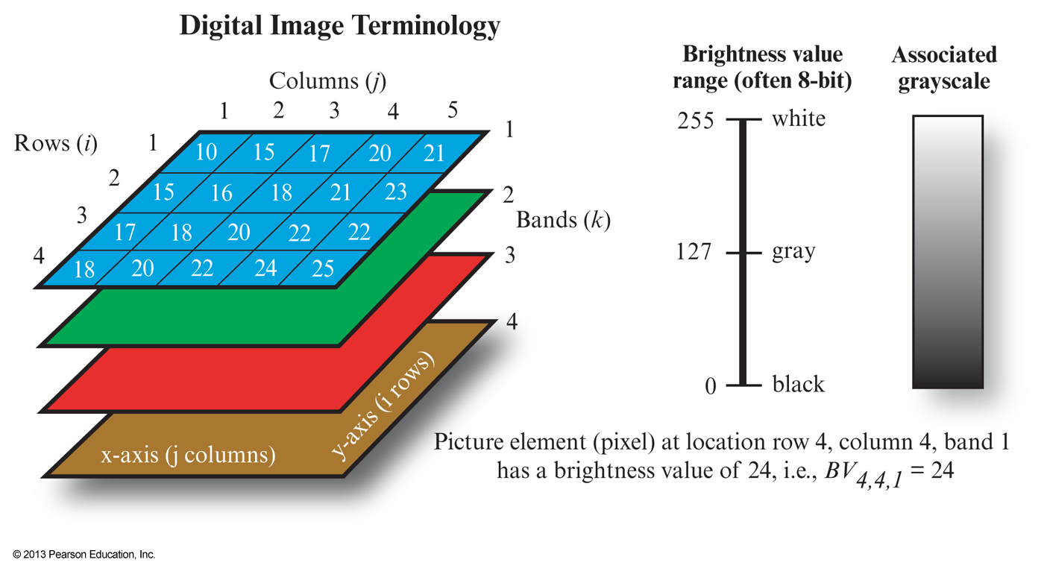
Remote sensing terminology
time

Slide 15
Comparisons of common satellites
Satellites | Spatial resolution | Temporal resolution | Spectral resolution
AVHRR | 1 km | 1 day | 2 bands
GOES | 700 m | 15 minutes | 1 band
MODIS | 1 km/500 m/250 m | 1 day | 36 bands
Landsat TM | 30-60 m | 16 days | 6 bands
Sentinel-2 | 10-60 m | 5 days | 13 bands
SPOT-5 | 2.5-5 m | 2-3 days | 5 bands
WorldView-2 | 0.46 m | 1-3 days | 8 bands

Slide 16
Satellite remote sensing data sources
NASA Earth Observations
NASA's Land Processes Distributed Active Archive Center
Landsat satellite data
MODIS satellite data
USGS Earth Explorer
NOAA Digital Coast
https://neo.sci.gsfc.nasa.gov/
https://lpdaac.usgs.gov
https://landsat.gsfc.nasa.gov/
https://modis.gsfc.nasa.gov/
https://earthexplorer.usgs.gov/
https://coast.noaa.gov/digitalcoast/

Slide 17
Land Processes Distributed Active Archive Center
NASA's Land Processes Distributed Active Archive Center (LP DAAC) is located at the U.S. Department of the Interior, U.S. Geological Survey (USGS) Earth Resources Observation and Science (EROS) Center in Sioux Falls, SD. LP DAAC was established in 1990 to process NASA land processes data products and provide vital contributions to inter-disciplinary studies of the integrated Earth system.
https://lpdaac.usgs.gov/

Slide 18
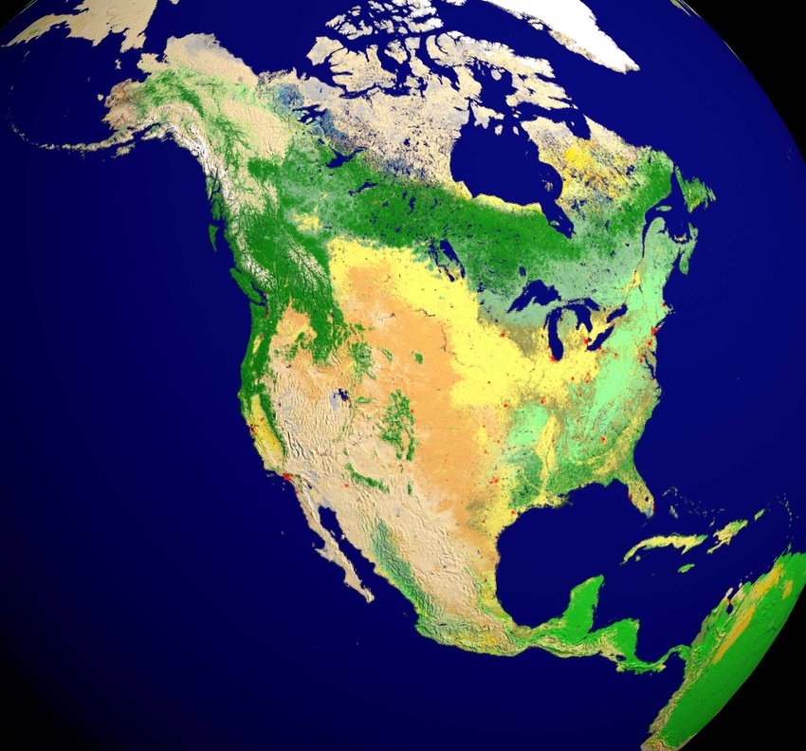
MODIS Land Cover (MCD12Q1)
Land Cover Type 1: IGBP global vegetation classification scheme
Land Cover Type 2: University of Maryland (UMD) scheme
Land Cover Type 3: MODIS-derived LAI/fPAR scheme
Land Cover Type 4: MODIS-derived Net Primary Production (NPP) scheme
Land Cover Type 5: Plant Functional Type (PFT) scheme

Slide 19
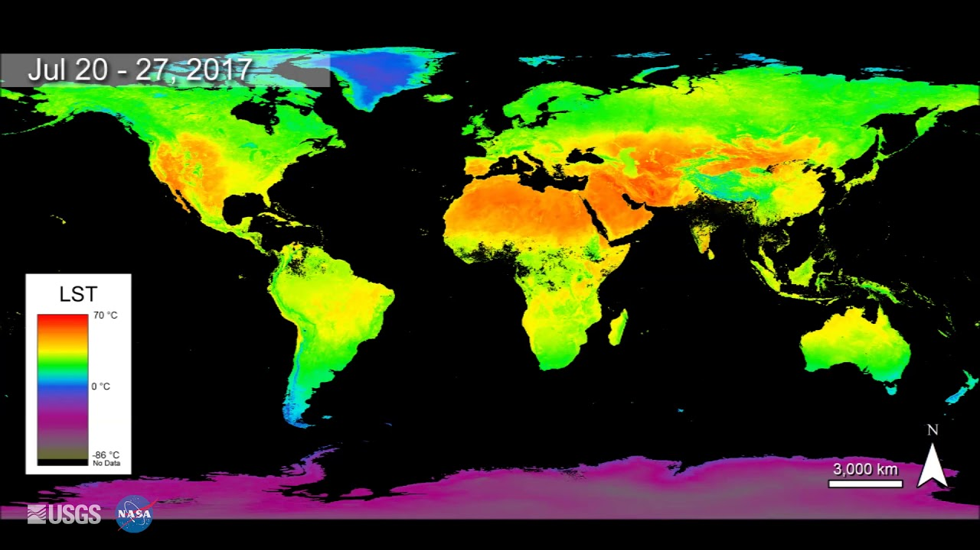
MODIS land surface temperature (MOD11A2)

Slide 20
National Ecological Observatory Network
https://www.neonscience.org/

Slide 21
National Ecological Observatory Network
NEON is a continental-scale ecological observation facility, fully funded by NSF. NEON collects and provides open data from 81 field sites across the United States that characterize and quantify how our nation's ecosystems are changing.
NEON offers over 170 open access data products collected using a variety of methods including automated instruments, observational sampling and airborne remote sensing.
NEON's primary purpose is to provide:
Continental-scale environmental data and archival samples
Infrastructure for ecological research studies
Educational tools to work with large data

Slide 22
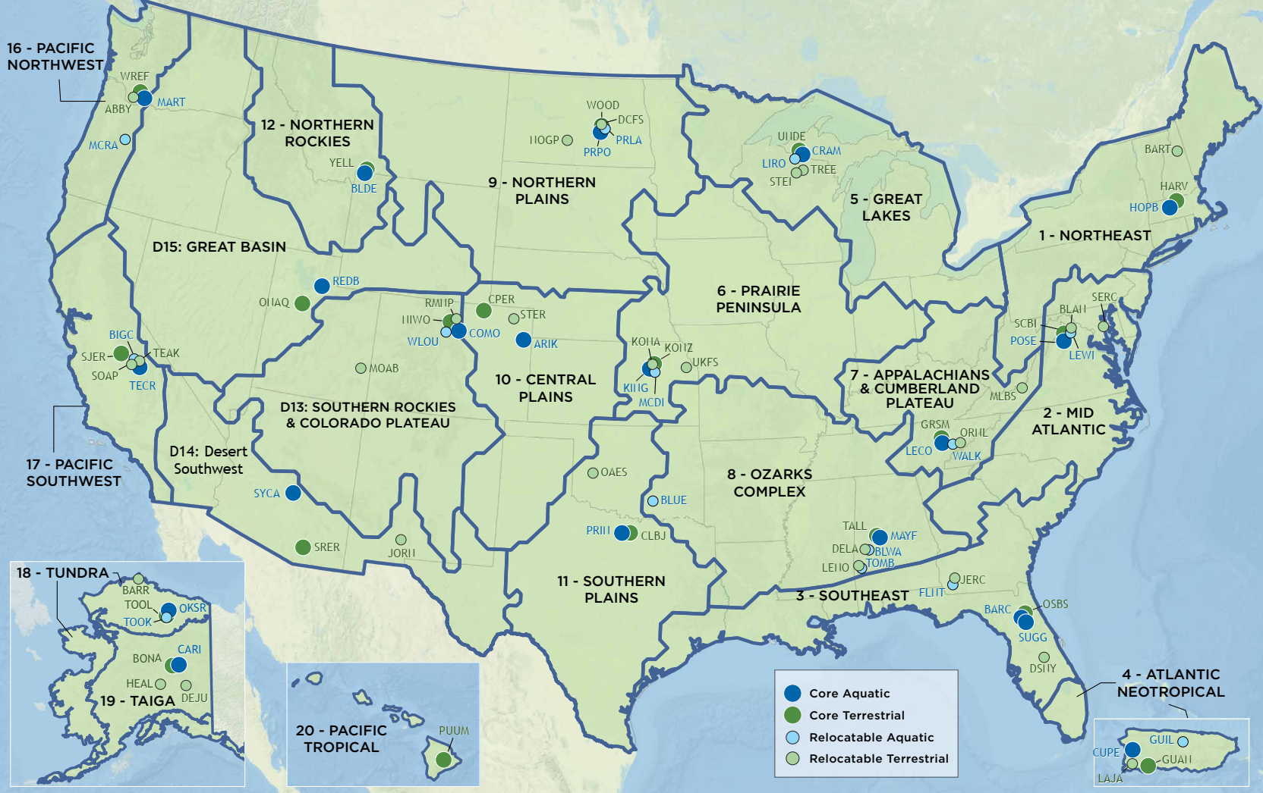
NEON sites
NEON data are collected from 81 terrestrial and freshwater aquatic field sites across the United States located in 20 different ecoclimatic domains.

Slide 23
NEON Airborne Remote Sensing
A NEON Airborne Observation Platform (AOP) is an array of instruments installed into a light aircraft to collect high resolution remote sensing data at low altitude.
https://www.neonscience.org/data-collection/airborne-remote-sensing

Slide 24
NEON Airborne Remote Sensing
Data products:
Discrete return Lidar point cloud
Lidar slant range waveform
Slope and Aspect - Lidar
Elevation - Lidar
Ecosystem structure
fPAR
Leaf Area Index
Total biomass
Vegetation indices
Albedo
Canopy water content, lignin, nitrogen and xanthophyll cycle
Hyperspectral cube from the spectometer
Orthorectified and mosaicked aerial photo
Point cloud from the lidar system
https://www.neonscience.org/data-collection/airborne-remote-sensing

Slide 25
Data access
The data collected by the AOP are processed by the NEON project and then published to the NEON data portal.
Format: GeoTiff
Spatial resolution: 1 meter
Size: 1 by 1 km tile in each data file
Download data:
Manually download from the data portal
Use R packages
https://data.neonscience.org/data-products/explore

Slide 26
https://www.neonscience.org/field-sites/field-sites-map/HARV

Slide 27
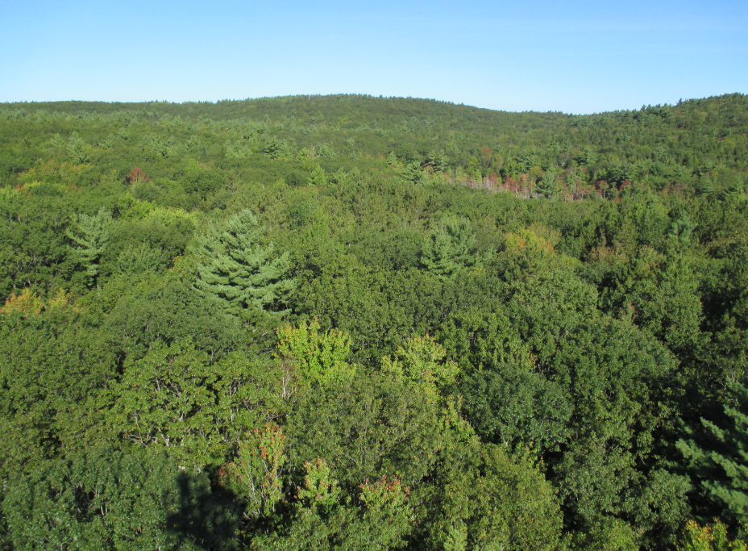
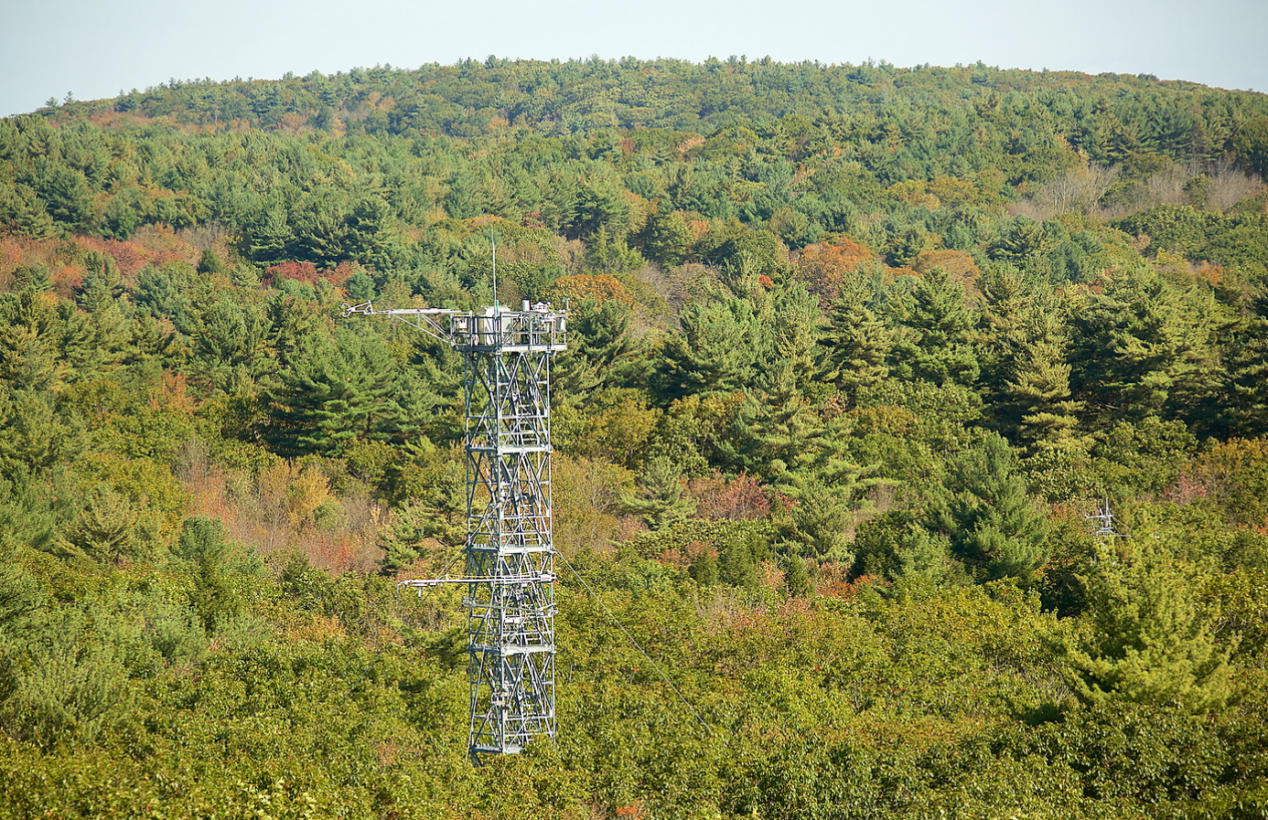
Harvard Forest - HARV
Elevation:351 m
Mean Annual Temperature:8C/46.4F
Mean Annual Precipitation:967 mm

Slide 28
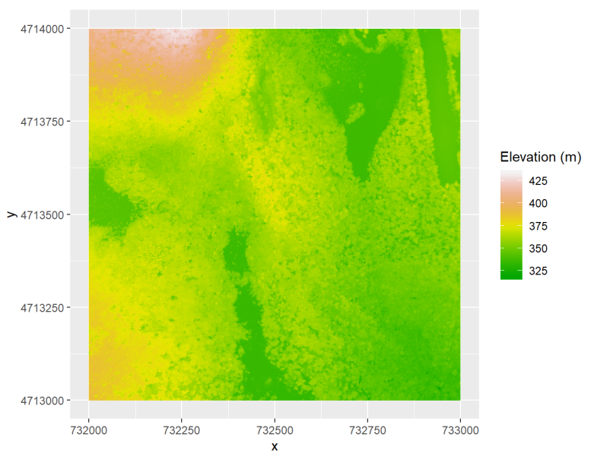
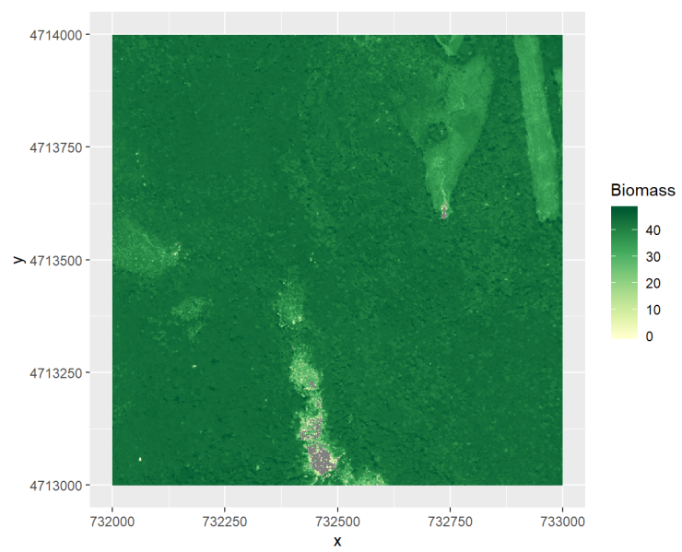
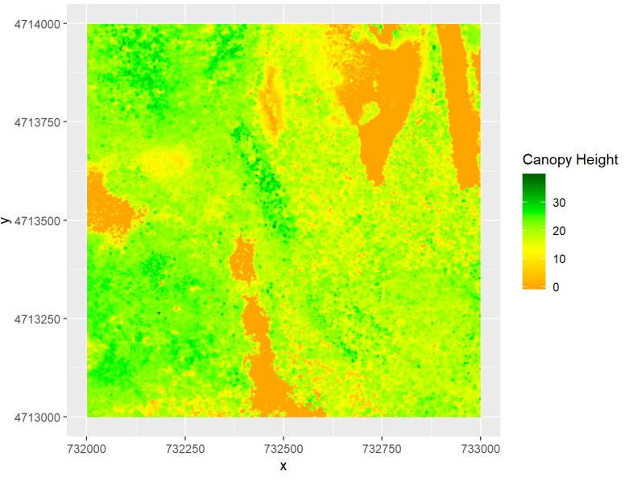
Data products
Elevation
Canopy height
Biomass
Topography (elevation, slope, aspect)
Water indices (NDII, NDWI, NMDI, WBI, MSI)
Vegetation indices (NDVI, EVI, PRI, ARVI, NDLI, NDNI)
Biomass
Canopy height

Slide 29
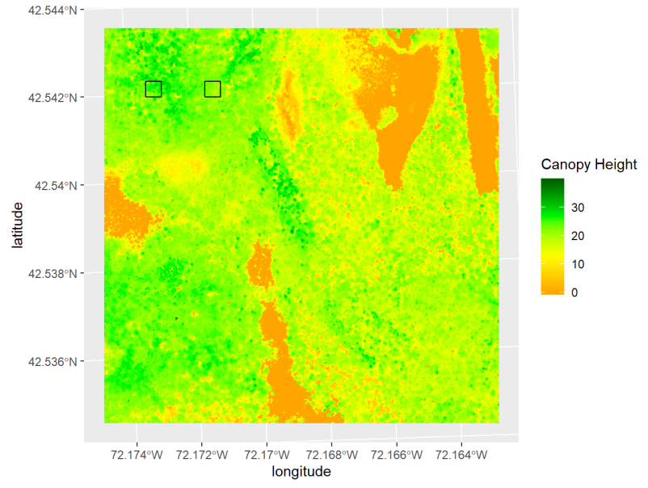
Comparisons between baseplots
Two baseplots (40*40m):
HARV_036 HARV_045

Slide 30
Examine relationships
One of main goals in monitoring biological and ecological processes at NEON sites is to examine the relationships between environmental conditions and these processes, so that we can understand how environmental changes affect ecosystems and predict how ecosystems respond to future changes.
Canopy height
Biomass
Topography
Water indices
Vegetation indices

Slide 31
Remote sensing data processing workflow
1. Determine locations/spatial extent of data
2. Filter variables and time period (high quality)
3. Calculate new variables or summarize
4. Analysis (differences among sites, temporal trend, models…)
5. Visualization
a. Maps (basemap, points, polygon, rasters)
b. Data analysis results (scatter plot, histogram, etc.)

Slide 32
R code demonstration and practice

Slide 33
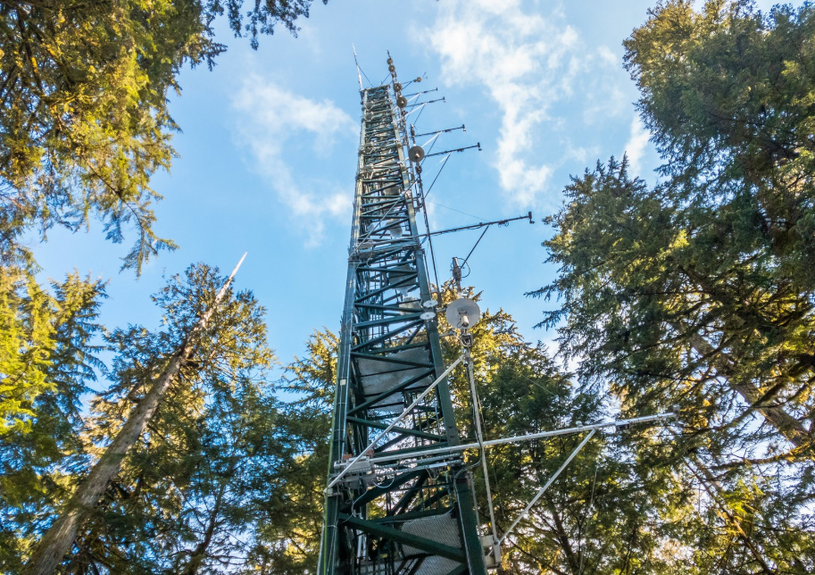
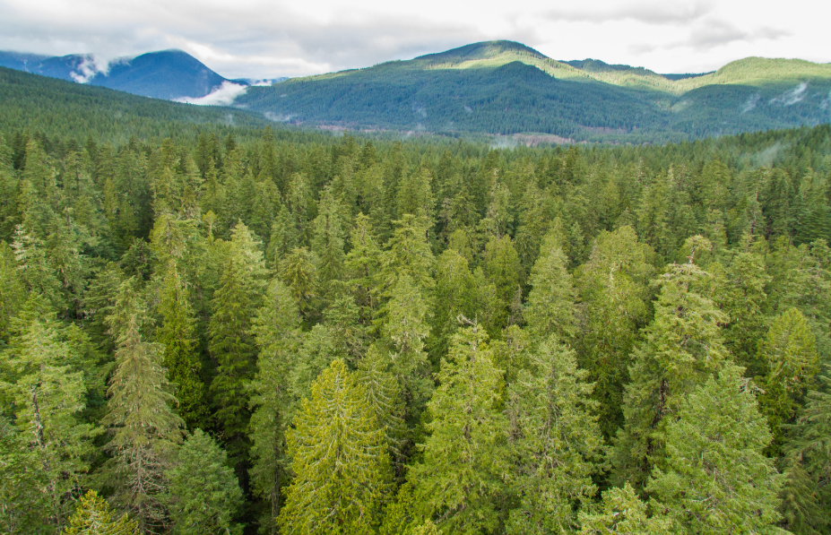
Wind River Experimental Forest - WREF
Core Terrestrial | Washington | D16: Pacific Northwest

Slide 34
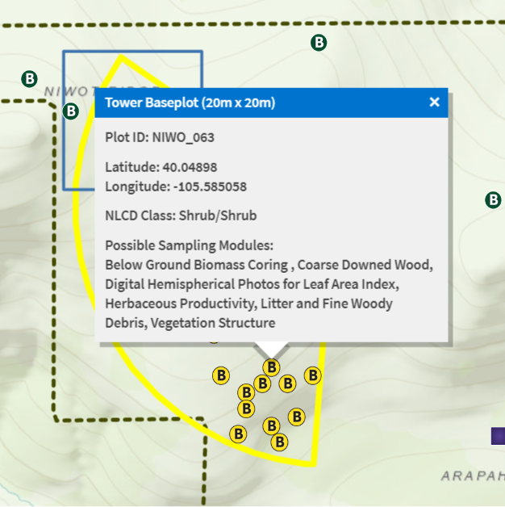
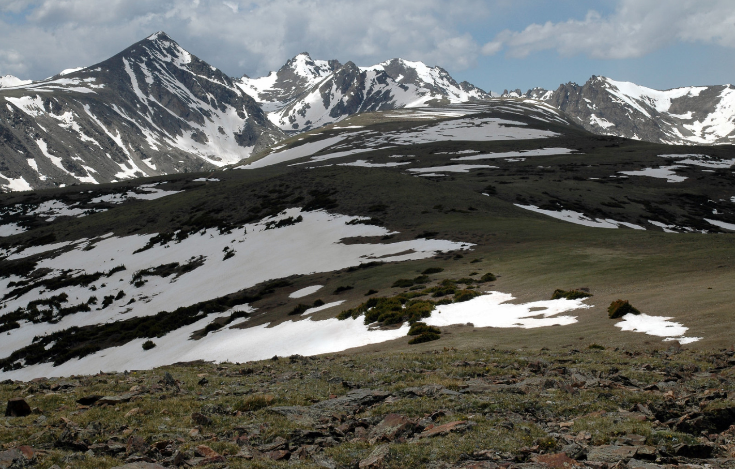
Niwot Ridge Mountain Research Station - NIWO
Core Terrestrial | Colorado | D13: Southern Rockies & Colorado Plateau

Slide 35
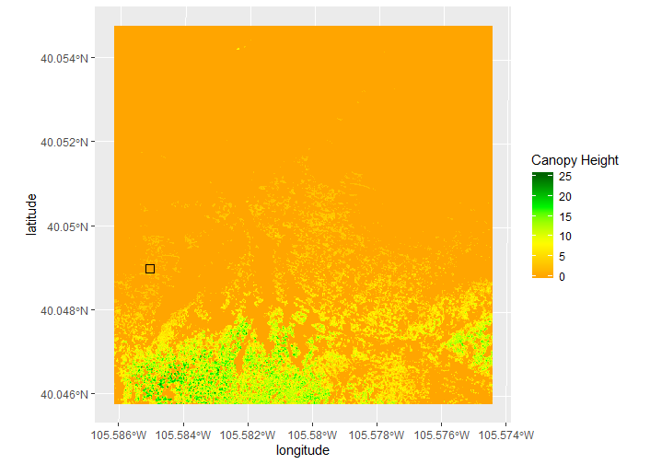
Wind River Experimental Forest - WREF
Niwot Ridge Mountain Research Station - NIWO
Elevation:407 m
Mean Annual Temperature:8C/46.4F
Mean Annual Precipitation:2530 mm
Elevation:3513 m
Mean Annual Temperature:0C/32F
Mean Annual Precipitation:758 mm

Slide 36
NEON sites
NEON data are collected from 81 terrestrial and freshwater aquatic field sites across the United States located in 20 different ecoclimatic domains.

Slide 37
Check field site information
Harvard Forest - HARV
Deciduous forest - plotID: HARV_036, HARV_045 (40*40m)
https://www.neonscience.org/field-sites/field-sites-map/HARV
Wind River Experimental Forest - WREF
Evergreen forest - plotID: WREF_078 (40*40m)
https://www.neonscience.org/field-sites/field-sites-map/WREF
Niwot Ridge Mountain Research Station - NIWO
Shrub - plotID: NIWO_063 (20*20m)
https://www.neonscience.org/field-sites/field-sites-map/NIWO
Year of data: 2017

Slide 38
Group discussion – Case study
Identify a question you want to address using the provided NEON data.
Come up your hypothesis for the question.
Identify variables you need from the data.
List the steps how you will analyze the data.
Describe the graphs you will produce to visualize data and analysis results.

Slide 39
How to earn extra credits!
You discuss and work with your group members, but you need to submit an independent report to earn credits. The extra credits you earn depend on how far and how well you go.
Tasks | Earned extra credits
List a clear question with hypothesis Identify necessary data and variables Describe how data will be analyzed (e.g. procedures, R functions, etc.) | 0.5
Show R code for data processing and analysis Show graphs of data and analysis results | 0.5
Explain the information from results to answer the question/test your hypothesis Nice data visualization Good organization of report document | 0.5

