Slide 1
Beyond Techniques: A Phenomenological Approach to Inclusive Teaching
Mays Imad, Ph.D.
mimad@pima.edu
@lrngsanctuary

Slide 2
Today we will: Part 1 Discuss a phenomenological approach to getting to know our students;

Slide 3
Today we will: Part 1 Discuss a phenomenological approach to getting to know our students; Part 2 Interrogate what it means to create an inclusive classroom.

Slide 4
“The tangles of teaching have three important sources. The first two are commonplace.”
Parker Palmer – The Courage to Teach

Slide 5
“First, the subjects we teach are as large and complex as life, so our knowledge of them is always flawed and partial.”
Parker Palmer – The Courage to Teach

Slide 6
“Second, the students we teach are larger than life and even more complex. To see them clearly and see them whole, and respond to them wisely in the moment, requires a fusion of Freud and Solomon that few of us achieve.”
Parker Palmer – The Courage to Teach

Slide 7
Who are our Students?
Beyond Techniques:
A Phenomenological Approach

Slide 8
Phenomenology
🡪 Concerned with the individual’s perception and experience of objects and events as the basis for the investigation of reality.
🡪 How can I have knowledge of my students’ world, as it really is to them?
Notes:
🡪 concerned with the perception and experience of objects and events as the basis for the investigation of reality.

Slide 10
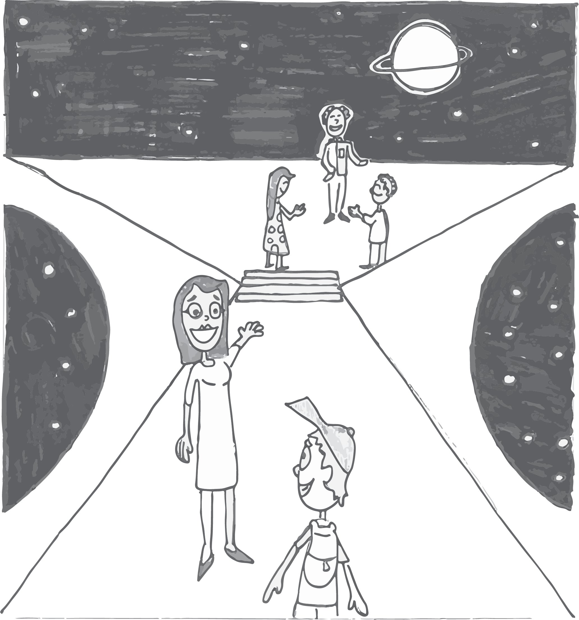
Come on a Journey with Me
Art by Emil Bubala

Slide 11
🡪 Students keep a learning journal to document their learning experiences.
🡪 Students follow the rubric shown here.
Notes:
Learning Journals
This is what I was reading instead …

Slide 12
Disenchanted!
“I wish we could talk about the news in the classroom.”
“I feel I'm attending a school for robotic education. It feels suffocating and so far removed from the real world. There is no spontaneity nor .... beauty.”
“How hard life can be on you on some days, and how drab and dull the world feels without passion. I wish my teacher knew just how badly some people struggle with the weight of the work and the world as you try and wriggle your way through the tight and unrelenting cookie-cutter format of the educational system.”
Notes:
5 minutes total. 3 minutes, 2 minutes report out

Slide 13
Salient Questions
What do I think students want to get from their education?
What do I hope for students to get from their education?
What do students actually want out of their education?
Notes:
5 minutes total. 3 minutes, 2 minutes report out

Slide 14
How Can I Ensure that My Perception of What Students Want Aligns with What Students Actually Want from Their Education?
Notes:
ttps://www.bing.com/videos/search?q=dying+of+publishing+youtube&view=detail&mid=C06FCB137CE23869C42FC06FCB137CE23869C42F&FORM=VIRE

Slide 15
Why is that Important?

Slide 16
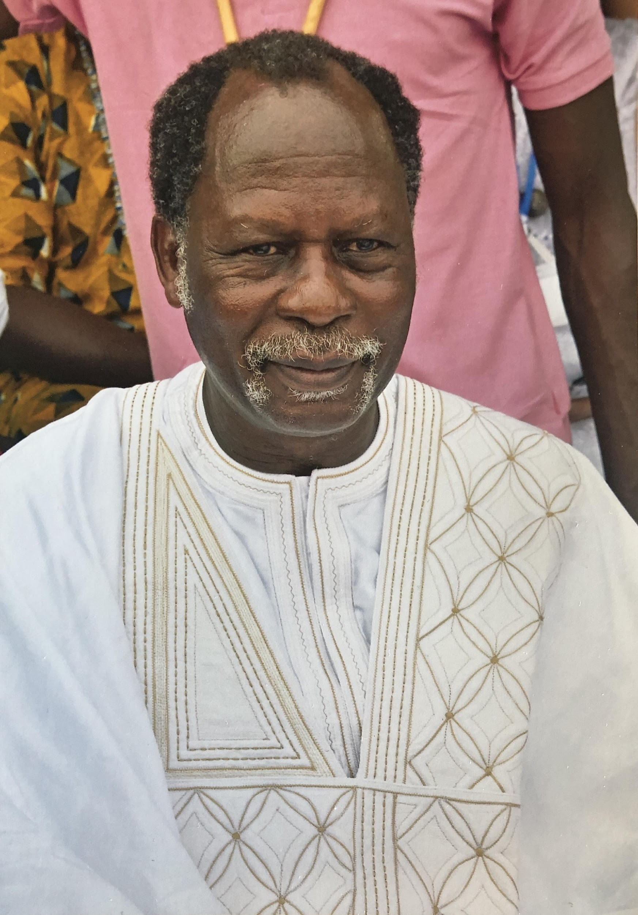
“When you want to become a healer, you must begin by forgetting about yourself.”
Dr. Erick Gbodossou

Slide 17
Between 2017 and 2019, I conducted research with Pima Community College and the University of California-San Diego students about their educational experience.

Slide 18
Between 2017 and 2019, I conducted research with Pima Community College and the University of California-San Diego students about their educational experience.
The purpose of the research was to better understand what matters to students in their education and how to better align my perception with their actual experiences.

Slide 19
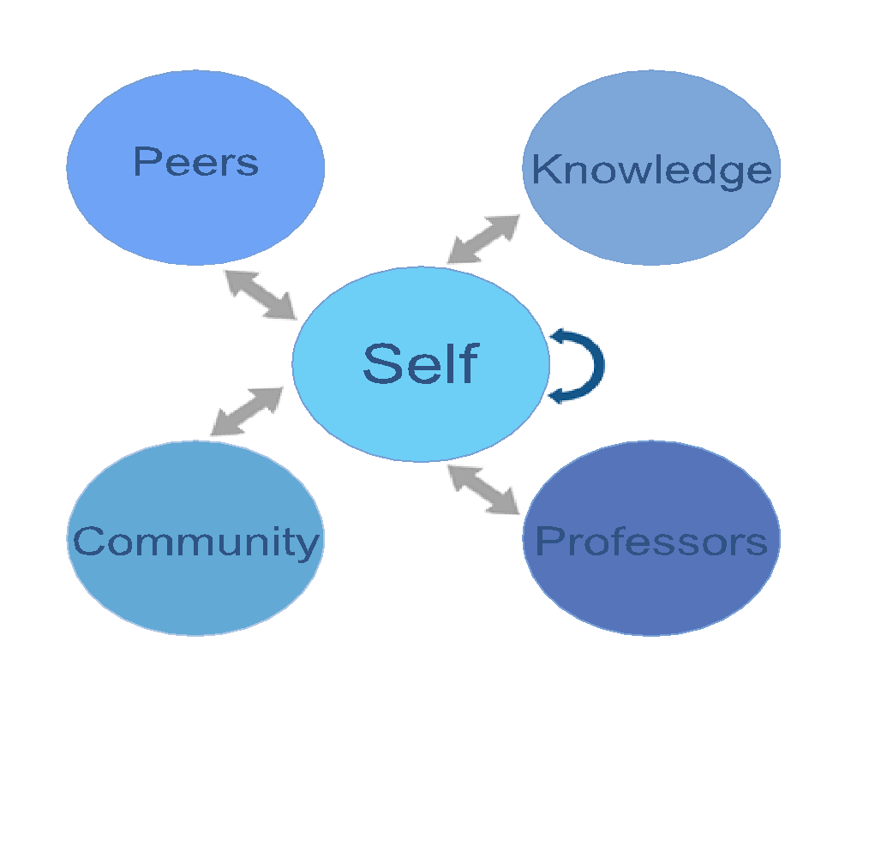
Surveyed >1000 first- and second-year students from across disciplines from two-year and four-year institutions, including dual-enrolled students at Pima Community College.

Slide 20
Breakout Room
Describe your optimal learning environment:
Notes:
Breakout room

Slide 21
Describe your optimal learning environment:
Go to menti.com and use the code
58 46 63
Notes:
Mentimeter after breakout room

Slide 22
What Did the Students Say?

Slide 23
“Professors should foster stimulation to keep the students mentally engaged in the subject matter and that they are capable of owning it.”

Slide 24
“I think it makes it better for the class if the teacher talks about their personal life and listens [to] other students’ lives and stories because it really brings the class together and it’s more of a relaxed environment. When the students have a better relationship with each other in class, then more people will be involved with activities and again feel more comfortable in class.”

Slide 25
“[One] factor that I would find helpful in creating an optimal learning environment would be helping the students get to know each other for a few minutes when class starts for the semester.”

Slide 26
“[Professors] can create an optimal learning environment by building relationships with students and making themselves available to those who need help.”

Slide 27
“I would like to know more people I can relate to in the class. If the professor helped facilitate that, it would help me. I can join study groups then.”
Notes:
Why can’t they just do it themselves?

Slide 28
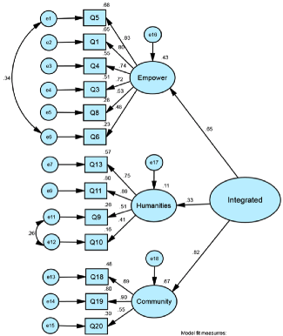

Slide 29
What Matters to Students?
Having a sense of purpose
Meaning, Context, & Impact
Feeling a sense of autonomy
Empowerment & Advocacy
Having a sense of belonging
Community & Contributions

Slide 30
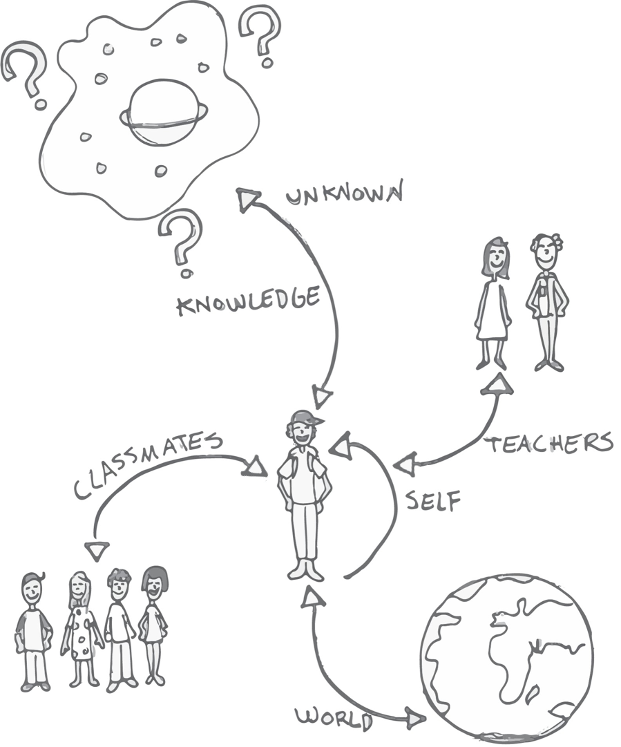
Art by Emil Bubala

Slide 31
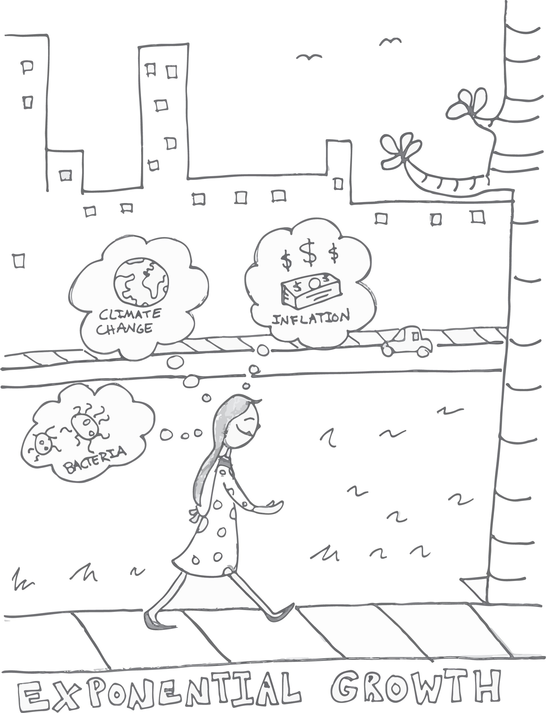
“It is not until very recently that I have begun to appreciate the beauty and knowledge found in nature and our reality. There is a difference between understanding and appreciating. While it is possible to teach students both of these through science education, the appreciation is often lost in the academics.”
Art by Emil Bubala

Slide 32
Practical Strategies for Aligning my Perceptions with my Students’

Slide 33
Practical Strategies for Aligning My Perceptions with my Students’
How Do I Create Inclusive Learning Environments?

Slide 34
Reflection
What are your Guiding Principles?
Notes:
Reflect and enter into chat

Slide 35
My Guiding Principles:
Act intentionally;
Model transparency;
Ask my students (and colleagues);
Reflect on how I would want to be treated when I am most vulnerable;
Remember that learning is not one size fits all;
Observe, journal, & dialogue.
Commit to learning new ways;
Assume that I have implicit biases, work to identify them, and mitigate their impacts;
Take for granted that we are all experiencing traumatic stress;
Notes:
#4 For example, careful with preferred pronoun

Slide 36
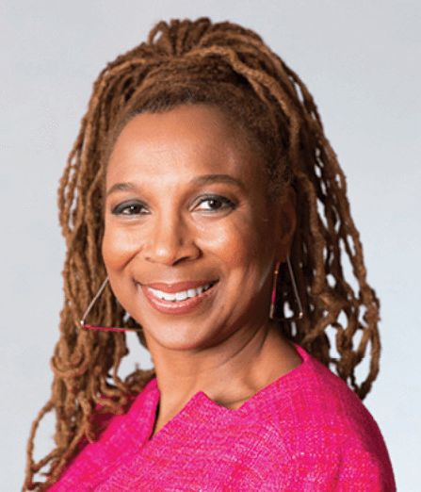
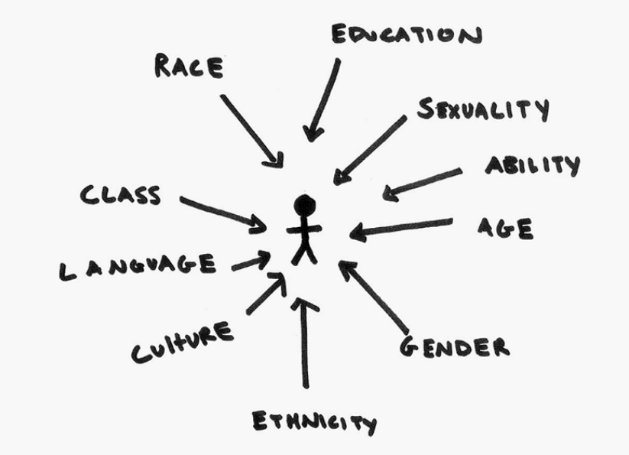
Use an Intersectional Lens When Working with Students
Kimberlé Crenshaw

Slide 37
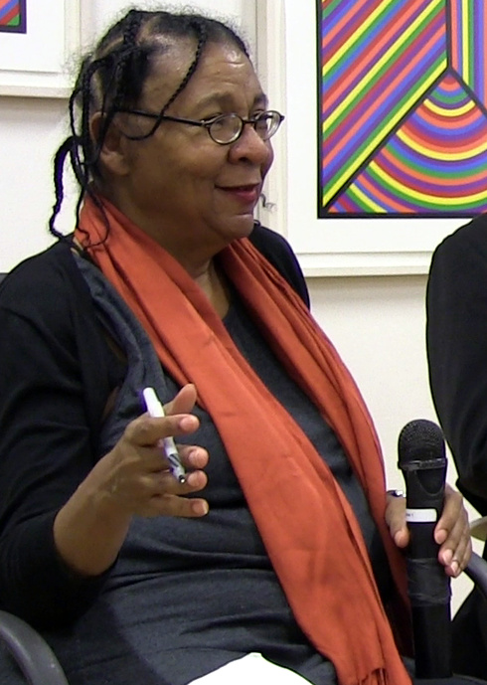
10. "... make the classroom a place that is life-sustaining and mind-expanding, a place of liberating mutuality where teacher and student together work in partnership."
bell hooks
Teaching to Transgress
Notes:
Give them 30 seconds. What will your guiding principles be?

Slide 38
How to Cultivate a Sense of Meaning?

Slide 39
“Meaning is primarily a matter of relationship. If something is connected to absolutely nothing—symbolically, linguistically, physically, psychologically—it is literally meaningless. And in the same way, if something is connected to everyone and everything, it would be supremely meaning-full.”
- Lawrence Kushner

Slide 40
Meaningful Assignments
Ask students to make connections.
Intentionally model connections making for them: “I chose this assignment because, for me, it relates to …. which speaks to me because …”

Slide 41
Meaningful Assignments
Osmosis, Technology, and Water Scarcity in South Africa
Graphs, Variables, Payday Loans, and Zip-codes
HIV, AIDS, and HOPE Act
Wearing Masks: Science, Ethics, & Freedom
Stress, learning, health, and disease.

Slide 42
How to Cultivate a Sense of Empowerment?

Slide 43
Co-Create a Plan for Feedback
“Excellent teaching is work in progress. I always seek feedback from my students so I can improve my teaching. In other words, I rely on you.”
Do you feel comfortable giving me feedback?
What does it mean to give constructive feedback?
What does it mean to advocate for yourself/others in this class?

Slide 44
Classroom Student Advocate
“I have been in the position where I have been afraid to talk to a professor about the difficulty in the class. Even having a professor’s assistant or student advocate for students to talk to could potentially help many students that feel that the material is moving too fast.”

Slide 45
How to Cultivate a Sense of Belonging & Community?

Slide 46
We are in this TOGETHER
Why community matters to learning
How can we create it in online courses?

Slide 47
How We Will Survive and Thrive?
Who are you?
“What might you say to a classmate who is struggling to learn or remain enrolled in the course?”

Slide 48
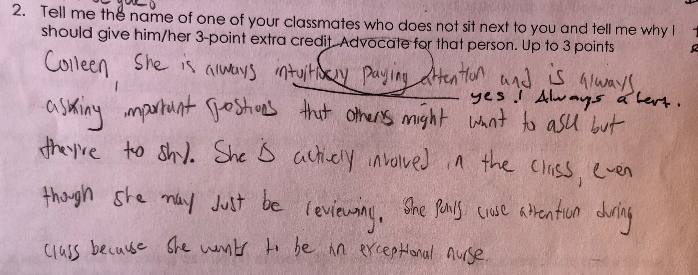

Slide 49
In addition …
Normalize uncertainty;
Setbacks = transitory instead of proof that they don’t belong
“I’ve been there, too;” and “It gets better.”
Invite them to normalize uncertainty;
Ask:
How can I make this better?
Is there anything I am doing or not doing that might make someone feel excluded?

Slide 50
“But there is another reason for these complexities [of teaching]: We teach who we are. Teaching, like any truly human activity, emerges from one’s inwardness, for better or worse. As I teach, I project the condition of my soul onto my students, my subject, and our way of being together.”
Parker Palmer – The Courage to Teach

Slide 51
“Teachers should reflect every day why they do what they do.”

Slide 52
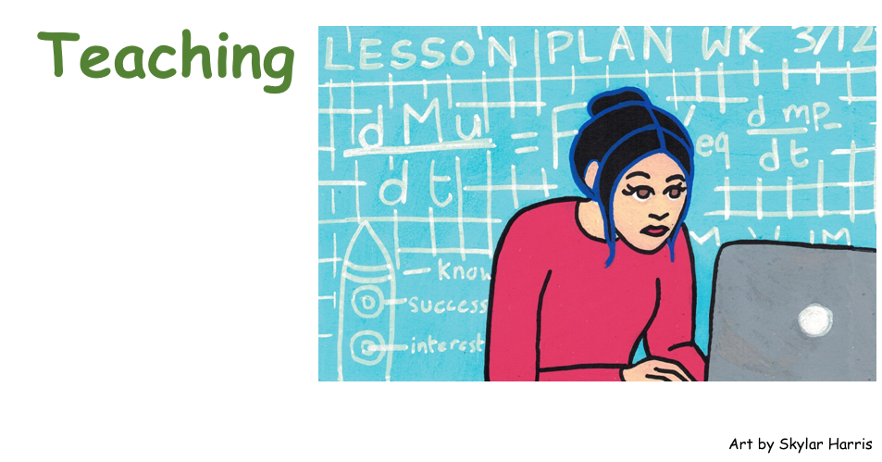

Slide 54
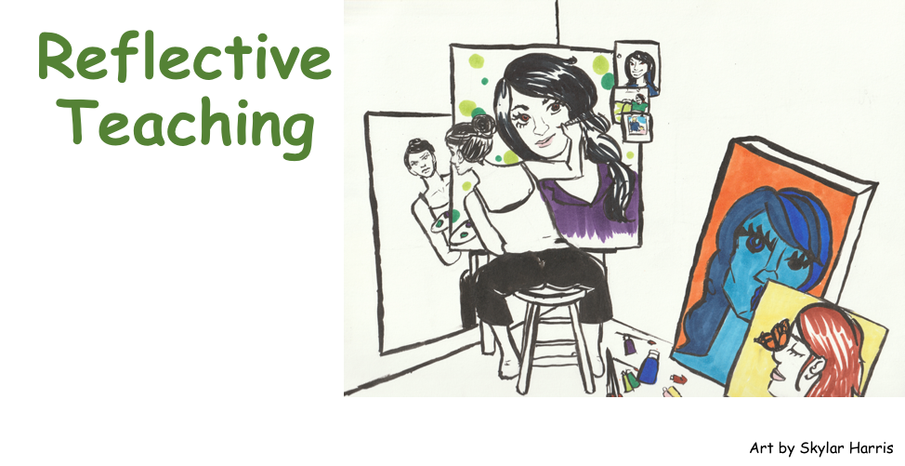

Slide 55
Reflection
How will you learn about who your students are?
Notes:
Breakout room

