Slide 1
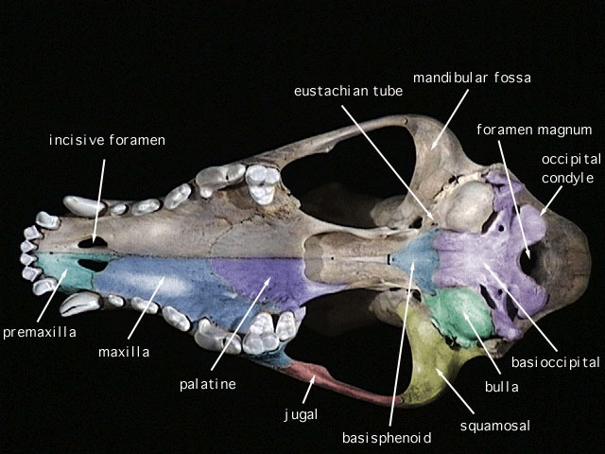
Figure 1. Ventral view of a mammal skull with important bones indicated.

Slide 2
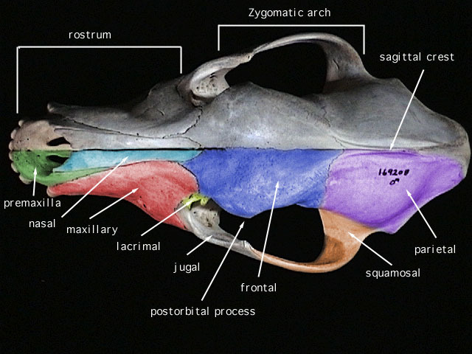
Figure 2. Dorsal view of a mammal skull with important bones indicated.

Slide 3
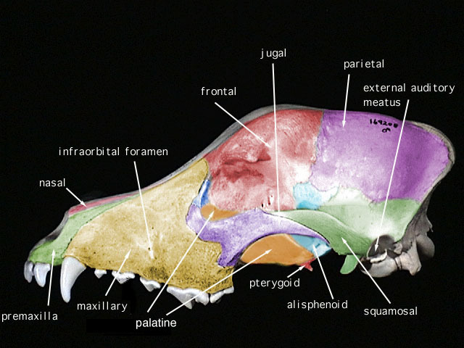
Figure 3. Lateral view of a mammal skull with important bones indicated.

Slide 4
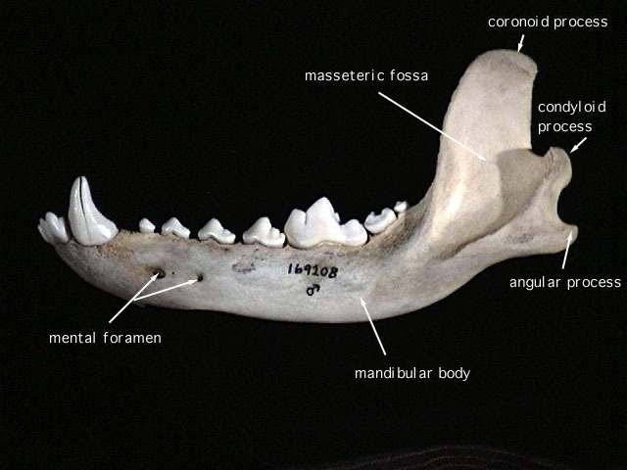
Figure 4. Lower jaw (or dentary) of a mammal skull with important features indicated.

Slide 5
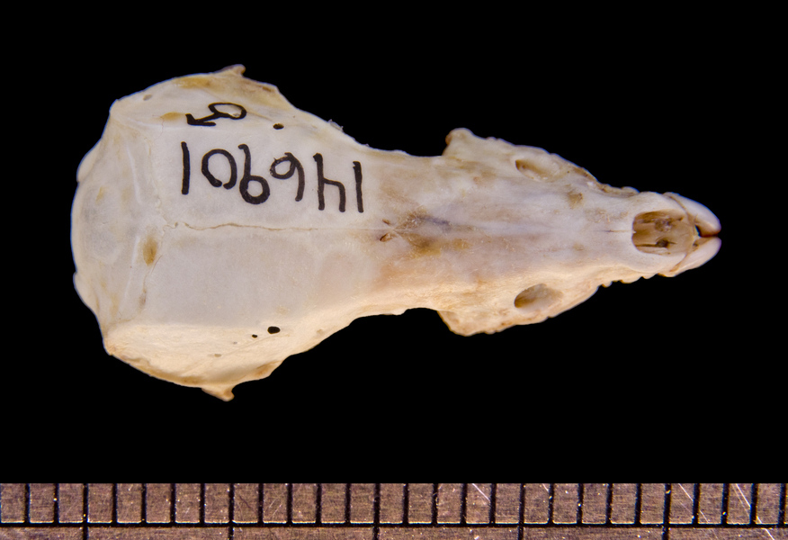
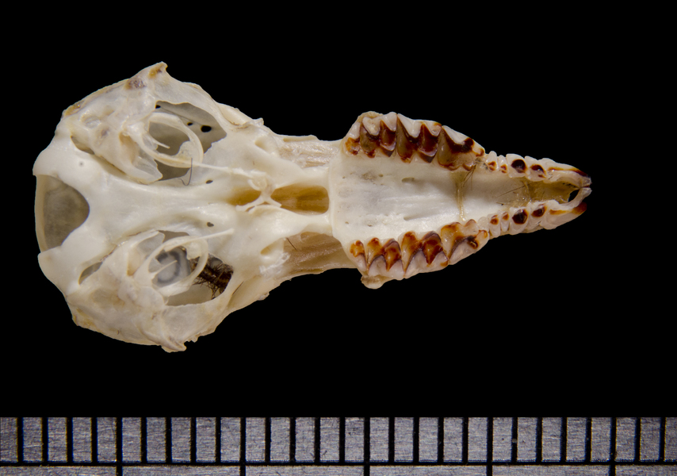
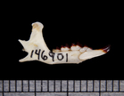
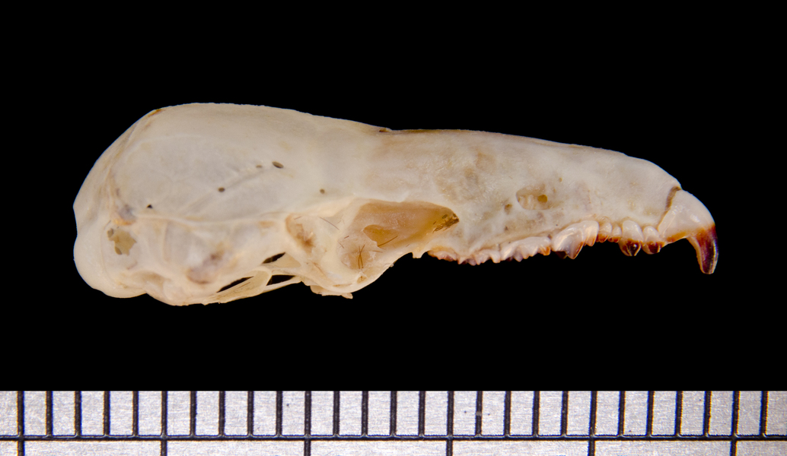
Key to Mammal Orders – Specimen A (scale bar in mm below images)

Slide 6
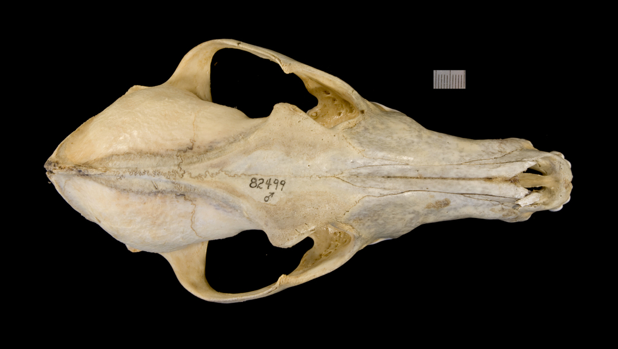
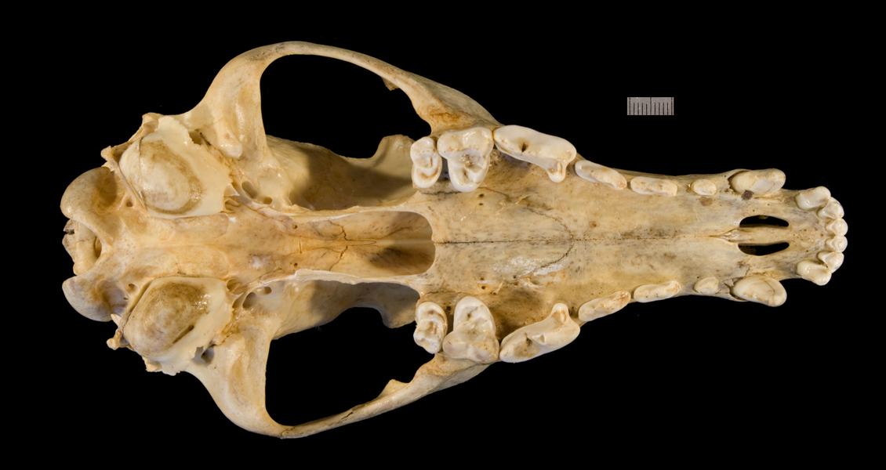
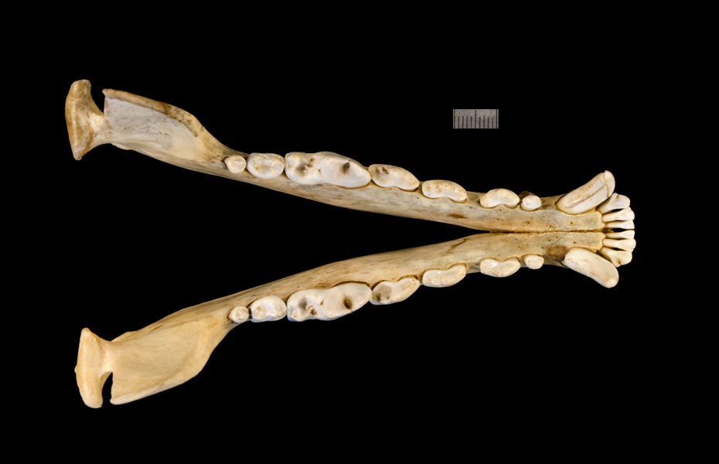
Key to Mammal Orders – Specimen B (scale bar in mm below images)

Slide 7
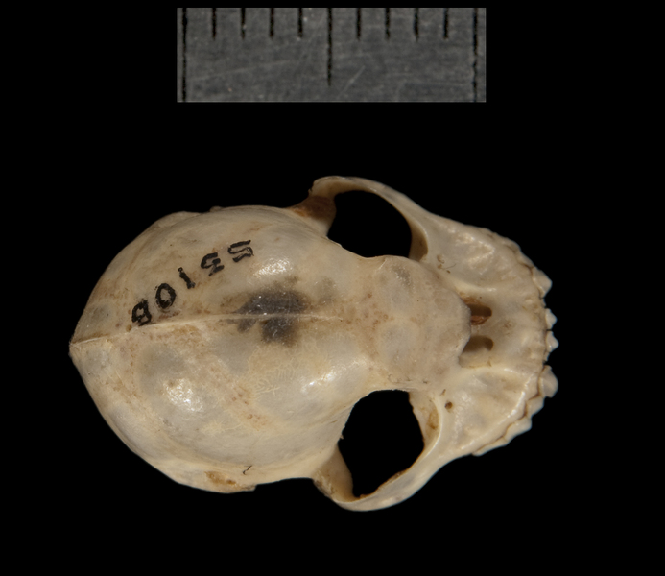
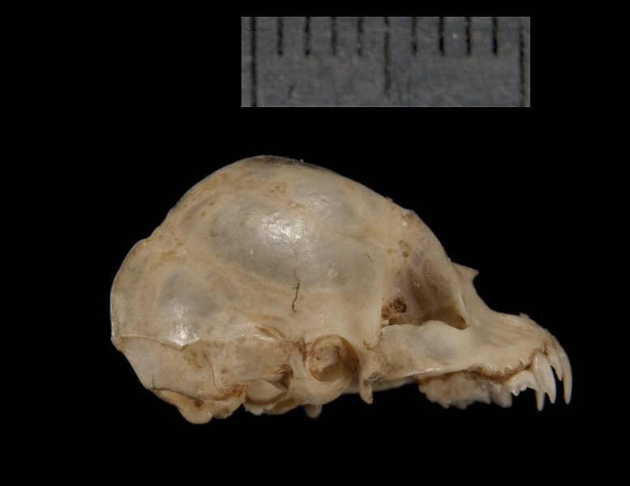
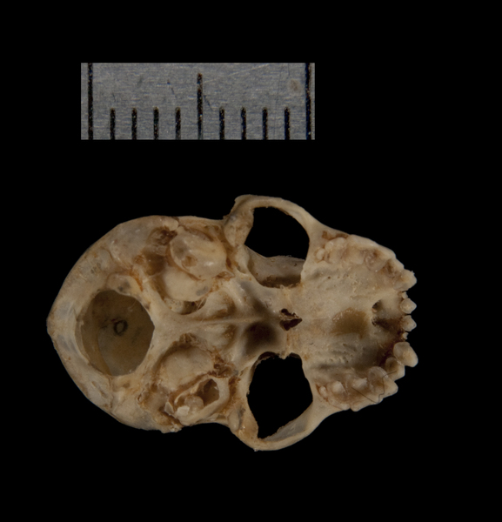
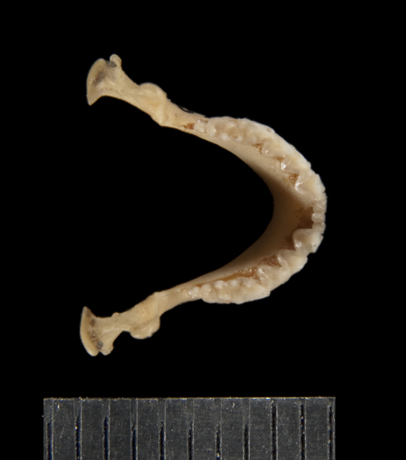
Key to Mammal Orders – Specimen C (scale bar in mm above images)

Slide 8
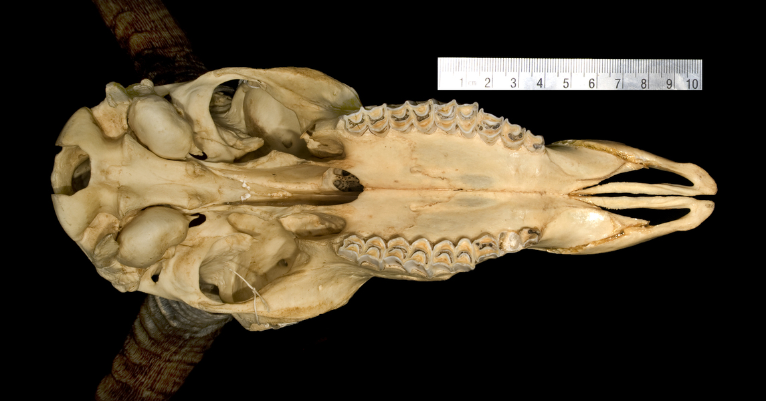
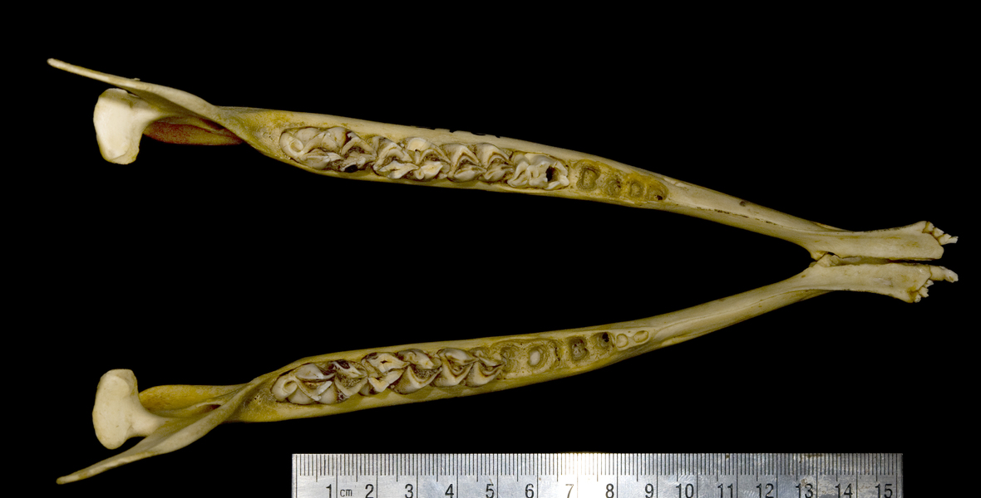
Key to Mammal Orders – Specimen D (scale bar in cm above and below images)

Slide 9
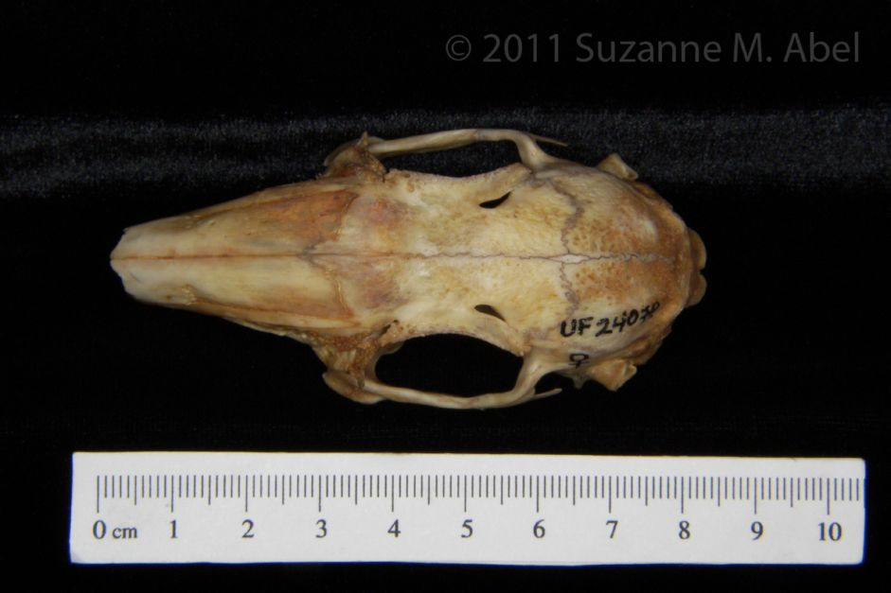
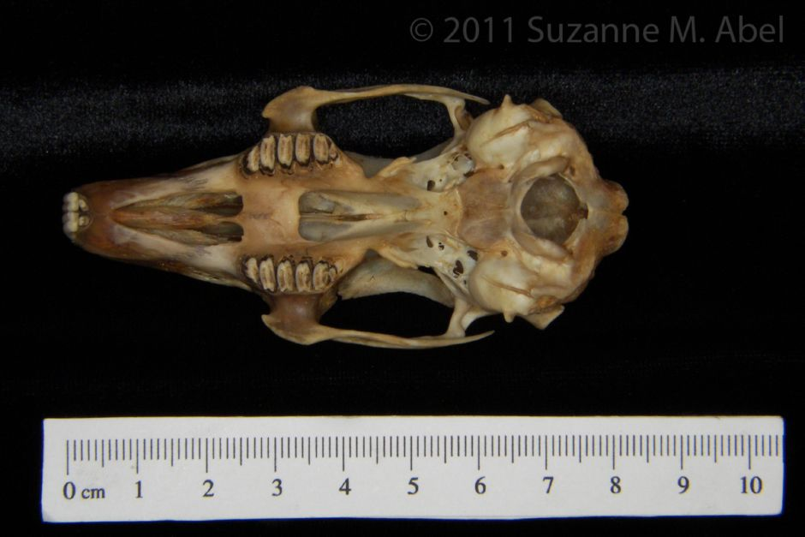
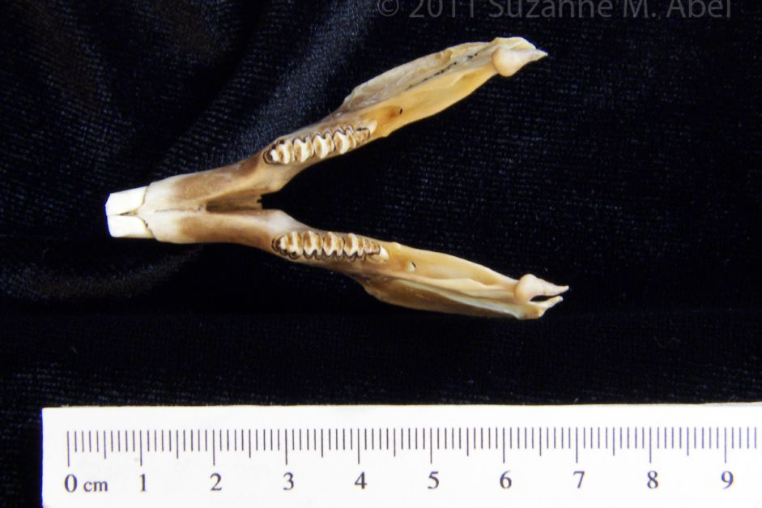
Key to Mammal Orders – Specimen E (scale bar in cm below images)

