Slide 1


Carbon Sequestration and the Urban heat Island Effect
Evan Blais

Slide 2
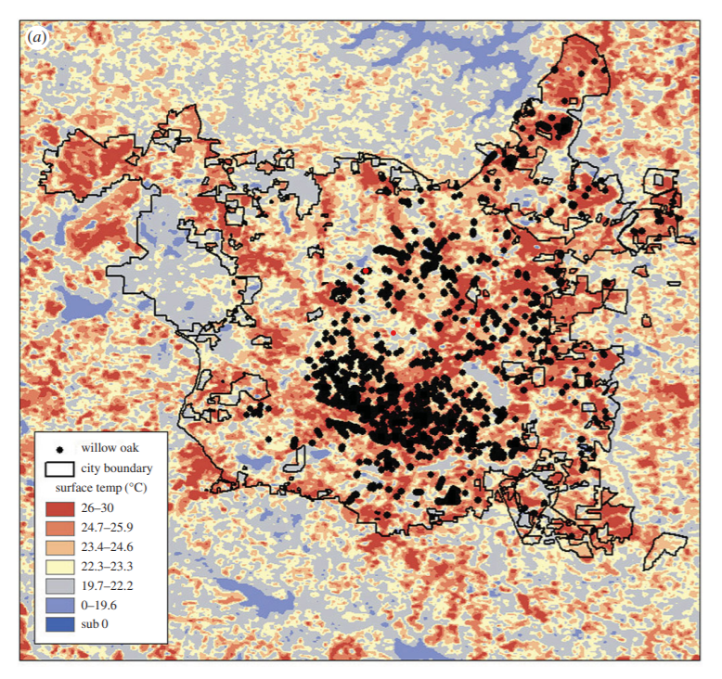
Background
Based on a paper titled Urban warming reduces aboveground carbon storage
  The paper investigates the effects of climate warming and native pests on the carbon storage capabilities of mature willow oaks
  Uses the urban heat effect in Raleigh NC as a proxy for climate change
  The researchers quantified carbon sequestration using photosynthetic and growth capabilities under varying circumstances.
  The research occurred over a span of two years and included over 40 sites

Slide 3
Lesson Plan
1. Brief explanation of the Urban Heat Island Effect
2. Discussion of urban trees and the role they play
3. Transition into carbon sequestration and how it fits into UHI effect
4. Provide information on statistics portion of the lesson
5. Finally meet the scientist followed by and introduction to the data

Slide 4
R/Statistics
Run linear regression models using temperature, photosynthetic, and growth data
Test the validity of the data and results
Present the readers with guided learning questions to walk them through the objectives
Follow up questions to test the readers knowledge after completing the lesson

Slide 5
Objectives
Walk away with an intermediate understanding of
  The urban heat island effect
  Carbon cycle/sinks
  Benefits of urban trees
  Potential impacts of climate change
The ability to understand the relationships between rising temperatures and urban carbon storage
Draw further conclusions based on the information presented and the analysis

