Slide 1
APPLYING PHYLOGENETIC TREE BUILDING IN MEGA X TO FORENSIC INVESTIGATIONS FOR IDENTIFYING UNKNOWN SPECIMENS
Prepared by Drs. Nicholas Lorusso and Denise Gemmellaro
Exercise Introduction PowerPoint
Documents available at:

Slide 2
Goals for the exercise:
Apply the scientific method to questions relating phylogenetics to forensic science
Identify appropriate computational approaches to address biological questions
Evaluate evolutionary relationships using graphical methods
Critically assess results of barcoding datasets
Find and interpret data from major online databases such as Barcode Of Life
Use the software package MEGA X to construct and evaluate phylogenetic trees
Apply bioinformatics methods to solving biological problems in forensic science

Slide 3
What you will need:
A computer running either Microsoft Windows or a supported Apple operating system (see MEGA system requirements)
Internet access for downloading software and accessing databases
Student exercise handout
The “unknown.fas” data file
MEGA X downloaded and installed to your computer (instructions in exercise document)
Note: Your instructor may provide you with additional data files to use – if they do be sure to read the instructions carefully

Slide 4
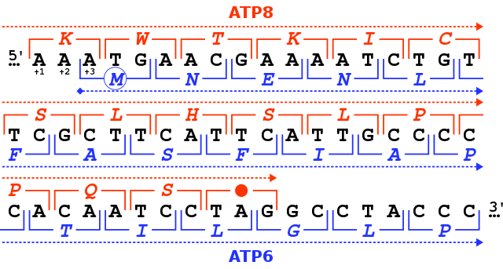
Exercise Overview – Gene sequence applications
Many fields in biology rely on gene sequence data for different applications
Specific gene sequences can be used for identification, finding evolutionary relationship, or developing therapeutic techniques
Despite being very common – there are many different approaches the depend on the question researchers have
In some cases, looking at the most similar match for one particular sequence might be enough
In other cases, you might want to compare MANY sequences from many organisms

Slide 5
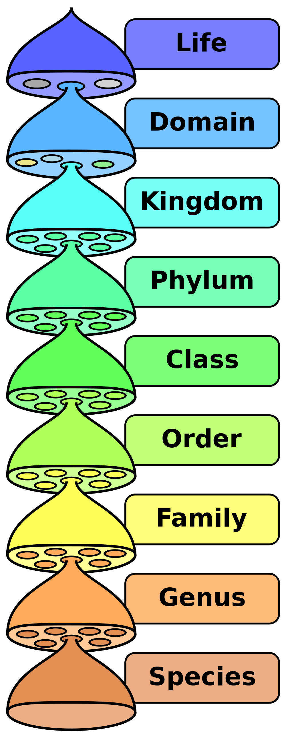
Exercise Overview – Taxonomy and ID
Sequences taken from different organisms can be used to identify taxa
Taxa are categories of organisms – like species or families – that we want to compare or relate to each other
This can help identify unknown specimens or make connections between specimens collected in an experiment by comparing similarity

Slide 6
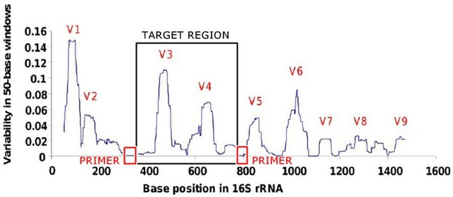
Exercise Overview – Barcoding
One particular way different fields standardize identification of specimens is called barcoding
Comparing one specific gene across species and treating the sequence like a…barcode
Scientists that study different organisms choose specific genes – can differ by group
E.g. Bacteria use 16S rRNA gene where fungi use ITS gene
Chosen because it can be found across the group but evolves enough to identify one taxa from another

Slide 7
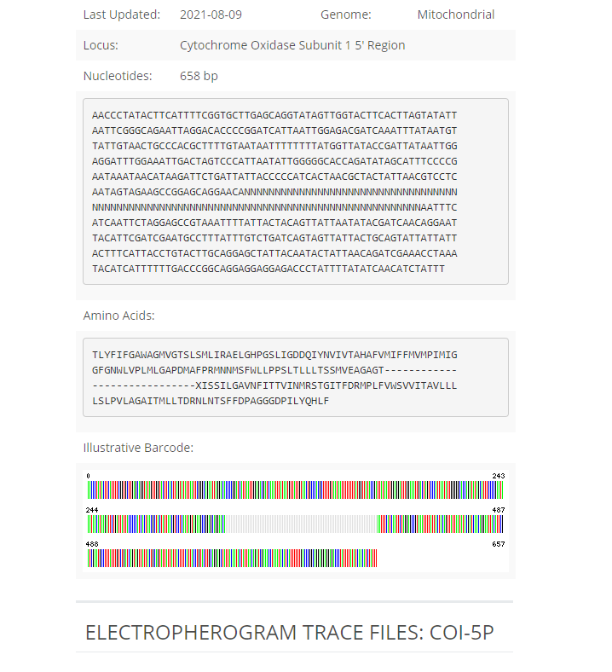
Exercise Overview - Phylogenies
One way we can use sequences collected from multiple specimens is to make a database that we can then check new specimens against
This can help us find what taxonomic group a specimen belongs to – or at least the most closely related taxa
There are different ways we can use this – with one of the ways being constructing phylogenies
These are graphical ways of showing relationships between taxa that can then incorporate unknown samples

Slide 8
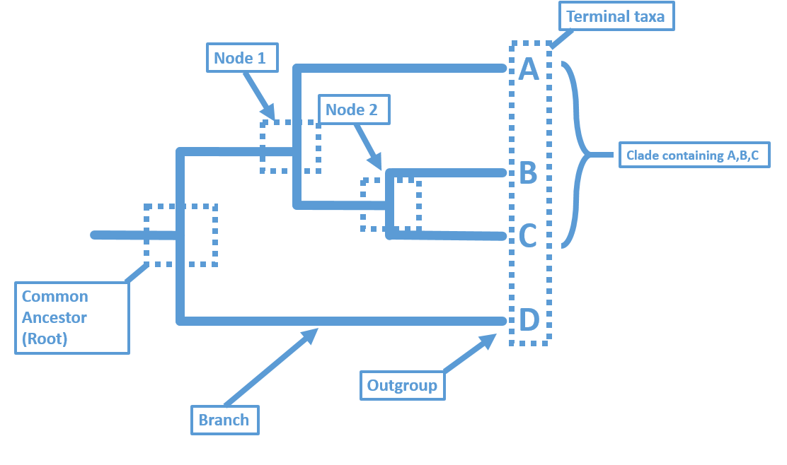
Exercise Overview – Interpreting Phylogenies

Slide 9
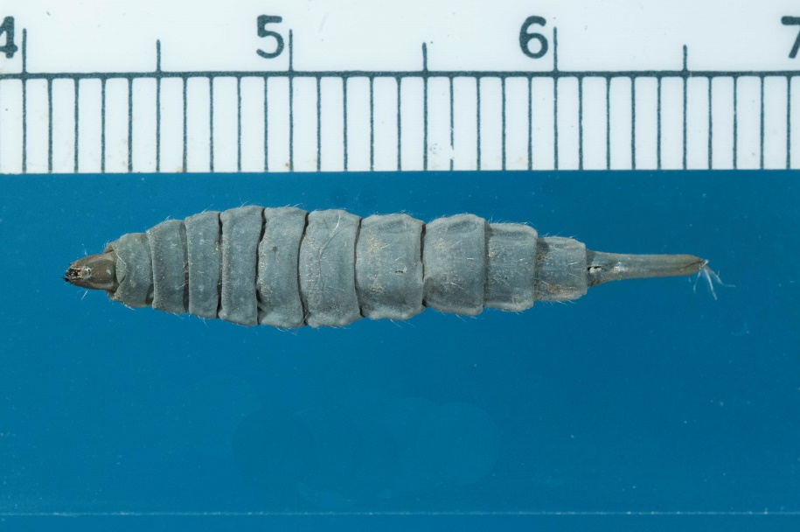
Exercise Overview – Creating phylogenies to identify unknown specimen
A specimen was found feeding on a decomposing specimen in a forensic study that had not been previously observed
The specimen was found both as a pupae and a larva
Since the specimen had not been observed by the group conducting the forensic survey – you have been asked to use the sequence data they have to identify it
The sequence is from the COI gene – a common barcoding gene for animals – this and a comparison sequence are saved in “unknown.fas”

Slide 10
Procedure Overview

Slide 11
Retrieving other sequences from the Barcode of Life Database (BOLD)
The BOLD database provides many barcode sequences for specimens submitted by researchers
You will:
Search BOLD for a tentative ID for the unknown
Download sequences from the genus for the tentative ID
Download sequences from other dipteran species

Slide 12
Alignment
After the sequences are downloaded and put into you FASTA file – we will align the sequences
This makes it so MEGA is comparing the sequences relative to each other – some sequences might come from different parts of the gene and need to be “lined up”
MEGA will construct and alignment and you will then check/trim that alignment so we can construct out phylogenies

Slide 13
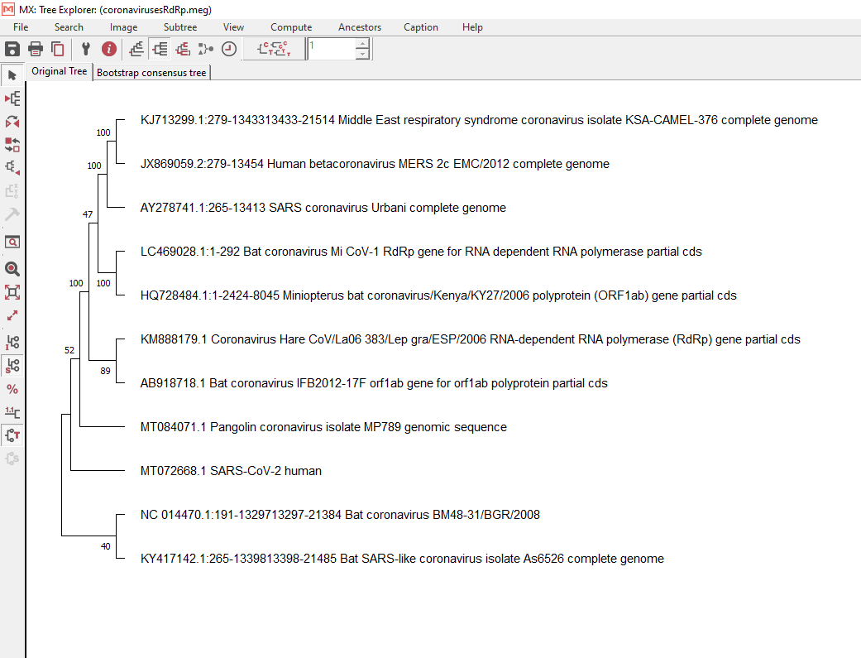
Tree construction
Next, we will use the Maximum Parsimony method in MEGA to create a predicted tree
This method checks what tree can be constructed that makes connections based on similarity and the fewest changes/branch points possible
The tree will also “check its work” by calculating bootstrap values
This tells us how confident we are in the way the tree was made (100 = perfect, 0 = no support)

Slide 14
By the end of this exercise you should have/turn in:
3 total FASTA files
2 total alignment files
2 predicted phylogenies saved as image files
The answers to the questions from the student handout saved as a word document

