Slide 1


Pharmaceutical Contamination and its effects on estuarine organisms
Leah Shotwell

Slide 2
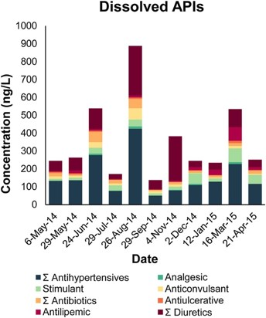
Background
According to a 2016 study, 14 different pharmaceutical ingredients were present as dissolved substances within a Rhode Island estuary (Cantwell et al., 2016).
Eight substances were consistently found as particulates in the water, ranging from 0.2–18 ng/g in size (Cantwell et al., 2016).
Conclusions drawn from this study indicate that many of these compounds are bioavailable to aquatic organisms within the estuary (Cantwell et al., 2016).
Detection of these pharmaceuticals is important as its absorption in aquatic organisms can alter survivability (Cantwell et al., 2016).
Very little research has focused on estuaries specifically, making this data and the data of the primary literature more valuable.
Enviro Toxic and Chemistry, Volume: 35, Issue: 11, Pages: 2665-2673, First published: 08 April 2016, DOI: (10.1002/etc.3452)

Slide 3
Flow Diagram of Pharmaceutical Contamination Process
Ingestion and Disposal of Pharmaceuticals
Medications such as antibiotics, antihypertensives, and SSRIs are ingested
Portions of the medications are not absorbed and leave the body through bowel movements
Inadequate Removal of Pharmaceuticals at WWTPs
The high aqueous solubility and low sorption potential of many medications means that WWTPs cannot effectively remove them
Combined storm/sewer systems further limit filtration processes
Introduction of Pharmaceuticals into Estuarine Environment
WWTP effluent reaches local estuarine and marine environments
Aquatic organisms absorb the pharmaceuticals as well as their byproducts, which can alter their health and behavioral patterns
We have established that pharmaceutical contamination is present in many aquatic environments; however, we need to know how the process of contamination works in order to effectively address it (Cantwell et al., 2016).

Slide 4
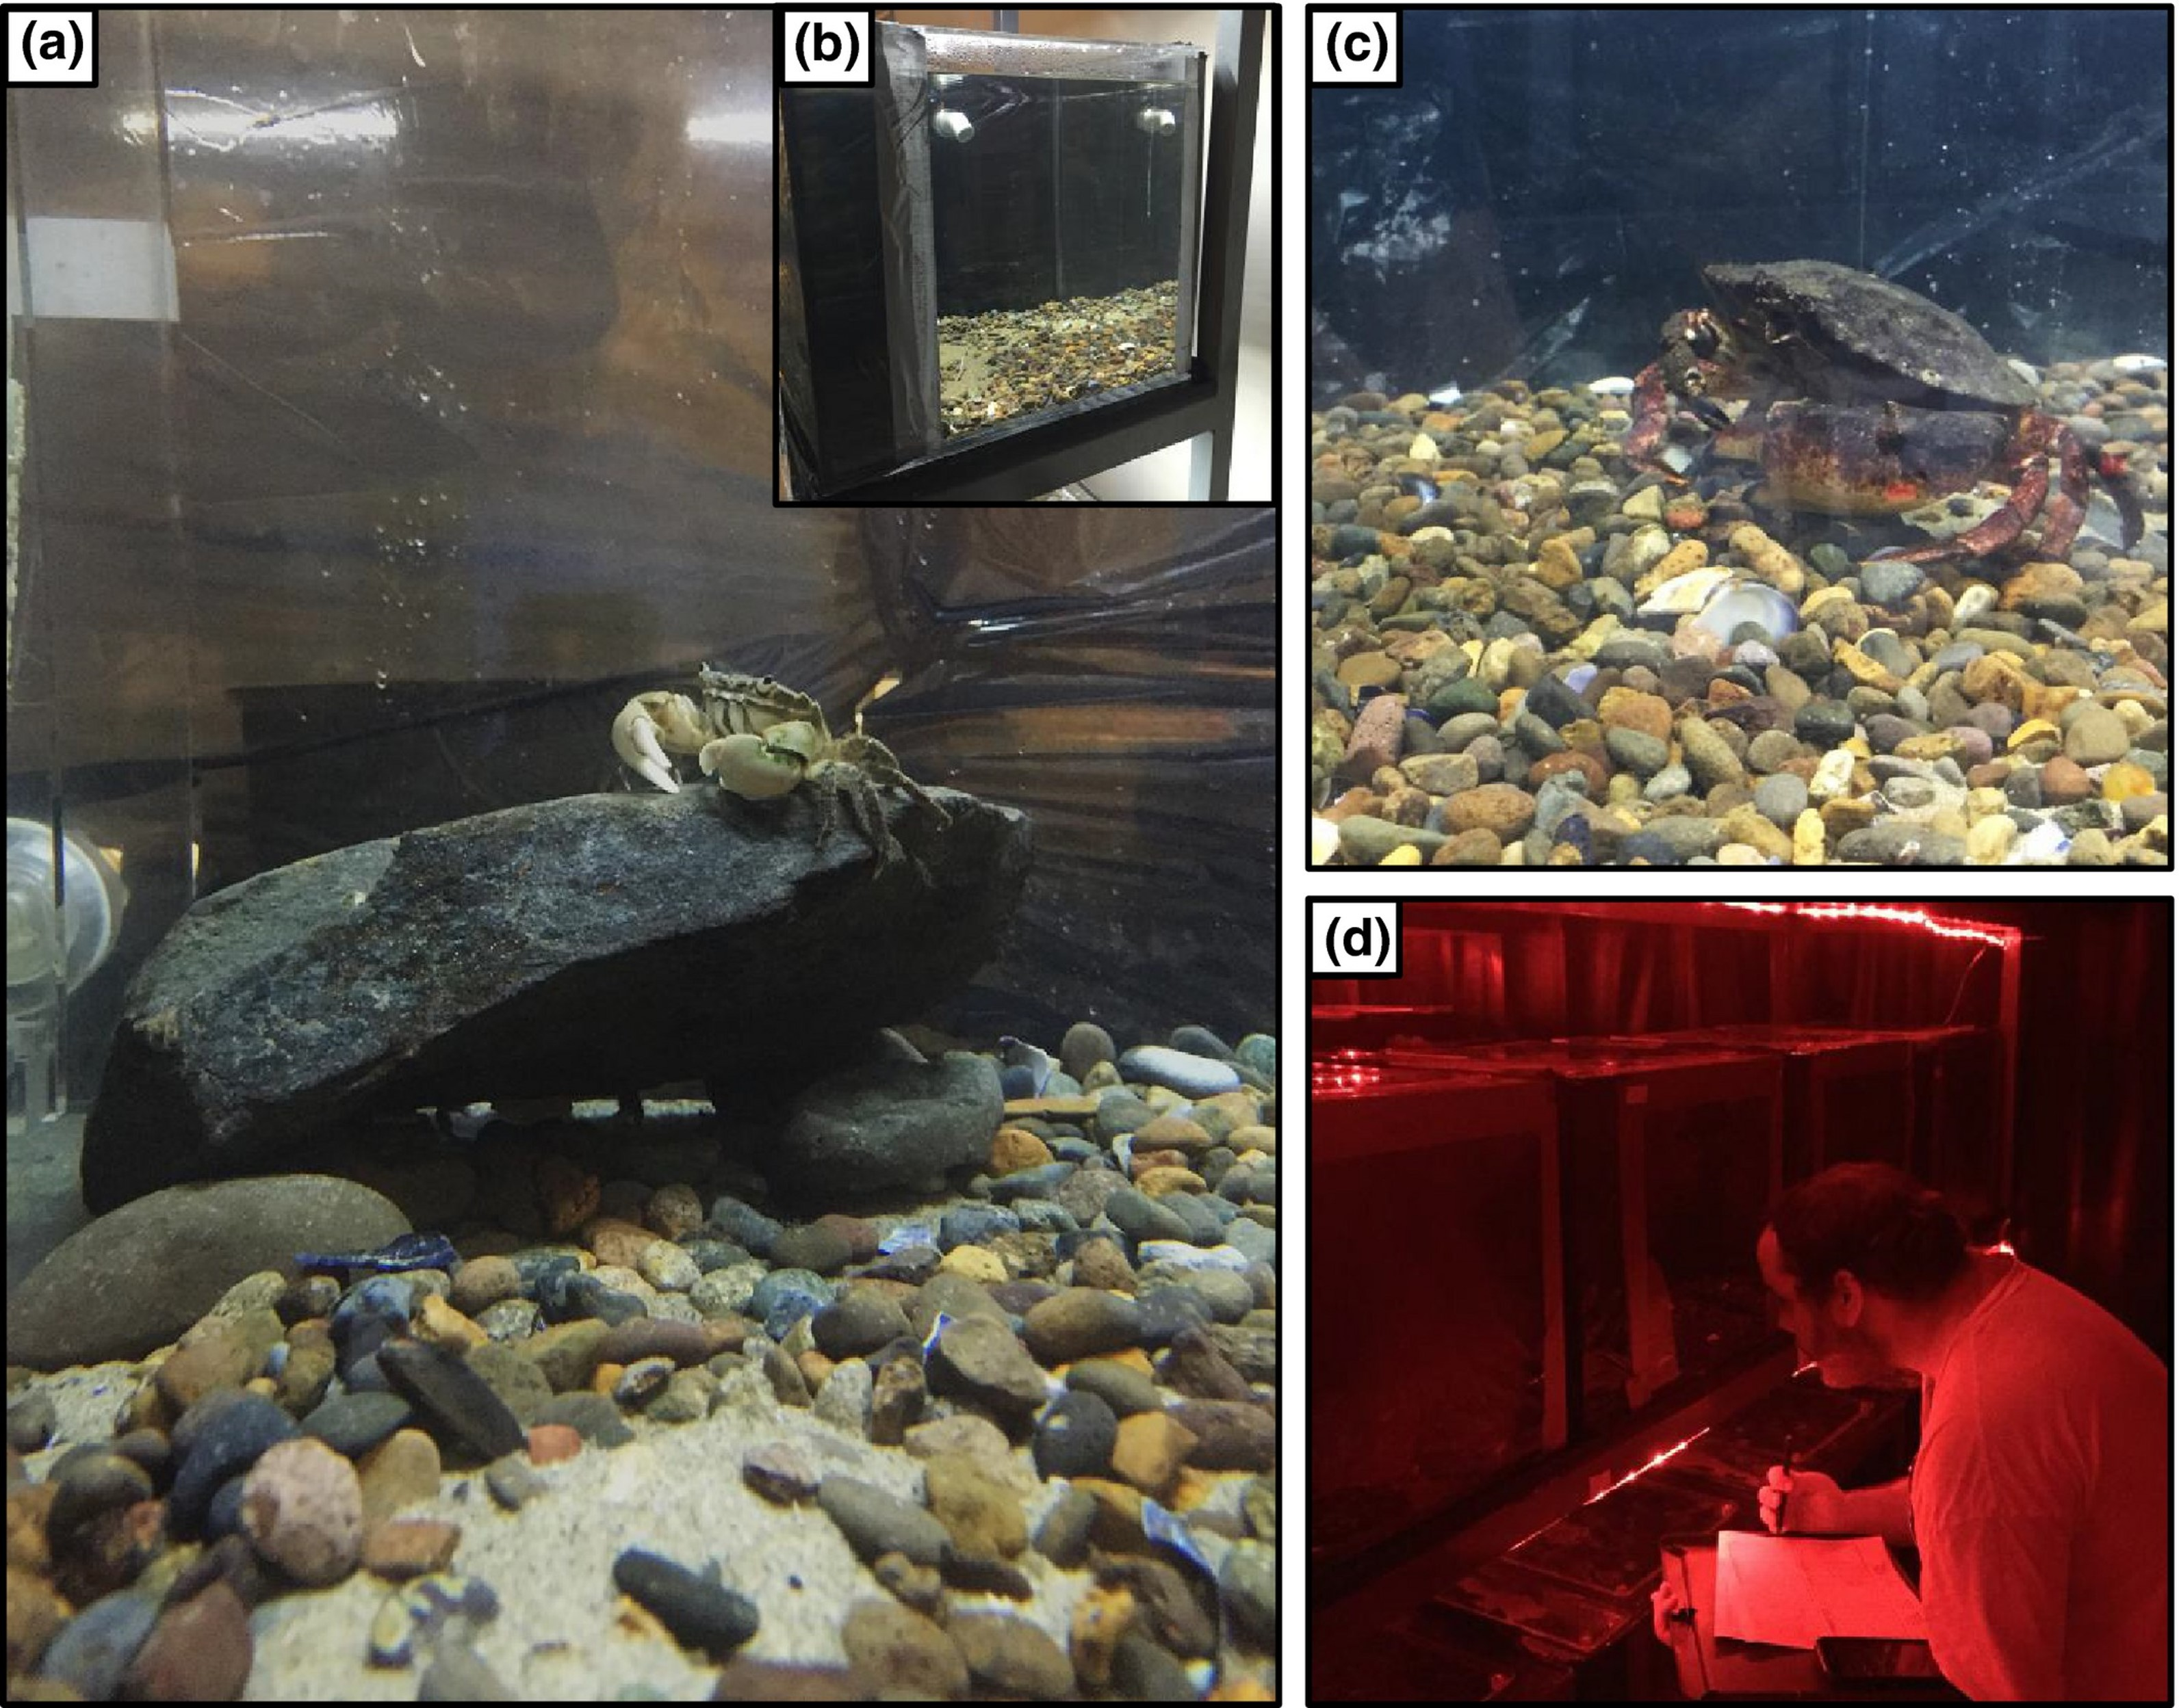
Paper Background – Shore Crab Hemigrapsus oregonensis
Hemigrapsus oregonensis typically limits risk through its nocturnal nature, as this minimizes interaction time with diurnal predators of the species (Peters et al., 2017).
The SSRI fluoxetine hydrochloride (commonly known as Prozac) was chosen as the pharmaceutical studied as it is one of the most prevalent contaminants found in aquatic environments (Peters et al., 2017).
Serotonin typically stimulates the release of hyperglycemic, neuro-depressing, molt-inhibiting, and gonad-stimulating hormones in crustaceans (Peters et al., 2017). Therefore, the authors of this study wanted to see how a medication directly impacting serotonin levels in humans would affect circadian rhythms and the concept of balancing risk in crabs.
Ecology and Evolution, Volume: 7, Issue: 21, Pages: 9151-9161, First published: 30 September 2017, DOI: (10.1002/ece3.3453)

Slide 5

Main Questions Addressed by the Authors
Does exposure to fluoxetine encourage crabs to exhibit more “risky” behavior patterns?
Is there a difference in survivability/mortality rate between crabs in fluoxetine-free water versus those who absorb the drug?
How does fluoxetine influence the circadian rhythms of this species?
Do different concentrations of fluoxetine yield different proportions of each crab behavior?

Slide 6
Paper Strengths and Weaknesses
Strengths
Weaknesses
The study accounts for four different types of crab behavior (interacting, foraging, mobile, and still) and can be further stratified by the time of day and presence of predators
Graphical representations were abundant and easy to understand
Authors utilized multiple methods of statistical analysis
The authors only studied each group of crabs for nine weeks, meaning that longer term behavioral patterns remain a mystery
Balancing of predation risk was only studied using one species of predator (Cancer productus). We do not know if the results would follow the same trends with a different species.
Graphs were overcomplicated and almost too much at times, resulting in some of the finer nuances being glossed over.

Slide 7
Lesson Objectives and Prerequisites
Objectives
Students will be able to determine why the authors chose specific means of visual representation and why certain variables such as sex and size were not included in visual representations.
Students will be able to observe how the interpretation of the data can be altered by changing the way in which it is displayed. Students will also determine which graphs display the data in a way that is not overcomplicated/too broad of a scope.
Prerequisites
A computer with R installed
Basic knowledge of statistical processes such as linear regression, analysis of variance, etc.
Basic knowledge of the R packages ggplot2, corTest, and dplyr

Slide 8
Steps of R Analysis
Step 1: Identifying areas of focus
Introduction of Figure 2 (next slide) and questions concerning assumptions, takeaways, and ease of understanding. Why did the authors choose to display these variables in this way?
Ask: what are the strengths and weaknesses of their analysis? Is there anything you would like to get more clarification on or have displayed differently?
Step 2: utilization of R packages
Correlation test of independent variables with mortality rate using corTest; those with strong correlations will be plotted using 3 methods from ggplot2 (animated bubble chart, stacked histogram, dumbbell plot).
Questions will be asked about each of the 3 methods pertaining to their clarity, efficiency, and accurate representation of data.
Step 3: Putting it all together
Ask: Which type of graph do you feel showcased the data most effectively? Why do you think that? What did the graph in the original paper get right and what would you change? Define what makes a particular graphical representation “effective”.
Summarize the lesson by reiterating the importance of displaying data in a succinct, straightforward way.

Slide 9

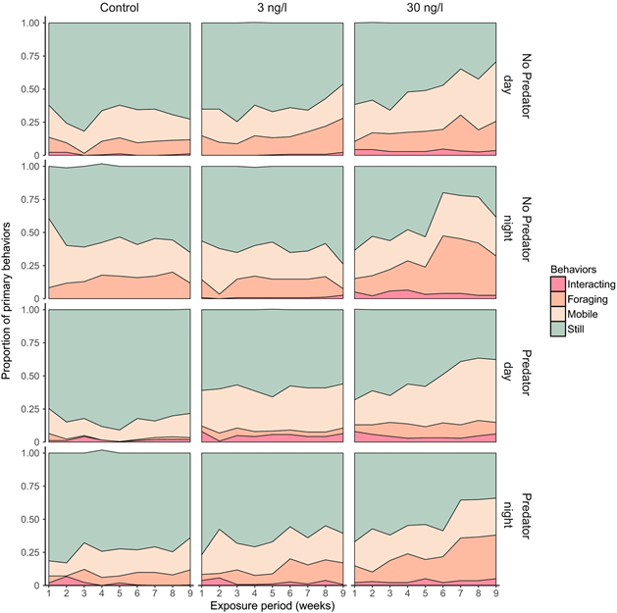
Figure 2
Ecology and Evolution, Volume: 7, Issue: 21, Pages: 9151-9161, First published: 30 September 2017, DOI: (10.1002/ece3.3453)

Slide 10
Main Takeaways
By making a visual representation too complex or incorporating too many variables, the information can become “lost in translation”.
Overall, the authors did a great job in holistically displaying the data. However, the paper is lacking smaller comparisons and conclusions that can go unnoticed in the current breadth of their analysis.
By utilizing different methods of calculating significance and subsequently plotting the data using multiple methods, the information can be made accessible to a wider array of people and make the less obvious conclusions clearer to those who do not consider themselves as well-versed in the subject material.

Slide 11
References
Peters, JR, Granek, EF, de Rivera, CE, Rollins, M. Prozac in the water: Chronic fluoxetine exposure and predation risk interact to shape behaviors in an estuarine crab. Ecol Evol. 2017; 7: 9151– 9161. https://doi.org/10.1002/ece3.3453
Cantwell, M.G., Katz, D.R., Sullivan, J.C., Ho, K., Burgess, R.M. and Cashman, M. (2016), Selected pharmaceuticals entering an estuary: Concentrations, temporal trends, partitioning, and fluxes. Environ Toxicol Chem, 35: 2665-2673. https://doi-org.proxy.library.vcu.edu/10.1002/etc.3452

