Slide 2
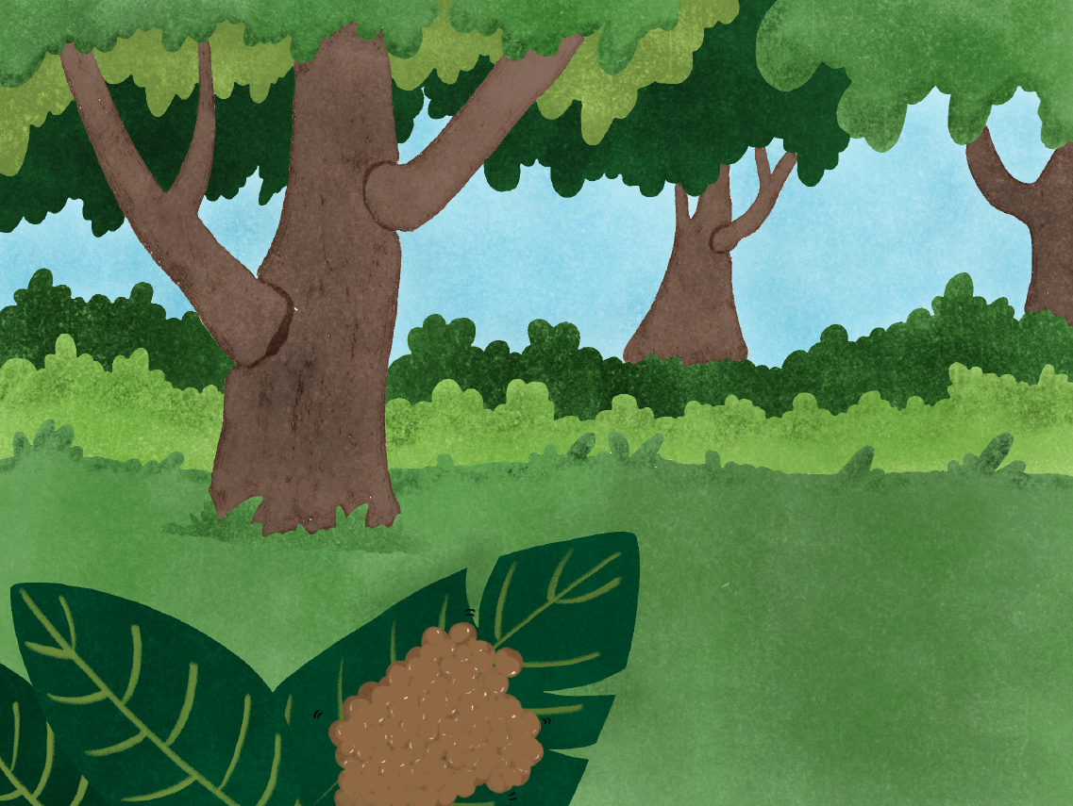
On a bright summer day in Canada, thousands of eggs lie on a leaf on the ground.

Slide 3
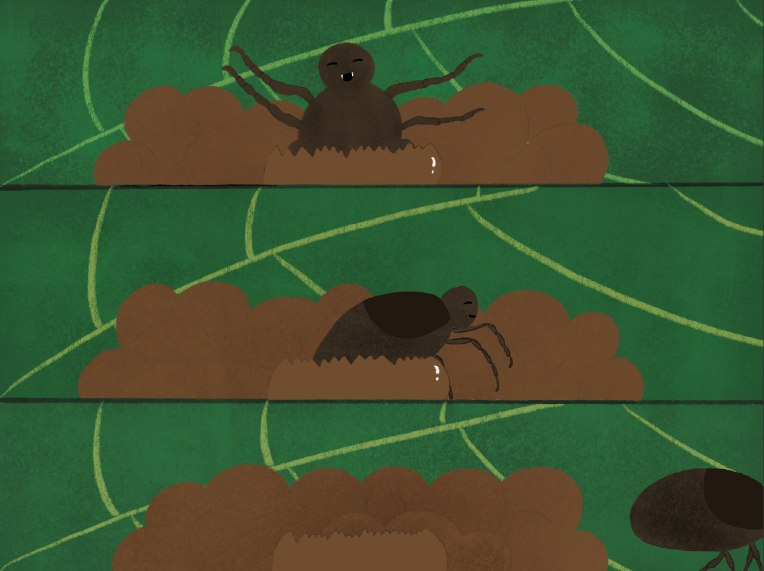
Among those eggs, Nick the Tick, hatches!
He crawls out of his shell and heads towards the ground and starts his journey to complete his life cycle.

Slide 4
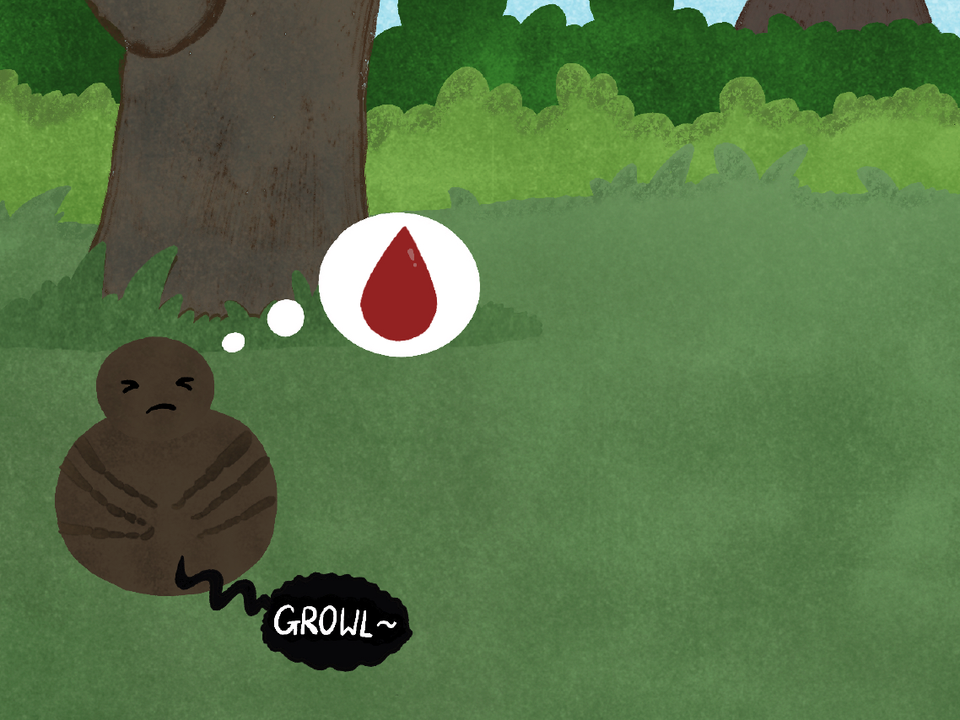
As Nick the Tick explores his surrounding, his stomach rumbles loudly! He’s hungry and needs a blood meal if he wants to complete his life cycle.

Slide 5
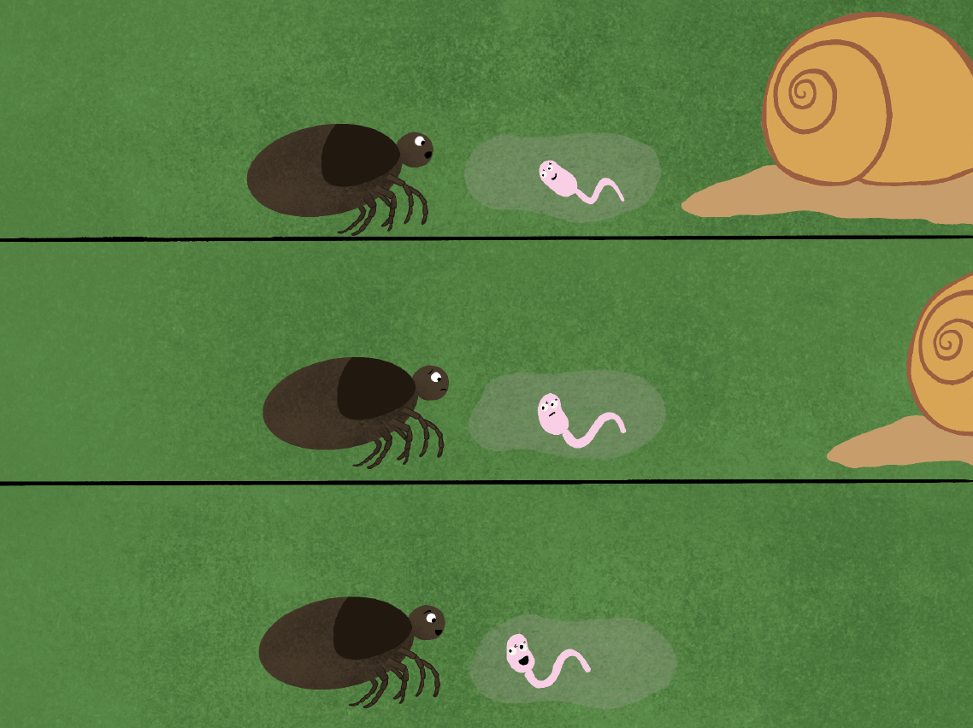
While searching for a blood meal, Nick the Tick meets his first friend
Hi, I’m Nick the Tick!
Who are you? I’m very hungry and need some blood. Can you help me?
Hi, I’m Cerissa the Liver Fluke. I wish I could help, but I don’t eat blood!
You don’t need blood?! Then how do you complete your life cycle?
My life cycle is very weird and complex! I’d be happy to tell you!

Slide 6
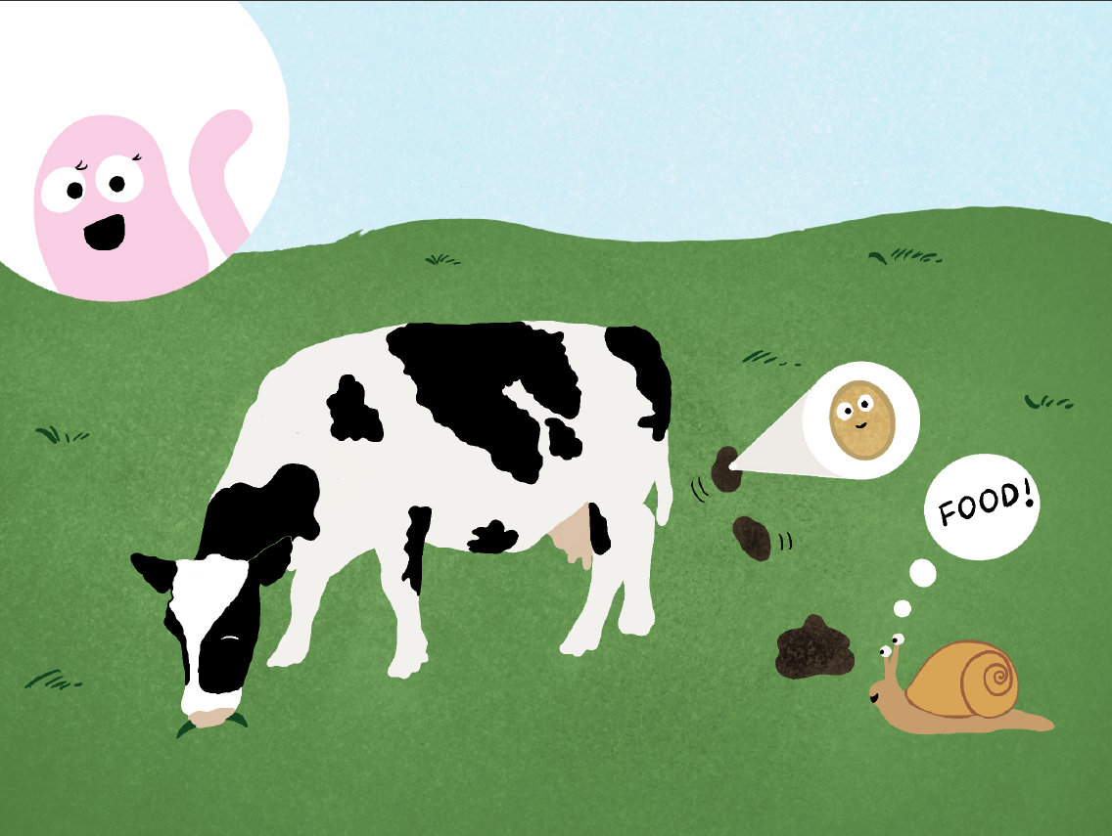
I start as an egg inside a cow, and come out with their poop! Once I hatch, I get eaten by a snail who is my first host.

Slide 7
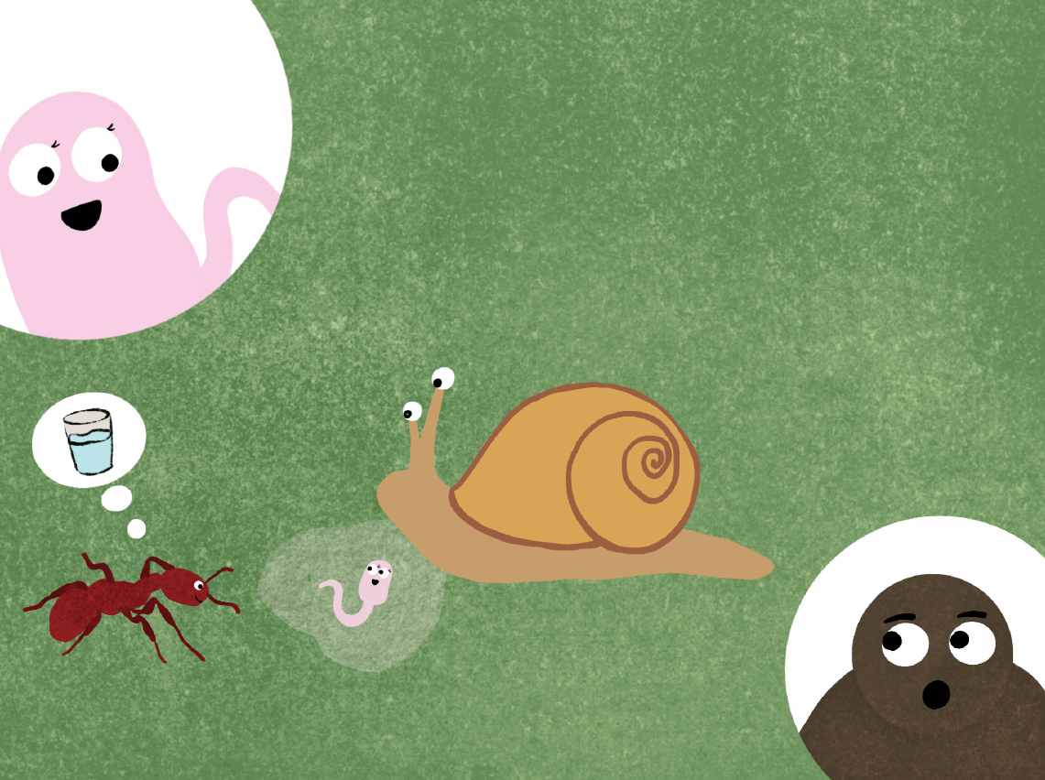
Inside the snail, I make lots of copies of myself. When there is enough of copies of me, the snail’s had enough and coughs up a slime ball full of me!
Wait, what is an ant doing there!?

Slide 8
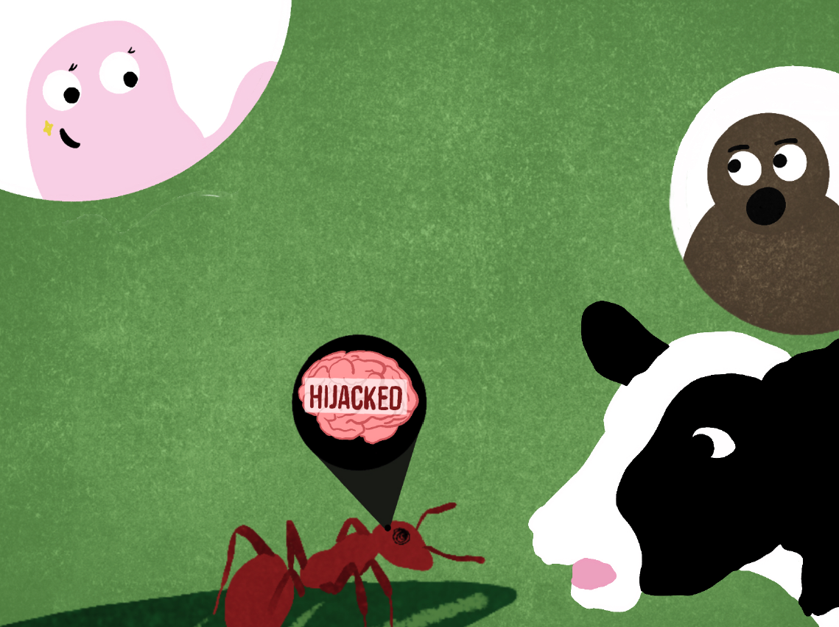
Well ants really like eating these slime balls so they end up eating me as well! When I’m inside the ant, I make my way to the brain and control the ant!
You brainwash ants?!
I do! I make these ‘zombie ants’ climb up flowers and grass so that cows accidentally eat them!

Slide 9
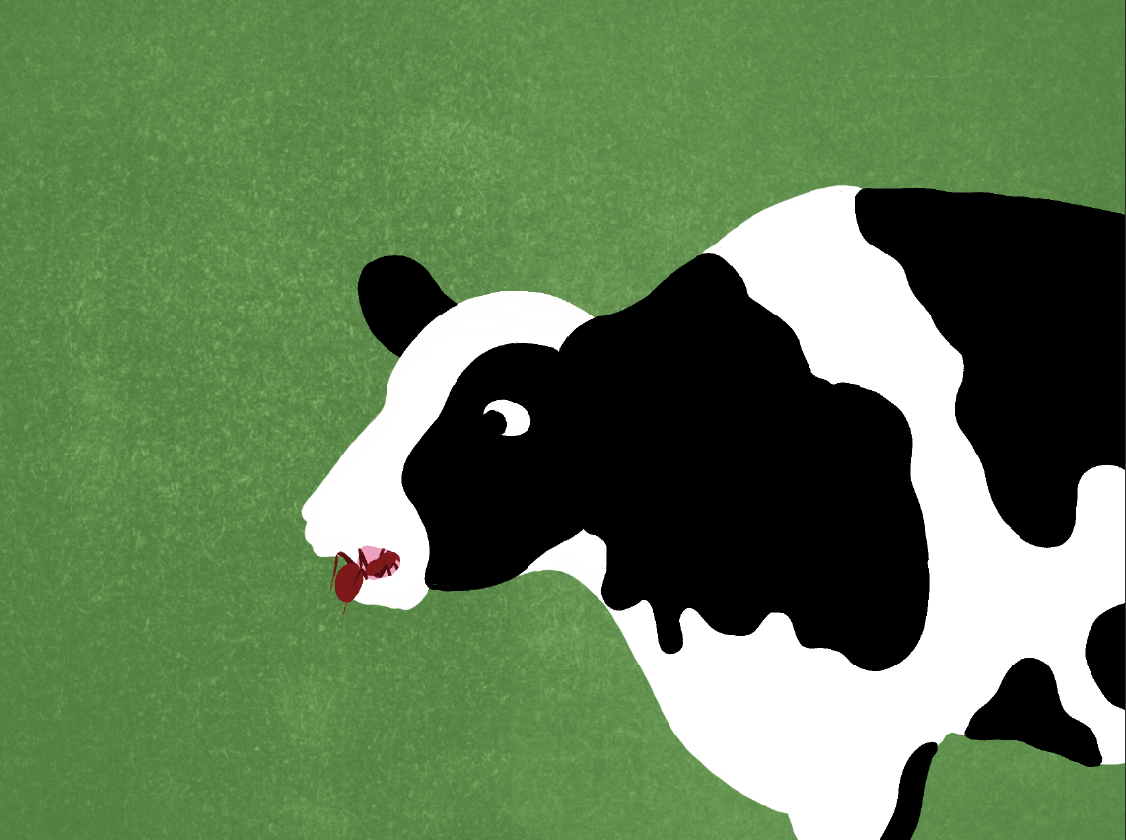
When infected ants are eaten by cows, flukes like me move to the gut. Adult flukes lay eggs, which come out with poop, restarting the life cycle all over again!

Slide 10
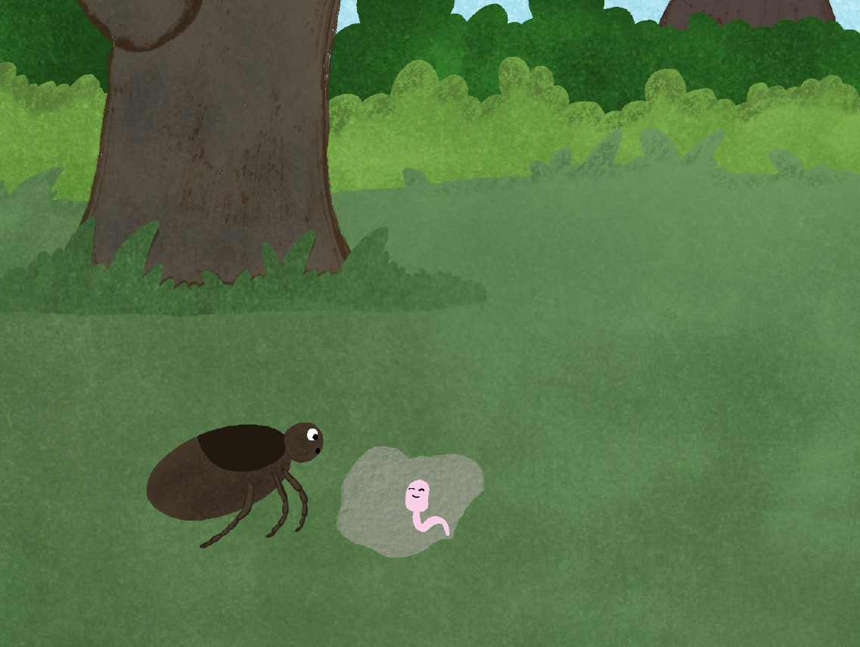
Wow your life cycle is so complex! I hope an ant comes to eat you soon so you can finish your life cycle!
Good luck finding a blood meal to finish your life cycle! Maybe you might find a meal at that pond over there?

Slide 11
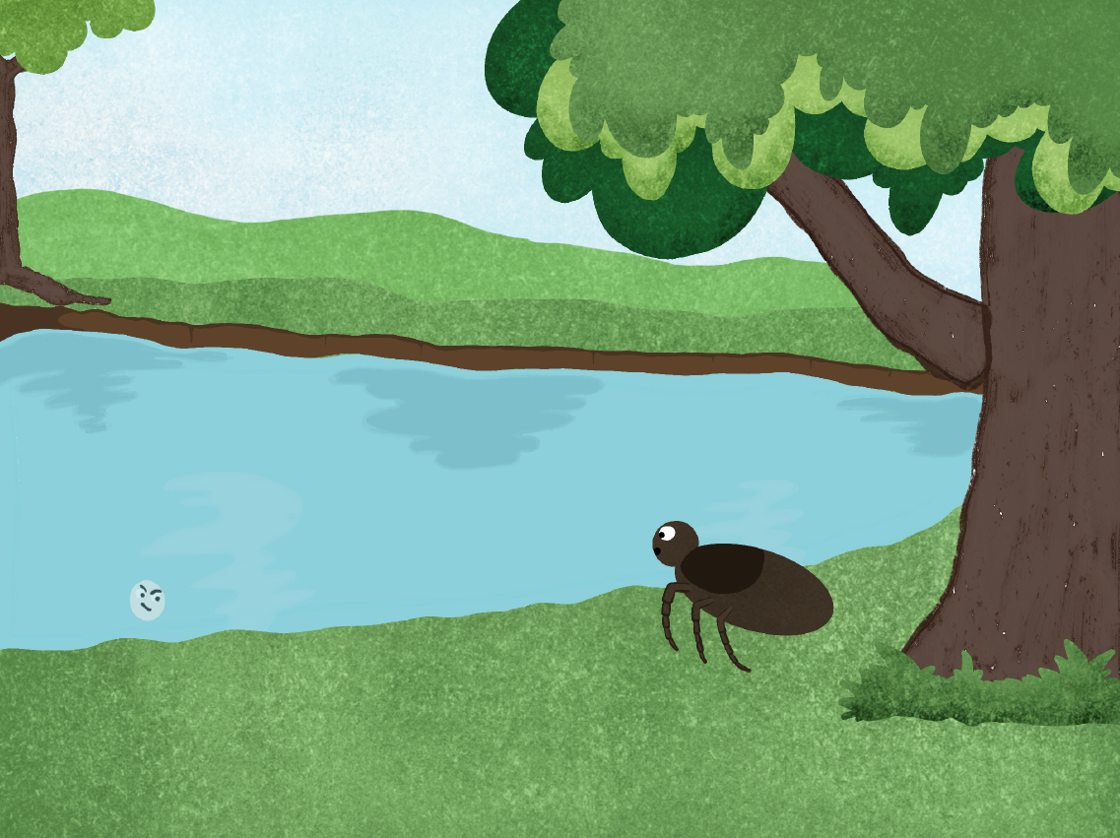
At the pond, Nick the Tick meets his second friend
Whoa, I didn’t see you there! Who are you? Can you help help me find a blood meal!
Hi, I’m Max, a myxozoan parasite! Unfortunately, I don’t think you’ll find a blood meal here.

Slide 12
Why not? Don’t you need a blood meal to finish your life cycle?
No, I don’t! You will understand if I tell you about my life cycle!

Slide 13
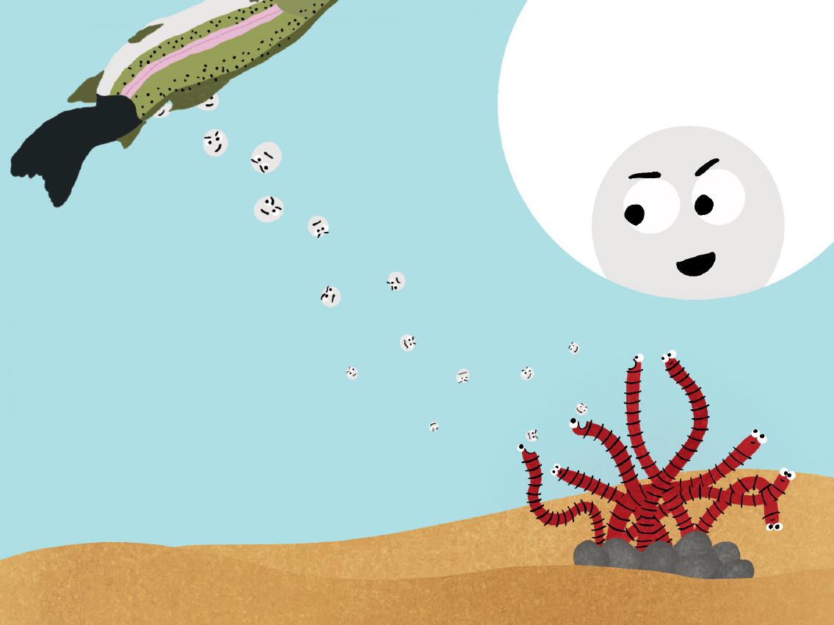
When a fish infected with me dies, I get released into the water. When I’m in the water, I hope to get eaten by a tubifex worm.

Slide 14
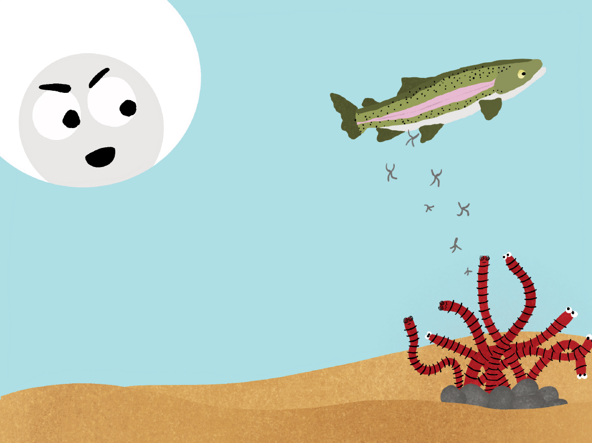
When I’m inside the worm, I change shape and come out with worm poop! At this point, I try to find a fish to infect.

Slide 15
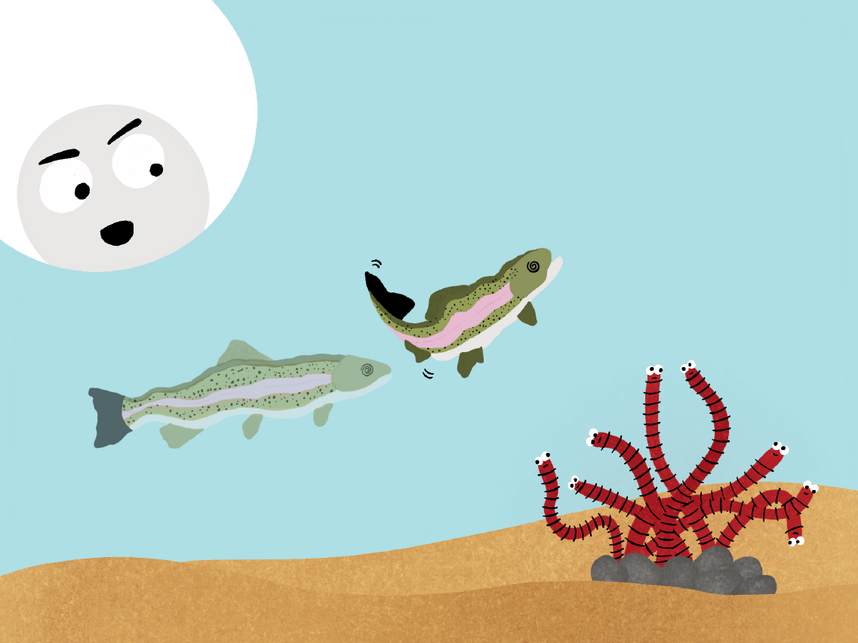
If you remember, I need the fish to die so that I can be released. To make the fish die easily, I hurt the tail and make it black and shriveled so it can’t swim!

Slide 16
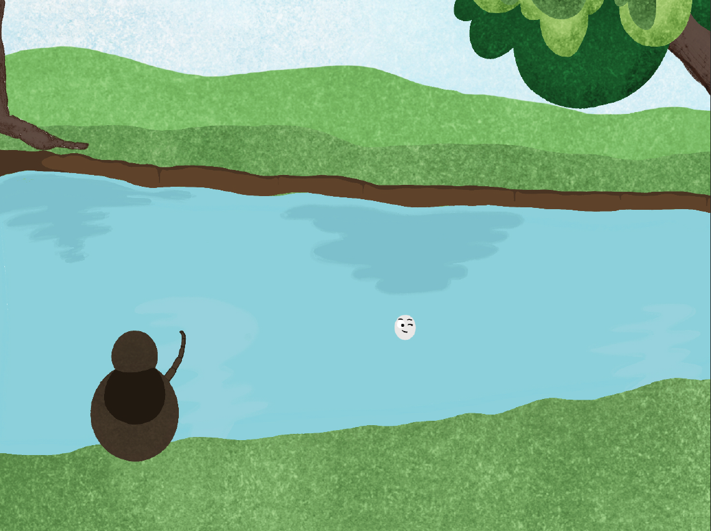
That’s crazy! I wouldn’t want to be infected by you!
Thanks for sharing your story with me.
You’re welcome! Maybe you’ll find a blood meal if you keep going down the river.
Good luck!

Slide 17
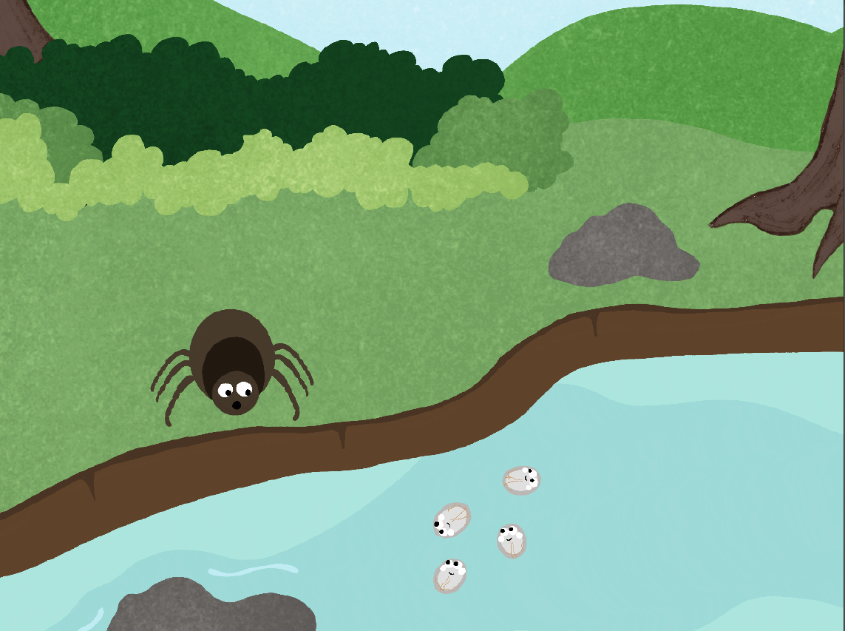
Down the river, Nick the Tick meets his third friend
Hi, I’m Nick the Tick. I’m very hungry and looking for a blood meal. Can you help me?
Hi Nick, I’m Giano the Giardia. I’m not sure if you’ll find a blood meal here

Slide 18
Why is that? Is your life cycle different than mine?
It sure is! Let me tell you about it!

Slide 19
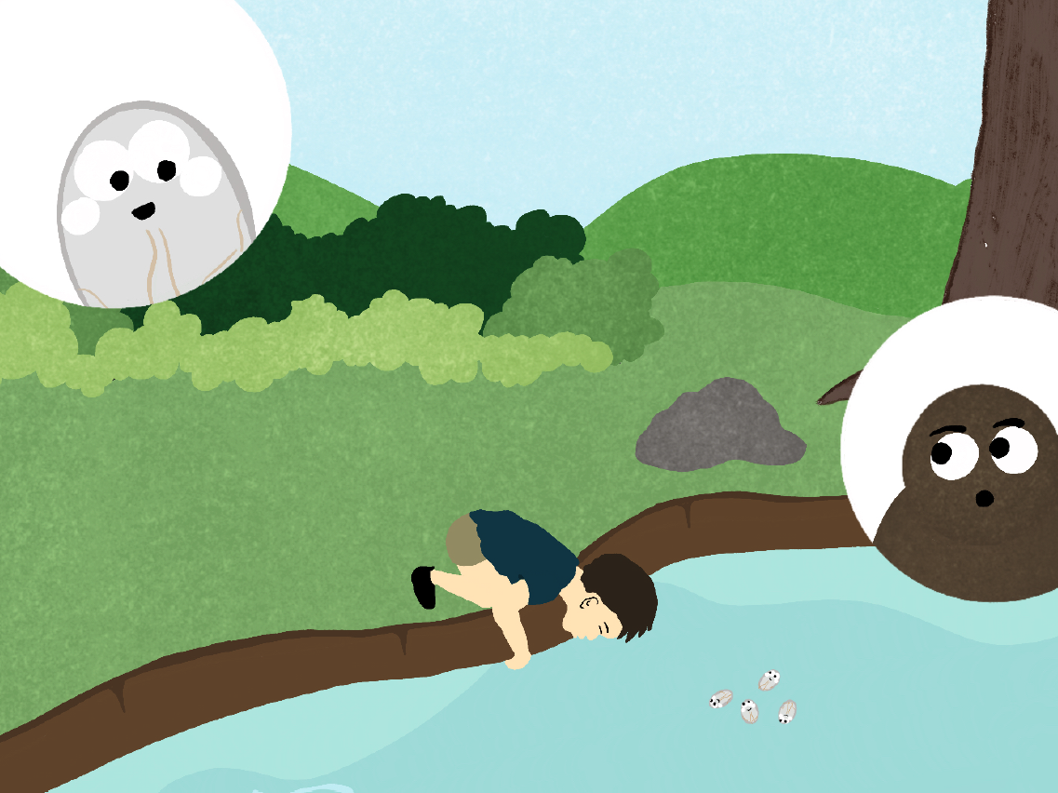
Right now, I’m waiting for a mammal to drink water with me inside. I can survive in water for a long time so I’m in no rush!
Oh hey! Here comes a human. They’re mammals, right?

Slide 20
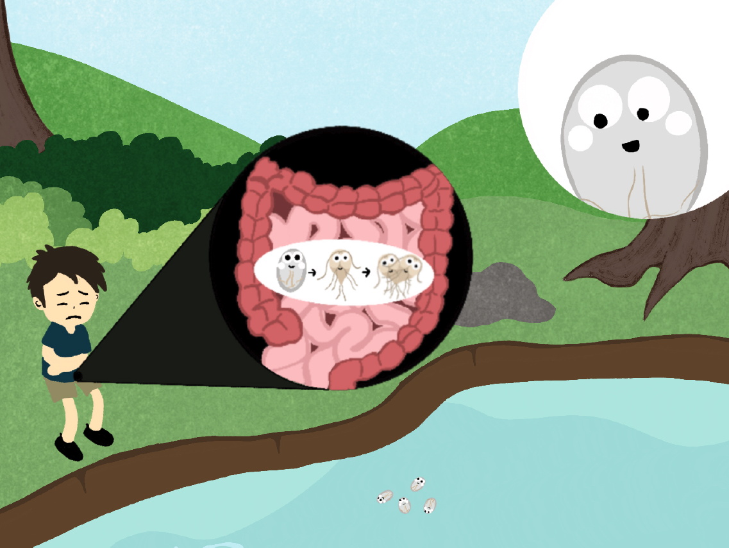
Yeah! If a mammal ends up drinking me I change form a few times and make a home in the intestines!

Slide 21
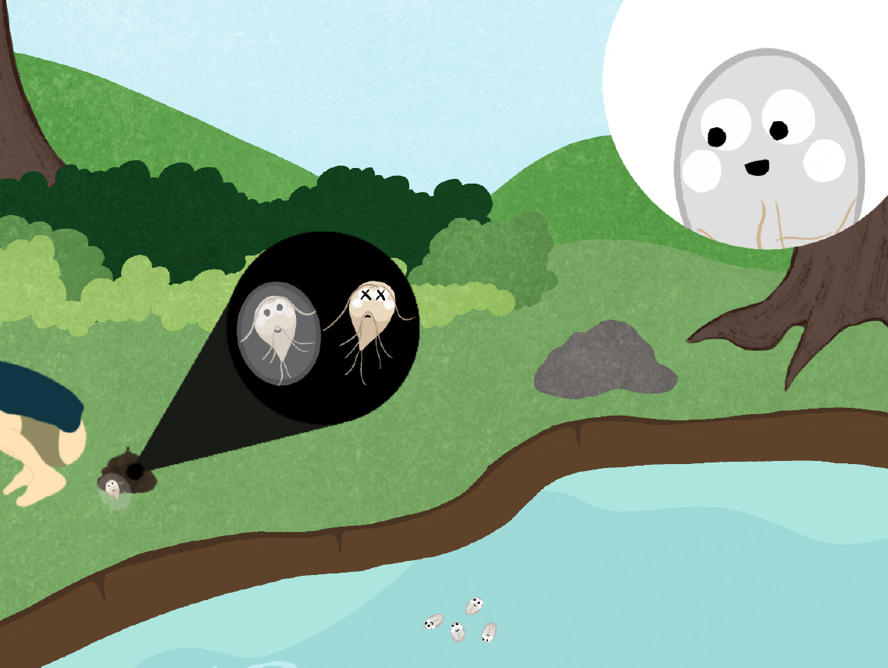
When I’m in the intestines, I make lots of copies of myself. Some of my copies are protected in a cyst and come out with poop.
I bother the intestines to make mammals poop. A lot! This means lots of my copies can come out! The ones that are protected by a sheath eventually get to water, starting my life cycle all over again.

Slide 22
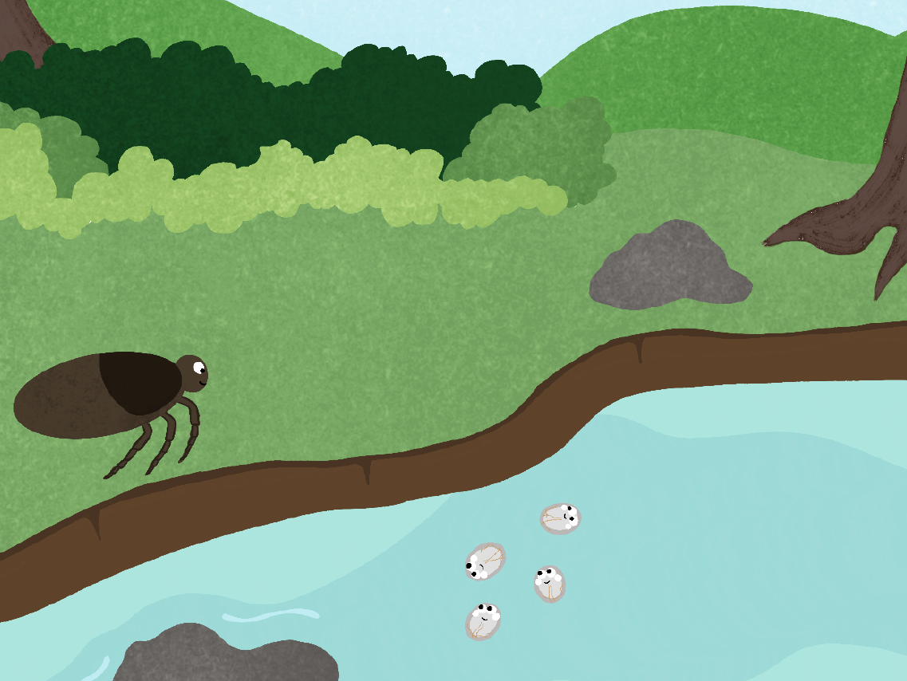
That’s disgusting! But your life cycle is also really cool!
Thanks for listening! Hope you find a blood meal soon to complete your life cycle!

Slide 23
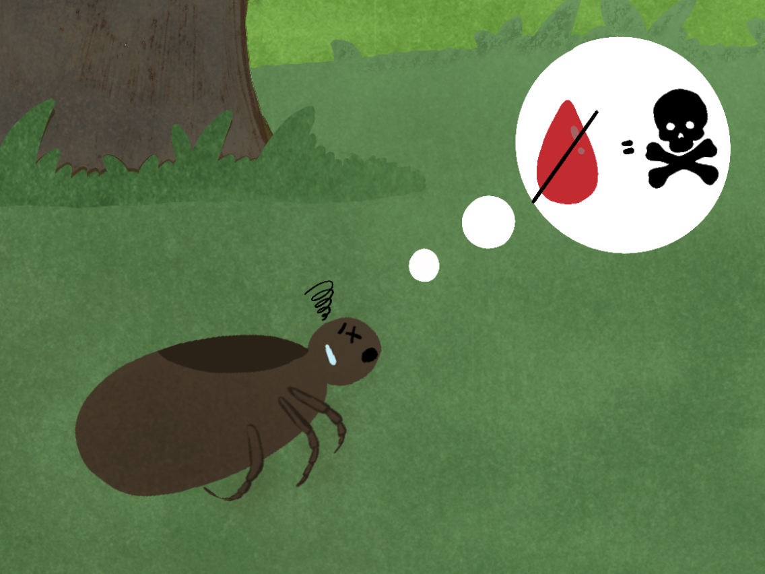
Nick the Tick learned a lot about other parasites life cycles, but he is still very hungry. Without blood, Nick won’t be able to survive for long!

Slide 24
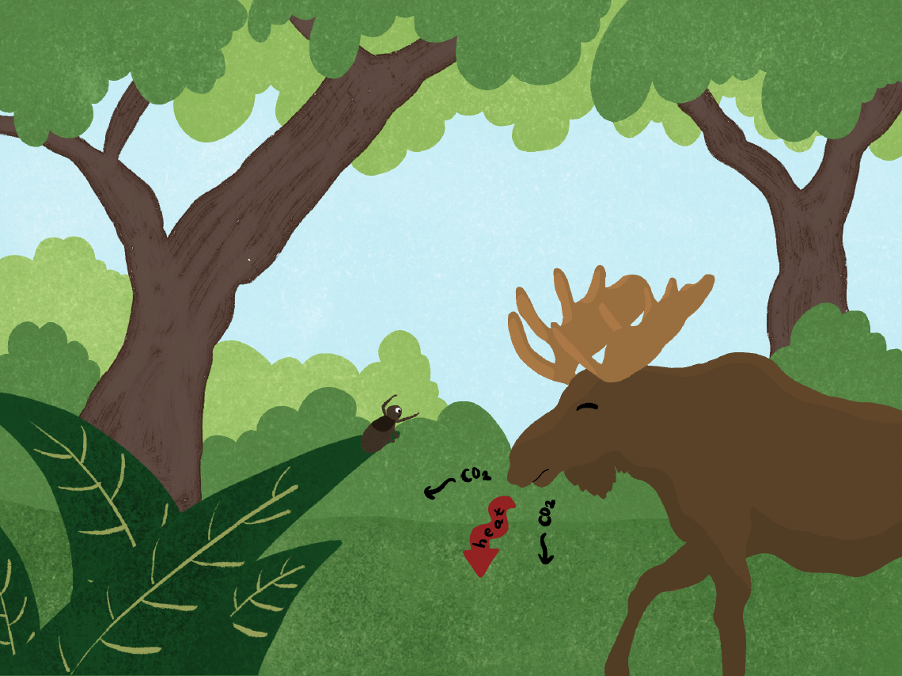
Looking for a blood meal, Nick senses heat and breathing from an animal near by and climbs up some grass.
This is it! This is my chance to get a blood meal!

Slide 25
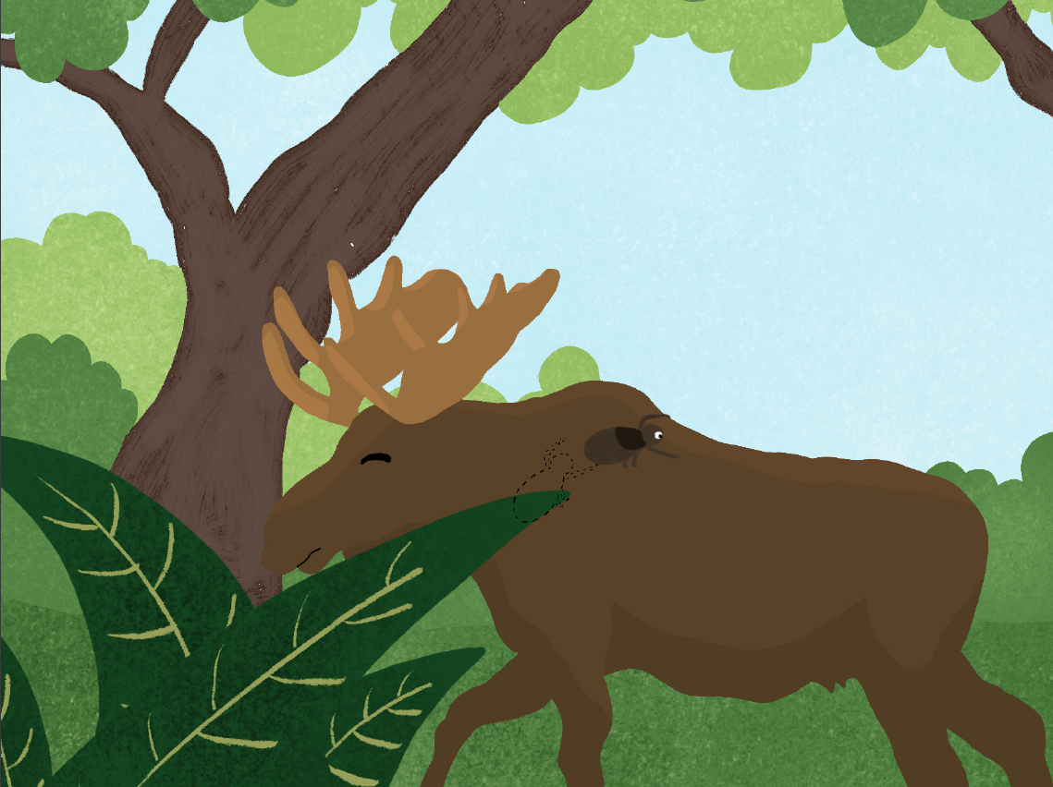
Desperately, Nick the Tick clings to the thick fur of the moose. He did it, he found a blood meal!

Slide 26
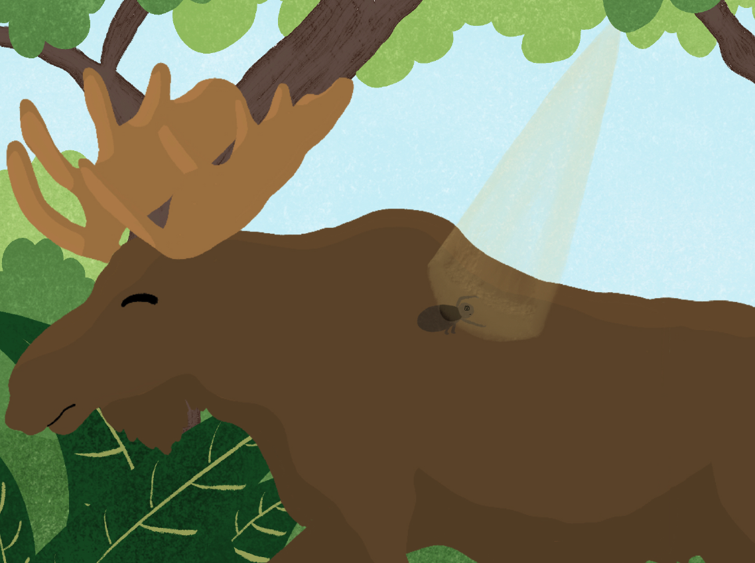
But Nick the Tick still has some work to do! The sun is too hot!
Oh no… I need to find a cooler and safer place.

Slide 27
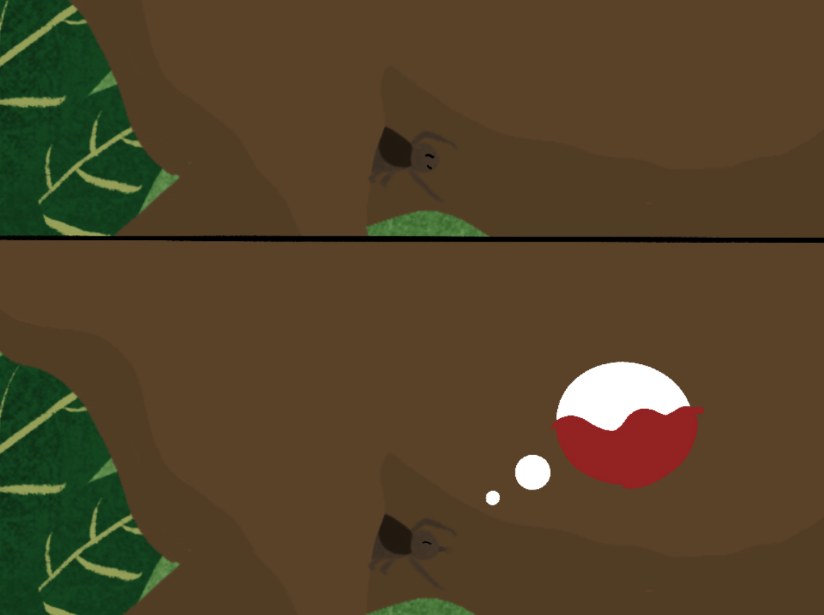
Moving around the moose, Nick the Tick finally finds a nice armpit to settle into. Feeling safe, he uses his sharp mouthparts to pierce the skin. He can finally have his blood meal!

Slide 28
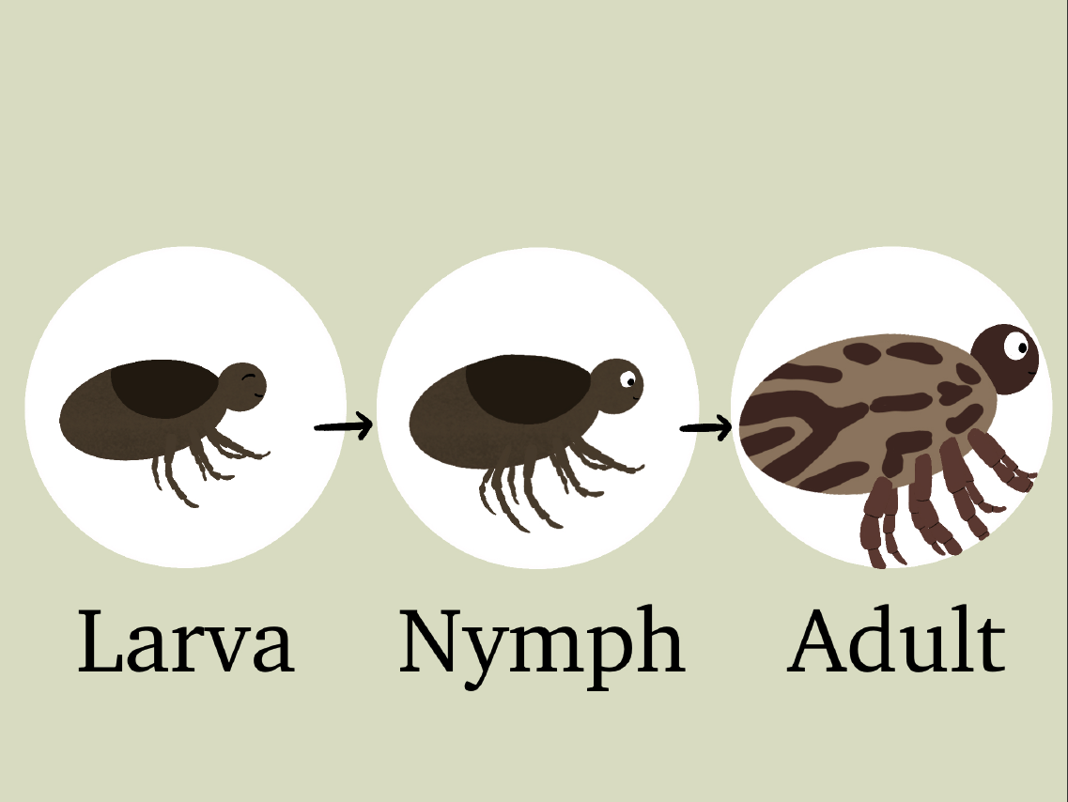
With blood being so nutritious, Nick the Tick transforms from a young larva to an adult tick!

Slide 29
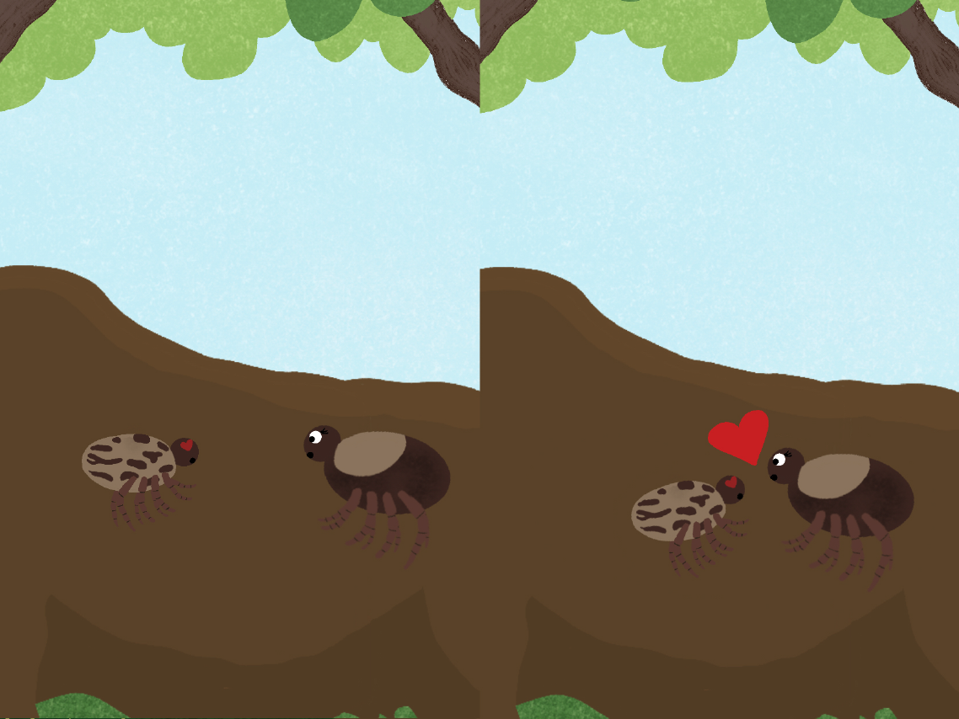
One day, Nick the Tick meets a female tick on the moose
Hi, I’m Nick the…. uh… Tick. Nice to meet you!
Nice to meet you! My name is Vick

Slide 30
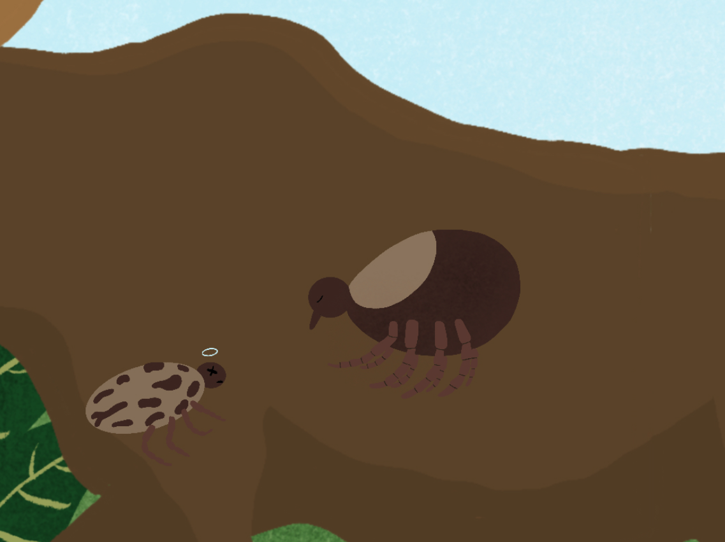
Nick and Vick’s meeting is beautiful but short. Nick doesn’t have much longer to live after finding and mating with Vick.
Vick will live a bit longer, drinking more blood to make as many eggs as possible!

Slide 31
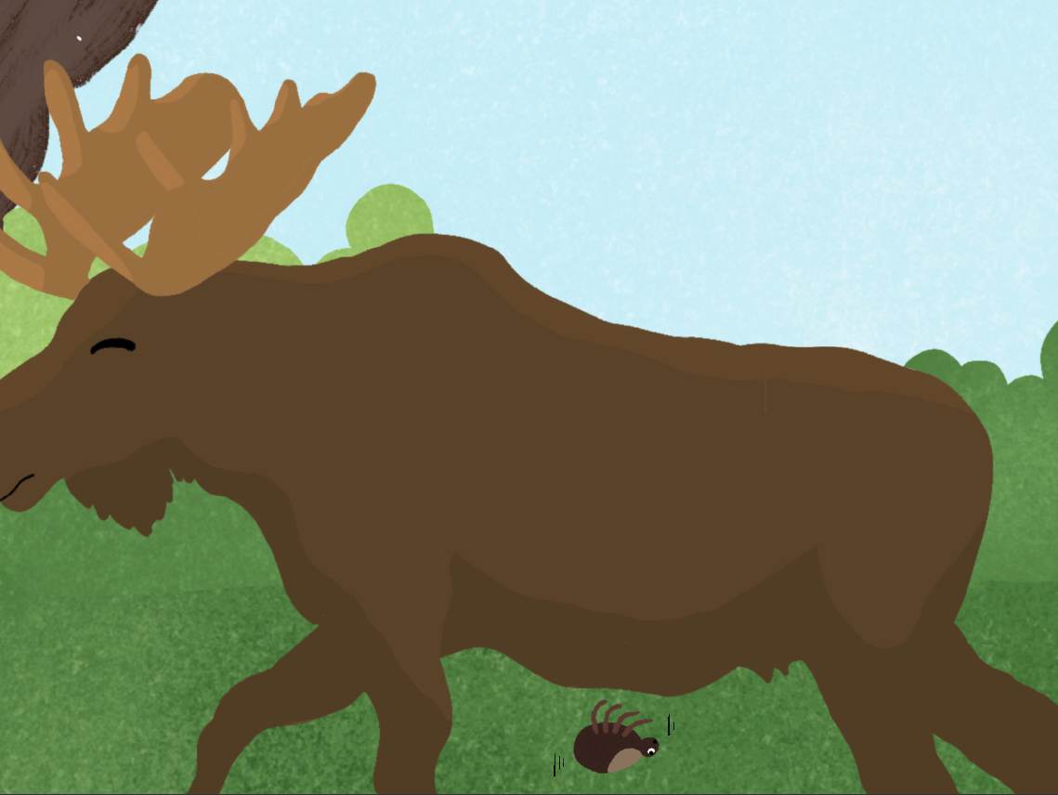
Eventually, Vick had her fill and drops off the moose. She’s had her last blood meal.

Slide 32
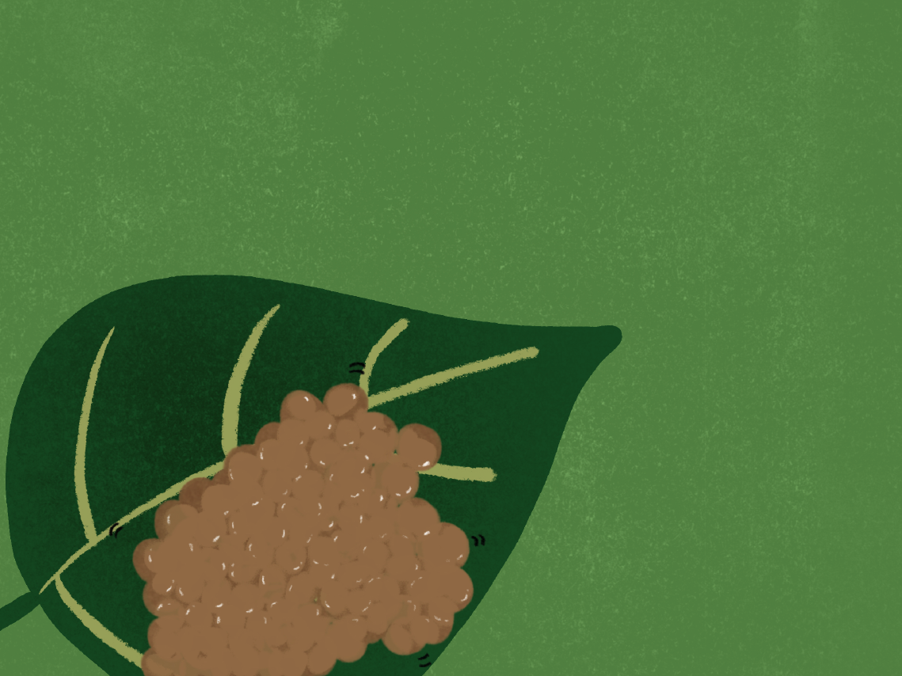
On the ground, Vick uses all her energy to lay hundreds of eggs.
Soon, Nick and Vick’s eggs will hatch and the next generation of ticks will go on their own journeys to find a blood meal!

