Slide 3
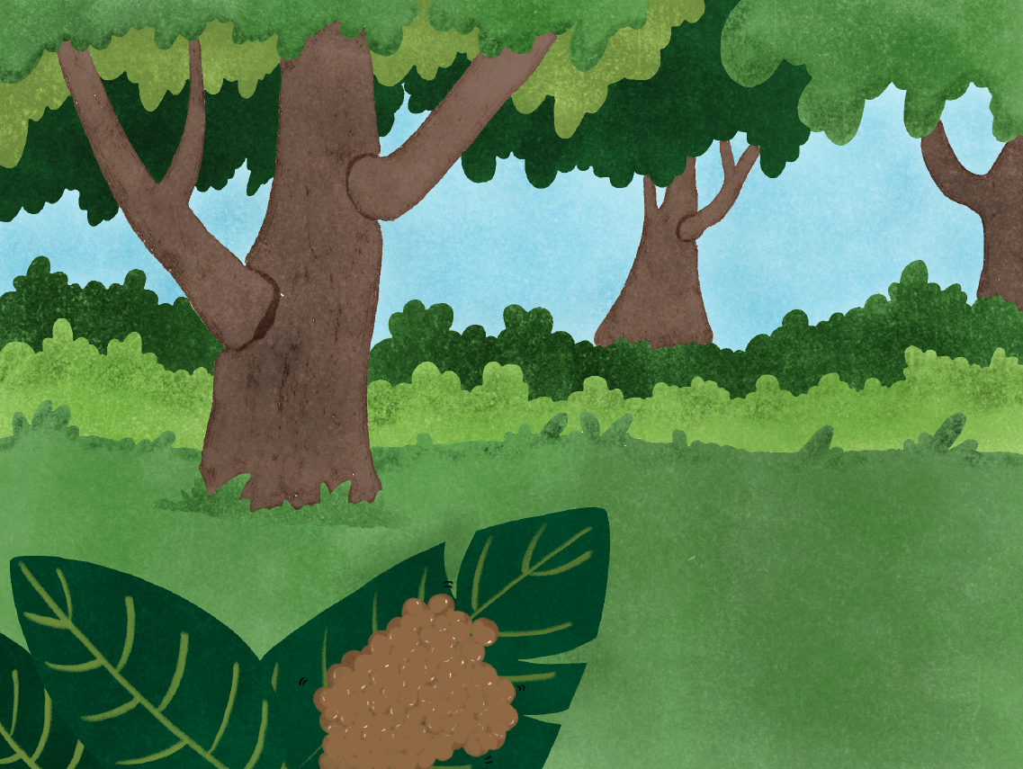
Notes:
On a bright summer day in Canada, thousands of eggs are on a leaf.

Slide 4
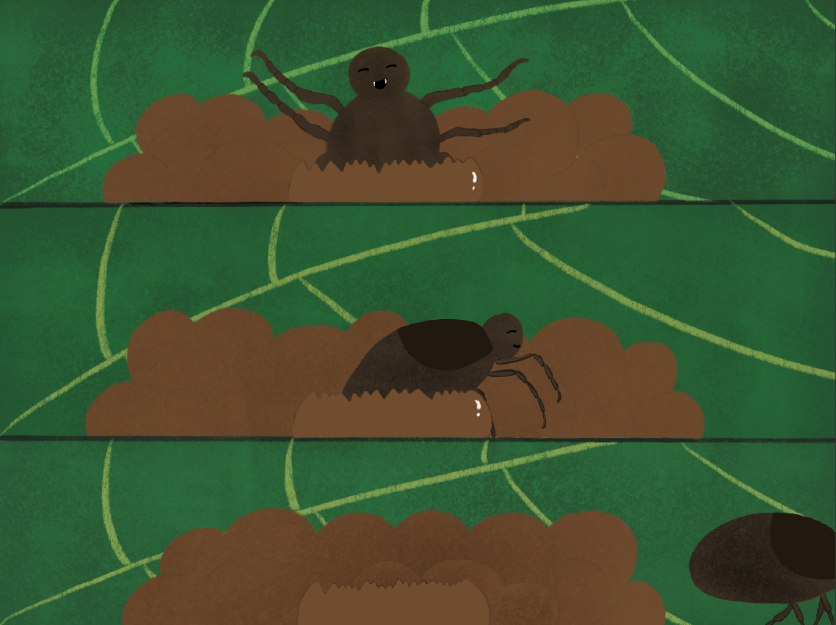
Notes:
Among those eggs, Nick the Tick (Dermacentor albipictus) hatches first.
He crawls out of his shell and heads towards the ground.
Fun fact:
1) Adult female ticks may lay up to 5000 eggs at once.
Did you know?
1) Ticks are more related to spiders than to insects.

Slide 5
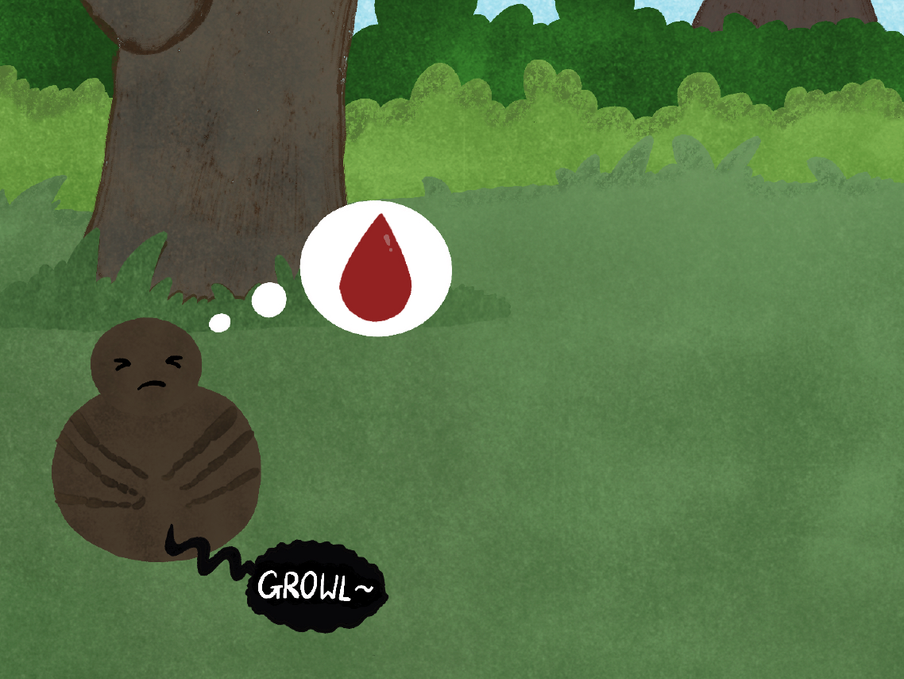
Notes:
Nick the tick must consume blood during all stages of his life. Otherwise, he will not be able to survive.

Slide 6
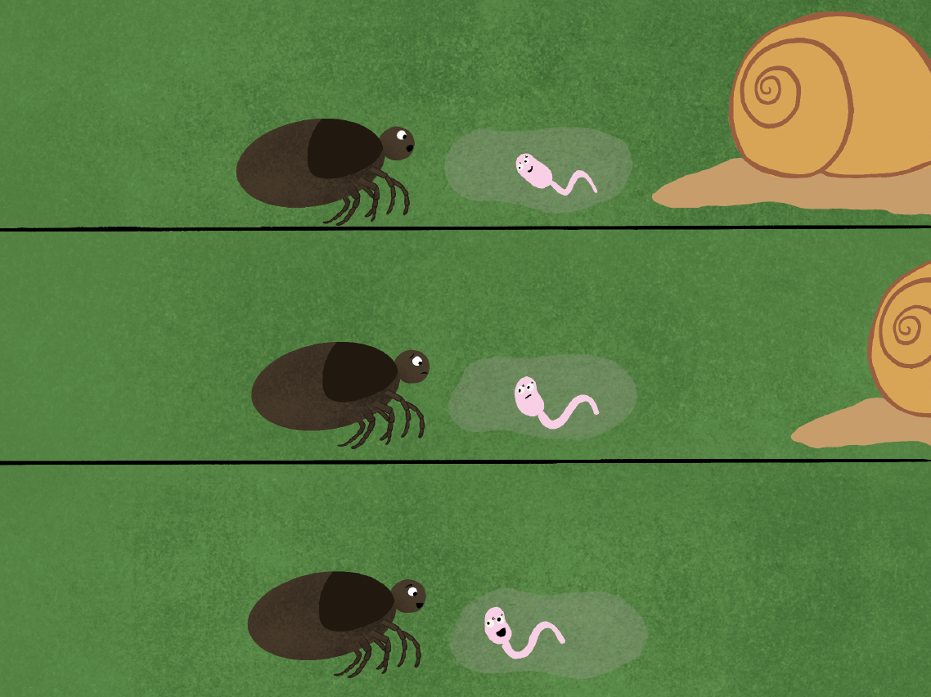
Notes:
Nick the tick sets out on a journey to find blood to eat. As he is walking along the forest floor, Nick the tick meets his first friend.
Nick the tick: "Who are you? I am trying to find a blood meal, but I have no idea where to go. Can you help me?"
Cerissa: "Hi! I'm Cerissa, a liver fluke cercaria (Dicrocoelium dendriticum). I would love to help you but we have different lifecycles so I'm not sure where you should look."
Nick the tick: "No worries ...... Hey Cerissa? What is your lifecycle like?"
Cerissa: "My lifecycle is extremely fascinating! I'm more than happy to share it with you."

Slide 7
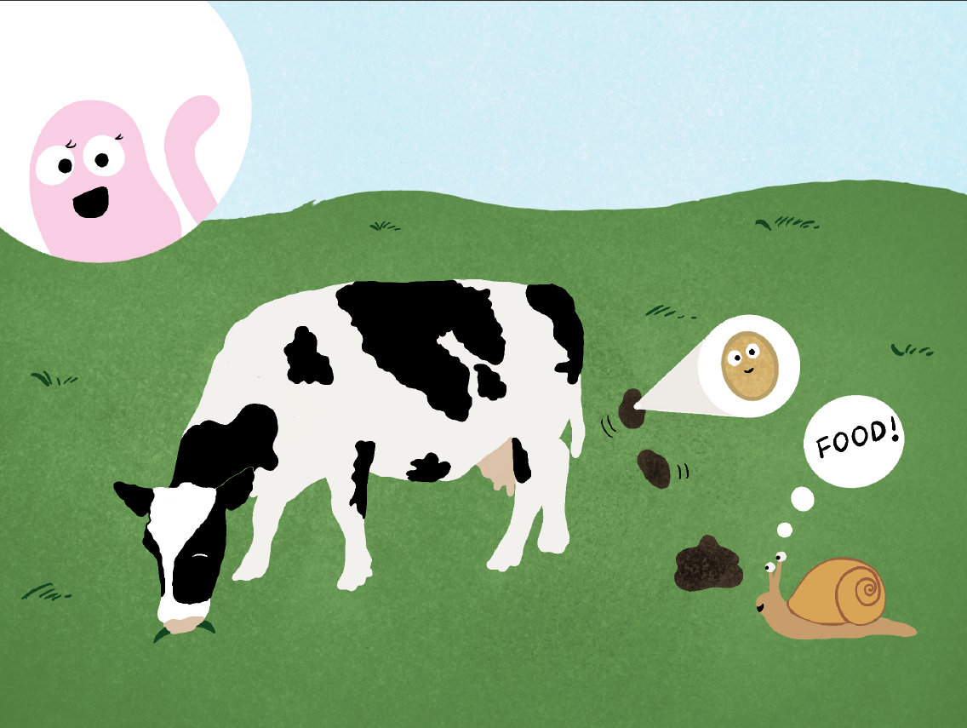
Notes:
Cerissa:
"I first started out in an egg like you, inside a sheep or cow. Once I was outside, I was eaten by a snail. I broke free of the egg and became a miracidium!”
Did you know?
1) Liver flukes almost always need to find a snail host in their lifecycle.

Slide 8
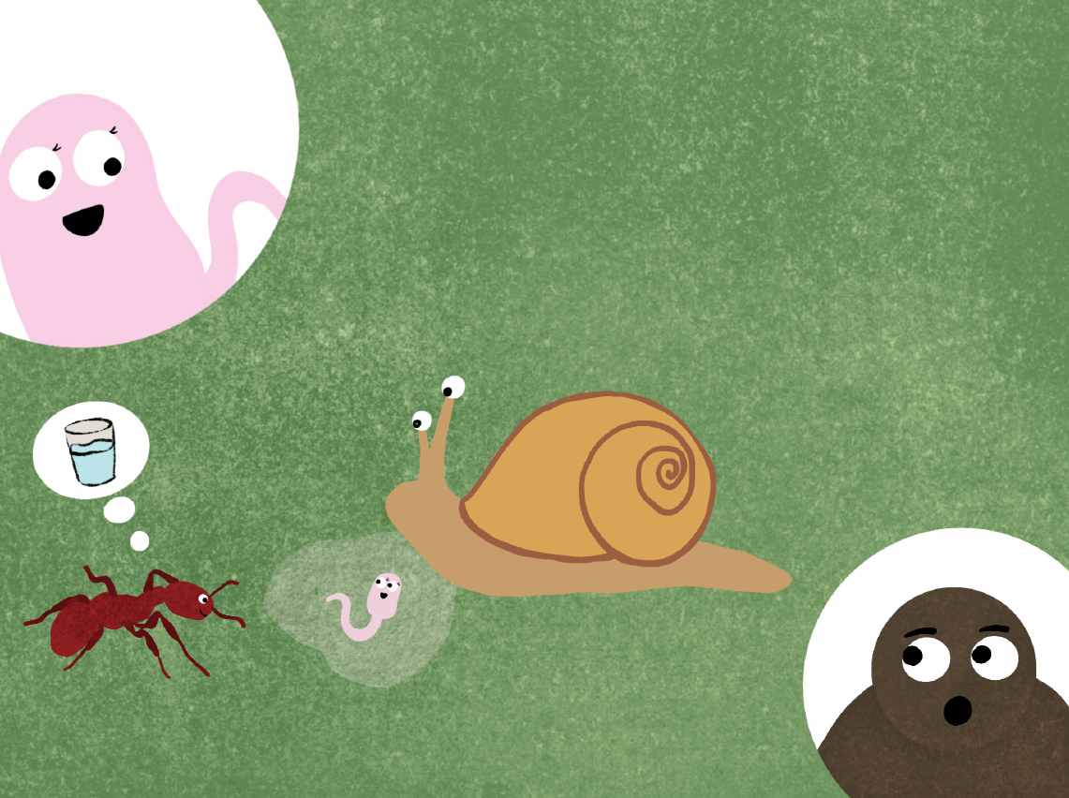
Notes:
Cerissa: "I was replicated many many times in the snail, and eventually became the swimming form I am now - called a cercaria. In order to develop into my next stage, I needed to leave the snail to get to an ant. Not easy when you don't have legs, so I got the snail to cough me up in a slime ball. I'm now just waiting for an ant to eat me and the slime ball."
Nick the tick: ''Whoa! What happens when you get in the ant?”
Fun fact:
1) The slime ball protects cercariae from drying out and the moisture also attracts ants.

Slide 9
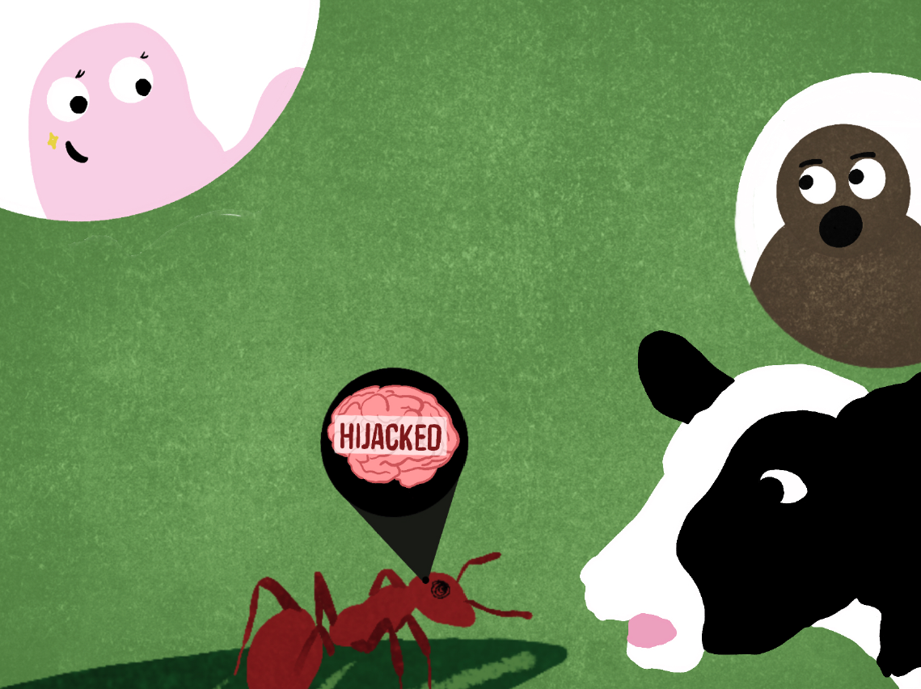
Notes:
Cerissa: "Once I get in the ant, if I can get to its brain, I will be able to control its behaviour!
Then the ant will crawl to the top of a blade of grass where it can be easily eaten by a cow or sheep.”
Nick the tick: "Wow! The ant becomes a zombie!"
Cerissa: "Yes! If all goes well, either my friends or I will become metacercariae in the ant and get into the liver of a cow or sheep, where we can develop into adults, lay eggs and start the process all over again!"

Slide 10
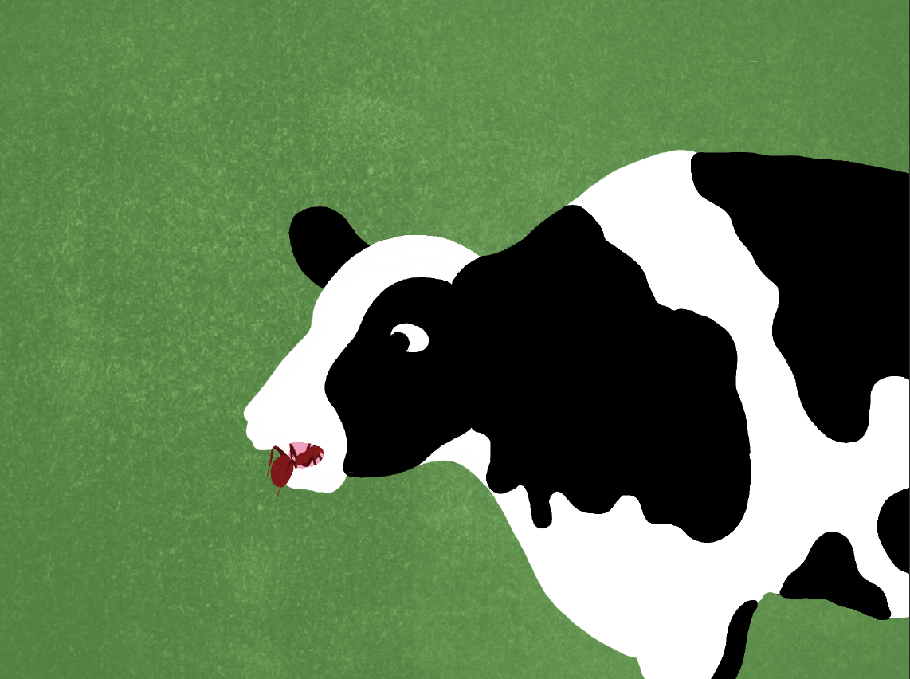
Notes:
Did you know?
1) Only one cercaria performs the mind-control in the ant's brain. The other cercariae from the slime ball develop into metacercariae in the ant abdomen. The cercaria in the brain never develops in the sheep or cow, essentially sacrificing itself so the others survive.
Fun fact:
1) Ants under mind­ control will climb down the grass blade during the hottest part of the day and return to the top when the temperature is cooler. This prevents the ant from drying out and increases its chances of being eaten.

Slide 11
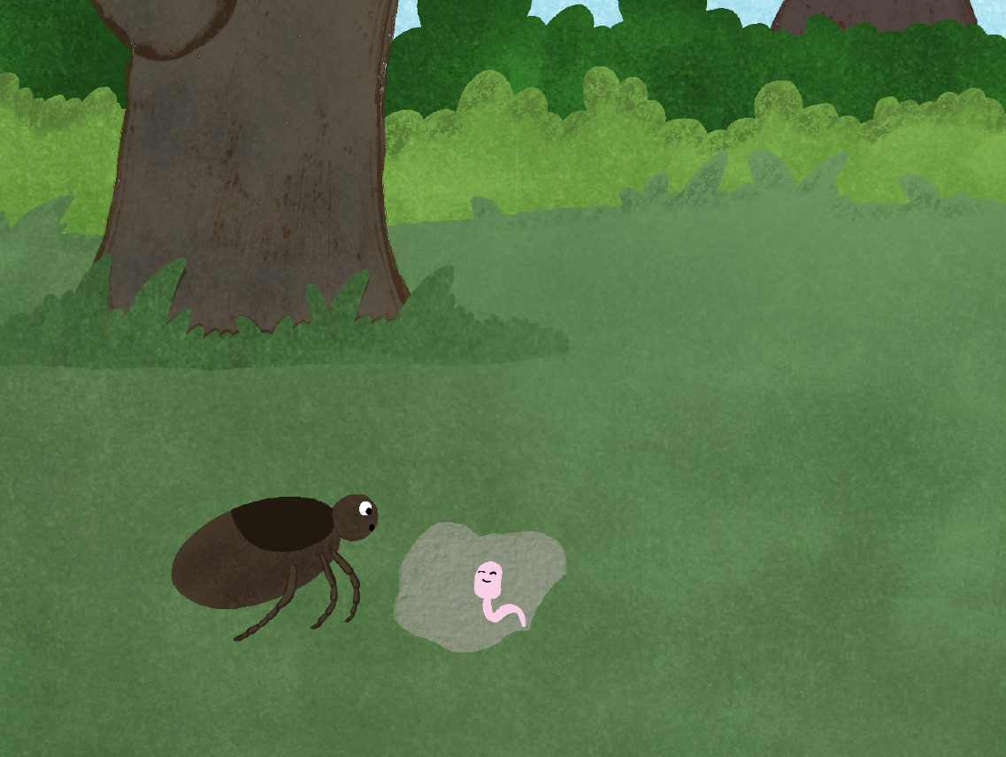
Notes:
Nick the Tick: ‘That sure sounds crazy… Hope an ant comes by soon! It was nice talking to you and listening to your lifecycle!’
Cerissa: ‘Thank you for taking the time to listen to my story! Maybe you can try looking for a blood meal over at the pond! I hope everything goes well for you!’

Slide 12
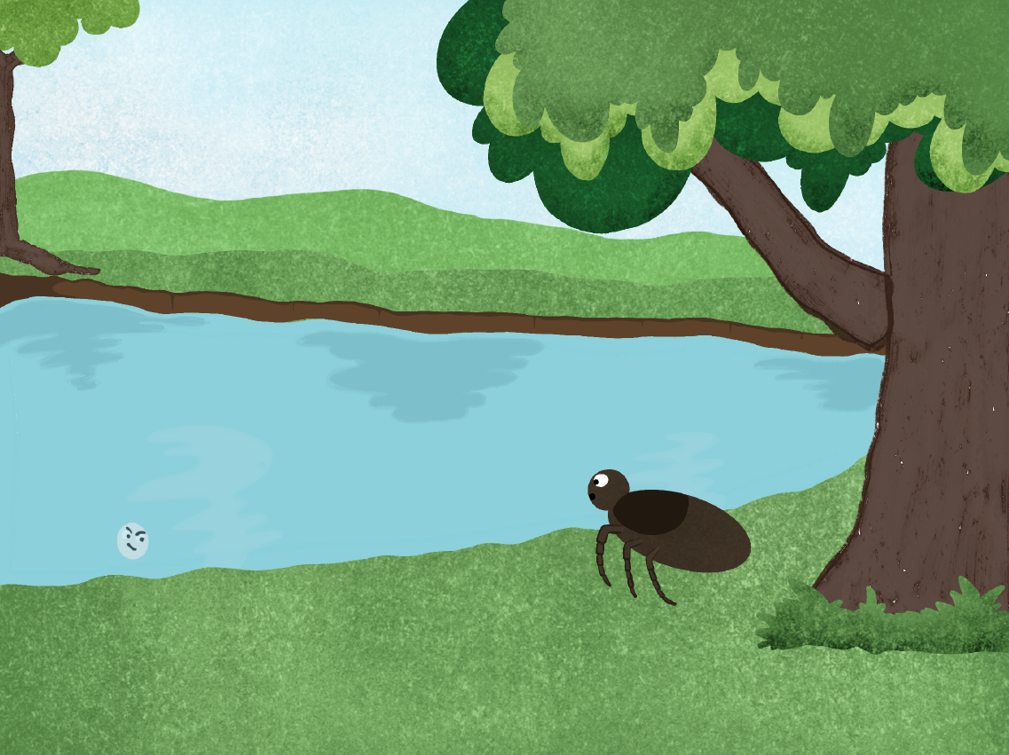
Notes:
Nick the tick meets his second friend at the pond.
Nick the tick: "Who are you? I am trying to find a blood meal, but I have no idea where to go. Can you help me?"
Max: "Hi! I'm Max, a myxospore of the parasite (Myxobolus cerebralis) that causes whirling disease.
Unfortunately, I don't think you will be able to find a blood meal here.”
Nick the tick: "Man ...... Hey Max? What is your life cycle like?"
Max: "I have an interesting life cycle. Let me tell you more about it!”
Did you know?
1) Myxobolus cerebralis, the parasite that causes whirling disease, is related to jellyfish.

Slide 13
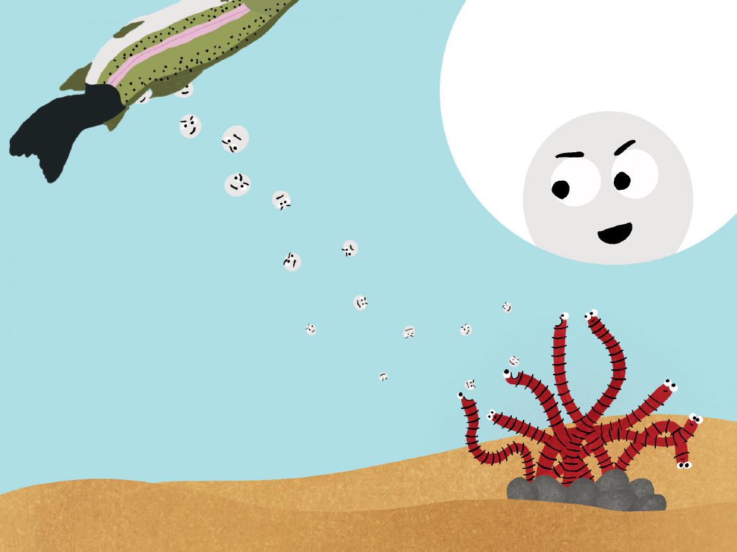
Notes:
Max: "I started off inside a dead fish, and then escaped into the water. I am hoping to be eaten by a Tubifex tubifex worm."
Did you know?
1) Whirling disease is being found more widely in Canada. It spreads more easily when boats, waders, and other water equipment is not properly cleaned.

Slide 14
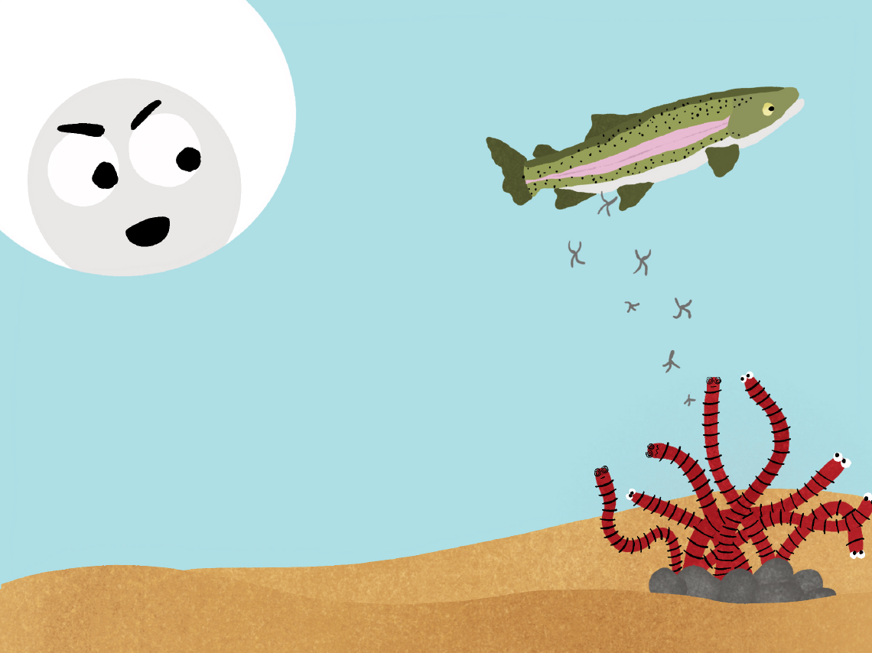
Notes:
Max: "Once in the Tubifex worm, I will become a triactinomyxon (TAM)! I will then have hooks to eventually attach to a new fish host. After that, I will transform into a sporoplasm and move into the nervous system."
Did you know?
1) Asexual and sexual reproduction happen within the Tubifex worms, making Tubifex the definitive host. Only asexual reproduction happens within the fish, making the fish an intermediate host.

Slide 15
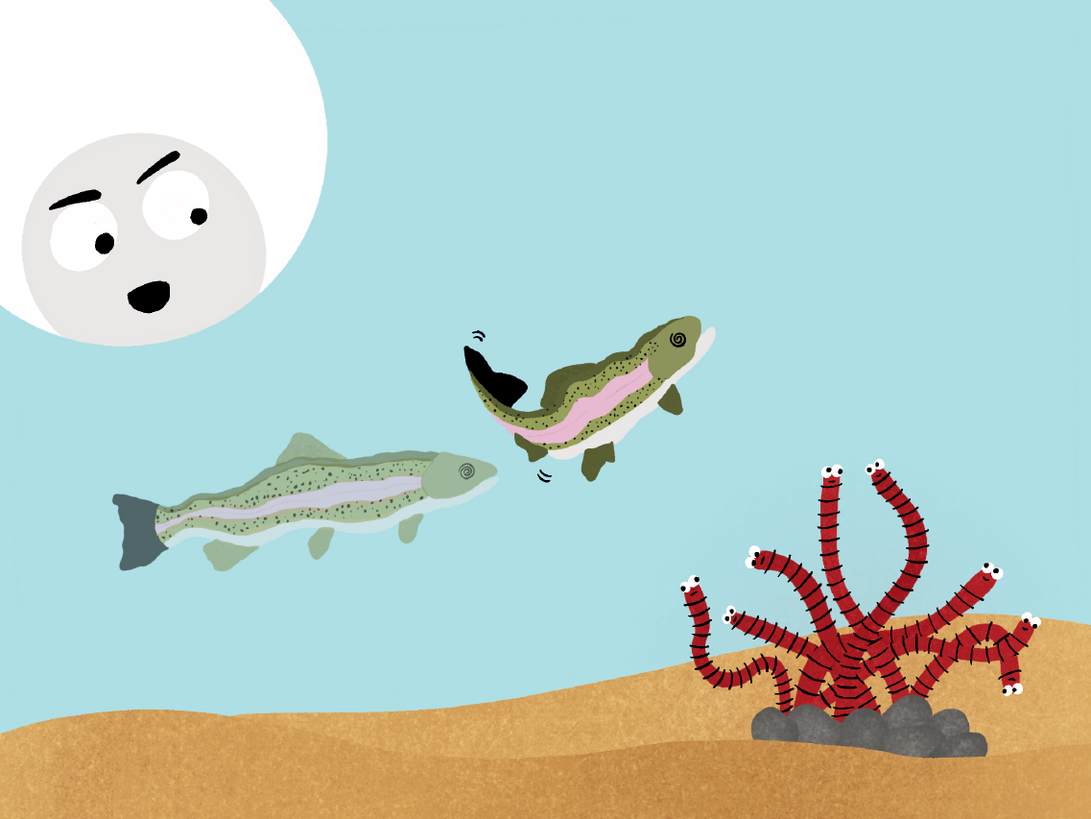
Notes:
Max: "You will know if I am successful if you see an infected fish - it will have a black tail, a deformed spine and swims in whirls. The cycle can then repeat again!"

Slide 16
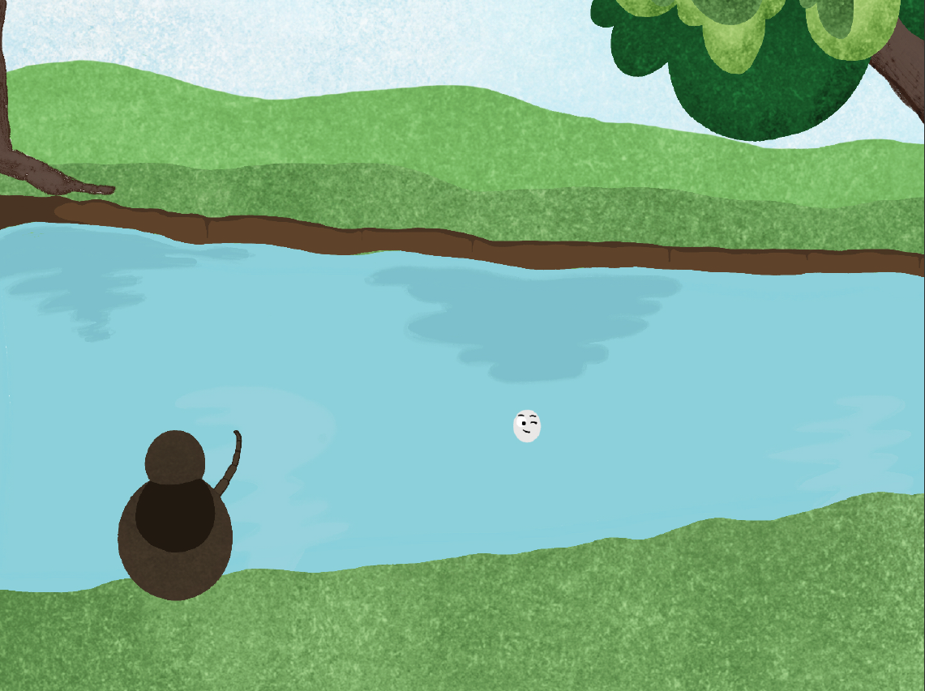
Notes:
Nick the tick: "That's such a bizarre life cycle ...... Thanks for sharing your story with me Max.”
Max: "No worries! Try going to the river to find your blood meal! Enjoy the rest of your trip."

Slide 17
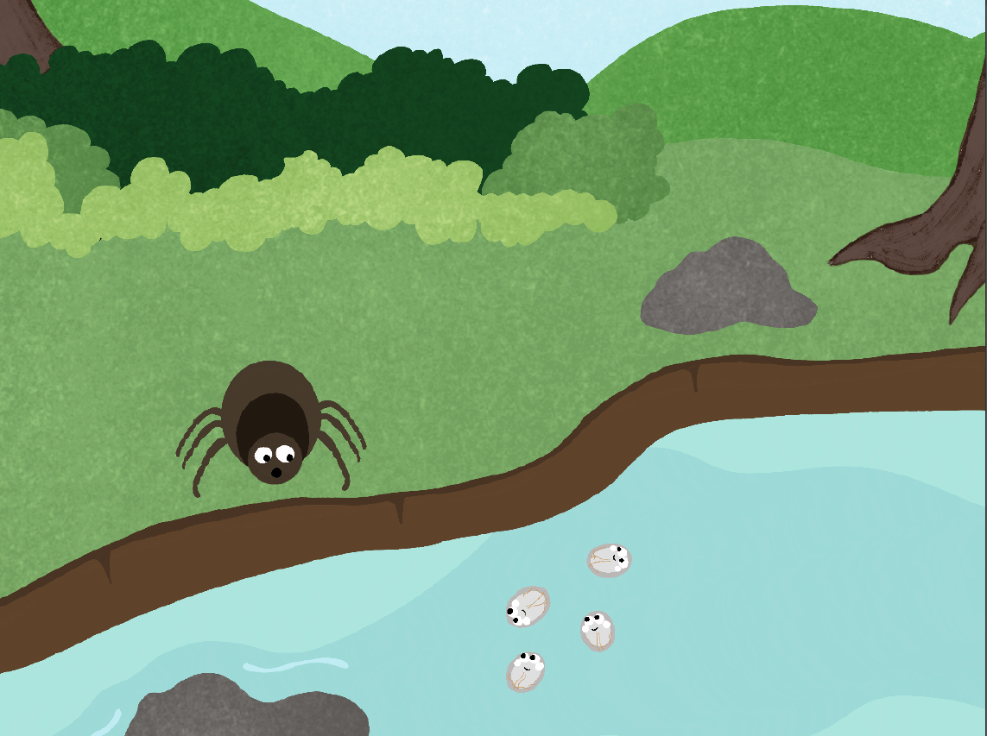
Notes:
Nick the tick meets his third friend at the river.
Nick the tick: "Who are you? I am trying to find a blood meal, but I have no idea where to go. Can you help me?”
Giano: "Hi! I'm Giano, a cyst from the parasite that causes beaver fever (Giardia duodenalis). I am not sure if you will encounter your blood meal here ......"
Nick the tick: "Oh ...... Hey Giano? What is your life cycle like?"
Giano: "I have a gripping life cycle. I will tell you about it!"

Slide 18
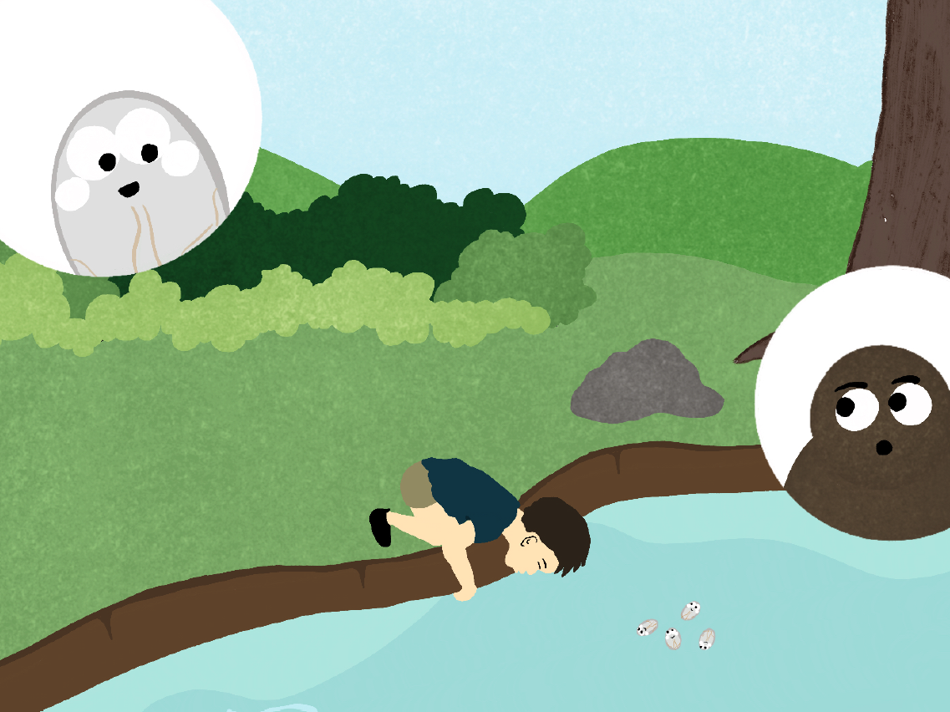
Notes:
Giano: "Currently, I am waiting for a mammal to drink the water I am in. I can survive in cold water for a long time, so I am not too worried.”
Nick the tick: "What happens once a mammal drinks water with you in it?"

Slide 19
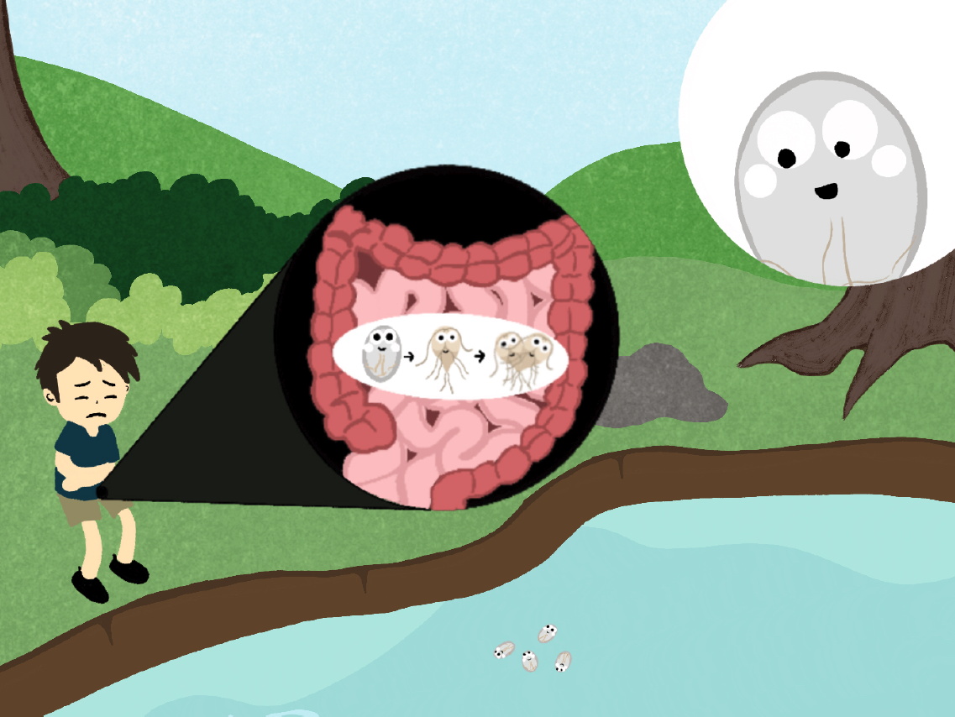
Notes:
Giano: "I travel to the intestine where I transform into two trophozoites that are active and feed.”
Fun fact:
1) A "smiling face" can be seen on a trophozoite under a microscope.

Slide 20
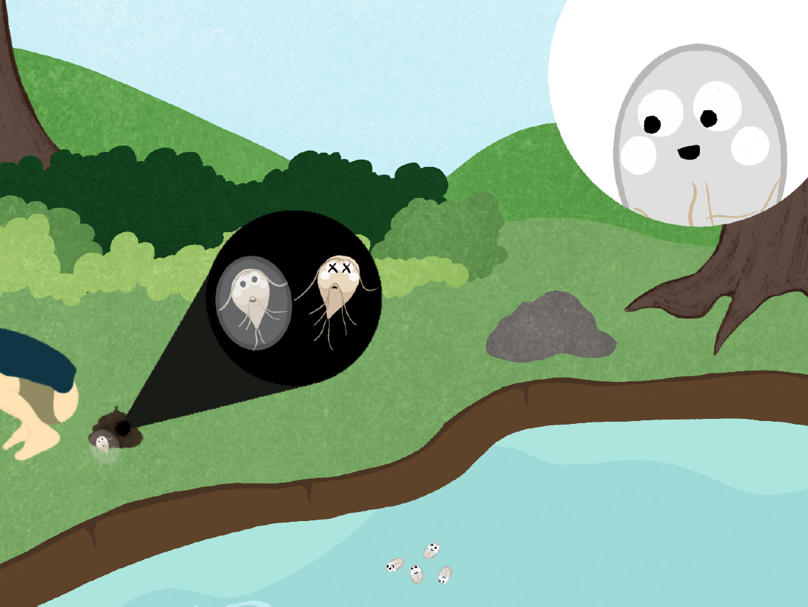
Notes:
Giano: "My copies will move through the intestine, some as trophozoites and others becoming cysts.
Eventually both will be released into the environment, where the cycle can continue!”
Did you know?
Trophozoites do not survive outside of the host, only cysts do.
Giardiasis can develop in a person who consumed only 10 cysts, but an infected person may shed up to 10 billion cysts in their stools every day.

Slide 21
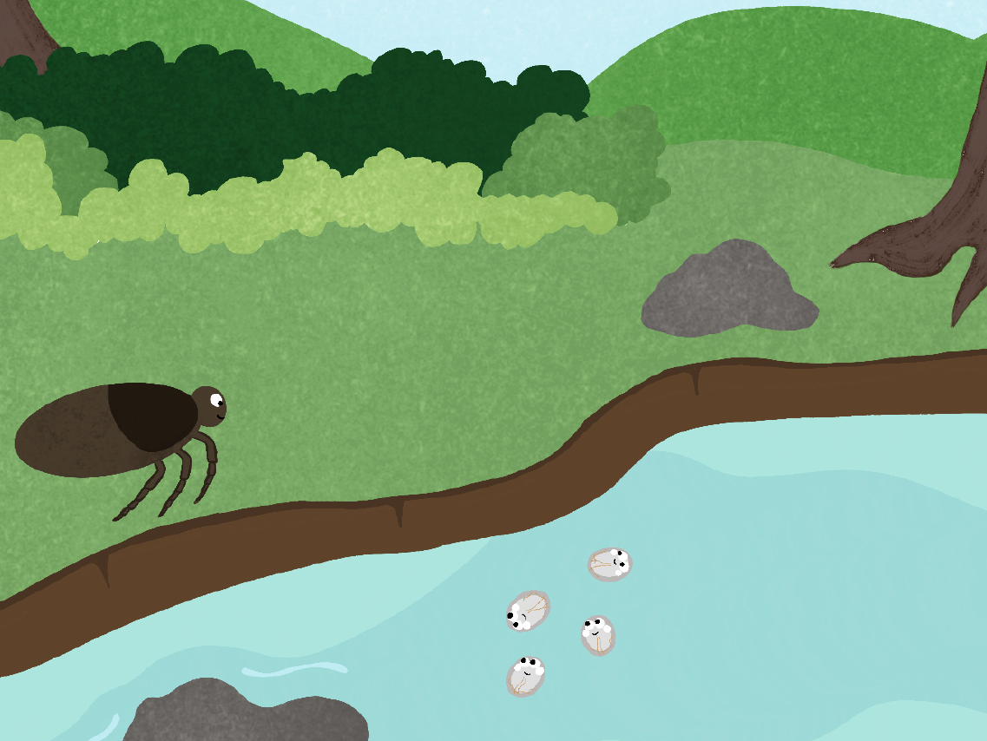
Notes:
Nick the tick: "Cysts and trophozoites are so cool! It was nice talking to you. I will continue on with my journey!”
Giano: "It was nice talking to you as well. You should try your luck in the forest!"

Slide 22
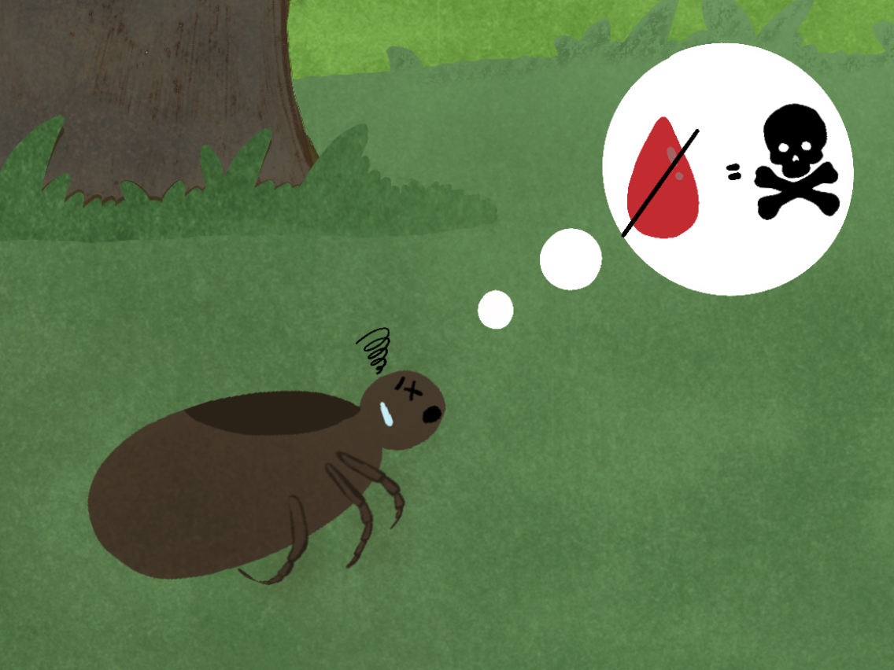
Notes:
At this point, Nick is very tired and very hungry. Without blood, Nick the tick won’t be able to survive.

Slide 23
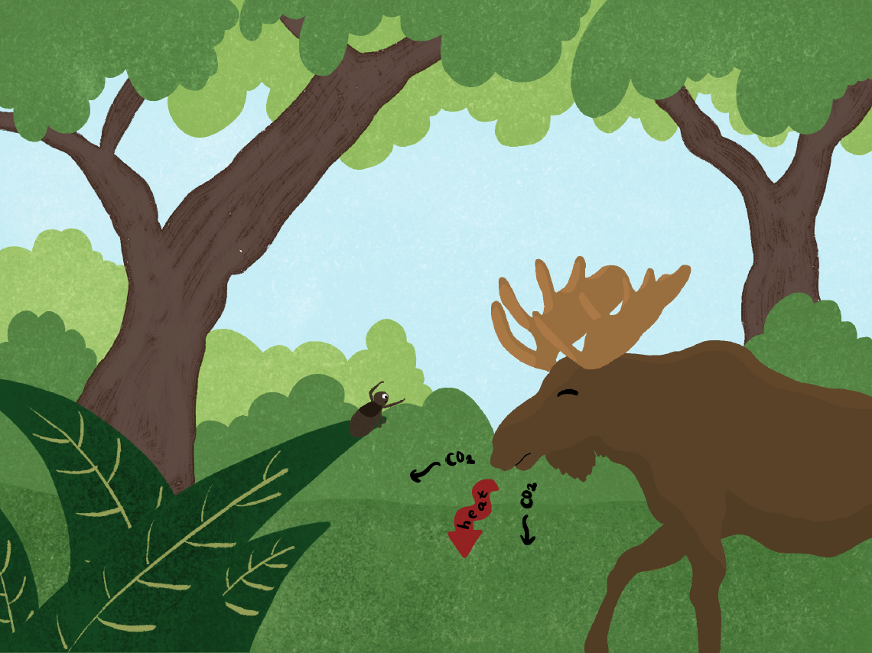
Notes:
As Nick the tick climbs up a blade of grass, he suddenly senses heat and carbon dioxide in the air. Nick the tick looks up and sees a moose in front of him!
Nick the tick: "That could be my blood meal! Can I do this? What if I miss my chance?"
Nick the tick waves his front legs in the air and waits.

Slide 24
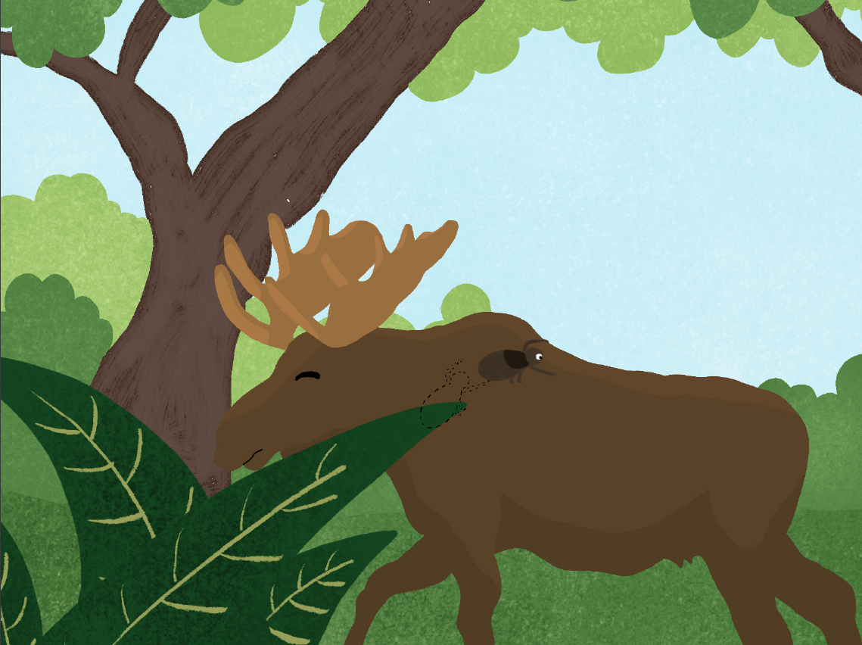
Notes:
Nick the tick attaches onto the thick fur of the moose.
Did you know?
1) Ticks don't fly or jump! There is a little
hook on the end of a tick's leg like the hooks on Velcro. These little hooks can grab onto the host's hair.

Slide 25
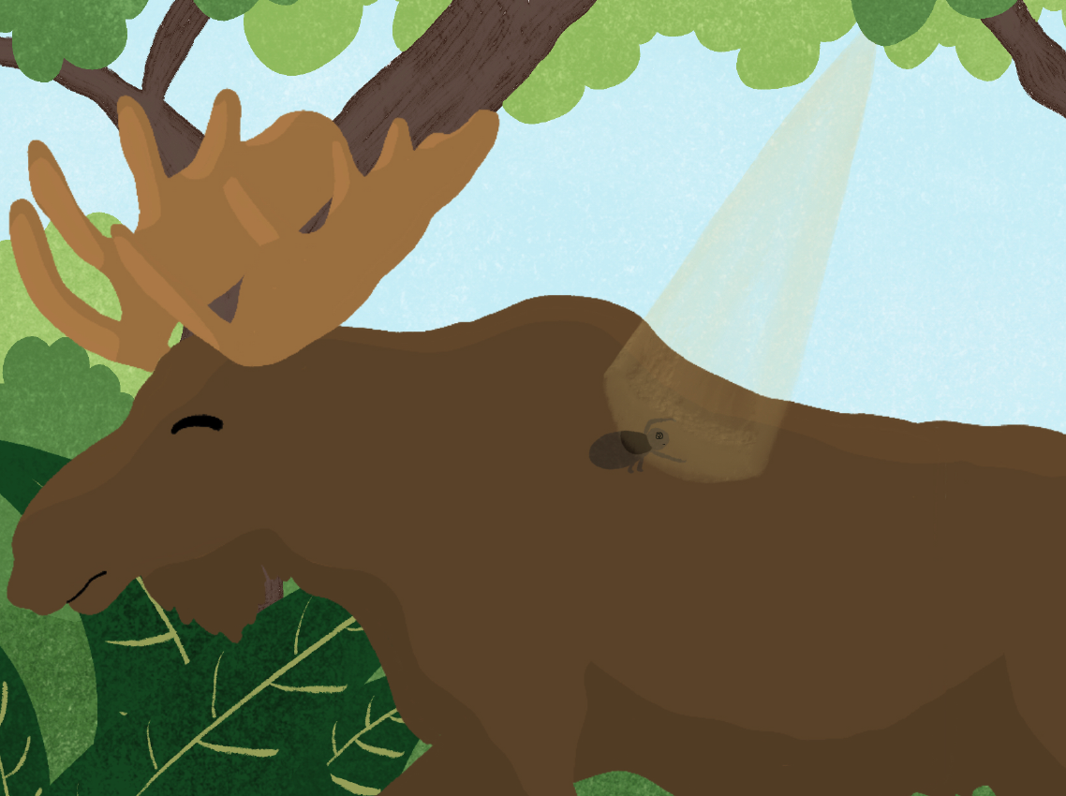
Notes:
ick the tick faces yet another challenge once he is on the moose. He is in direct sunlight, but he cannot survive the heat.
Nick the tick: "Oh no ...... This spot is too hot ...... I need to move somewhere else."

Slide 26
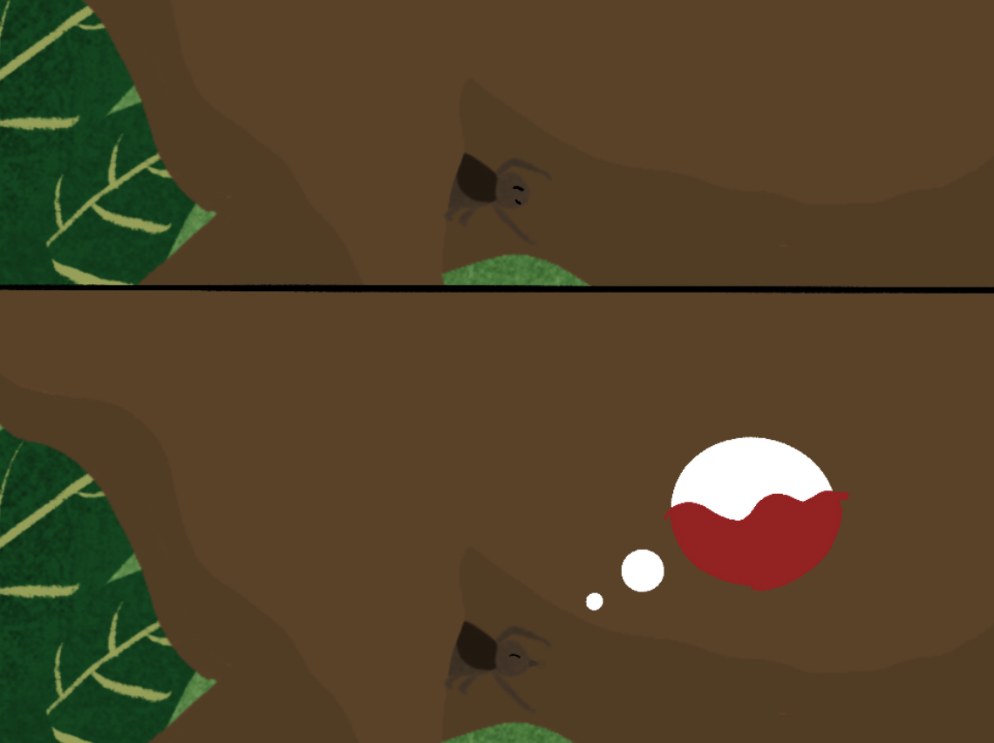
Notes:
Nick the tick moves to hide
under the moose's front legs.
He then pierces through the moose's skin with his sharp mouthparts. Nick the tick takes his first blood meal.

Slide 27
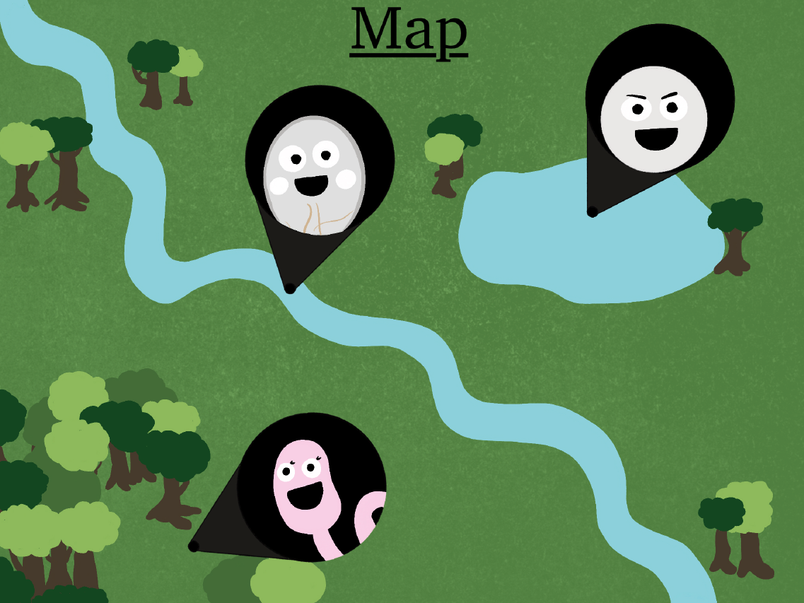
Notes:
Giano: ‘Congrats!’
Max: ‘Finally!’
Cerissa: ‘Yay!’

Slide 28
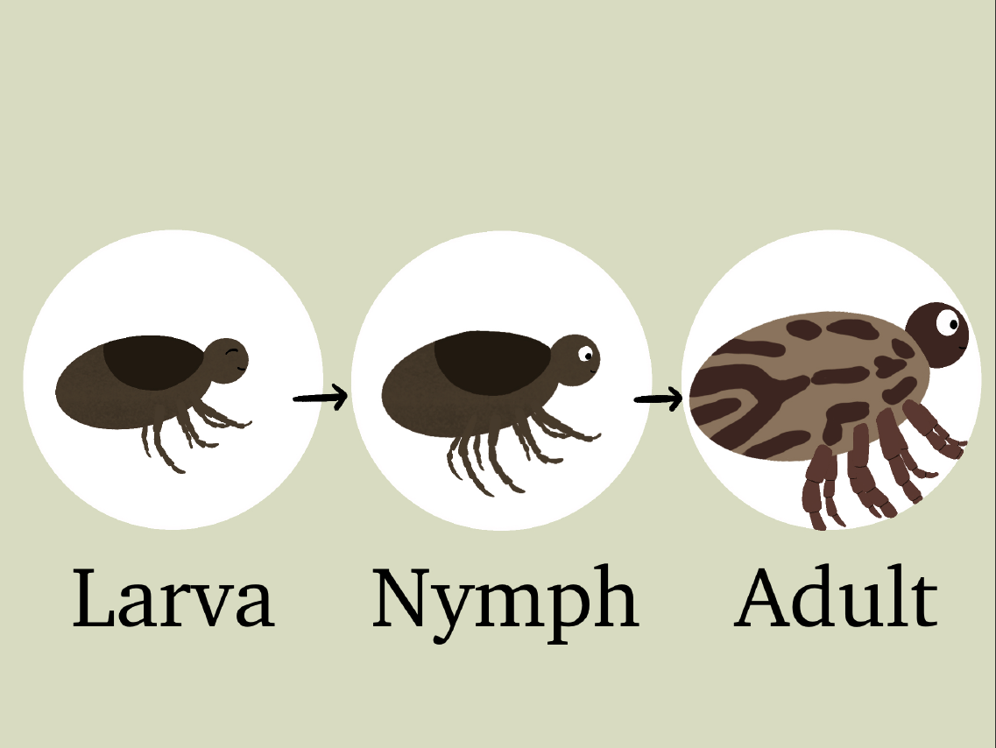
Notes:
As the days go by, Nick the tick transforms from a six-legged larva, into an eight-legged nymph and finally into an adult tick.

Slide 29
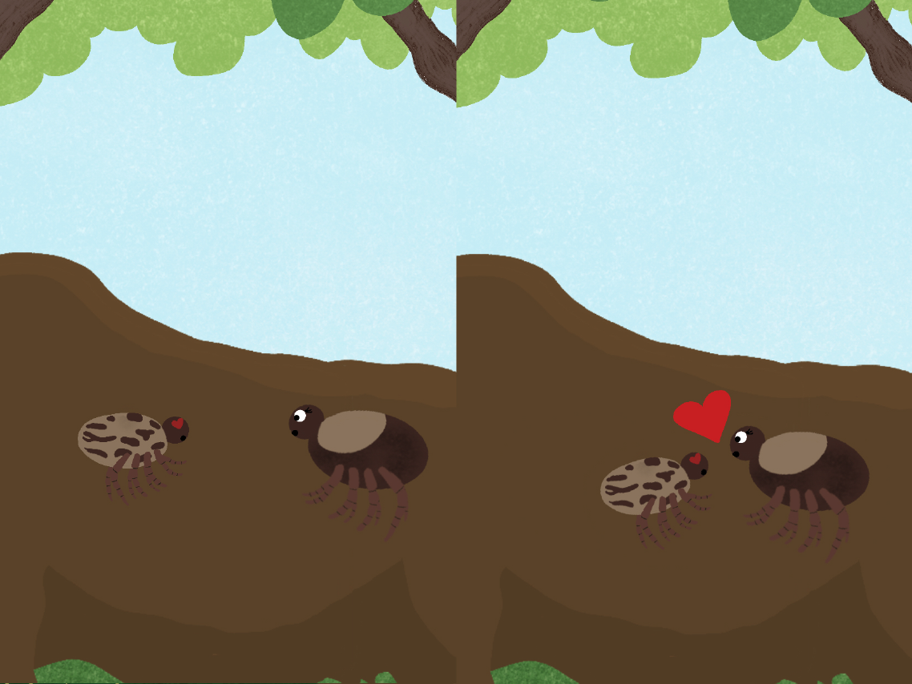
Notes:
One day, Nick the tick meets a female tick on the moose.
Nick the tick: "Hello ......
I'm ...... I’m Nick.”
Vick: "Glad to meet you! My name is Vick."

Slide 30
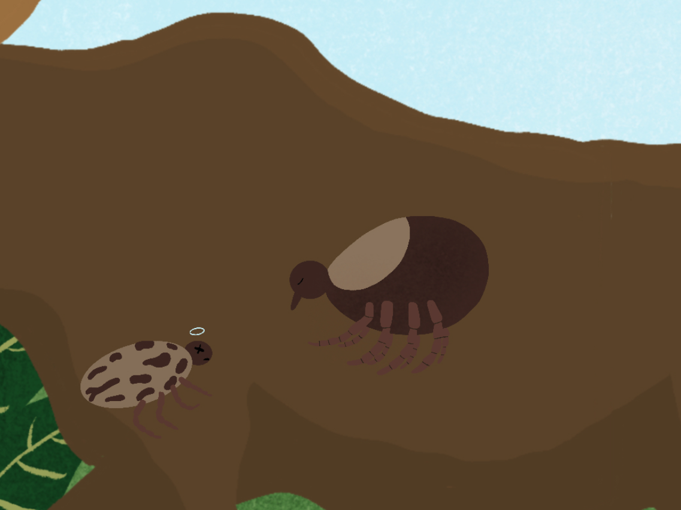
Notes:
After meeting Nick, Vick continues on with her blood meal. She swells dramatically full of blood and future eggs.
Did you know?
1) Ticks often die after mating. Meeting Vick is the end of Nick's journey.

Slide 31
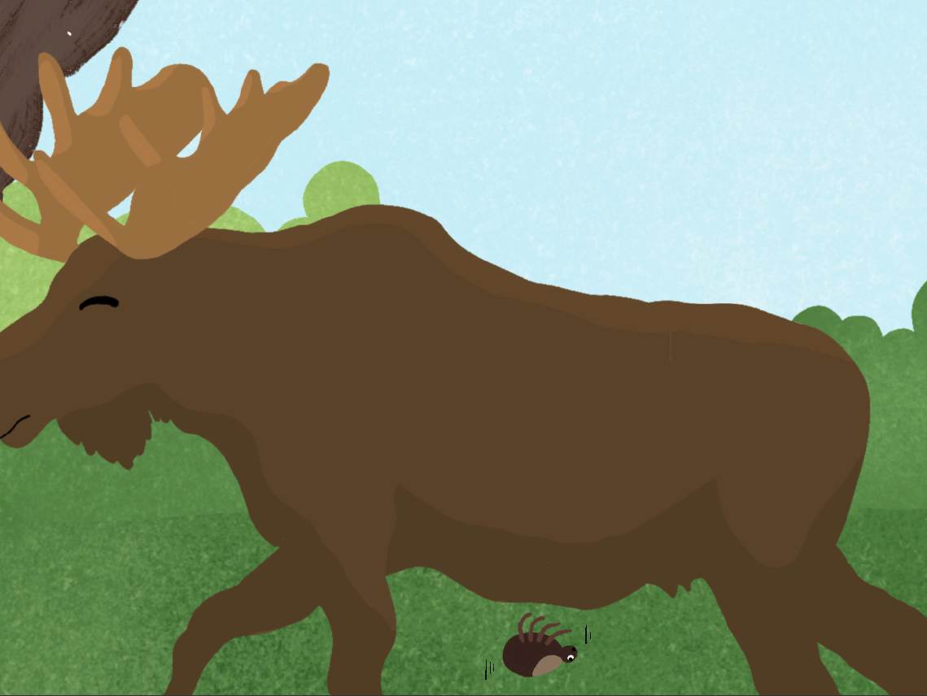
Notes:
One day, Vick detaches from the moose's body and drops to the forest floor.

Slide 32
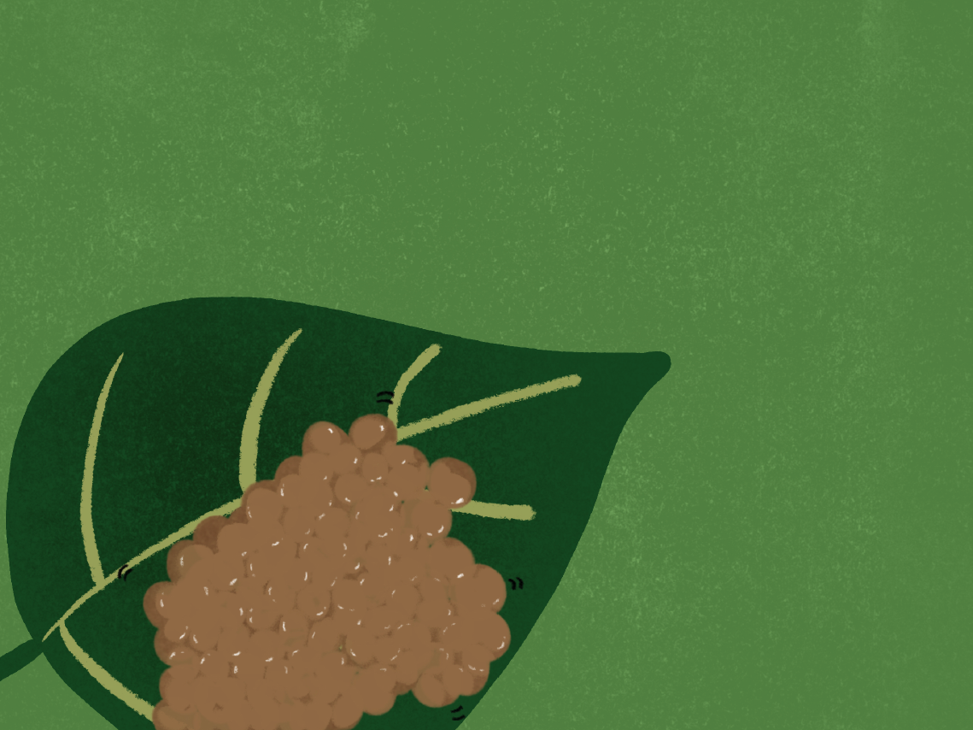
Notes:
Vick lays her eggs on a bright summer day. Just like Nick the tick, many young ticks are ready to take on new journeys and meet their own friends along the way.

