Slide 1
A CURE in traits and species distributions: Reproductive modes, ranges sizes, and natural history collections
Jessica Allen¹, Stephen Sharrett¹, Eli Denzer², James C. Lendemer²
¹Department of Biology, Eastern Washington University, Cheney, WA 99202, U.S.A.
²Institute of Systematic Botany, The New York Botanical Garden, Bronx, NY 10458-5126, U.S.A.

Slide 2
What lichen parts are called
Lichen morphology and chemistry
Who the major players in the lichen symbiosis are
Mycobionts and photobionts
How the symbionts interact
Specificity of biont relationships
Why do lichens live where they live
Factors that influence species distributions

Slide 3
Break up into two groups
List all of the factors or variables that you can think of that are most important in determining where a species occurs
Divide those factors into two groups: external environmental factors (e.g., precipitation) and intrinsic factors that are unique to the organisms’ biology (e.g., production of certain secondary metabolites)

Slide 4
How would you define each of the following terms?
Species Distribution
The complete set of geographic locations or areas where a species occurs.
Range Size
The total area over which a species’ distribution extends.
Rarity
A trait of a species determined by the frequency with which it occurs throughout its distribution and/or the total size of the distribution. The degree of rarity assigned to a species is considered by comparing with the rarity of other species or against quantitative thresholds set by conservation organizations. For instance, a species may have a large range size but only occur at for locations throughout that range, in which case it may be rare. Alternatively a species may be abundant but only occur in a small area and be considered rare.

Slide 5
Overview and Learning Objectives
Goal
Generate and analyze a dataset to determine how reproductive mode may influence range sizes of lichens in the Appalachian Mountains.
Learning Objectives
By engaging in this project students will:
Develop hypotheses regarding the relationship of reproductive biology with evolutionary and/or ecological processes,
Create a morphological trait dataset using digitized herbarium specimens,
Summarize, visualize, and analyze data,
Write a research report discussing their hypotheses, methods, and results,
Present a research project using a PowerPoint.

Slide 6
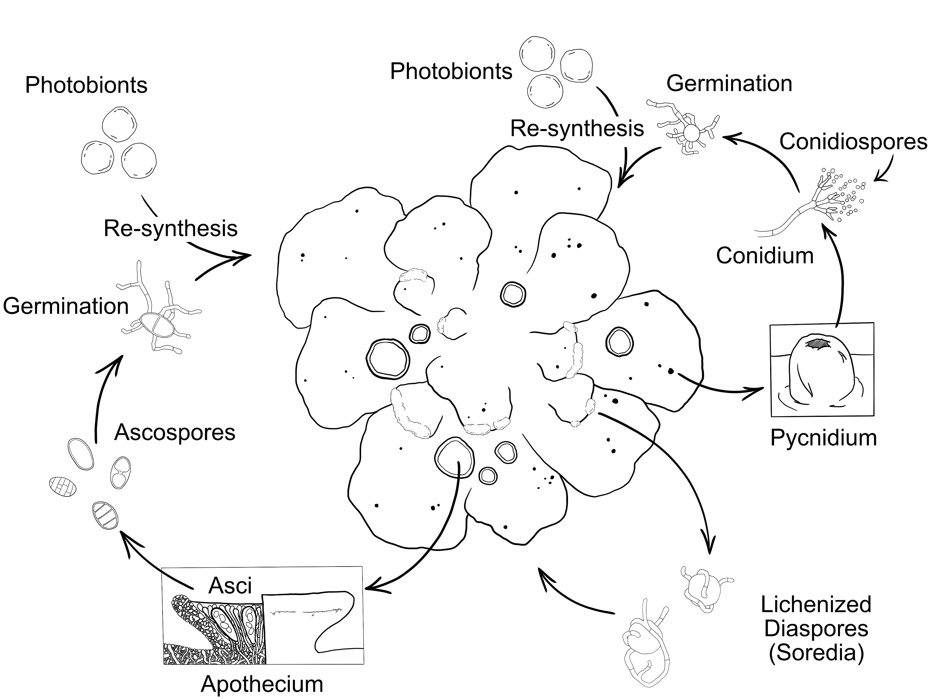
Lichen Reproduction
Asexual
(fungus)
Asexual
(fungus+alga)
Sexual
(fungus)
Illustration: Jordan Hoffman; in Allen & Lendemer, Urban Lichens. Yale Press.

Slide 7
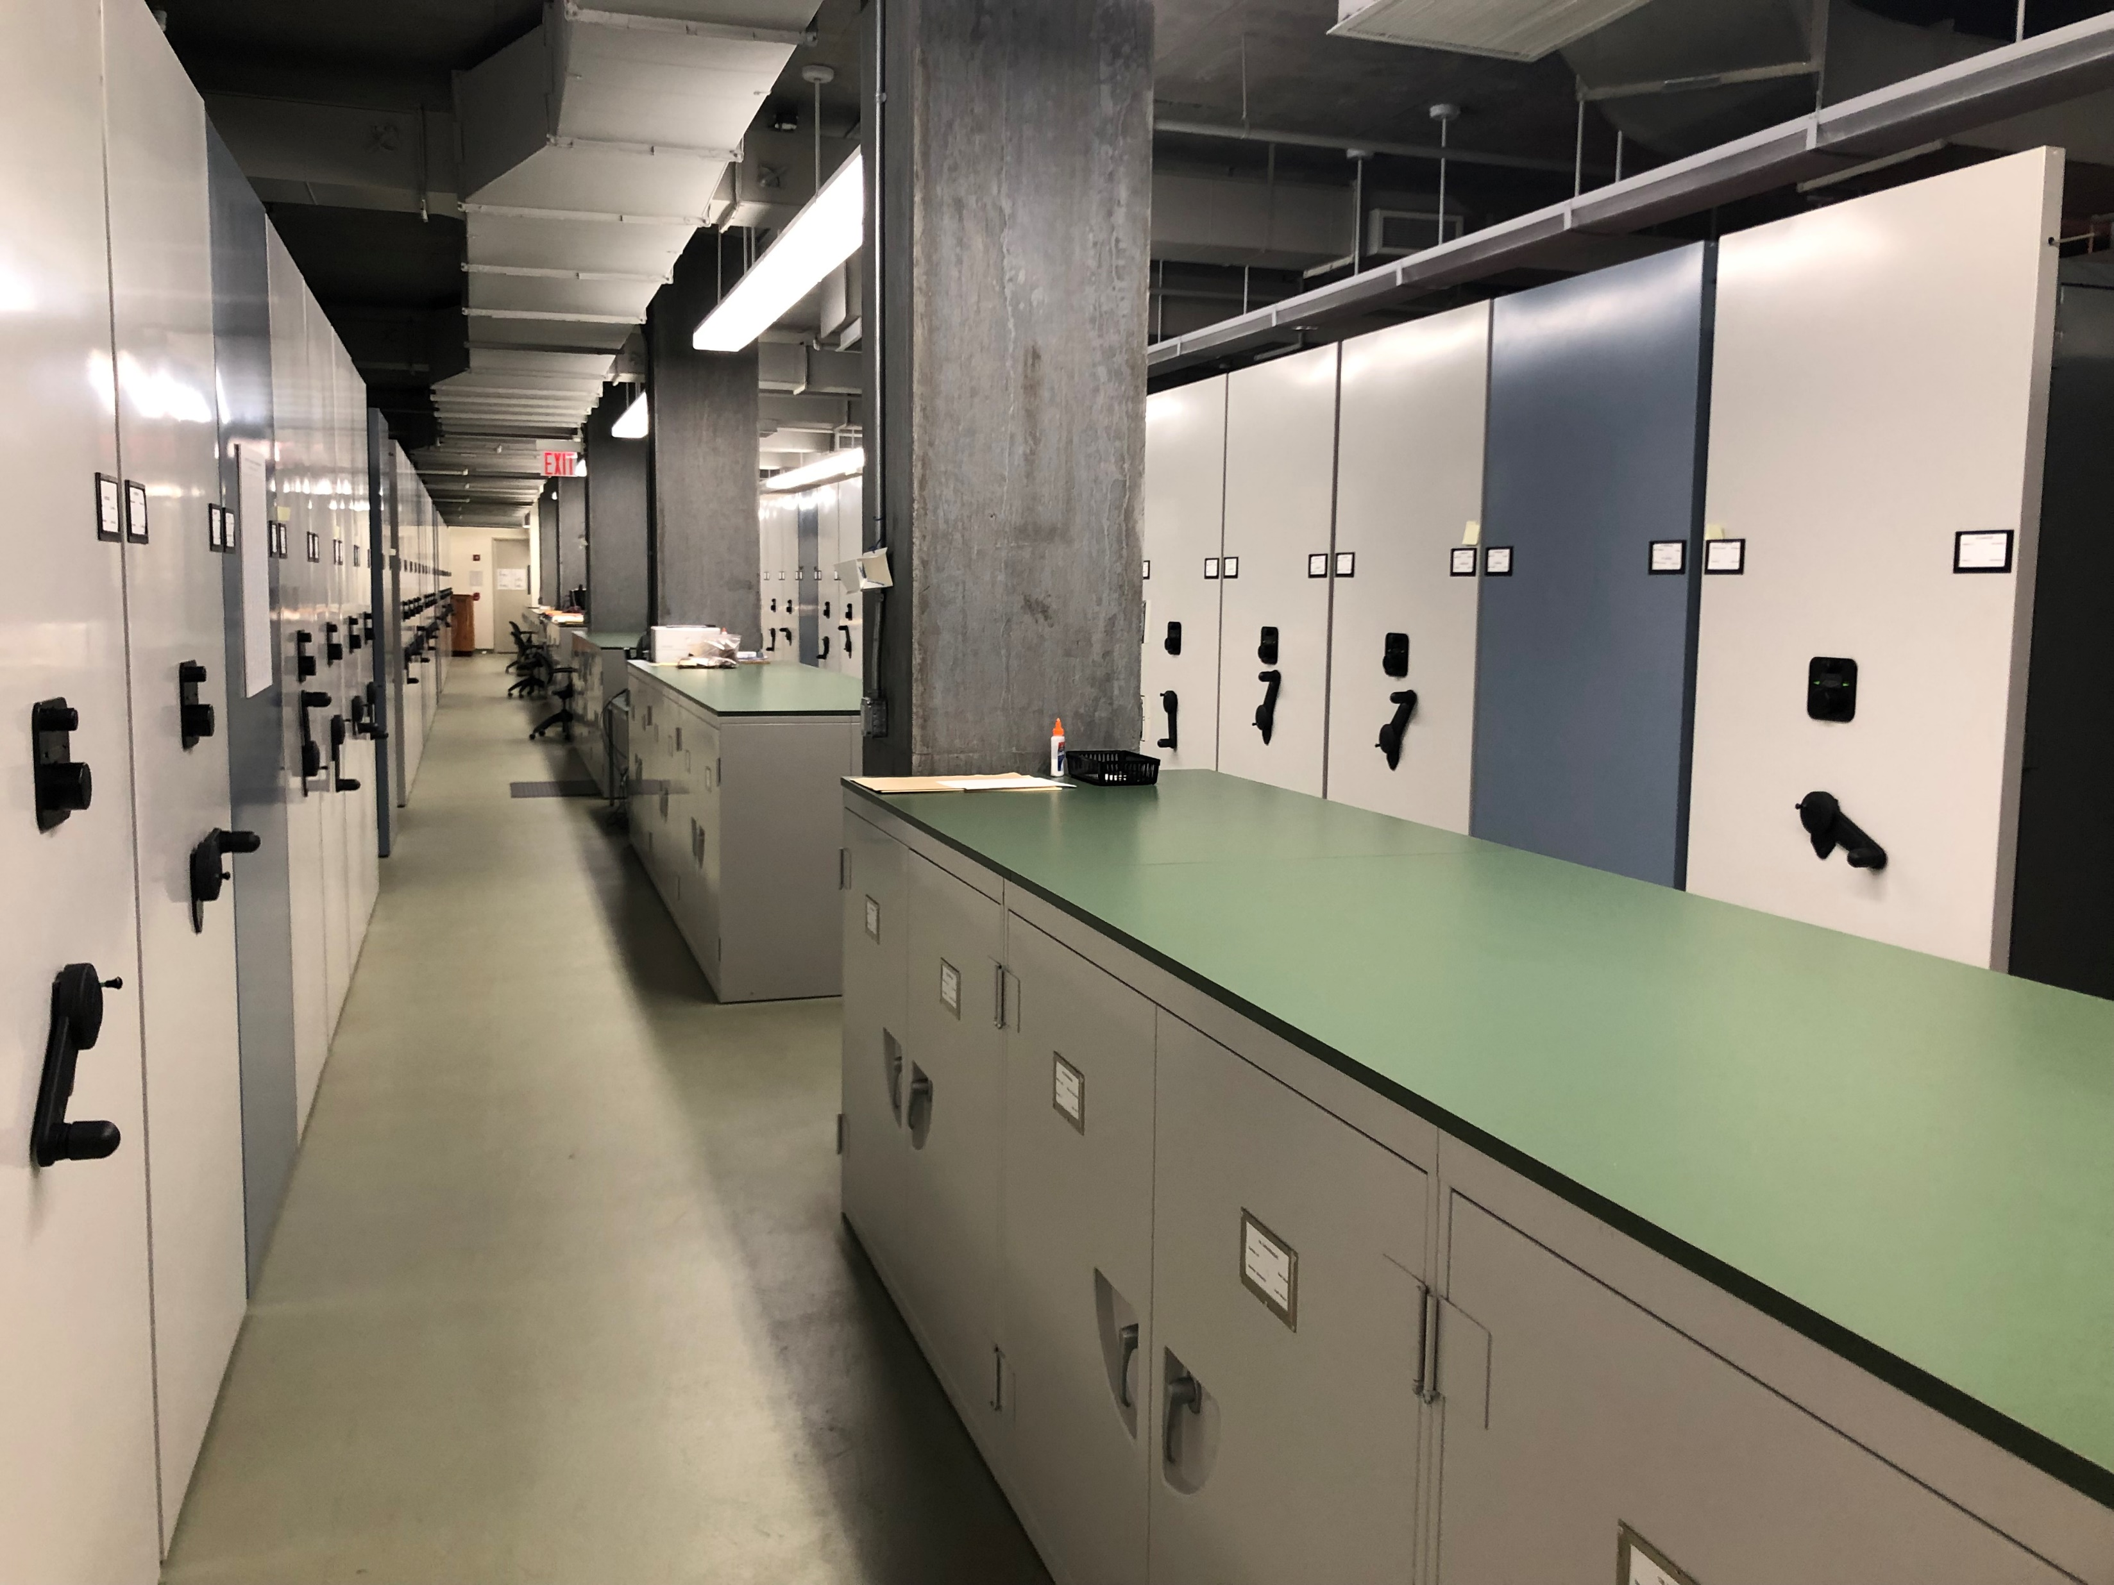
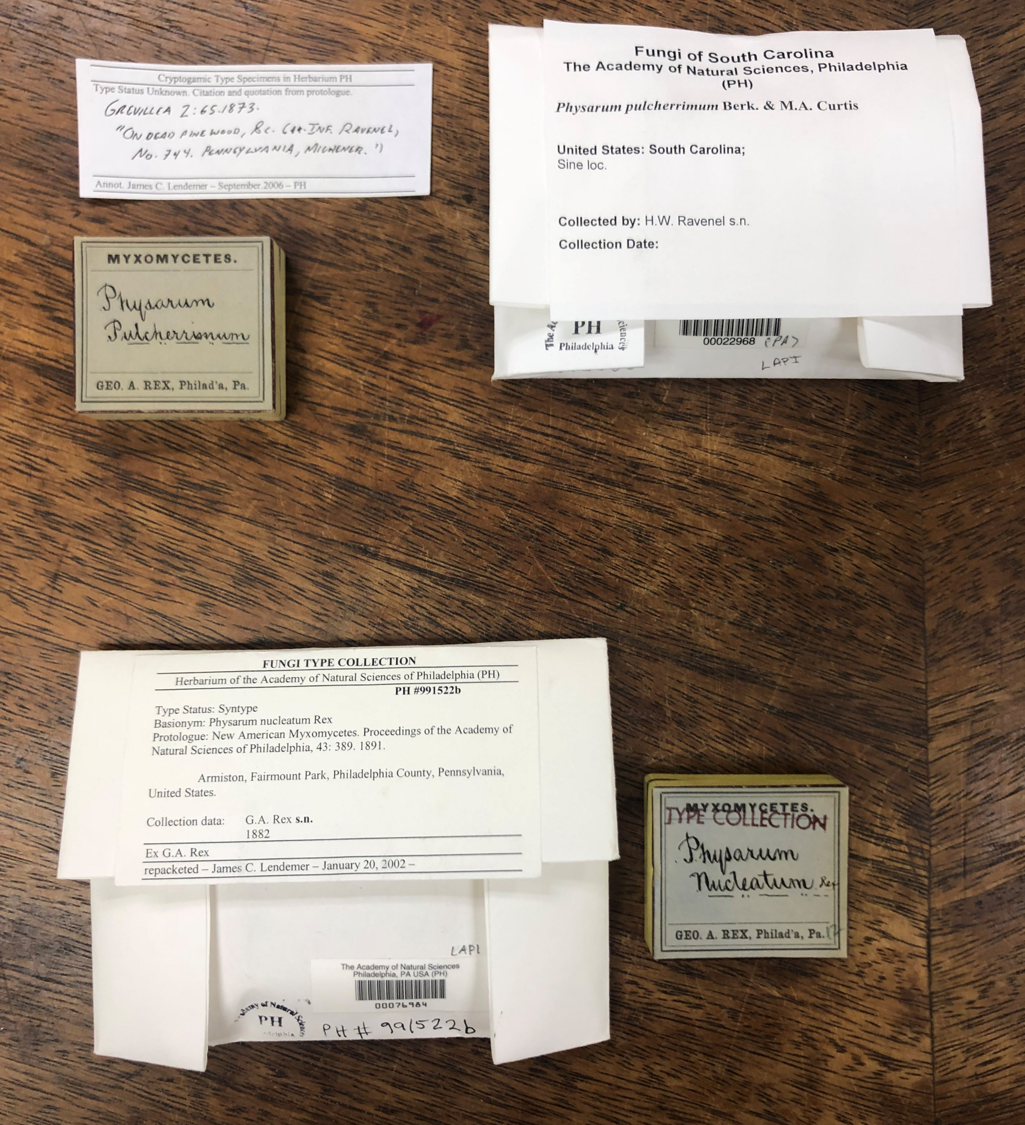
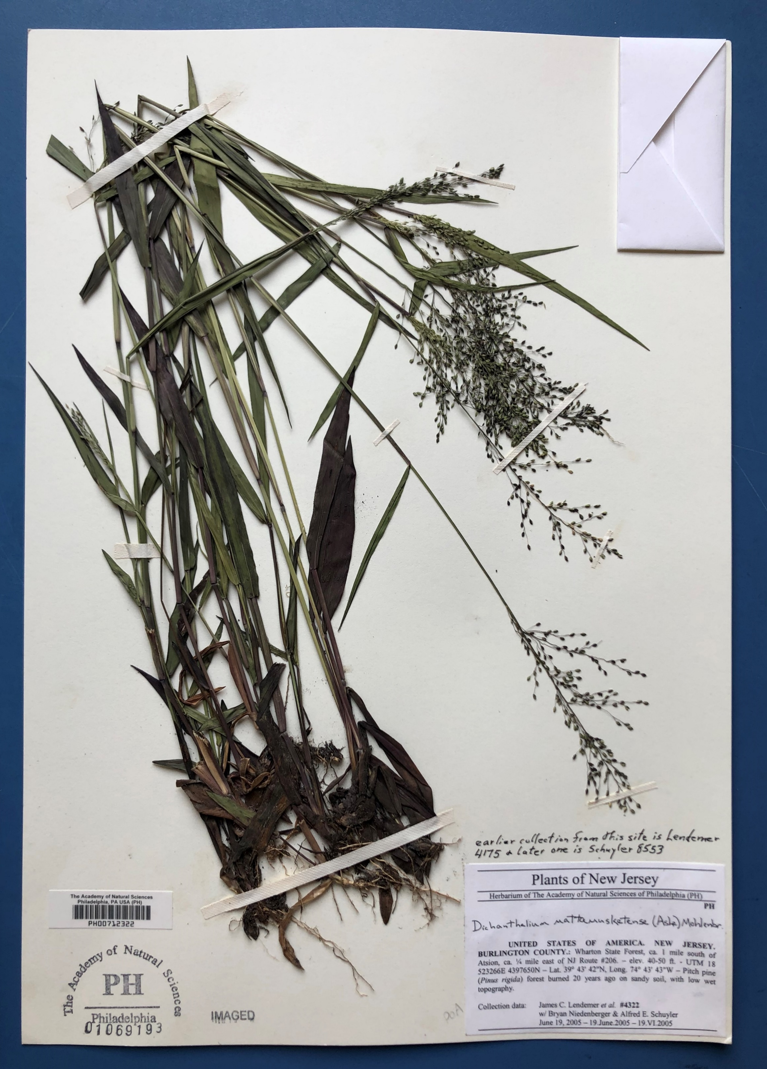
Herbaria, a Kind of Natural History Collection
Many museums, colleges and universities maintain biological collections that document the natural world, are used in diverse research areas, and publicly accessible to visitors

Slide 8
A Brief Introduction to the Appalachian Mountains

Slide 9
J.C. Lendemer

Slide 10
J.L. Allen

Slide 11
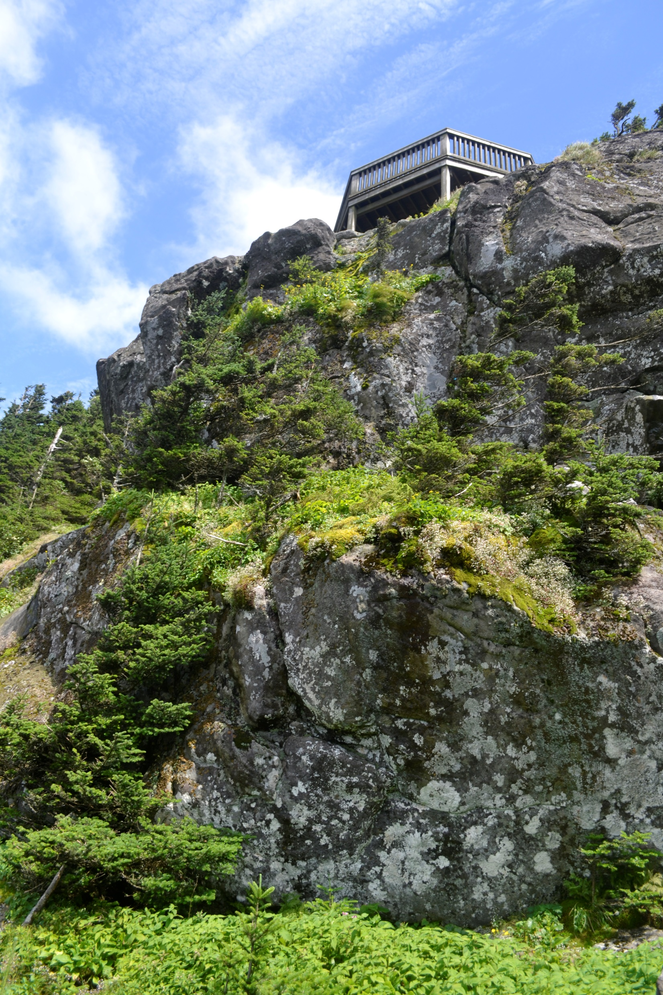
J.L. Allen

Slide 12
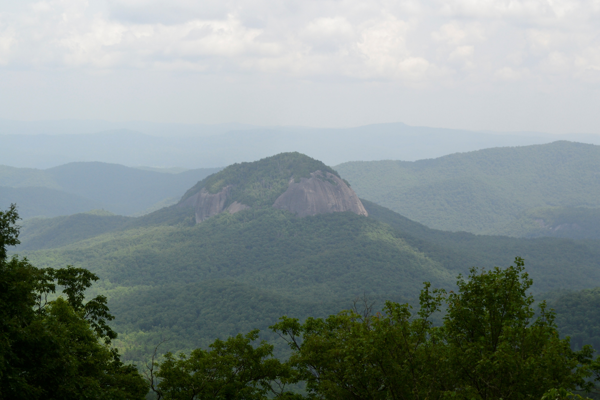
J.L. Allen

Slide 13
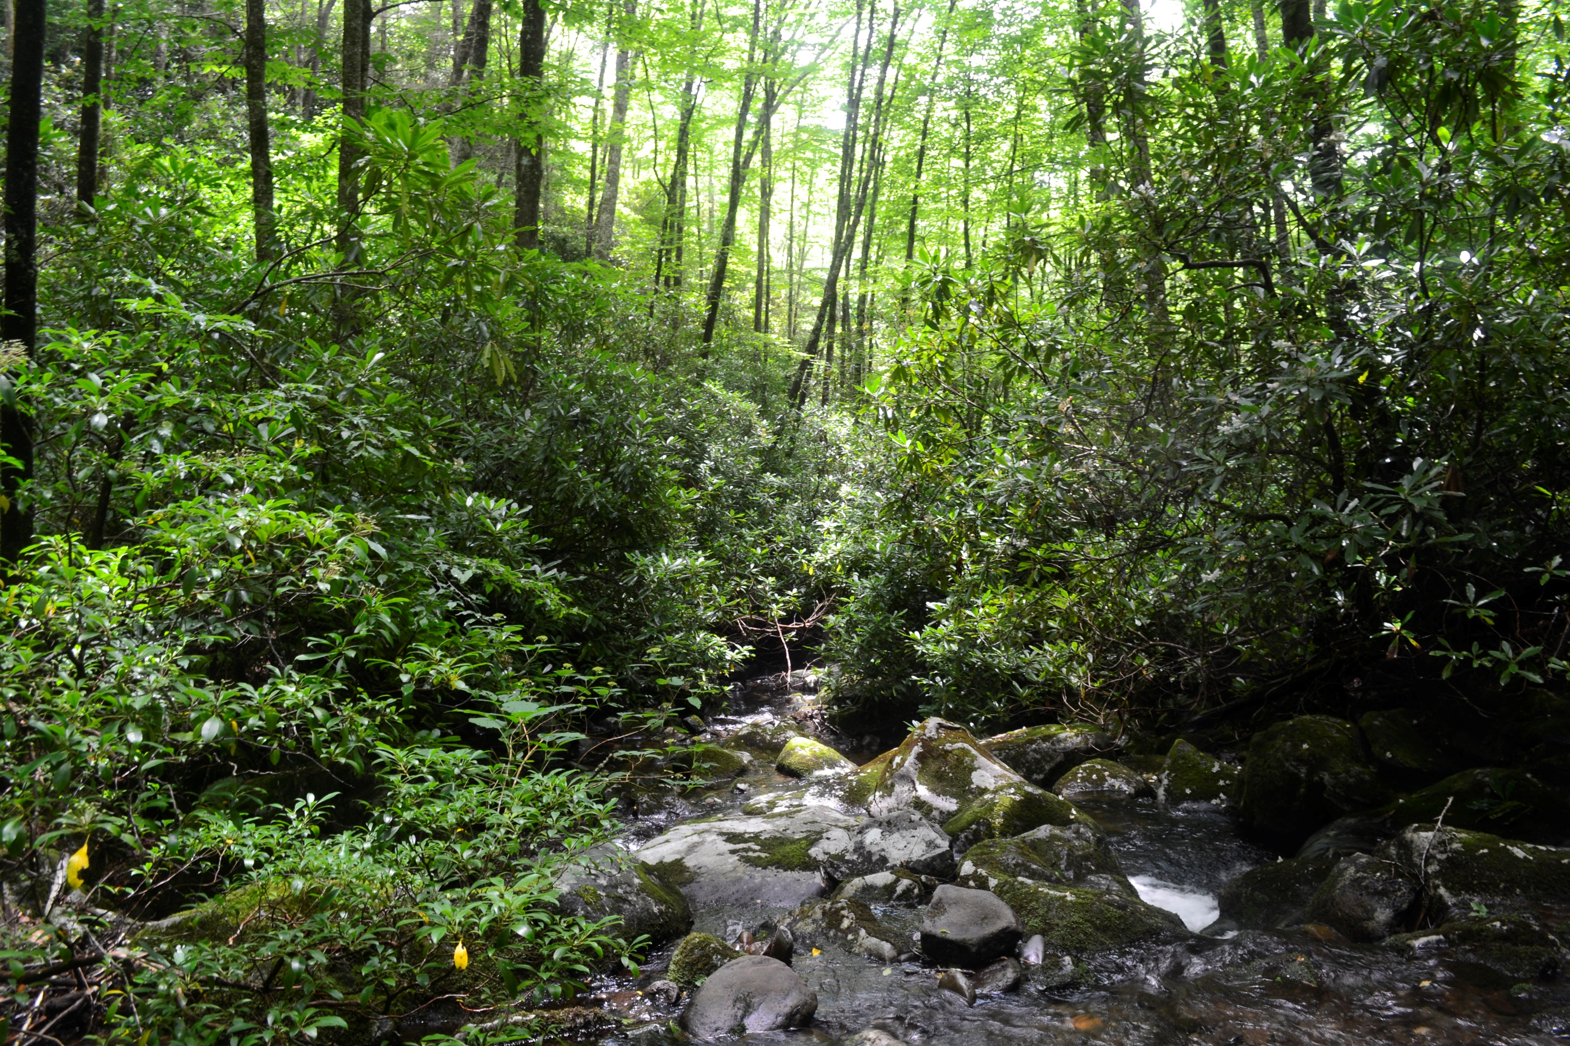
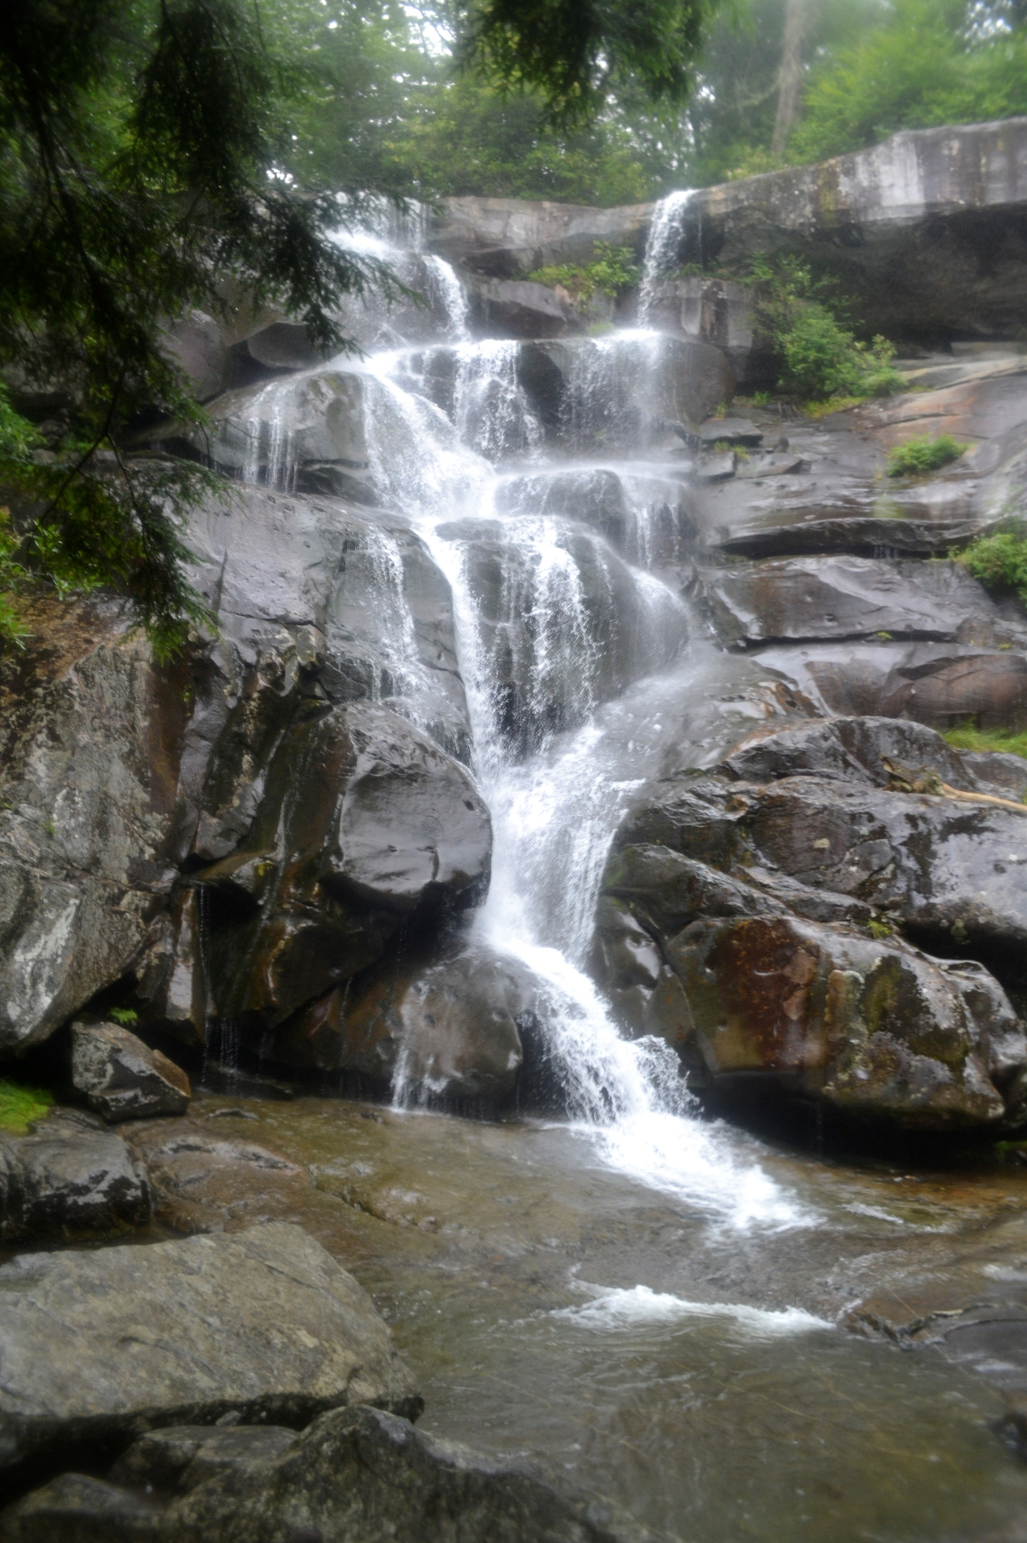
J.L. Allen

Slide 14
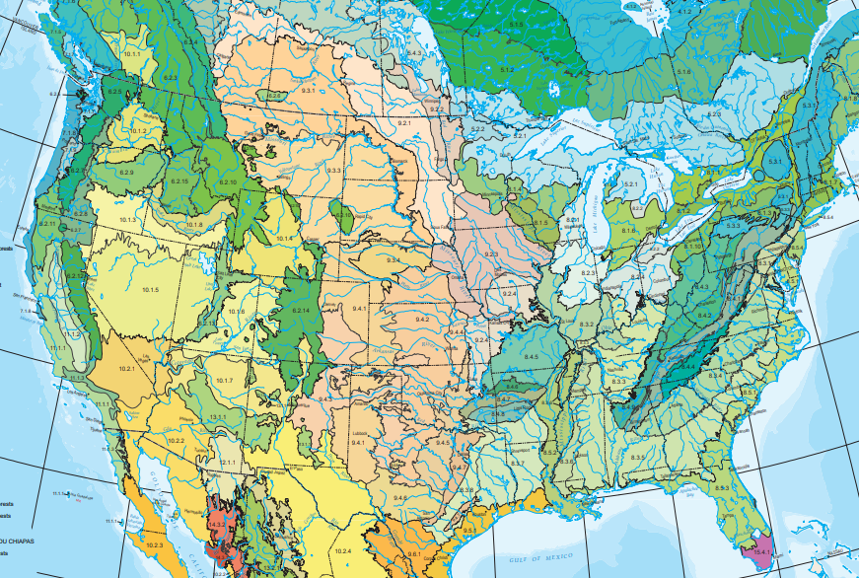
Level III Ecoregions

Slide 15
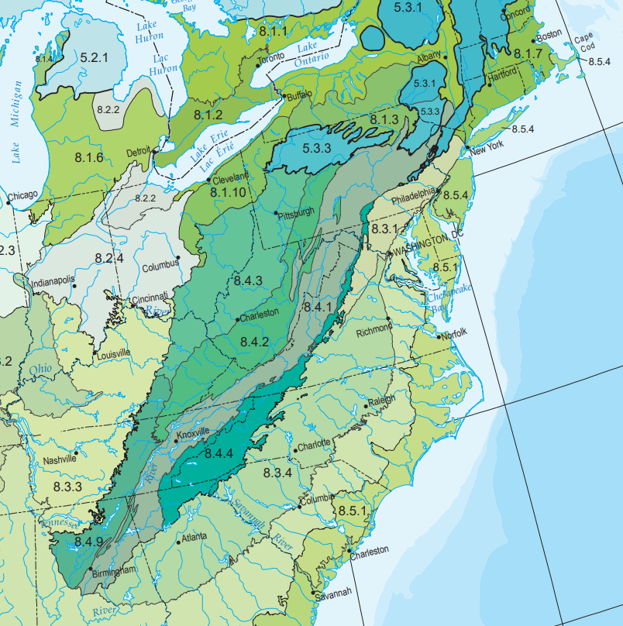
North Central Appalachians
Western Allegheny Plateau
Ridge and Valley
Central Appalachians
Blue Ridge
Southwestern
Appalachians

Slide 16
The Appalachian Mountains are a Biodiversity Hotspot
>100,000 total species in the Great Smoky Mountains National Park (!!!)
Long-term continuous availability of habitat – Mountain range formed and has been continuously exposed for >250 million years (Cascade Mountains formed ~90 mya and the Rockies formed ~75 mya).
Geological complexity – incredible underlying diversity of rock/soil types
Topographic complexity – Wide variety of niches given range of elevations and aspects
High-productivity system – high water availability and moderate temperatures

Slide 17
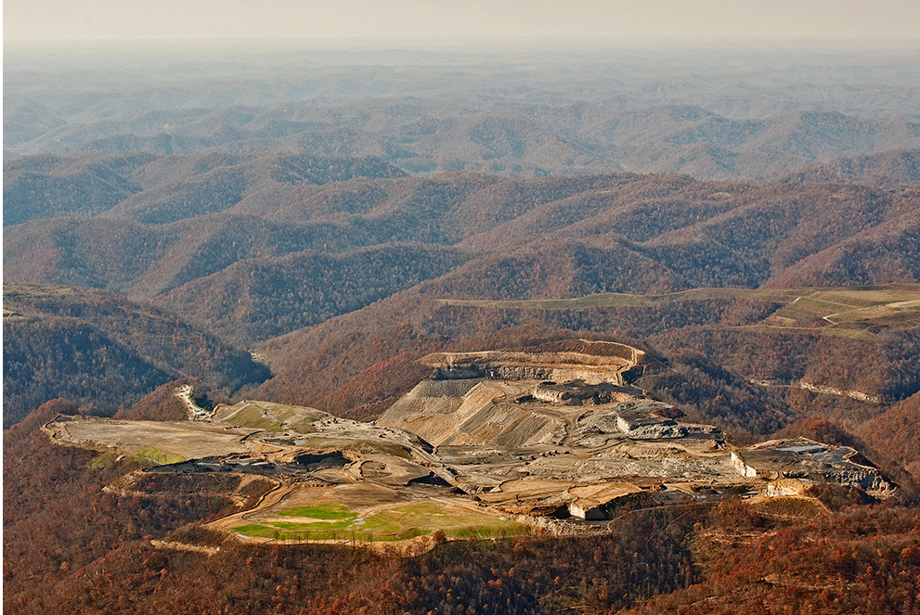
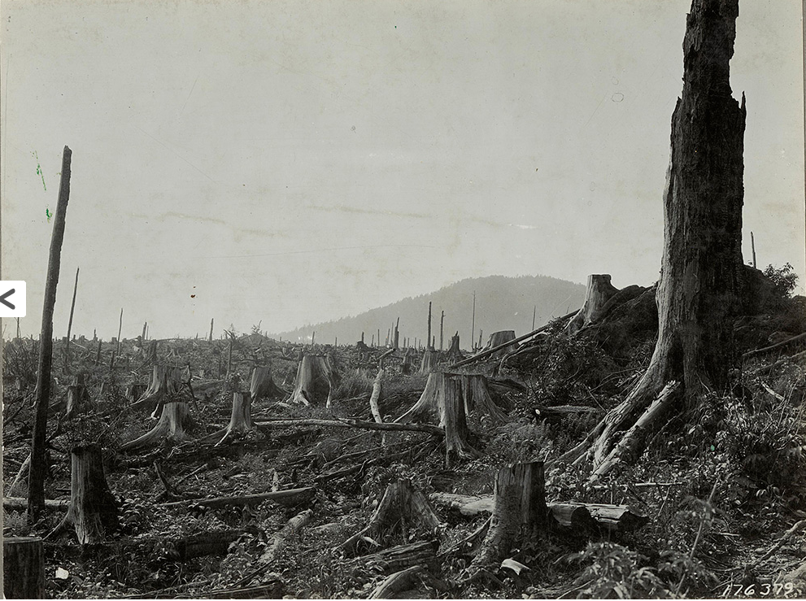
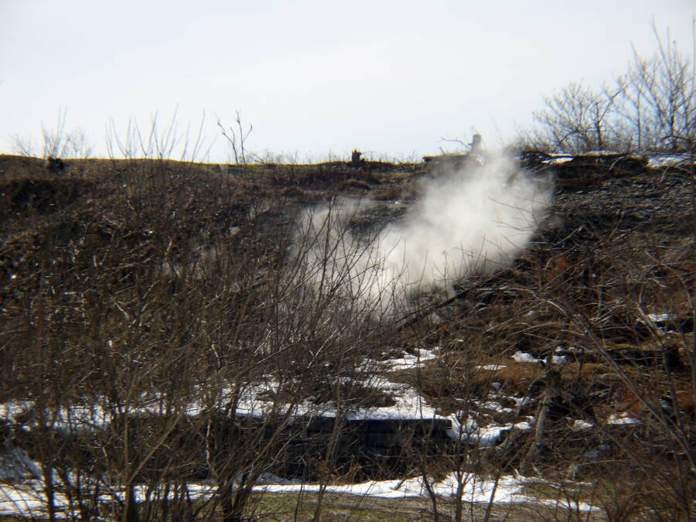
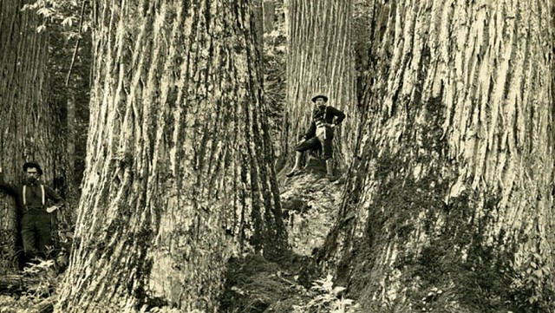
Human impacts to natural systems
History of clear cuts across the entire region
Invasive species causing mass die-offs of dominant tree species fundamentally reshaping the woody plant communities
Mountain top removal mining and other forms of coal mining
Fracking
Acid rain and other forms of air pollution
https://appvoices.org/2015/12/09/land-through-the-lens/
Centralia, PA on fire since 1962: https://allthatsinteresting.com/centralia-pa
American Chestnut
https://acf.org/the-american-chestnut/history-american-chestnut/
https://www.usda.gov/media/blog/2019/04/29/what-it-takes-bring-back-near-mythical-american-chestnut-trees

Slide 18
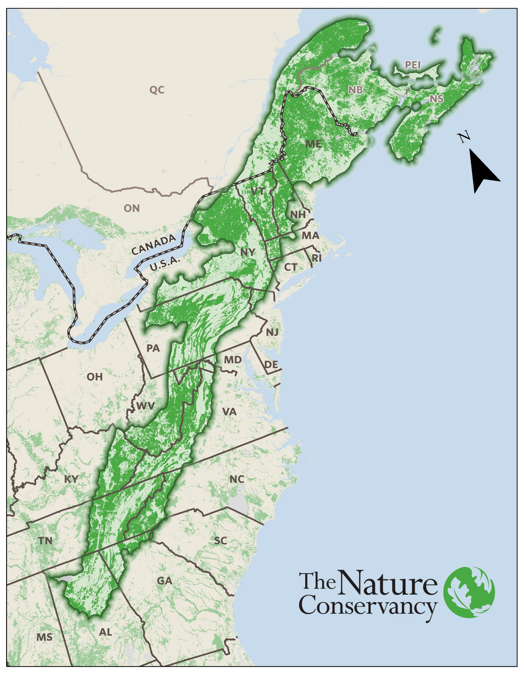
Protected areas and conservation corridors
Conservation corridor - connected protected areas that span large geographic distances and allow the movement and migration of biodiversity follow natural processes

Slide 19
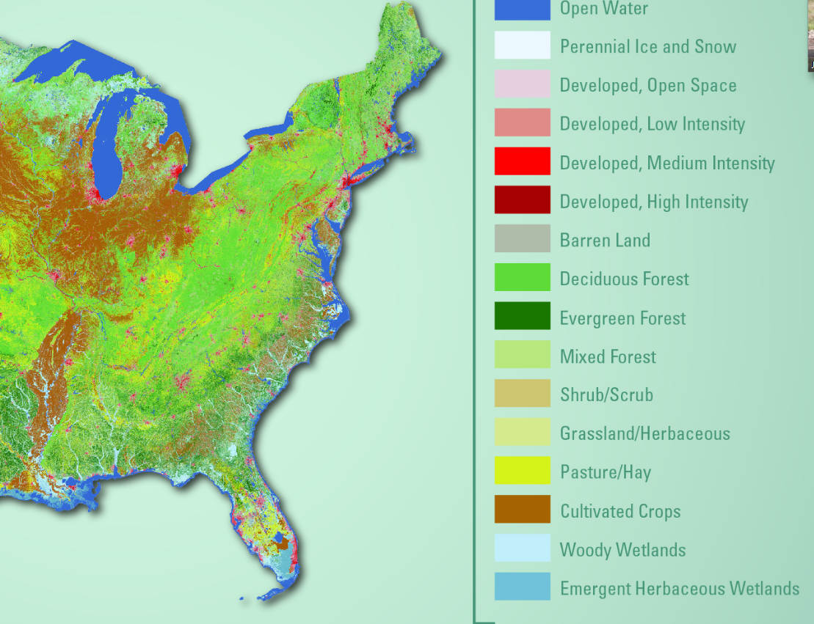
Washington D.C.

Slide 20
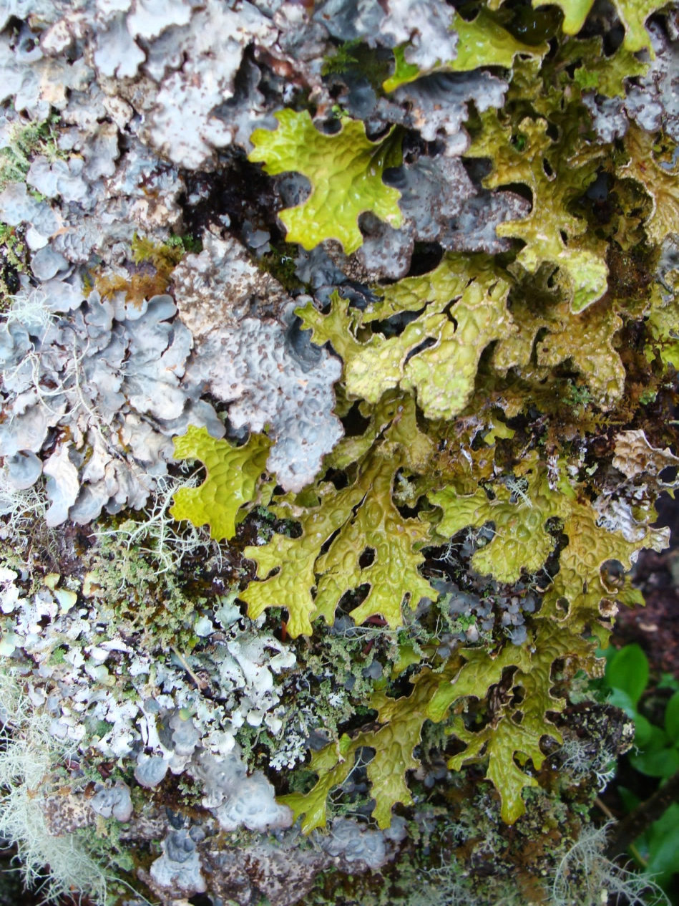
Over the CURE…
Step 1: Form groups and develop a hypothesis, or multiple hypotheses
Step 2: Generate Dataset
Step 3: Mapping Distributions and Calculating Range Sizes in QGIS
Step 4: Statistical Analyses
Step 5: Communicating Results

