Slide 1
Marshall Islands
Jenny Martinez-Carino
Ewaoluwa Ogundana
Kimberly King
Ingris Flores

Slide 2
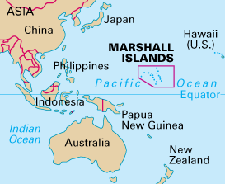
About Marshall Islands
The Marshall Islands are a chain of volcanic islands and coral atolls in the central Pacific Ocean, between Hawaii and the Philippines.
Official Name: The Republic of the Marshall Islands
Capital: Majuro
Population: 53,066 people
Language and Nationality: Marshallese
Government Type: Presidential Republic
Fun fact: It’s about the size of Washington D.C.

Slide 3
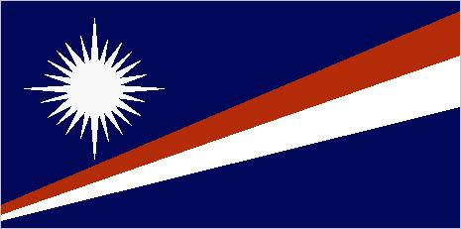
History & Geography
The Marshall Islands were given their name by British Naval Captain John William Marshall in 1788.
Marshall Islands are located in the central of the Pacific ocean and consists of 29 atolls.
Total Land Area: 181 sq km
October 21st 1986, the Marshall Islands attained independence .
Notes:
The total land area is about the size of washington dc
http://www.bbc.com/news/world-asia-15598732

Slide 4
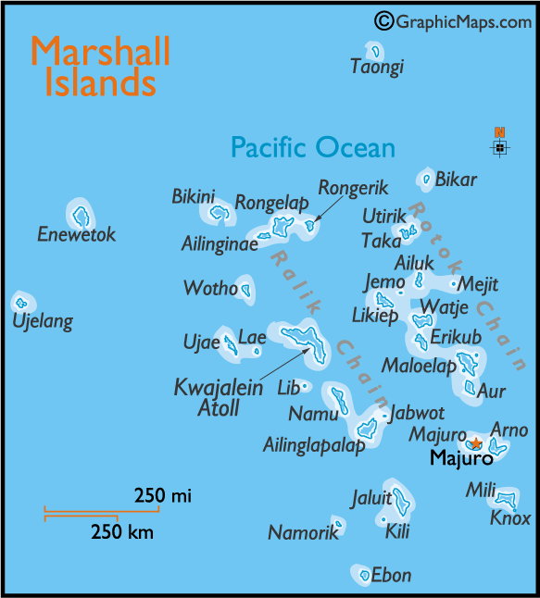

Slide 5
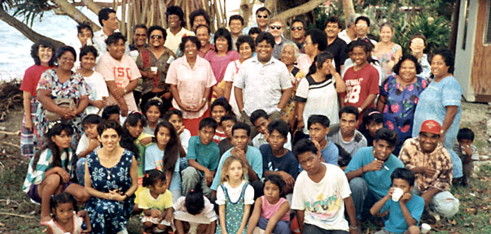
Culture & Traditions
RELIGION: 51.5% Christian, Roman Catholic Church 8.4%
TRADITIONAL FOOD: Sweet Macadamia Pie
TYPICAL FOOD: Boiled potatoes, Breadfruit, and and pumpkin tossed with a combination of coconut milk.
MUSIC: Micronesian which does not involve many drums
TRADITION: The two-day event will open on Friday, May 3, with a tipnol (canoes that are 19 plus feet long) sailing canoe race along the lagoon from the airport to the Outrigger Marshall Islands Resort.

Slide 6
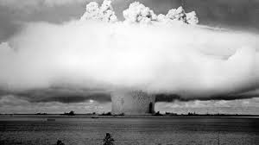
Why did the U.S choose the Marshall Islands?
The Marshall Islands were chosen, specifically the Bikini atoll, due to:
Its location away from regular air
The Islands sea routes
“The good of mankind and to end all world wars"
The US tested 67 nuclear weapons between 1946 and 1958.

Slide 7
Marshall Islands Today

Slide 8
WORK CITED
Niedenthal, Jack. “The Atomic History of Bikini Atoll.” The Guardian, Guardian News and Media, 6 Aug. 2002,
www.theguardian.com/travel/2002/aug/06/travelnews.nuclearindustry.environment
“Marshall Islands Profile - Timeline.” BBC News, BBC, 31 July 2017, www.bbc.com/news/world-asia-15598732.
“The World Factbook: MARSHALL ISLANDS.” Central Intelligence Agency, Central Intelligence Agency, 23 Mar. 2018, www.cia.gov/library/publications/the-world-factbook/geos/rm.html.

