Slide 1
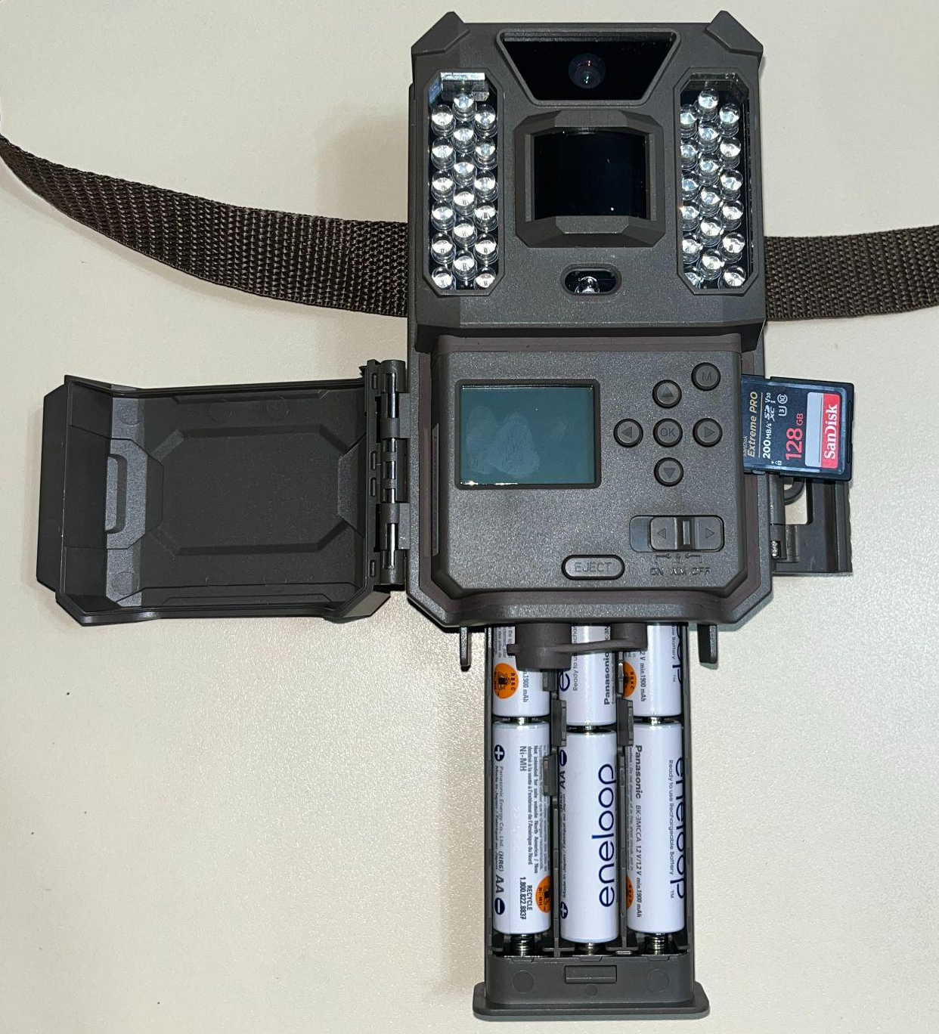
Lens
LED IR Flash
Strap
Motion Indicator & Light Sensor
Memory Card Slot
LCD
Screen
Control Panel Cover
Button Panel
Latch
Battery Release
Power/Mode Switch
Battery Tray

Slide 2
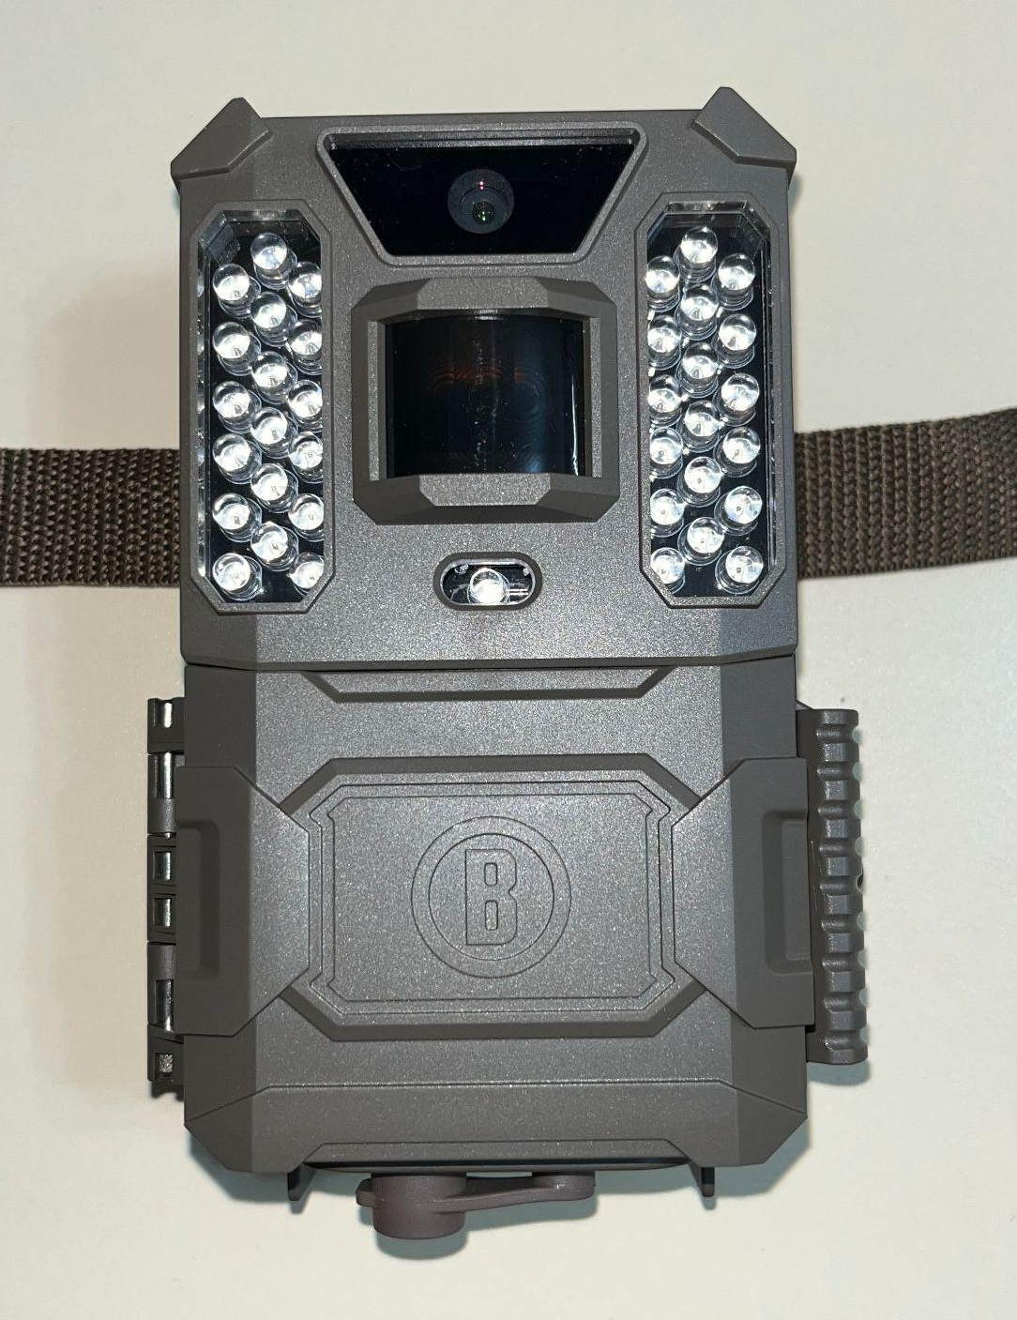
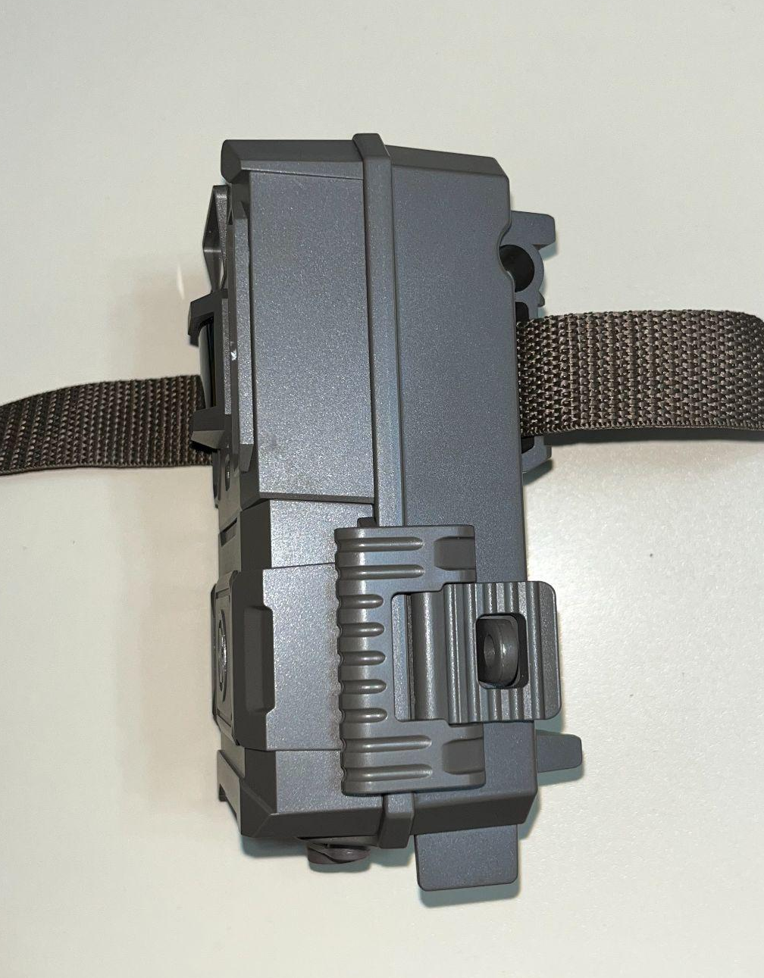

Slide 3
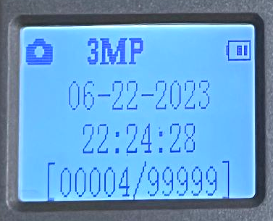
Still Photo Mode
Battery Level
Date
(Month-Day-Year)
Time
(Hour:Minute:Second)
# of Photos Taken
Remaining Photo Capacity

Slide 4
Road
20 meters radius around camera
Notes:
1: A birds-eye view graphic of where a camera should be placed and directed (away from traffic with >20m visibility). This can include a brief description of the walk test.

Slide 5
Tree is straight
& 6 inches in diameter
Camera strap/lock tightened and tucked in and behind len
6 inches
Camera parallel to ground & facing right side up
Camera
Camera placed at knee height
Ground
Notes:
2: A graphic showing ideal camera height off ground, location of strap and/or lock, and its position parallel with the ground.

Slide 6
Road
Cameras should be placed 200 meters away from one another
Notes:
3: A graphic showing that cameras should be placed 200m away from one another.

Slide 7
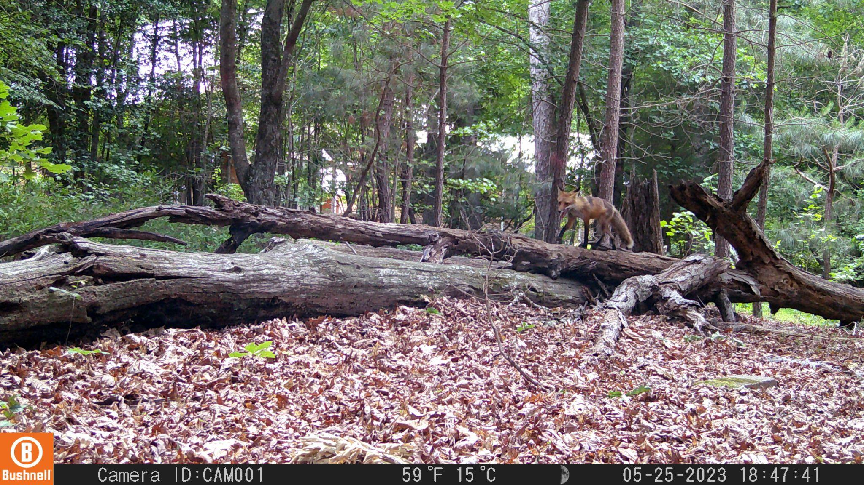
Temperature
(use Celsius)
Date
(Month-Day-Year)
Time
(Hour:Minute:Second)
Lunar Phase

