Slide 1
Terrestrial Trophic Cascades & Population Structure
A Learning Activity to Accompany HHMI Video Some Animals Are More Equal than Others: Keystone Species and Trophic Cascades

Slide 2
Terrestrial Food Webs
Like marine ecosystems, terrestrial food webs have the same trophic structure and should show the same trophic cascade responses.
The big difference is that in marine systems nutrients are dissolved in the water for uptake by algae, but nutrients in terrestrial systems are taken up by plants from the soil.
Carnivores
(Consumers)
Herbivores
(Consumers)
Omnivores
(Consumers)
Decomposers
(Consumers)
Plants
(Producers)
Nutrients

Slide 3
National Parks As Unintended Experiments To Study Trophic Cascades
Ecologists realized that ecosystems protected by the United States National Park Services provided excellent resource for studying trophic cascades in terrestrial communities.

Slide 4
Bison: Almost Hunted To Extinction
Habitat loss and overhunting greatly reduced the population sizes of species such as bison and elk in the western United States.
Bison bison
A pile of bison bones from thousands of animals
Notes:
Bison

Slide 5
United States National Park Service
Founded in 1916, the United States National Park Service provided refuges where plants and animals under pressure from overhunting and habitat destruction could be protected.

Slide 6
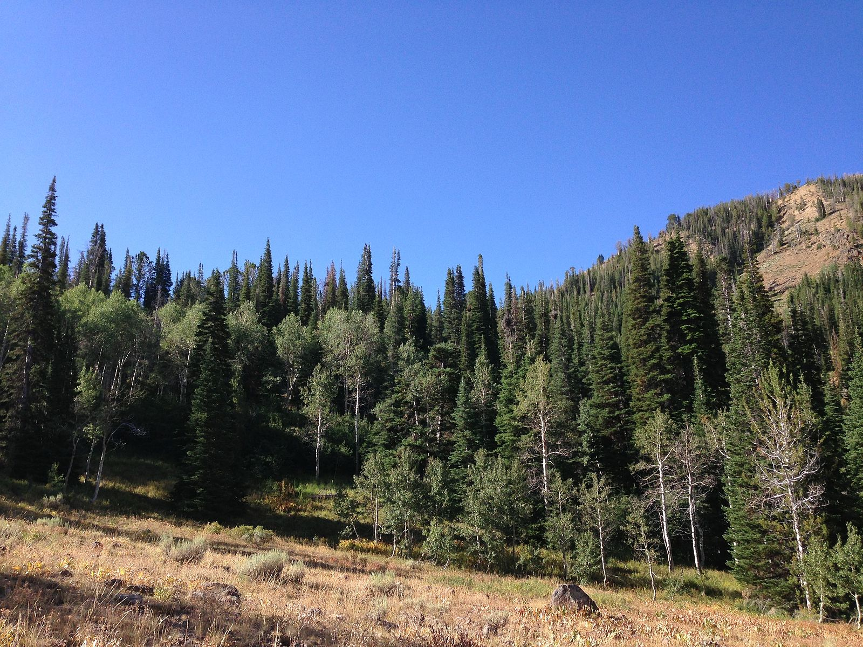
United States National Park Service
Although National Parks such as Yellowstone, Zion Canyon, and Yosemite were set aside to protect natural habitats for endangered elk, bison, and other species,
something was still missing in many parks that could potentially have a huge impact on these ecosystems.
What do you think it could be?
Notes:
Part of the Wind Cave bison herd photographed in 2003.https://commons.wikimedia.org/wiki/File:Wind_Cave_bison_herd_2003.jpg, This file is licensed under the Creative Commons Attribution-Share Alike 3.0 Unported license

Slide 7
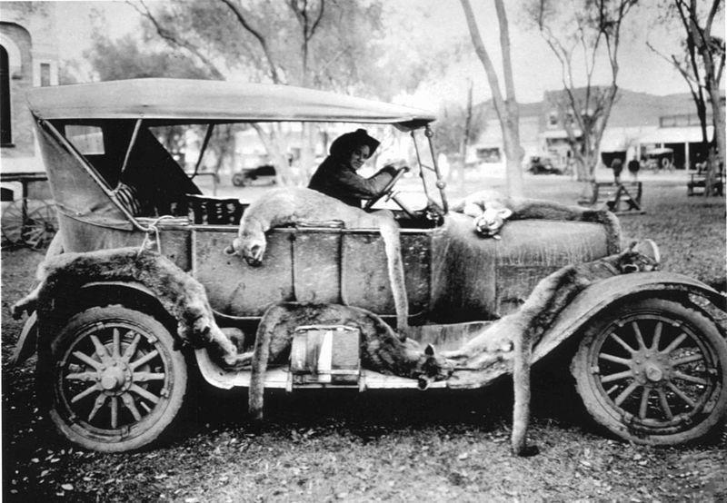
Predators, People, & Parks
For many years, top predators including bears, wolves, and mountain lions were the targets of hunting.
They were often driven to extinction in all or part of the western United States.
Notes:
USFWS Mountain-Prairie - A Pair on the Prowl https://commons.wikimedia.org/wiki/Category:Cervus_canadensis#/media/File:A_Pair_on_the_Prowl_(12396301355).jpg This file is licensed under the Creative Commons Attribution 2.0 Generic license.

Slide 8
Predators, People, & Parks
Why do you think these activities were considered acceptable by people at the time?
What do you think were the consequences for these species and their prey inside and outside of National Park boundaries?
Notes:
USFWS Mountain-Prairie - A Pair on the Prowl https://commons.wikimedia.org/wiki/Category:Cervus_canadensis#/media/File:A_Pair_on_the_Prowl_(12396301355).jpg This file is licensed under the Creative Commons Attribution 2.0 Generic license.
100 pound wolf killed in Montana in 1928 in Highwood Mountains, east of Great Falls, Public Domain, Montana https://commons.wikimedia.org/wiki/File:Montana_wolf_100_lbs_1928_Young_%26_Goldman_USFWS.jpg
Market hunting of cougars, Public Domain, https://commons.wikimedia.org/wiki/File:Market_hunting_of_cougars.jpg

Slide 9
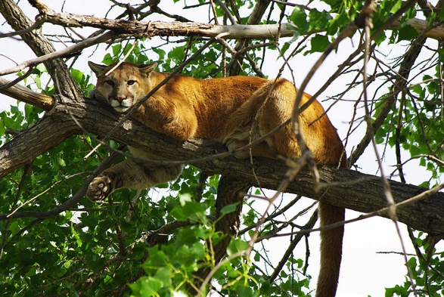
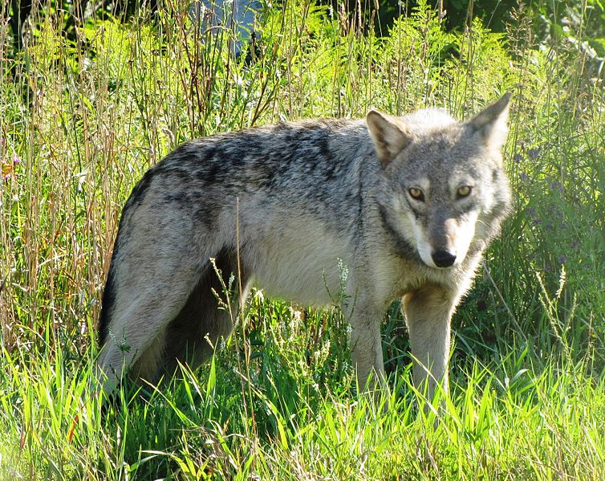
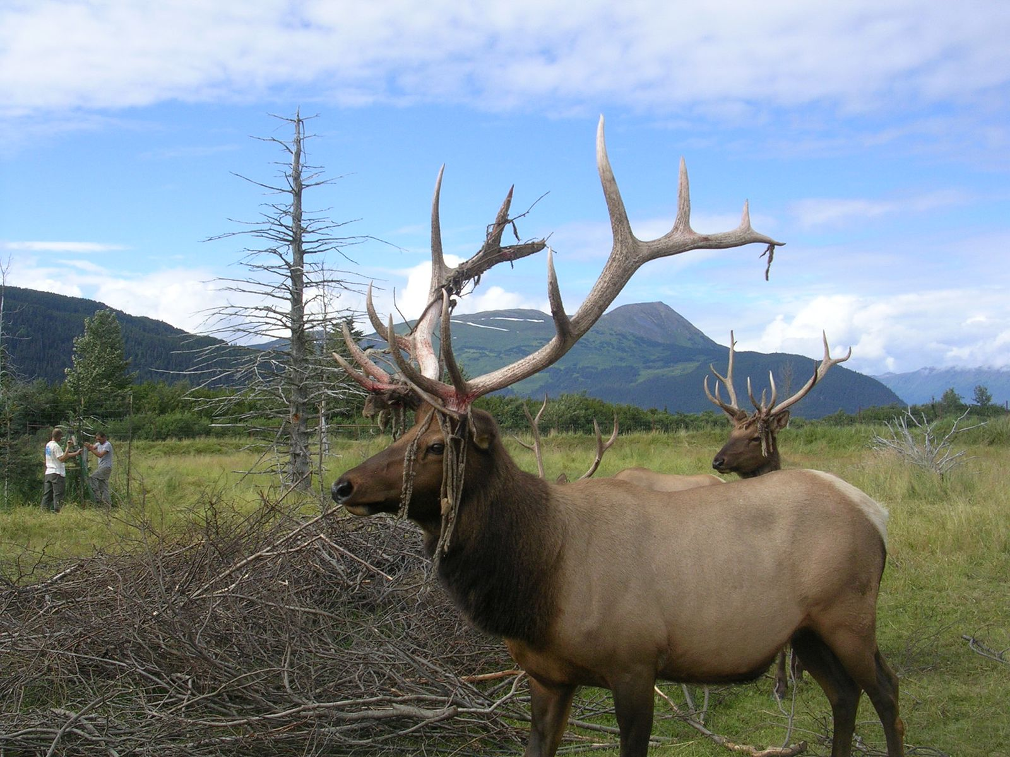
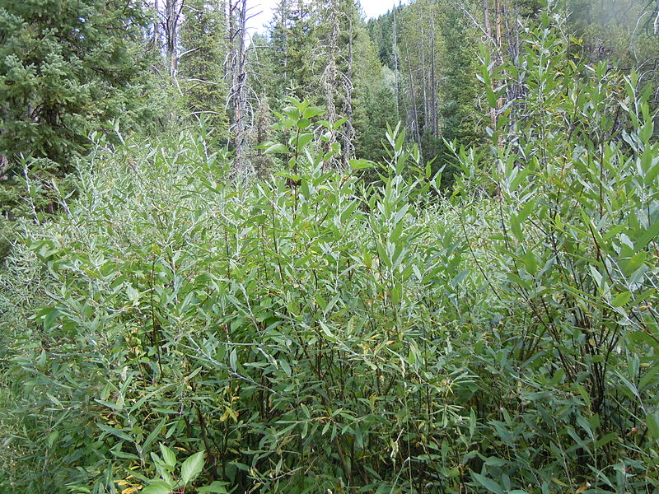
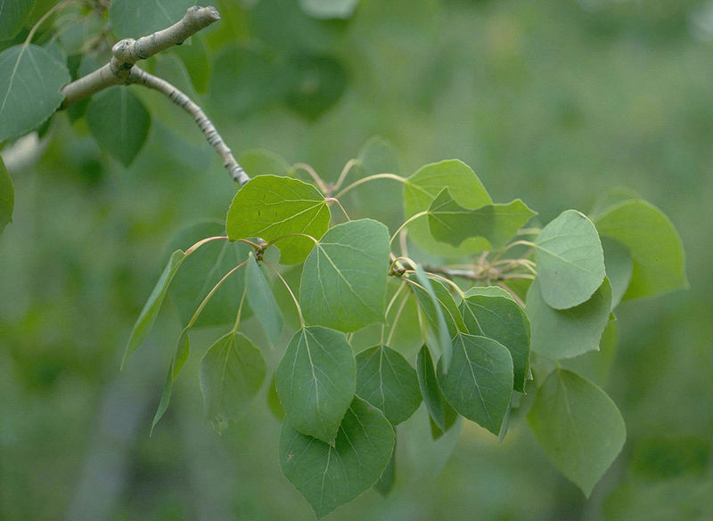
Predator-Prey Systems
Predator-prey-producers systems typical of the ecosystem in two parks are shown below.
ZION National Park
Yosemite National Park
Coyote
Mountain Lion
Elk
Moose
Willow
Aspen

Slide 10
Browsing For Saplings
Animals such as elk, deer, and moose are browsers, meaning that they mostly eat leaves and young stems of woody shrubs and trees.
Mutualistic bacteria in their gut help digest the plant material.
No branches below height browsers can reach.
Marks on tree trunks from browsers eating bark.

Slide 11
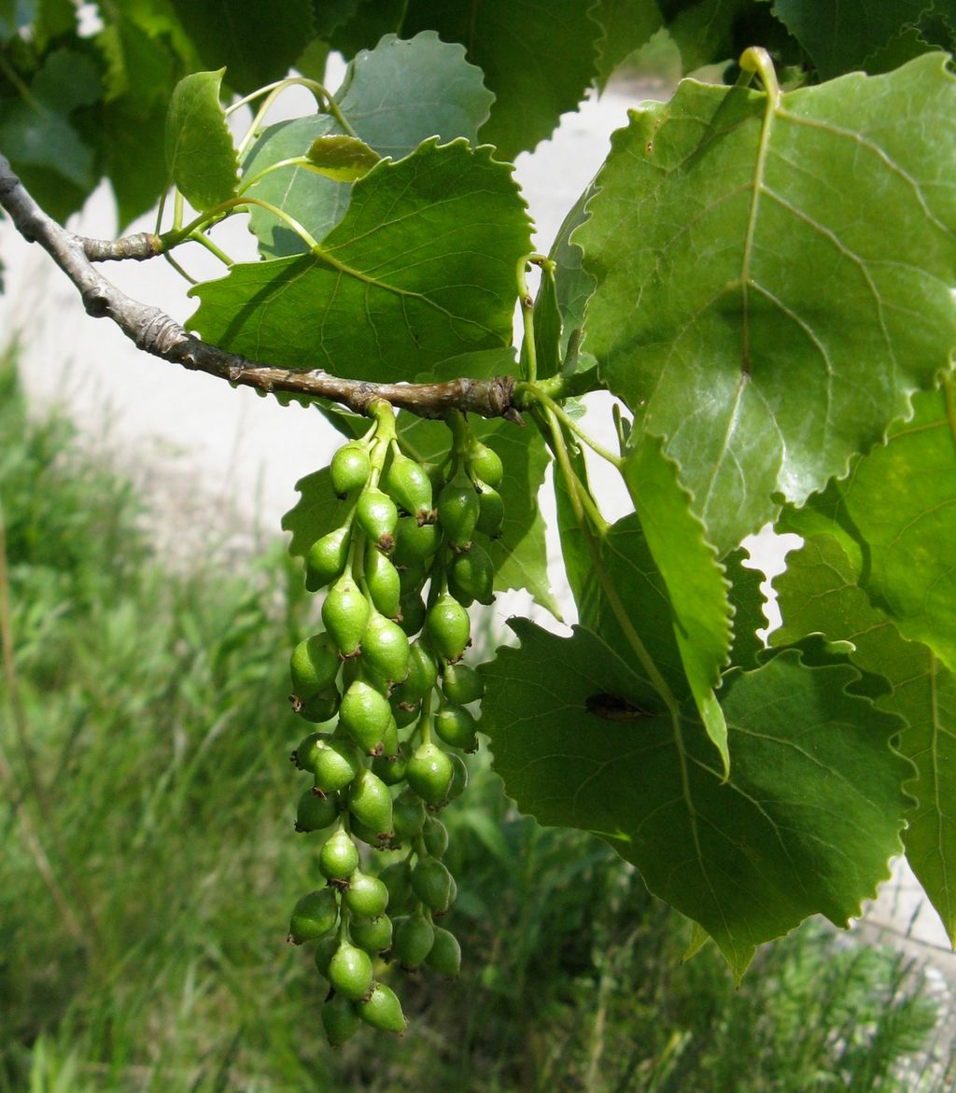
Browsing For Saplings
They also eat the fruits and seeds on branches, which can limit plant reproduction.

Slide 12
Predator-Prey Systems
Moose and elk browse on the leaves, buds, and twigs of willow or cottonwoods growing in wet areas and aspen that grow in drier areas.
ZION National Park
Yosemite National Park
Coyote
Mountain Lion
Elk
Moose
Willow
Aspen
Notes:
Mountain lion lounging in a cottonwood tree during the heat of the day., This file is licensed under the Creative Commons Attribution 2.0 Generic license. USFWS
https://commons.wikimedia.org/wiki/File:8th_Place_-_Mountain_Lion_(7487178290).jpg
A male moose takes a rest in a field during a light rainshower. Public Domain, https://commons.wikimedia.org/wiki/File:Male_Moose.jpg
Gray Wolf Canis lupus at Seney National Wildlife Refuge, Michigan. This file is licensed under the Creative Commons Attribution-Share Alike 2.0 Generic license.
https://commons.wikimedia.org/wiki/File:Gray_Wolf_Seney_NWR_2.jpg
An Elk poses for the camera https://commons.wikimedia.org/wiki/File:An_Elk_poses_for_the_camera_(9317643508).jpg This file is licensed under the Creative Commons Attribution-Share Alike 2.0 Generic license.
Often of montane riparian settings, Salix lemmonii can sometimes form pure stands. https://commons.wikimedia.org/wiki/File:Salix_lemmonii_(5027508048).jpg This file is licensed under the Creative Commons Attribution-Share Alike 2.0 Generic license.
Howard F. Schwartz, Colorado State University, USA Populus tremuloides foliage. https://commons.wikimedia.org/wiki/File:Populus_tremuloides_leaves_RMP.jpg This file is licensed under the Creative Commons Attribution 3.0 United States license.
A young mule deer buck shows off his velvet-covered antlers in June. Photo: Bill Hayden, NPS https://commons.wikimedia.org/wiki/File:Mule_deer_buck_at_Goat_Haunt_(4479394475).jpg This file is licensed under the Creative Commons Attribution 2.0 Generic license.
Populus deltoides https://commons.wikimedia.org/wiki/File:Populus_deltoides_subsp_monilifera_1.jpg This file is licensed under the Creative Commons Attribution-Share Alike 3.0 Unported license.

Slide 13
Predator-Prey Systems
What would you predict would happen in these ecosystems if the top predator went extinct or were removed?
ZION National Park
Yosemite National Park
Coyote
Mountain Lion
Elk
Moose
Willow
Aspen
Notes:
Mountain lion lounging in a cottonwood tree during the heat of the day., This file is licensed under the Creative Commons Attribution 2.0 Generic license. USFWS
https://commons.wikimedia.org/wiki/File:8th_Place_-_Mountain_Lion_(7487178290).jpg
A male moose takes a rest in a field during a light rainshower. Public Domain, https://commons.wikimedia.org/wiki/File:Male_Moose.jpg
Gray Wolf Canis lupus at Seney National Wildlife Refuge, Michigan. This file is licensed under the Creative Commons Attribution-Share Alike 2.0 Generic license.
https://commons.wikimedia.org/wiki/File:Gray_Wolf_Seney_NWR_2.jpg
An Elk poses for the camera https://commons.wikimedia.org/wiki/File:An_Elk_poses_for_the_camera_(9317643508).jpg This file is licensed under the Creative Commons Attribution-Share Alike 2.0 Generic license.
Often of montane riparian settings, Salix lemmonii can sometimes form pure stands. https://commons.wikimedia.org/wiki/File:Salix_lemmonii_(5027508048).jpg This file is licensed under the Creative Commons Attribution-Share Alike 2.0 Generic license.
Howard F. Schwartz, Colorado State University, USA Populus tremuloides foliage. https://commons.wikimedia.org/wiki/File:Populus_tremuloides_leaves_RMP.jpg This file is licensed under the Creative Commons Attribution 3.0 United States license.

Slide 14
Predator-Prey Systems
What data could you collect from tree populations in each of these parks to test if your prediction is correct?
ZION National Park
Yosemite National Park
Elk
Moose
Willow
Aspen
Notes:
Mountain lion lounging in a cottonwood tree during the heat of the day., This file is licensed under the Creative Commons Attribution 2.0 Generic license. USFWS
https://commons.wikimedia.org/wiki/File:8th_Place_-_Mountain_Lion_(7487178290).jpg
A male moose takes a rest in a field during a light rainshower. Public Domain, https://commons.wikimedia.org/wiki/File:Male_Moose.jpg
Gray Wolf Canis lupus at Seney National Wildlife Refuge, Michigan. This file is licensed under the Creative Commons Attribution-Share Alike 2.0 Generic license.
https://commons.wikimedia.org/wiki/File:Gray_Wolf_Seney_NWR_2.jpg
An Elk poses for the camera https://commons.wikimedia.org/wiki/File:An_Elk_poses_for_the_camera_(9317643508).jpg This file is licensed under the Creative Commons Attribution-Share Alike 2.0 Generic license.
Often of montane riparian settings, Salix lemmonii can sometimes form pure stands. https://commons.wikimedia.org/wiki/File:Salix_lemmonii_(5027508048).jpg This file is licensed under the Creative Commons Attribution-Share Alike 2.0 Generic license.
Howard F. Schwartz, Colorado State University, USA Populus tremuloides foliage. https://commons.wikimedia.org/wiki/File:Populus_tremuloides_leaves_RMP.jpg This file is licensed under the Creative Commons Attribution 3.0 United States license.

Slide 15
Browsing For Saplings
Researchers first compared areas with and without browsers.
How do you think the communities will differ in appearance?

Slide 16
Comparing Communities
Can you identify which image below shows an area where elk and deer have been excluded?

Slide 17
Comparing Communities
What observations did you base your conclusion on?

Slide 18
Comparing Communities
elk and Deer Present
Elk and Deer Excluded
Evidence of Browsing
Young Trees

Slide 19
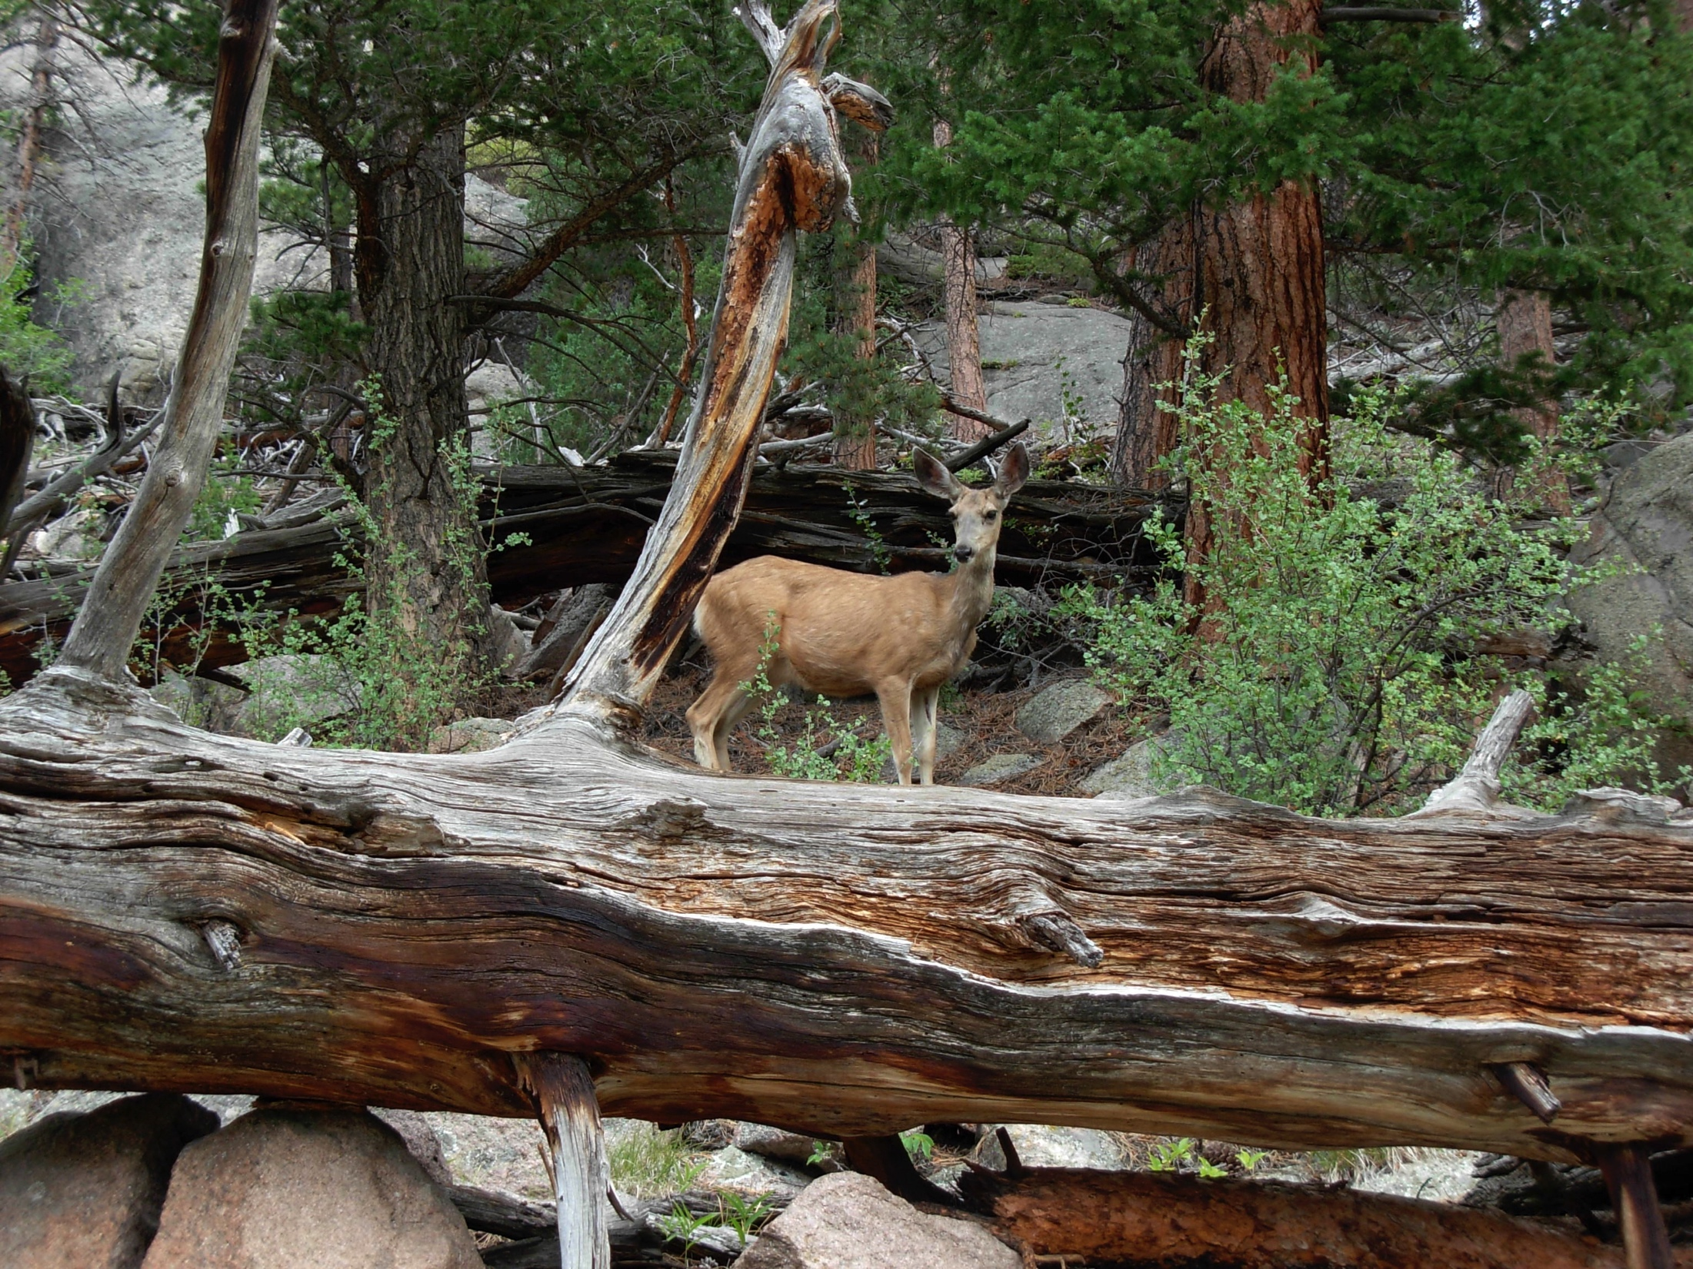
Predicting Age Structure of Trees
Once parks were established, populations of deer, elk, and moose increased rapidly in many of them.
Notes:
MY picture copyright

Slide 20
Predicting Age Structure of Trees
Because young saplings, seedlings, and even seeds in fruits are at the greatest risk from browsers, how might this impact growth, establishment of new trees, and age distribution in their populations?
Notes:
MY picture copyright

Slide 21
Predicting Age Structure of Trees
Researchers made detailed study of age distributions for different tree and shrub species in the parks.
What should they expect to see when they compare areas where apex predators are present or absent?
Show your prediction in the form of a graph with year of tree establishment as the x-axis and number of trees on the y-axis. The example shown next will help you get started.
Notes:
MY picture copyright

Slide 22
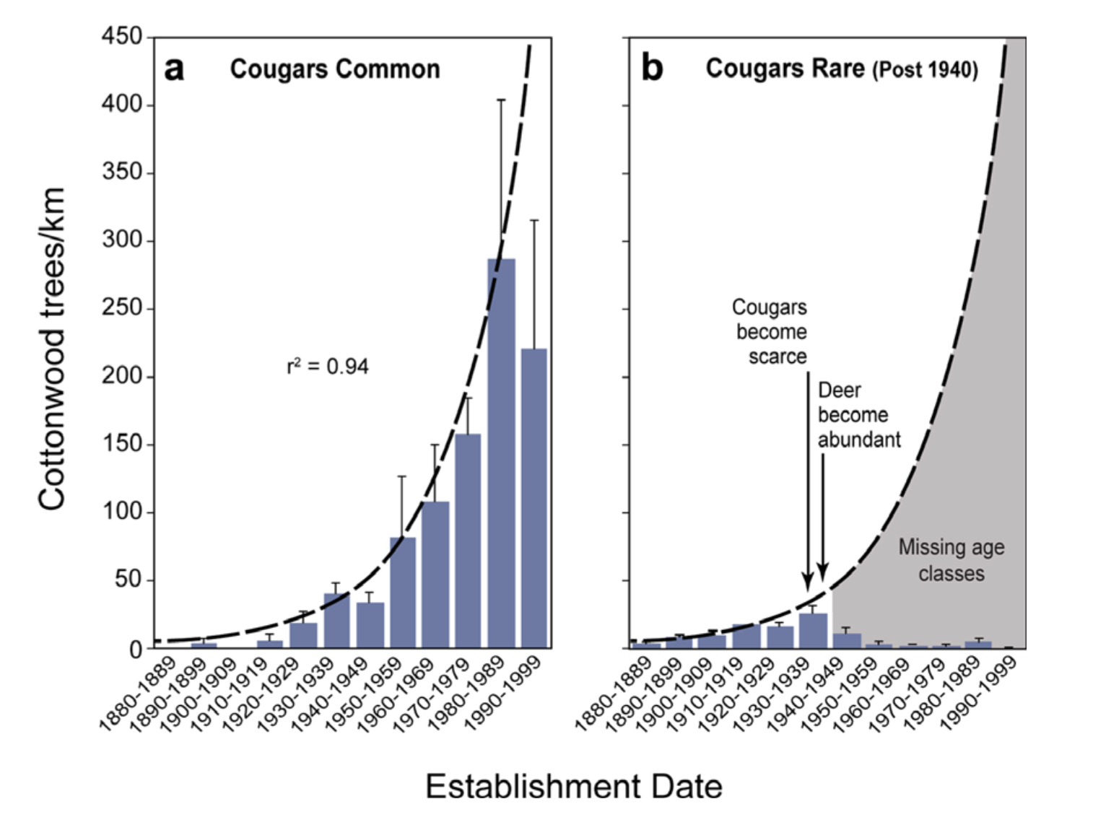
Age Structure of Cottonwood Trees in Zion Canyon National Park
Notes:
Ripple, W. J., & Beschta, R. L. (2006). Linking a cougar decline, trophic cascade, and catastrophic regime shift in Zion National Park. Biological Conservation, 133(4), 397-408.

Slide 23
Age Structure of Cottonwood Trees in Zion Canyon National Park
Notes:
Ripple, W. J., & Beschta, R. L. (2006). Linking a cougar decline, trophic cascade, and catastrophic regime shift in Zion National Park. Biological Conservation, 133(4), 397-408.

Slide 24
Age Structure of Cottonwood Trees in Zion Canyon National Park
Notes:
Ripple, W. J., & Beschta, R. L. (2006). Linking a cougar decline, trophic cascade, and catastrophic regime shift in Zion National Park. Biological Conservation, 133(4), 397-408.

Slide 25
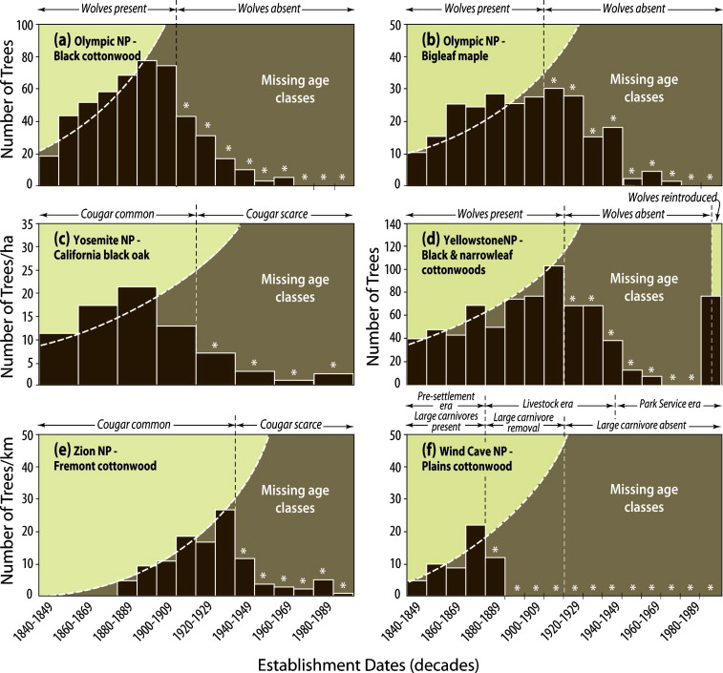
Age Structure of Trees in Other Parks
Different tree species in multiple parks show the same pattern.
Where browsers are protected, their populations grow and establishment of new trees is greatly reduced.
Notes:
Beschta, R. L., & Ripple, W. J. (2009). Large predators and trophic cascades in terrestrial ecosystems of the western United States. Biological Conservation, 142(11), 2401-2414.

Slide 26
Trophic Cascades & Conservation

Slide 27
Reintroduction & Conservation
Apex predators have been reintroduced into some US National Parks to protect the predators species and as part of a larger conservation plans.
How would introduction of the apex predators be a beneficial part of conservation in these areas? Are there potential problems?

Slide 28
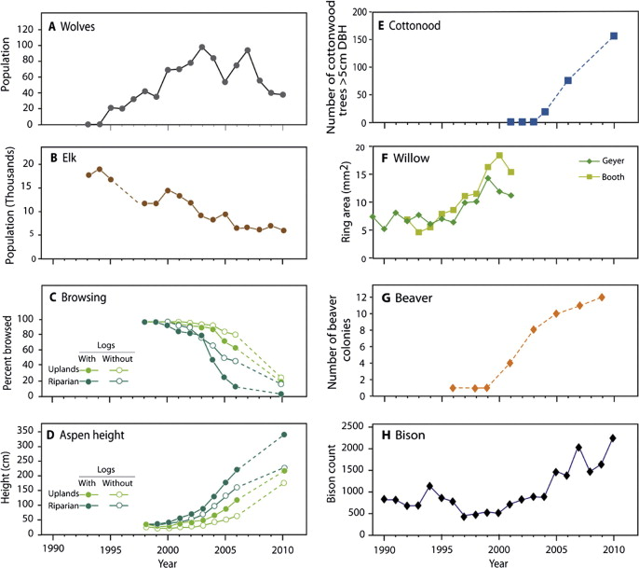
Results From Yellowstone
Wolves were reintroduced into Yellowstone in THE EARLY 1990’s.
Elk populations were large in the park.
What changes occurred in predator and prey population sizes after wolf reintroduction?
Notes:
Ripple, W. J., & Beschta, R. L. (2012). Trophic cascades in Yellowstone: The first 15 years after wolf reintroduction. Biological Conservation, 145(1), 205-213.

Slide 29
Results From Yellowstone
How do you expect browsing intensity and aspen height will change after wolf reintroduction?
Notes:
Ripple, W. J., & Beschta, R. L. (2012). Trophic cascades in Yellowstone: The first 15 years after wolf reintroduction. Biological Conservation, 145(1), 205-213.

Slide 30
Results From Yellowstone
How would you predict this would affect population sizes of the following species:
Cottonwood trees
Willows?
Beaver?
Bison?
Notes:
Ripple, W. J., & Beschta, R. L. (2012). Trophic cascades in Yellowstone: The first 15 years after wolf reintroduction. Biological Conservation, 145(1), 205-213.

Slide 31
Results From Yellowstone
Cottonwood, willow, and beaver populations increased.
Bison populations increased, but have fluctuated. What might that be related to?
Summarize the results of wolf reintroductions on biodiversity of the park.
Notes:
Ripple, W. J., & Beschta, R. L. (2012). Trophic cascades in Yellowstone: The first 15 years after wolf reintroduction. Biological Conservation, 145(1), 205-213.

Slide 32
Trophic Cascades & Community Biodiversity

Slide 33
Brainstorming
There is clearly a direct effect between predators, their prey, and the plants that their prey eat.
What could be some of the indirect effects that impact the population sizes and presence of other species present in the community?

Slide 34
Riparian Areas: Where the Terrestrial & Aquatic Environments Meet
Riparian areas and wetland communities along rivers, streams, and lakes are used heavily by many browsers, particularly moose.
In addition to prey and their predators, other species in the community depend on the quality of the riparian habitat.

Slide 35
Riparian Community Food Web
The species shown below are part of the typical community found in riparian areas along creeks, streams, and rivers in Zion National Park.
Woody Tree Species: willows, cottonwoods
(producers)
Amphibians: frogs, toads
(juveniles eat algae
adults eat insects)
Mule Deer
(woody browser)
Beaver
(browser, preference for willows)
Wildflowers
(producer)
Cougar
(predator)
Butterflies
(juveniles eat leaves, adults drink floral nectar)
Wetland plants: sedges, rushes, cattails (producers)

Slide 36
Riparian Community Food Web
Arrange the species below to produce a new food web diagram that includes not only the predator and prey, but also other species in the community. Arrows should be drawn from food items to the species that eats them.
Woody Tree Species: willows, cottonwoods
(producers)
Amphibians: frogs, toads
(juveniles eat algae
adults eat insects)
Mule Deer
(woody browser)
Beaver
(browser, preference for willows)
Wildflowers
(producer)
Cougar
(predator)
Butterflies
(juveniles eat leaves, adults drink floral nectar)
Wetland plants: sedges, rushes, cattails (producers)

Slide 37
Riparian Community Food Web
Cougar
(predator)
There are direct effects between species and what they eat.
Amphibians: frogs, toads
(juvenile – algae
adult - insects)
Butterflies
(juvenile- leaves, adult - floral nectar)
Beaver
(browser, preference for willows)
Mule Deer
(woody browser)
Woody Tree Species: willows, cottonwoods
(producers)
Wetland plants: sedges, rushes, cattails (producers)
Wildflowers
(producer)

Slide 38
Riparian Community Food Web
Cougar
(predator)
For example, the direct relationship between cougar and mule deer.
Amphibians: frogs, toads
(juvenile – algae
adult - insects)
Butterflies
(juvenile- leaves, adult - floral nectar)
Beaver
(browser, preference for willows)
Mule Deer
(woody browser)
Woody Tree Species: willows, cottonwoods
(producers)
Wetland plants: sedges, rushes, cattails (producers)
Wildflowers
(producer)

Slide 39
Riparian Community Food Web
Cougar
(predator)
But the impact of apex predators on their prey can also have indirect effects on other members of the community.
Amphibians: frogs, toads
(juvenile – algae
adult - insects)
Butterflies
(juvenile- leaves, adult - floral nectar)
Beaver
(browser, preference for willows)
Mule Deer
(woody browser)
Woody Tree Species: willows, cottonwoods
(producers)
Wetland plants: sedges, rushes, cattails (producers)
Wildflowers
(producer)

Slide 40
Riparian Community Food Web
Cougar
(predator)
Based on this food web, what would you predict would be the indirect effect of cougar presence or absence on the other species in the community?
Amphibians: frogs, toads
(juvenile – algae
adult - insects)
Butterflies
(juvenile- leaves, adult - floral nectar)
Beaver
(browser, preference for willows)
Mule Deer
(woody browser)
Woody Tree Species: willows, cottonwoods
(producers)
Wetland plants: sedges, rushes, cattails (producers)
Wildflowers
(producer)

Slide 41
Riparian Community Food Web
Indicate whether cougar presence or absence should increase or decrease the numbers of the different types of species listed.
Species | Cougar Present | Cougar Absent
Mule Deer
Woody Trees & Shrubs
Amphibians
Wetland Plants
Beaver
WIldflowers
Butterflies

Slide 42
Riparian Community Food Web
When they compared areas with and without cougars, here is what they found.
Species | Cougar Present | Cougar Absent
Mule Deer | Decrease | Increase
Woody Trees & Shrubs | Increase | Decrease
Amphibians | Increase | Decrease
Wetland Plants | Increase | Decrease
Beaver | Increase | Decrease
WIldflowers | Increase | Decrease
Butterflies | Increase | Decrease

Slide 43
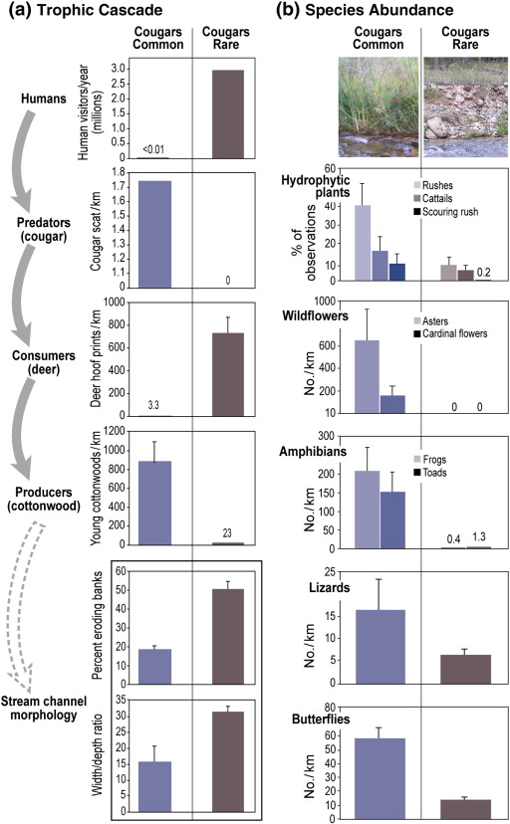
Riparian Community Food Web
When cougars are present, the number of species (biodiversity) in the community was higher.
When cougars are are absent, community biodiversity is lower.
How do these results compare to studies of starfish in tidal pool communities?

Slide 44
Trophic Cascades & The Physical Environment

Slide 45
Biotic and Abiotic
Having noted the impacts of trophic cascades on the community composition, researchers wondered how biotic changes in the environment shape the functioning of the abiotic environment.

Slide 46
Investigating Nutrient Cycles
Producers, consumers, and decomposers are part of the biogeochemical cycles that move nutrients such as carbon, nitrogen, and phosphorus through the environment.
Abiotic Nutrient Pool
Consumers
Decomposers
Producers

Slide 47
Investigating Nutrient Cycles
How might changes in the producer community due to high herbivory result in changes in the biogeochemical cycles?
Abiotic Nutrient Pool
Consumers
Decomposers
Producers

Slide 48
Isle Royale National Park
Researchers chose to compare soil nutrient content and rates of nutrient flux between areas with high and low moose grazing and where they had been excluded for over 40 years.
Abiotic Nutrient Pool
Consumers
Decomposers
Producers

Slide 49
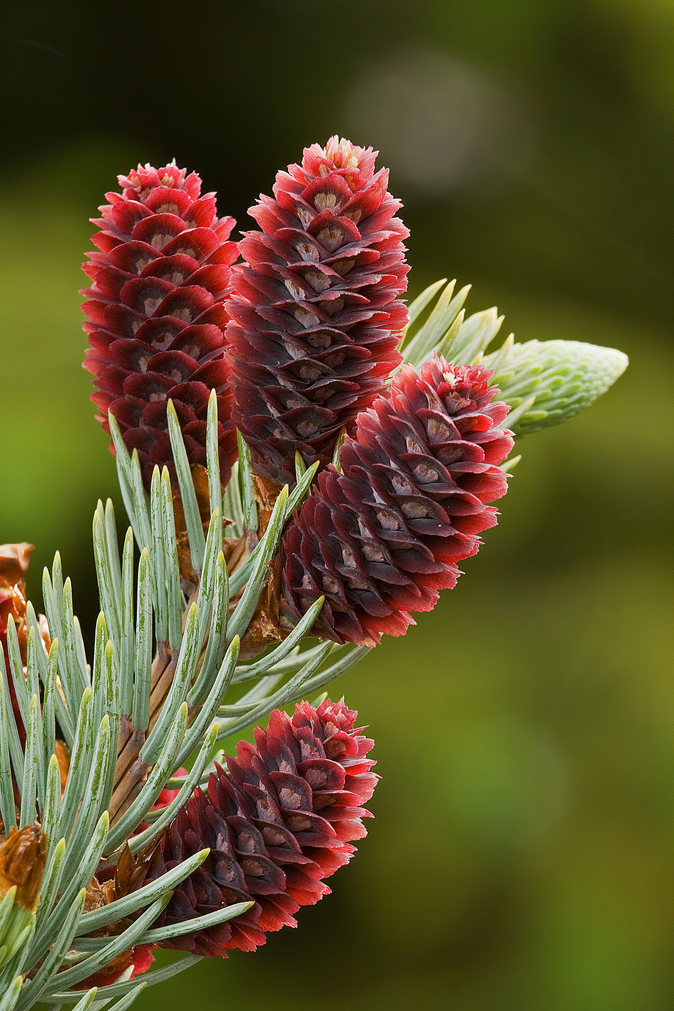
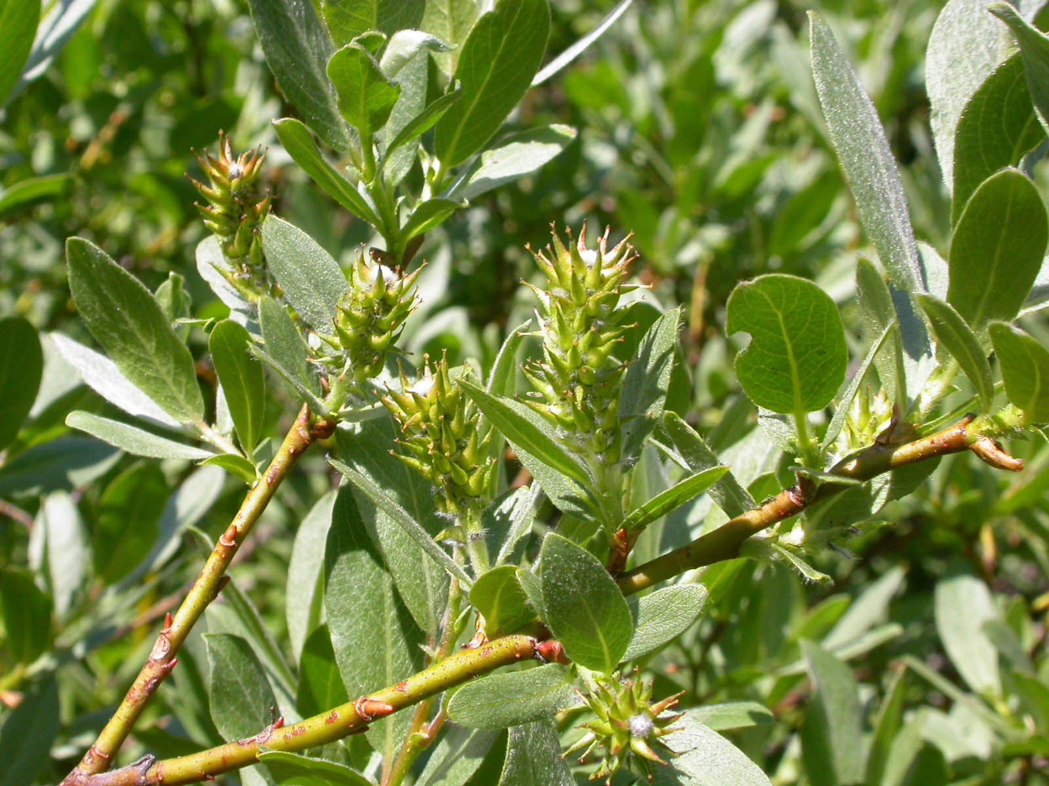
What Moose Eat & Don’t Eat
Moose selectively browse on birch, willows, and aspen.
Moose will not eat spruce.
willow leaves and fruits
spruce leaves and seed cones

Slide 50
Compare trees and their C:N
Willows, aspen, and birch have more nitrogen and less cellulose in their leaves than spruce.
Consequently, spruce will return fewer nutrients to the soil and decompose more slowly.

Slide 51
Isle Royale National Park
Because there are differences in the chemical composition of the plants moose do and do not eat, researchers wondered how could increased moose browsing will affect nutrient cycling in the ecosystem.
Abiotic Nutrient Pool
Consumers
Decomposers
Producers

Slide 52
Two Competing Hypotheses
Moose Pellets
Moose Herbivory depresses soil nutrient Levels
More Moose
Selective herbivory changes community
Decreased soil nutrients
Decreased productivity
Chemical changes in moose pellets

Slide 53
Two Competing Hypotheses
Moose Pellets
Moose herbivory Increases soil nutrient levels
More Moose
Increased herbivory
Increased soil nutrients
More moose pellets and increased light
Increased productivity
Notes:
Elk excrement, https://commons.wikimedia.org/wiki/File:Elk_excrement.jpg This file is licensed under the Creative Commons Attribution-Share Alike 2.0 Germany license.

Slide 54
Which Do You Think Is Correct?
Moose Herbivory depresses soil nutrient Levels
Moose herbivory Increases soil nutrient levels
More Moose
Selective herbivory changes community
Decreased soil nutrients
Decreased productivity
Chemical changes in moose pellets
More Moose
Increased herbivory
Increased soil nutrients
More moose pellets and increased light
Increased productivity
Notes:
Elk excrement, https://commons.wikimedia.org/wiki/File:Elk_excrement.jpg This file is licensed under the Creative Commons Attribution-Share Alike 2.0 Germany license.

Slide 55
What Do You Predict?
 | Na | K | Mg | Ca
High Browsing
Inside Fence
Outside Fence
Low Browsing
Inside Fence
Outside Fence

Slide 56
Results: Soil Nutrient Content
 | Na | K | Mg | Ca
High Browsing
Inside Fence | higher | higher | higher | no difference
Outside Fence | lower | lower | lower | no difference
Low Browsing
Inside Fence | no difference | no difference | no difference | no difference
Outside Fence | no difference | no difference | no difference | no difference
Notes:
Based on: Pastor, J., Dewey, B., Naiman, R. J., McInnes, P. F., & Cohen, Y. (1993). Moose browsing and soil fertility in the boreal forests of Isle Royale National Park. Ecology, 74(2), 467-480.

Slide 57
What Do You Predict?
 |  | Nitrogen |  |  | Carbon
 | Spring | Summer | Fall | Spring | Summer | Fall
High Browsing
Inside Fence
Outside Fence
Low Browsing
Inside Fence
Outside Fence

Slide 58
Results: Soil Nitrogen and Carbon
 |  | Nitrogen |  |  | Carbon
 | Spring | Summer | Fall | Spring | Summer | Fall
High Browsing
Inside Fence | No Difference | No Difference | Higher | No Difference | No Difference | No Difference
Outside Fence | No Difference | No Difference | Lower | No Difference | No Difference | No Difference
Low Browsing
Inside Fence | No Difference | No Difference | No Difference | No Difference | No Difference | No Difference
Outside Fence | No Difference | No Difference | No Difference | No Difference | No Difference | No Difference
Notes:
Based on: Pastor, J., Dewey, B., Naiman, R. J., McInnes, P. F., & Cohen, Y. (1993). Moose browsing and soil fertility in the boreal forests of Isle Royale National Park. Ecology, 74(2), 467-480.

Slide 59
Summary of Results
Nitrogen levels Mineralization
Higher inside exclosures in fall.
Differences only temporary
Other soil nutrients
Most are lower in areas with high browsing
Productivity
Higher inside exclosures.
Decreases with increased moose browsing.

Slide 60
Conclusion?
Selective Herbivory Hypothesis
Increased Fertilizer Hypothesis
More Moose
Selective herbivory changes community
Decreased soil nutrients
Decreased productivity
Chemical changes in moose pellets
More Moose
Increased herbivory
Increased soil nutrients
More moose pellets and increased light
Increased productivity

Slide 61
Conclusion!
Selective Herbivory Hypothesis
More Moose
Selective herbivory changes community
Decreased soil nutrients
Decreased productivity
Chemical changes in moose pellets
Any benefits from extra browsing and more moose pellets returning nutrients to the soil is offset by decreased nutrient availability caused by the increase in spruce.

Slide 62
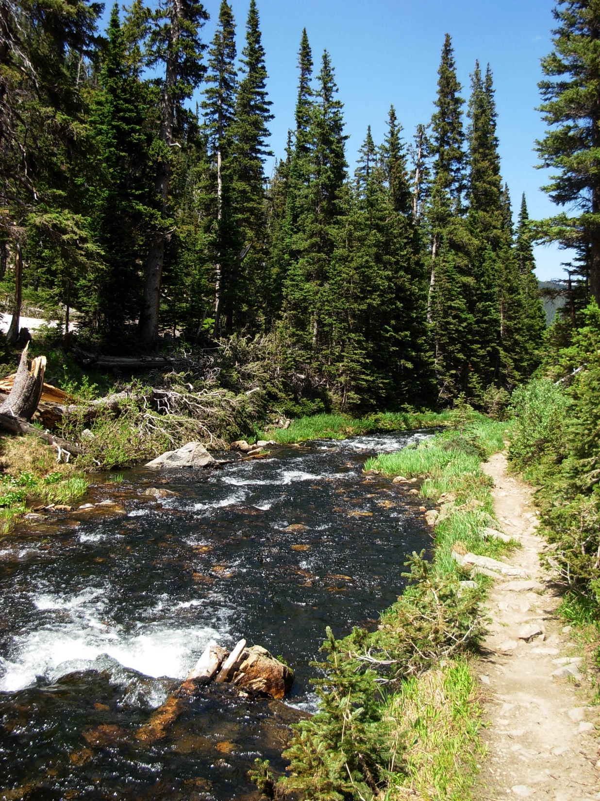
Linking Terrestrial and Aquatic Systems
Because browsers often eat species that grow along streams, researchers wondered whether terrestrial predator presence or absence could shape the physical features of aquatic systems.

Slide 63
Effects Of Predator Removal On Riparian Environments
Sort the items below to show how you would predict predator presence or absence should affect features of streams.
Apex Predator Present
Apex Predator Absent
Fewer grazing ungulates
Increased stream depth
Decreased bank erosion
Decreased woody vegetation along streams
More grazing ungulates
Decreased stream depth
Increased woody vegetation along streams
Decreased stream width
Increased stream width
Increased bank erosion

Slide 64
Effects Of Predator Removal On Riparian Environments
The items should be sorted into the groups shown below. Now, place the items into a sequence that shows a possible sequence of the consequences of predator removal.
Apex Predator Present
Apex Predator Absent
Increased stream depth
Increased woody vegetation along streams
Decreased stream depth
Increased stream width
Decreased bank erosion
Decreased stream width
Decreased woody vegetation along streams
More grazing ungulates
Fewer grazing ungulates
Increased bank erosion

Slide 65
Effects Of Predator Removal On Riparian Environments
Decreased bank erosion
Increased stream depth
Decreased stream width
Apex predator present
Fewer grazing ungulates
Decreased stream depth
Increased stream width
Increased bank erosion
More grazing ungulates
Apex predator absent
Increased woody stream vegetation
Decreased woody stream vegetation

Slide 66
Summary

Slide 67
Summary and Conclusions
Trophic Cascade Theory unifies the many different interacting parts of environment. It explains relationships in processes from the chemical to the ecosystem.
Although marine and terrestrial systems are different in their species composition and physical environment, they operate according to the same fundamental principles
Predators
Prey
Ecosystem Changes
Biotic environment
Abiotic environment
Producers
Reduce producer
Regulate prey populations
Support prey populations
Link different parts of the ecosystem
Support predator populations

Slide 68
Trophic Cascade Model Summary
Studies investigating different aquatic and terrestrial systems have demonstrated that removing apex predators can cause changes throughout the ecosystem through direct and indirect effects.
Predators Removed
Decreased Predation
Prey Populations Increase
Increased Herbivory
Producer Populations Change
Species preferred by herbivores decrease
Species avoided by herbivores increase
Ecosystem
Nutrient cycles change
Biodiversity changes
Habitats change
Feedback throughout system

Slide 69
Terrestrial Trophic Cascade Model Summary
Predators
Ungulate Prey
Ecosystem Changes
Biotic environment
Abiotic environment
Plants
Reduce plant populations
Regulate prey populations
Support prey populations
Link different parts of the ecosystem
Support predator populations

Slide 70
Terrestrial Trophic Cascade Model Summary
Predators
Ungulate Prey
Ecosystem Changes
Biotic environment
Abiotic environment
Plants
Reduce plant populations
Regulate prey populations
Support prey populations
Link different parts of the ecosystem
Support predator populations
Predators Removed
Decreased Predation
Ungulate Prey Populations Increase
Increased Herbivory
Plant Populations Change
Species preferred by herbivores decrease
Species avoided by herbivores increase
Ecosystem
Nutrient cycles change
Loss of species
Terrestrial habitats change
Increased invasive species
Aquatic habitats change

Slide 71
Community Composition Influences Nutrient Cycles
Number of Predators
What Herbivore Eats
Available Plants
Composition of Herbivore Feces
Number of Herbivores
Nutrient Availability & Fluxes
Fungi & Bacterial Community
Number & Type of Available Plants

Slide 72
Changes in Riparian Systems
These studies show how trophic cascades that alter the terrestrial riparian habitat can also affect the neighboring aquatic environment and have consequences for the ecological functioning of the larger watershed.
Altered Stream Flow
Water Temperature
Nutrient Fluxes
Dissolved Oxygen
Stream Community

Slide 73
The End

Slide 74
Resources
Beschta, R. L., & Ripple, W. J. (2009). Large predators and trophic cascades in terrestrial ecosystems of the western United States. Biological Conservation, 142(11), 2401-2414.
Pastor, J., Dewey, B., Naiman, R. J., McInnes, P. F., & Cohen, Y. (1993). Moose browsing and soil fertility in the boreal forests of Isle Royale National Park. Ecology, 74(2), 467-480.
Ripple, W. J., Larsen, E. J., Renkin, R. A., & Smith, D. W. (2001). Trophic cascades among wolves, elk and aspen on Yellowstone National Park’s northern range. Biological conservation, 102(3), 227-234.
Ripple, W. J., & Beschta, R. L. (2006). Linking a cougar decline, trophic cascade, and catastrophic regime shift in Zion National Park. Biological Conservation, 133(4), 397-408.
Ripple, W. J., & Beschta, R. L. (2007). Restoring Yellowstone’s aspen with wolves. Biological Conservation, 138(3), 514-519.
Ripple, W. J., & Beschta, R. L. (2012). Trophic cascades in Yellowstone: The first 15 years after wolf reintroduction. Biological Conservation, 145(1), 205-213.

Slide 75
Image Credits
SLIDE 14
Sea-otter-morro-bay 13.jpg https://commons.wikimedia.org/wiki/File:Sea-otter-morro-bay_13.jpg Attribution: "Mike" Michael L. Baird This file is licensed under the Creative Commons Attribution 2.0 Generic license.
Starfish Image from Public domain images websiTEhttp://www.public-domain-image.com/full-image/fauna-animals-public-domain-images-pictures/fishes-public-domain-images-pictures/starfish.jpg.html
SLIDE 19
Yosemite Valley, Yosemite National Park, California, USA. https://commons.wikimedia.org/wiki/File:YosemitePark2_amk.jpg This file is licensed under the Creative Commons Attribution-Share Alike 2.5 Generic license.
SLIDE 20
Skull pile, Public Domain, https://en.wikipedia.org/wiki/Bison#/media/File:Bison_skull_pile_edit.jpg
American Bison https://commons.wikimedia.org/wiki/File:American_Bison_(Yellowstone).jpg This file is licensed under the Creative Commons Attribution-Share Alike 3.0 Unported license.
SLIDE 21
Part of the Wind Cave bison herd photographed in 2003. https://commons.wikimedia.org/wiki/File:Wind_Cave_bison_herd_2003.jpg, This file is licensed under the Creative Commons Attribution-Share Alike 3.0 Unported license.
SLIDE 22
Subalpine Fir and Quaking Aspen trees along the Jarbidge River TrailSouth ofSawmill Creek in Nevada.jpg https://commons.wikimedia.org/wiki/File:2013-08-09_08_54_52_Subalpine_Fir_and_Quaking_Aspen_trees_along_the_Jarbidge_River_Trail_south_of_Sawmill_Creek_in_Nevada.jpg Attribution: FAMartin. This file is licensed under the Creative Commons Attribution-Share Alike 3.0 Unported license.
SLIDE 23:
100 pound wolf killed in Montana in 1928 in Highwood Mountains, east of Great Falls, Public Domain, Montana https://commons.wikimedia.org/wiki/File:Montana_wolf_100_lbs_1928_Young_%26_Goldman_USFWS.jpg
Market hunting of cougars, Public Domain, https://commons.wikimedia.org/wiki/File:Market_hunting_of_cougars.jpg
SLIDE 25, 28, 29, & 30:
Mountain lion lounging in a cottonwood tree during the heat of the day.,
https://commons.wikimedia.org/wiki/File:8th_Place_-_Mountain_Lion_(7487178290).jpg This file is licensed under the Creative Commons Attribution 2.0 Generic license. USFWS
A male moose takes a rest in a field during a light rainshower. Public Domain, https://commons.wikimedia.org/wiki/File:Male_Moose.jpg
This file is licensed under the Creative Commons Attribution-Share Alike 2.0 Generic license.
Gray Wolf Canis lupus at Seney National Wildlife Refuge, Michigan. This file is licensed under the Creative Commons Attribution-Share Alike 2.0 Generic license.
https://commons.wikimedia.org/wiki/File:Gray_Wolf_Seney_NWR_2.jpg
An Elk poses for the camera https://commons.wikimedia.org/wiki/File:An_Elk_poses_for_the_camera_(9317643508).jpg This file is licensed under the Creative Commons Attribution-Share Alike 2.0 Generic license.
Often of montane riparianSettings,Salix lemmonii canSometimes form pureStands. https://commons.wikimedia.org/wiki/File:Salix_lemmonii_(5027508048).jpg This file is licensed under the Creative Commons Attribution-Share Alike 2.0 Generic license.
Populus tremuloides foliage. https://commons.wikimedia.org/wiki/File:Populus_tremuloides_leaves_RMP.jpg Attribution: Howard F.Schwartz, ColoradoState University, USA. This file is licensed under the Creative Commons Attribution 3.0 UnitedStates license.

Slide 76
Image Credits
SLIDE 26 & 31
Aspen with browsing scars. Copyright J. Phil Gibson
SLIDE 27
Populus deltoides subsp. monilifera female catkin https://commons.wikimedia.org/wiki/File:Populus_deltoides_subsp_monilifera_1.jpg This file is licensed under the Creative Commons Attribution-Share Alike 3.0 Unported license.
SLIDE 32, 33, & 34
Small stand of trees-1. Small stand of trees-2. Copyright J. Phil Gibson
SLIDE 35, 36, & 37
Young deer at RMNP. Copyright J. Phil Gibson
SLIDE 44
Mountain Stream at Indian Peaks Wilderness. Copyright J. Phil Gibson
SLIDE 55
Mitchell Lake 1. Copyright J. Phil Gibson
SLIDE 59
Browsing moose. Copyright J. Phil Gibson
Salix wolfii Matt Lavin from Bozeman, Montana, USA. https://commons.wikimedia.org/wiki/File:Salix_wolfii_(5027699626).jpg This file is licensed under the Creative Commons Attribution-Share Alike 2.0 Generic license.
Young cones of Picea pungens — Colorado BlueSpruce. https://en.wikipedia.org/wiki/Blue_spruce#/media/File:Picea_Pungens_Young_Cones.jpg Attribution: JJ Harrison. This file is licensed under the Creative Commons Attribution-Share Alike 3.0 Unported license.
SLIDE 60
Browsing moose. Copyright J. Phil Gibson
SLIDE 62 & 63:
Elk excrement, https://commons.wikimedia.org/wiki/File:Elk_excrement.jpg This file is licensed under the Creative Commons Attribution-Share Alike 2.0 Germany license.
SLIDE 72
Montane trail. Copyright J. Phil Gibson
SLIDE 77:
USFWS Mountain-Prairie - A Pair on the Prowl https://commons.wikimedia.org/wiki/Category:Cervus_canadensis#/media/File:A_Pair_on_the_Prowl_(12396301355).jpg This file is licensed under the Creative Commons Attribution 2.0 Generic license.
SLIDE 89
Headin’ out. Copyright J. Phil Gibson

