Slide 1
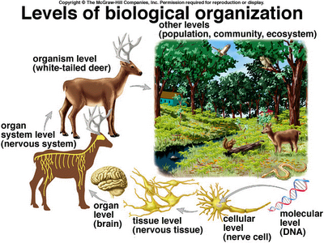
Biological organization is hierarchical, from the molecule to the organism to the biosphere

Slide 3
Thinking Big Picture:
How Does Life Work?
Meet your neighbors and fill out your card
Examine your case and the associated data to figure out how the pathway works
Name and year
Course of study/path you are considering
Something I do for fun is……..
The highlight of my summer was……

Slide 4
Thinking Big Picture:
How Does Life Work?
Regroup by number
Explain your system and figure to your other group members. Do you agree with the pathway sketched by the group and the interactions identified?
How do the regulatory scales differ across your groups?
What are the common themes in your pathways?

Slide 5
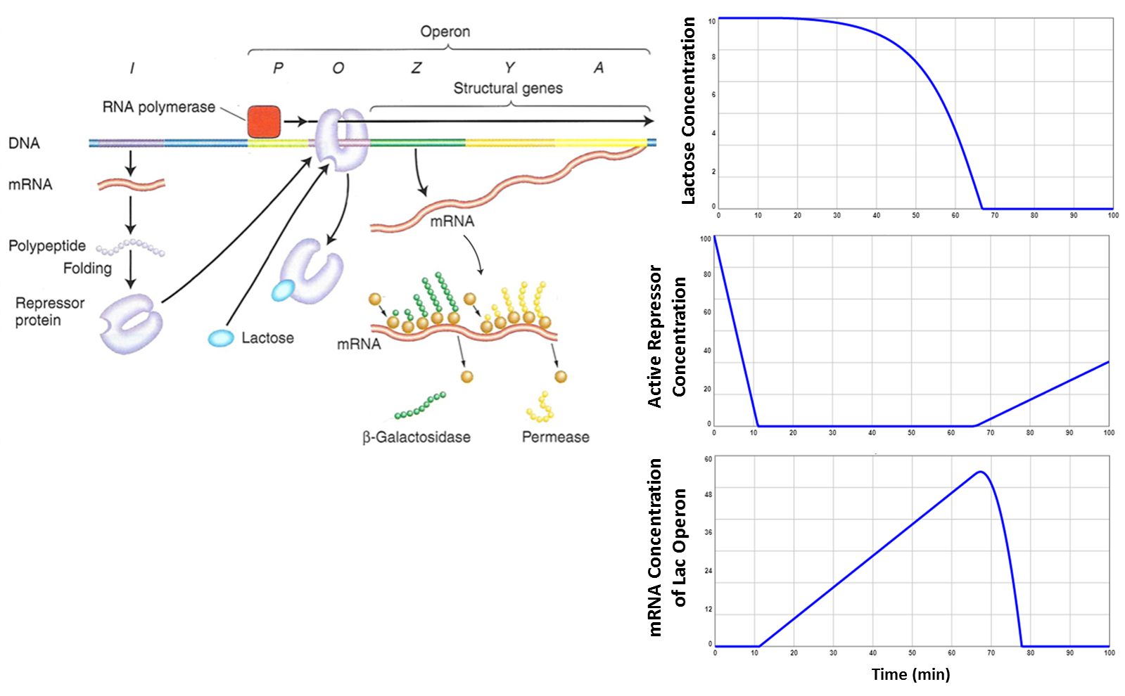

Slide 6
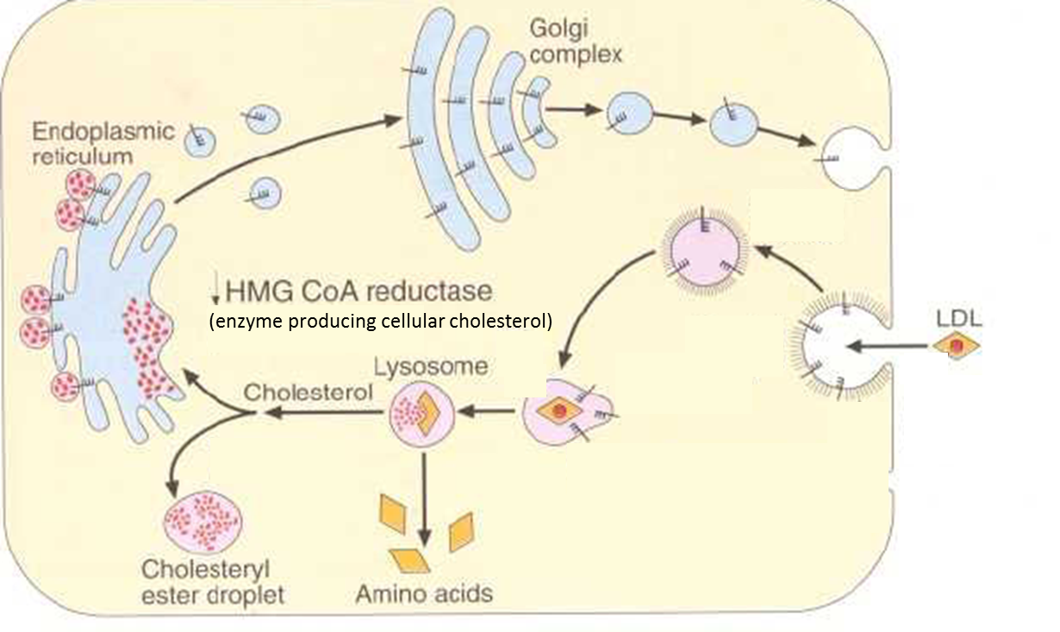
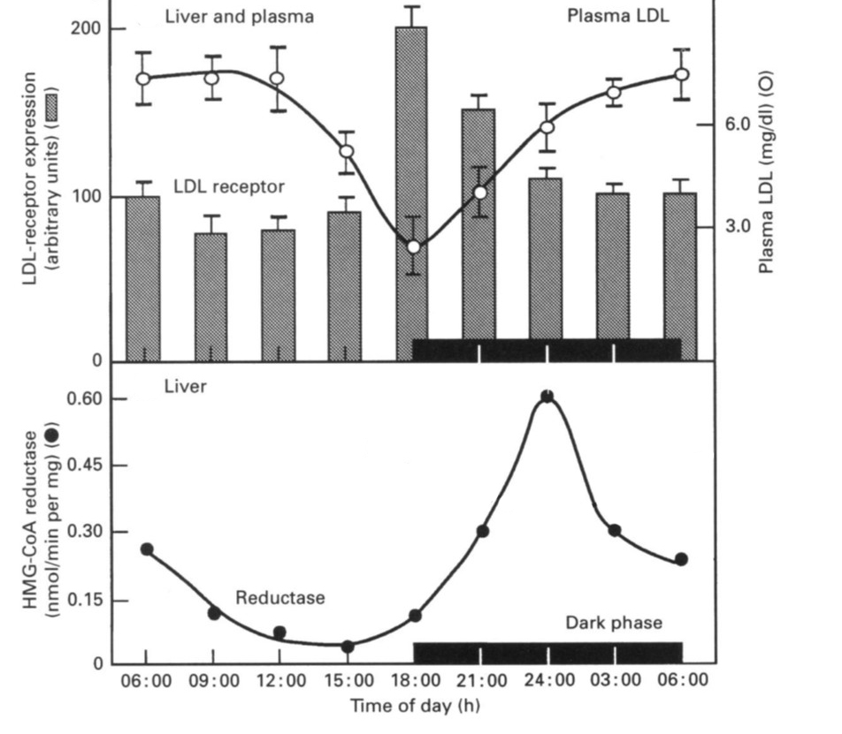
Notes:
How do Statins act?

Slide 7
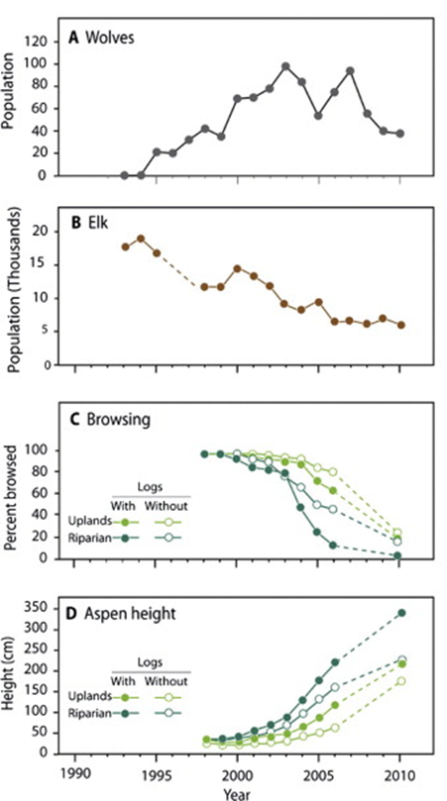
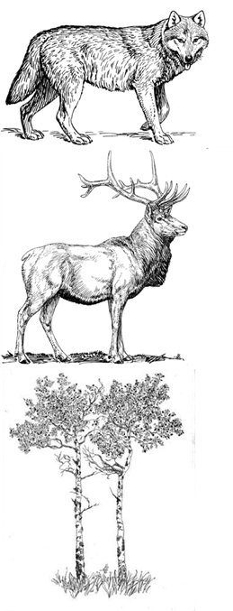

Slide 8
Thinking Big Picture:
How Does Life Work?
Notes:
Negative regulation: repressor, predation
Positive regulation: activator, enrichment

Slide 9
Thinking Big Picture:
How Does Life Work?

Slide 10
Thinking Big Picture:
How Does Life Work?
All of these systems were foundational to our understanding of regulation
  Lac operon held the key to understanding enzyme regulation
Notes:
Jacques Monod started working on bacterial growth in the 1940s, and was interrupted by the invasion of France in WW2. He continued his work, but served as a commander in the French Resistance movement. He teamed up with a geneticist in 1957 named Francois Jacob and cracked lactose synthesis in 1961.

Slide 11
Thinking Big Picture:
How Does Life Work?
Monod and Jacob described life in cells as a “society of macromolecules bound together by a complex system of communications regulating both their synthesis and activity.”
“It seems very unlikely that the main mechanism recognized in lower forms: allosteric inhibition, induction and repression, should not also be used in differentiated organisms.”
It is a “well-known axiom that anything found to be true of E. coli must be true of elephants”

Slide 12
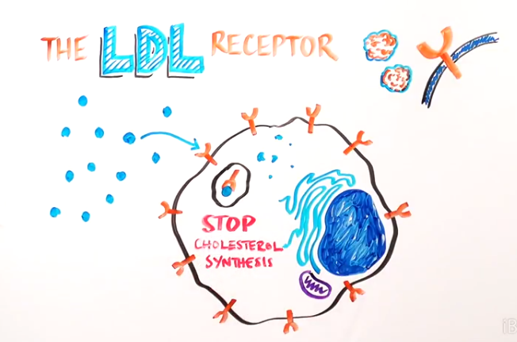
Thinking Big Picture:
How Does Life Work?
All of these systems were foundational to our understanding of regulation
  The LDL receptor was the first example of receptor-mediated endocytosis

Slide 13
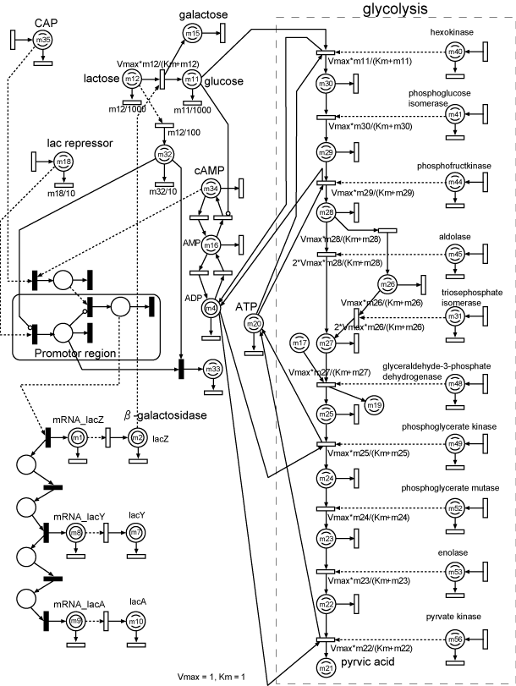
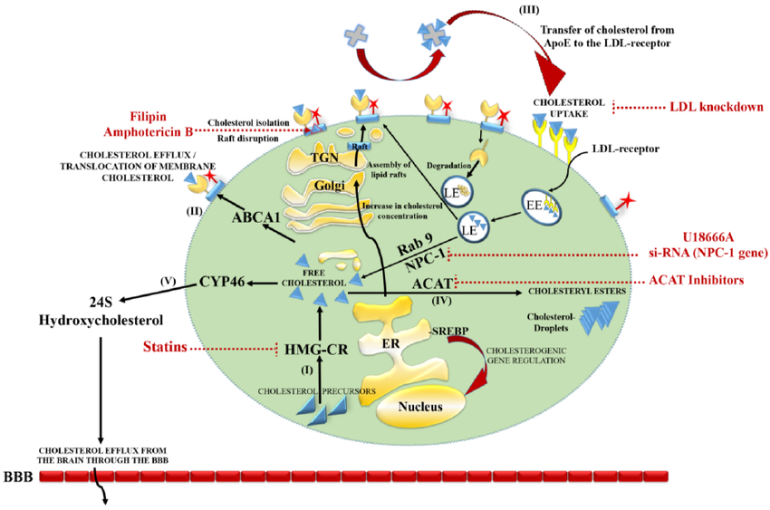
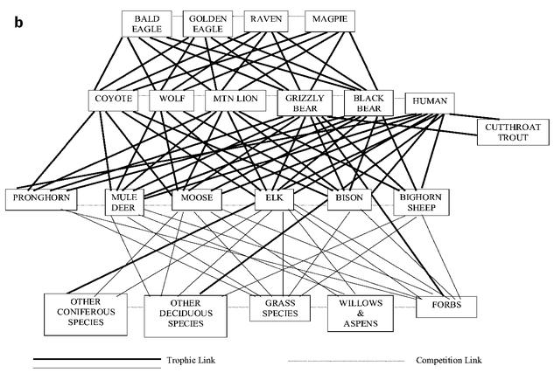
Cholesterol metabolism
Interacting species in the Yellowstone Ecosystem
HFPN modeling of the glycolytic pathway and lac operon gene regulatory mechanism of E. coli
Notes:
A HFPN modeling of the glycolytic pathway and lac operon gene regulatory mechanism of E. coli.
http://www.csml.org/models/csml-models/glycolytic-pathway-and-lac-operon-of-e-coli/
https://www.researchgate.net/publication/268788043_Cholesterol_Balance_in_Prion_Diseases_and_Alzheimer%27s_Disease
Douglas W. Smith, Rolf O. Peterson, Douglas B. Houston; Yellowstone after Wolves, BioScience, Volume 53, Issue 4, 1 April 2003, Pages 330–340, https://doi.org/10.1641/0006-3568(2003)053[0330:YAW]2.0.CO;2
https://academic.oup.com/bioscience/article/53/4/330/250155

