Slide 1
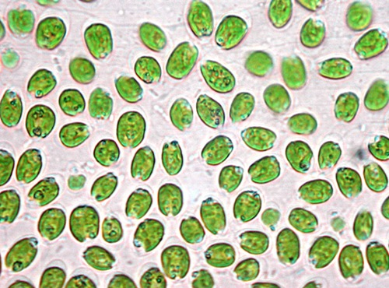
Algae

Slide 2
Moss
Liverwort

Slide 3
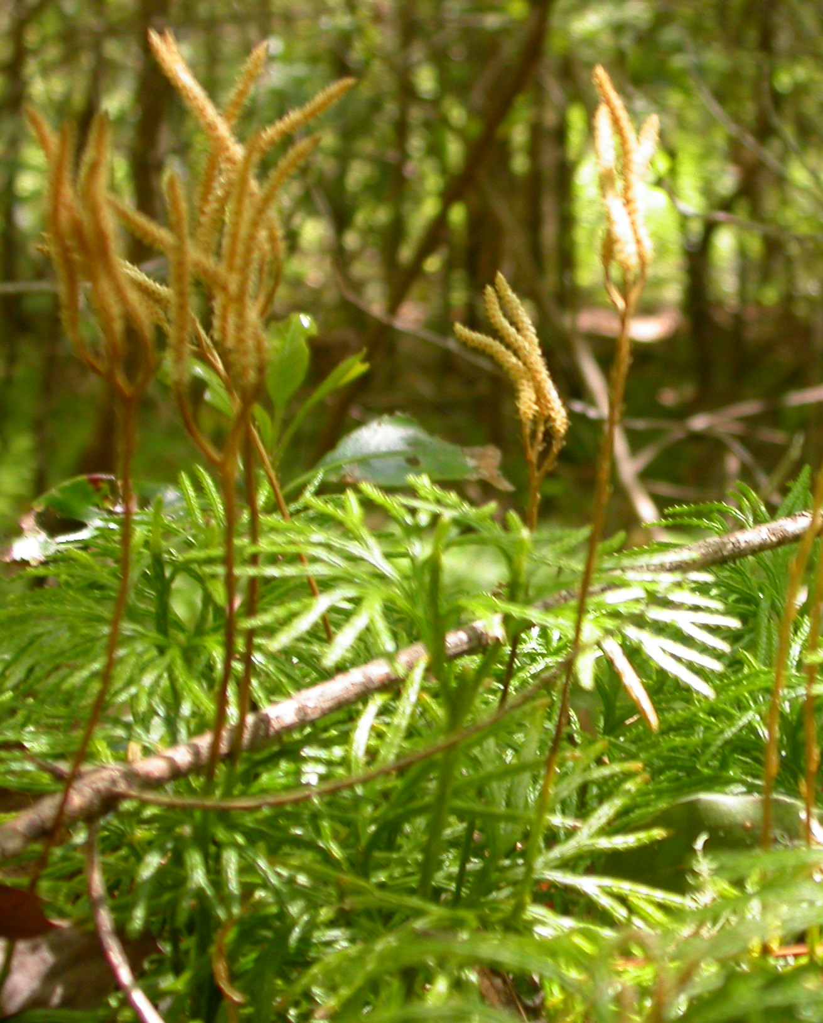
Fern
Club Moss

Slide 4
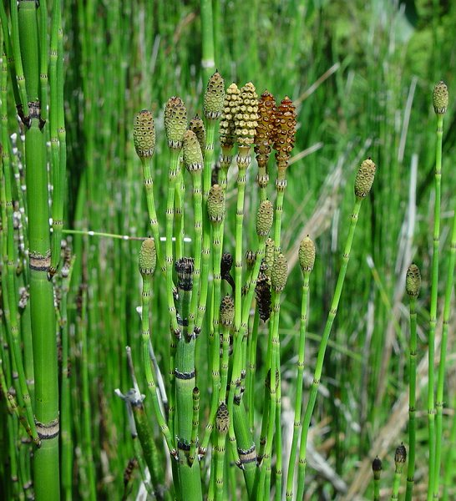
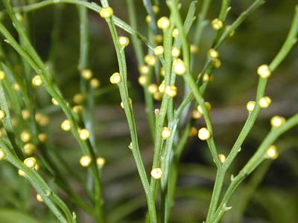
Horsetail
Whisk Fern

Slide 5
Red Cedar
Engelmann Spruce

Slide 6
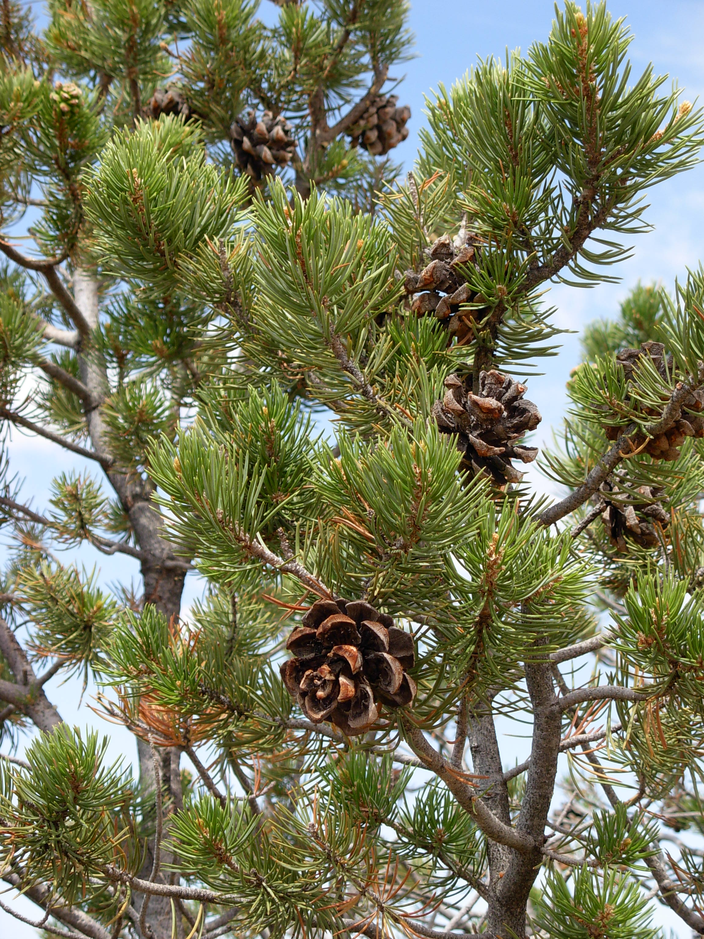
Ephedra
Piñon Pine

Slide 7
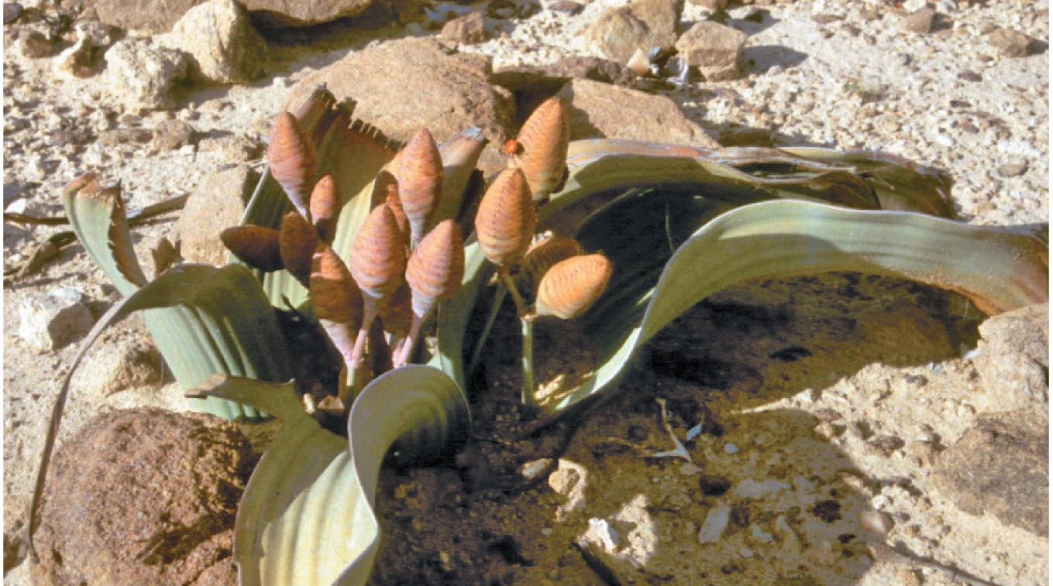
Douglas Fir
Welwitschia

Slide 8
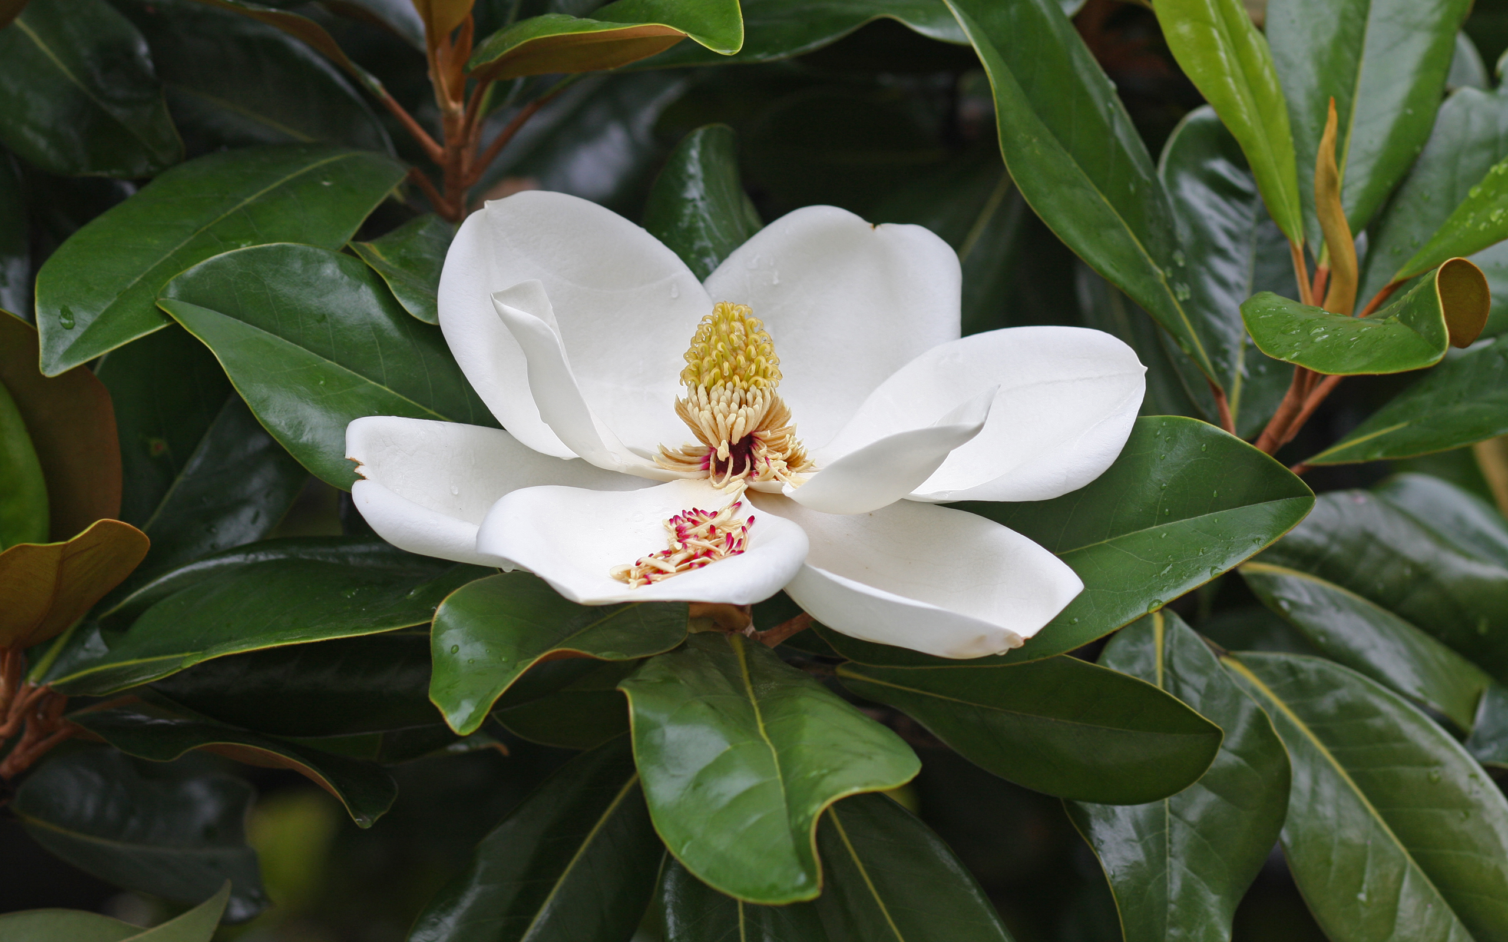
Spice Bush
Magnolia

Slide 9
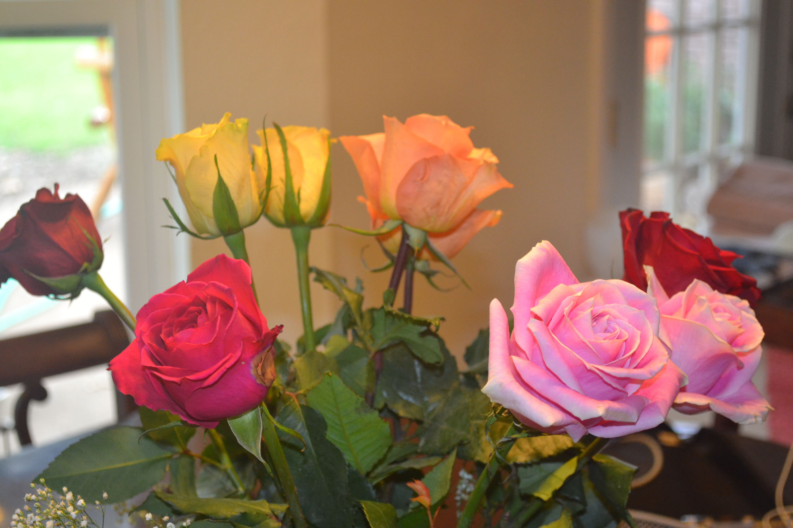
Cactus
Rose

Slide 10
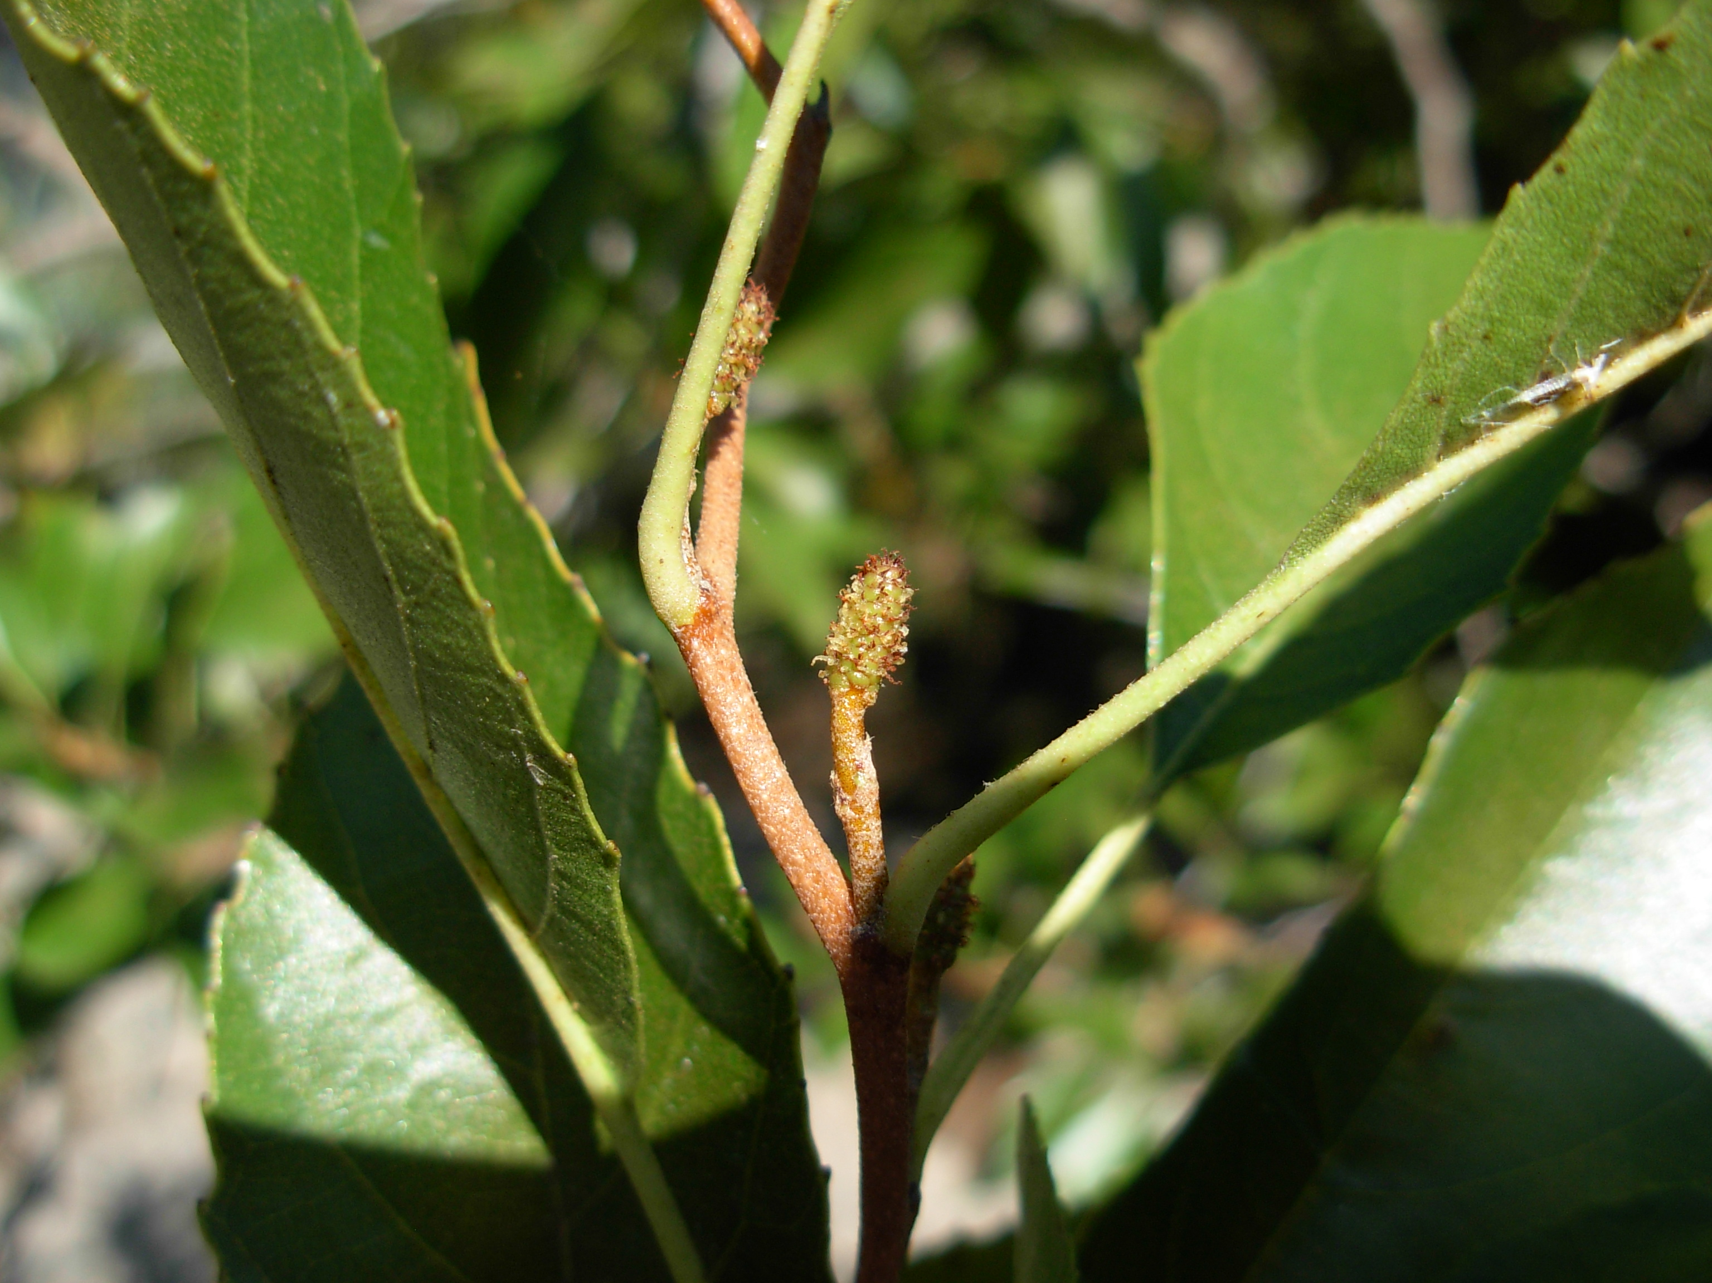
Columbine
Seaside Alder

Slide 11
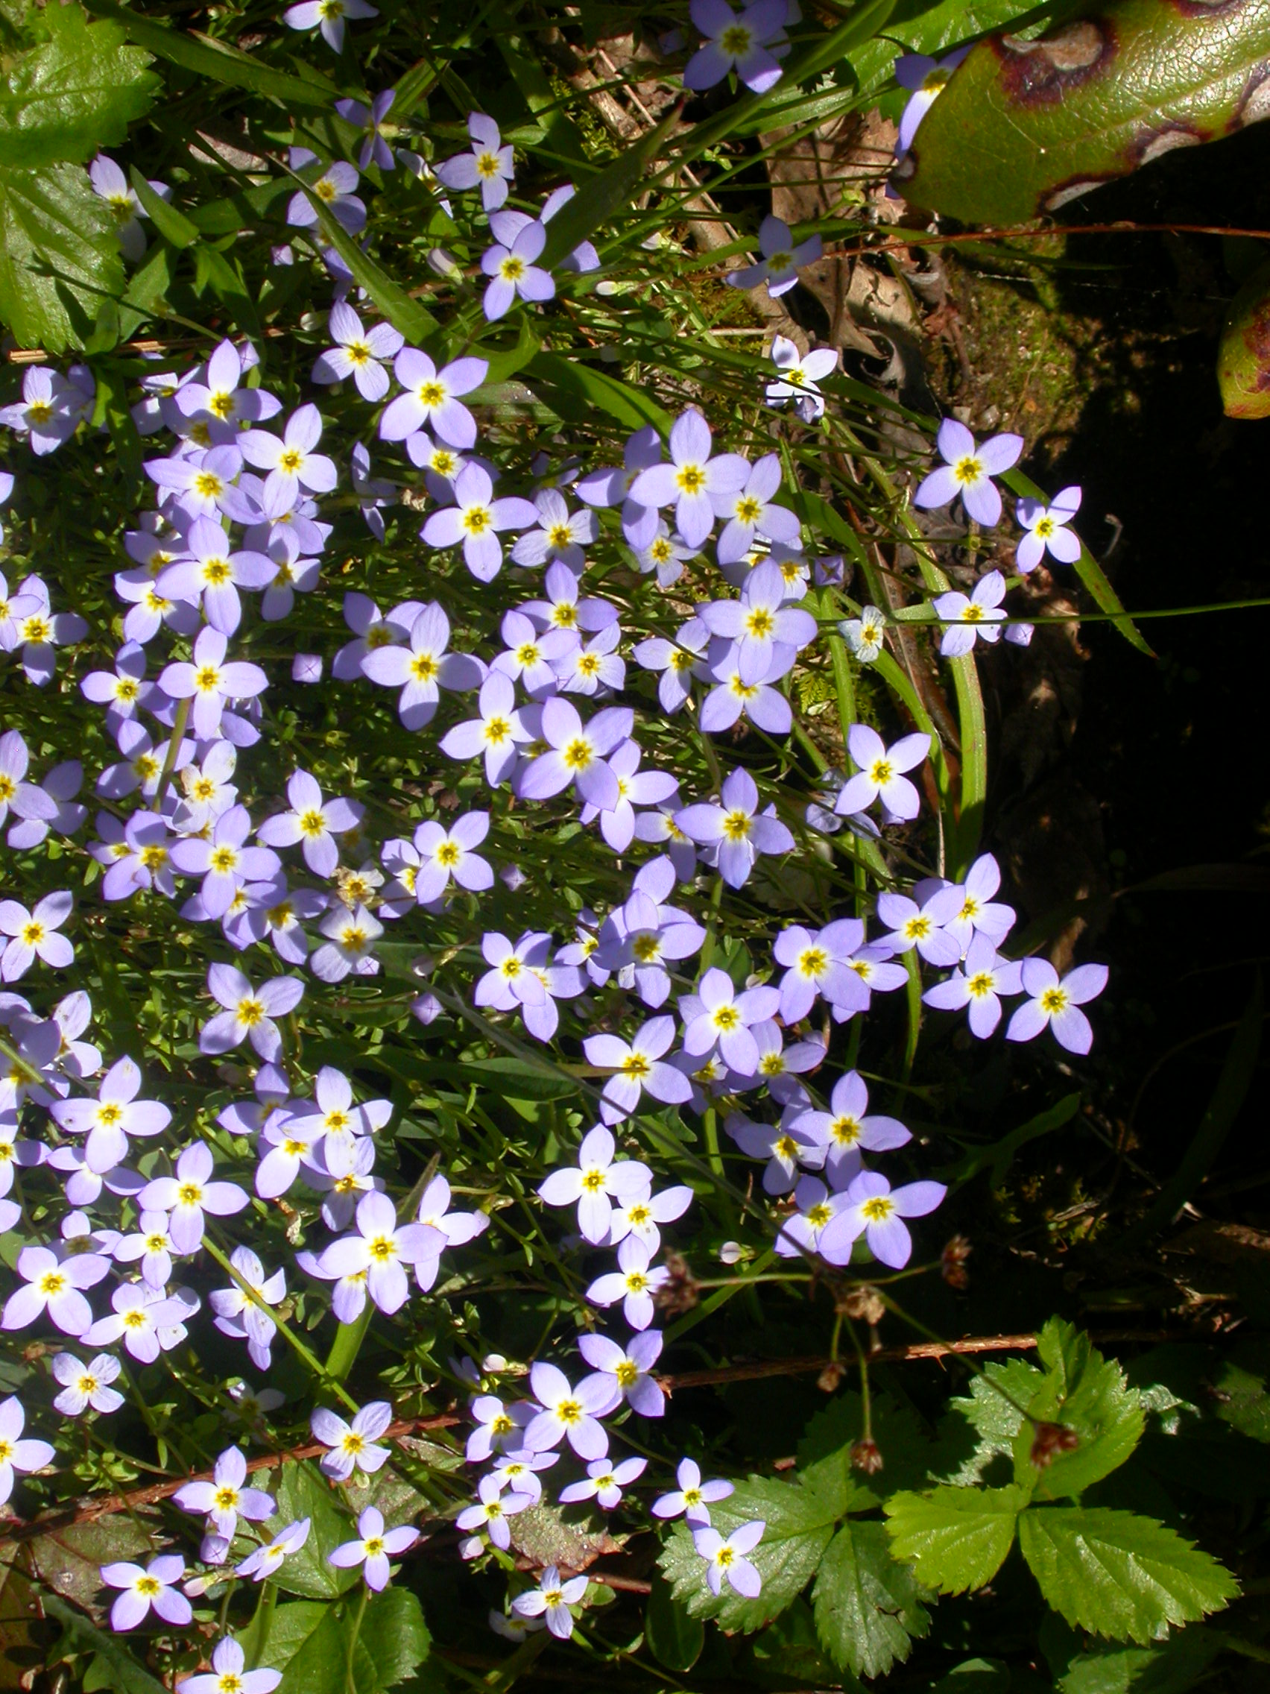
Sunflower
Bluets

Slide 12
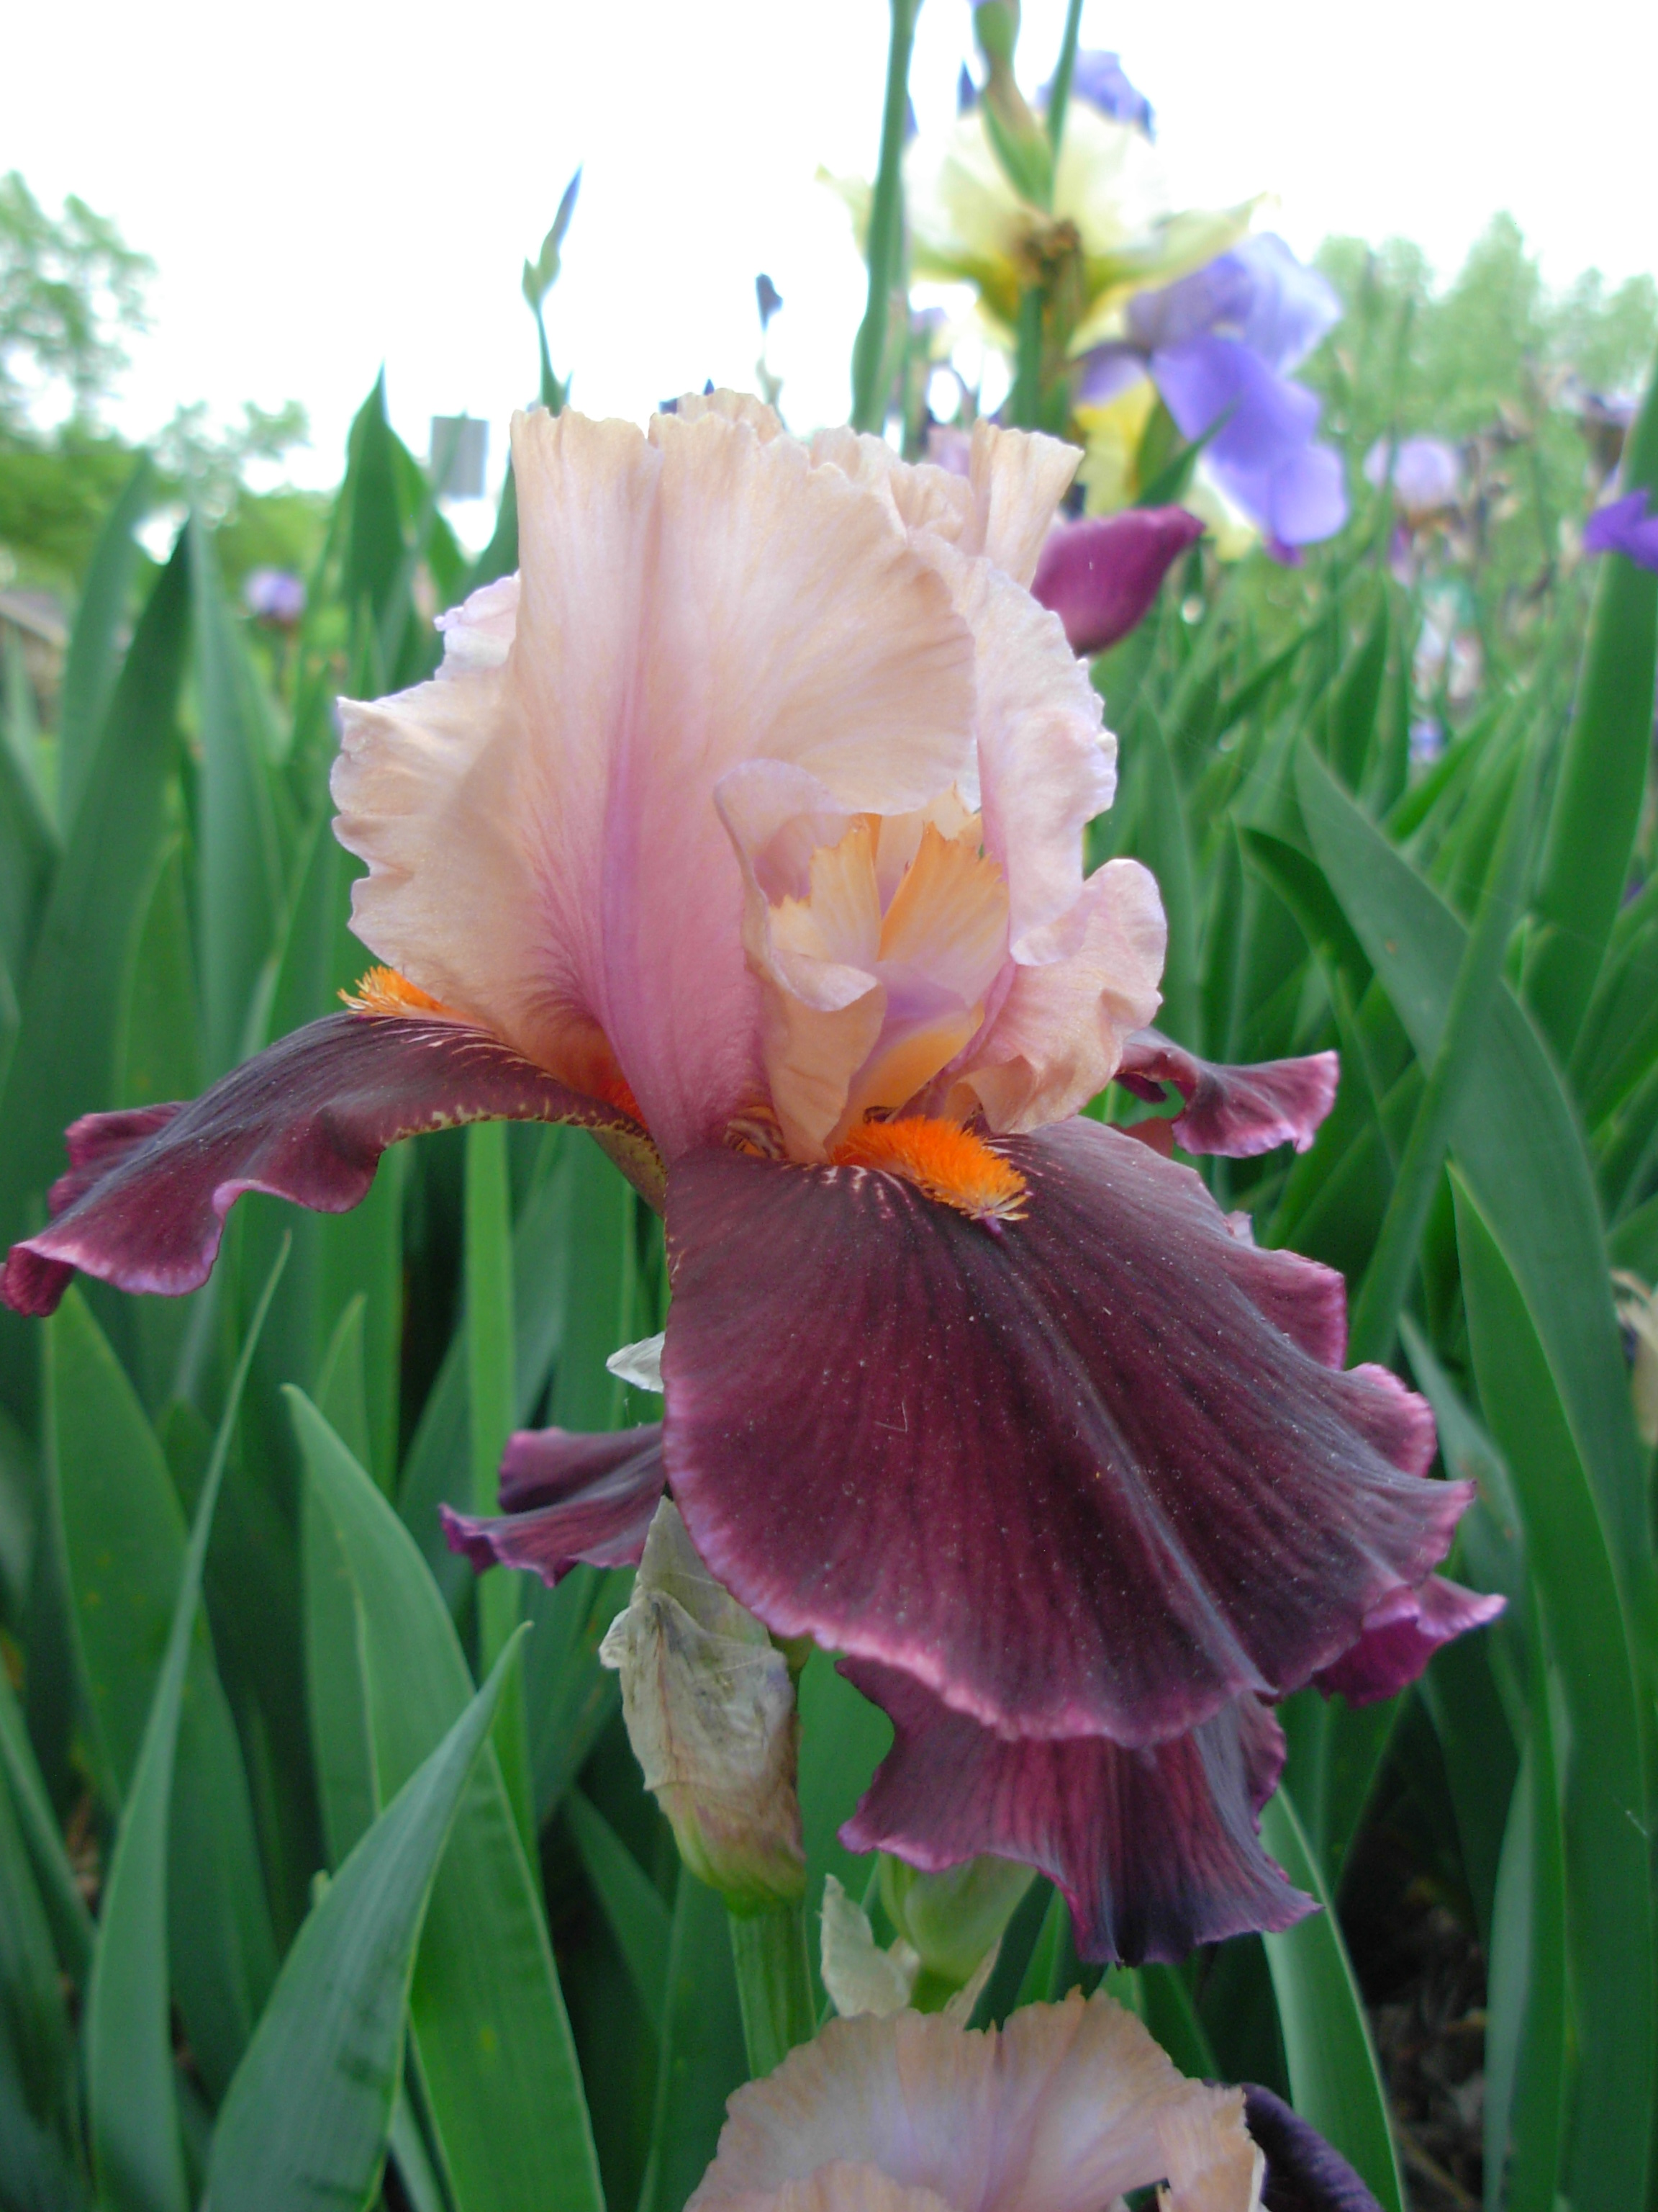
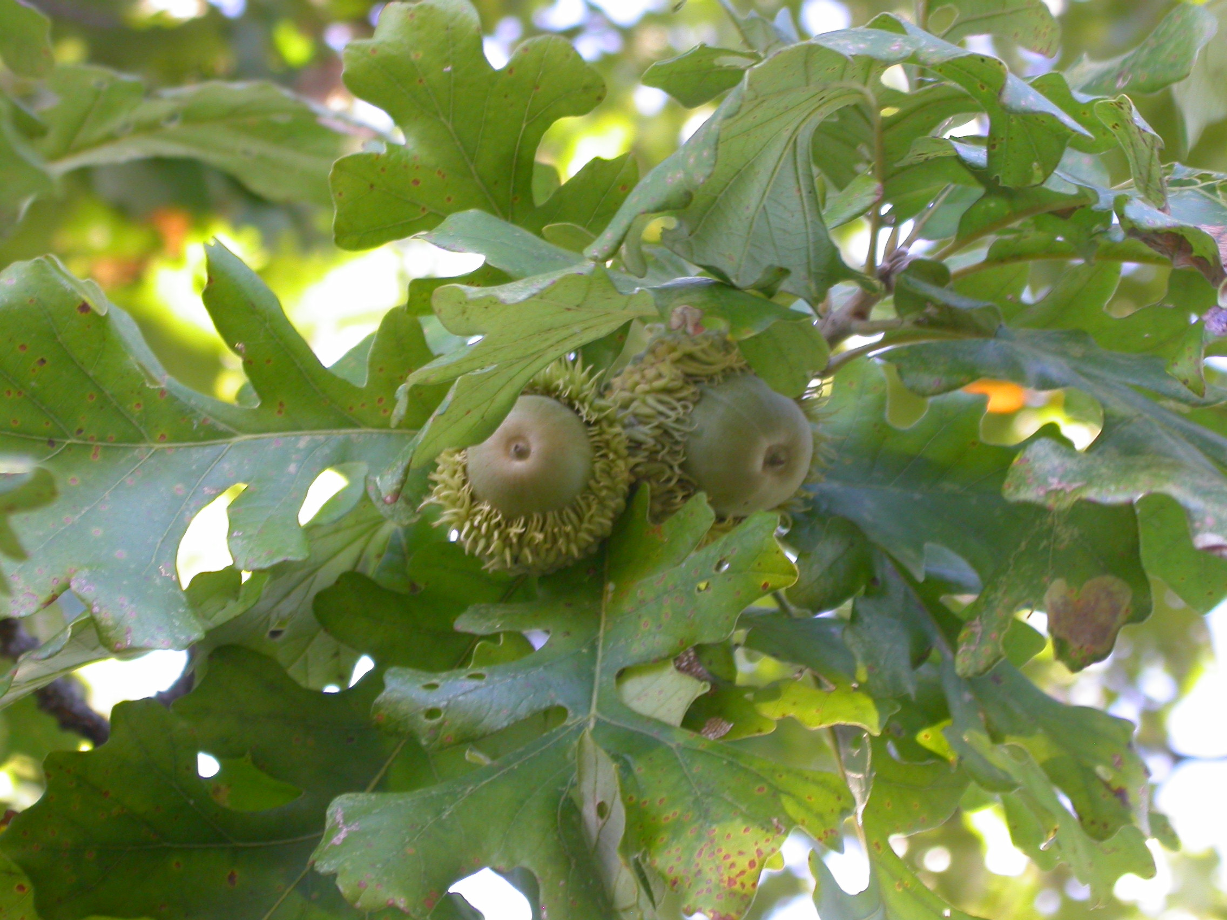
Iris
Oak

Slide 13
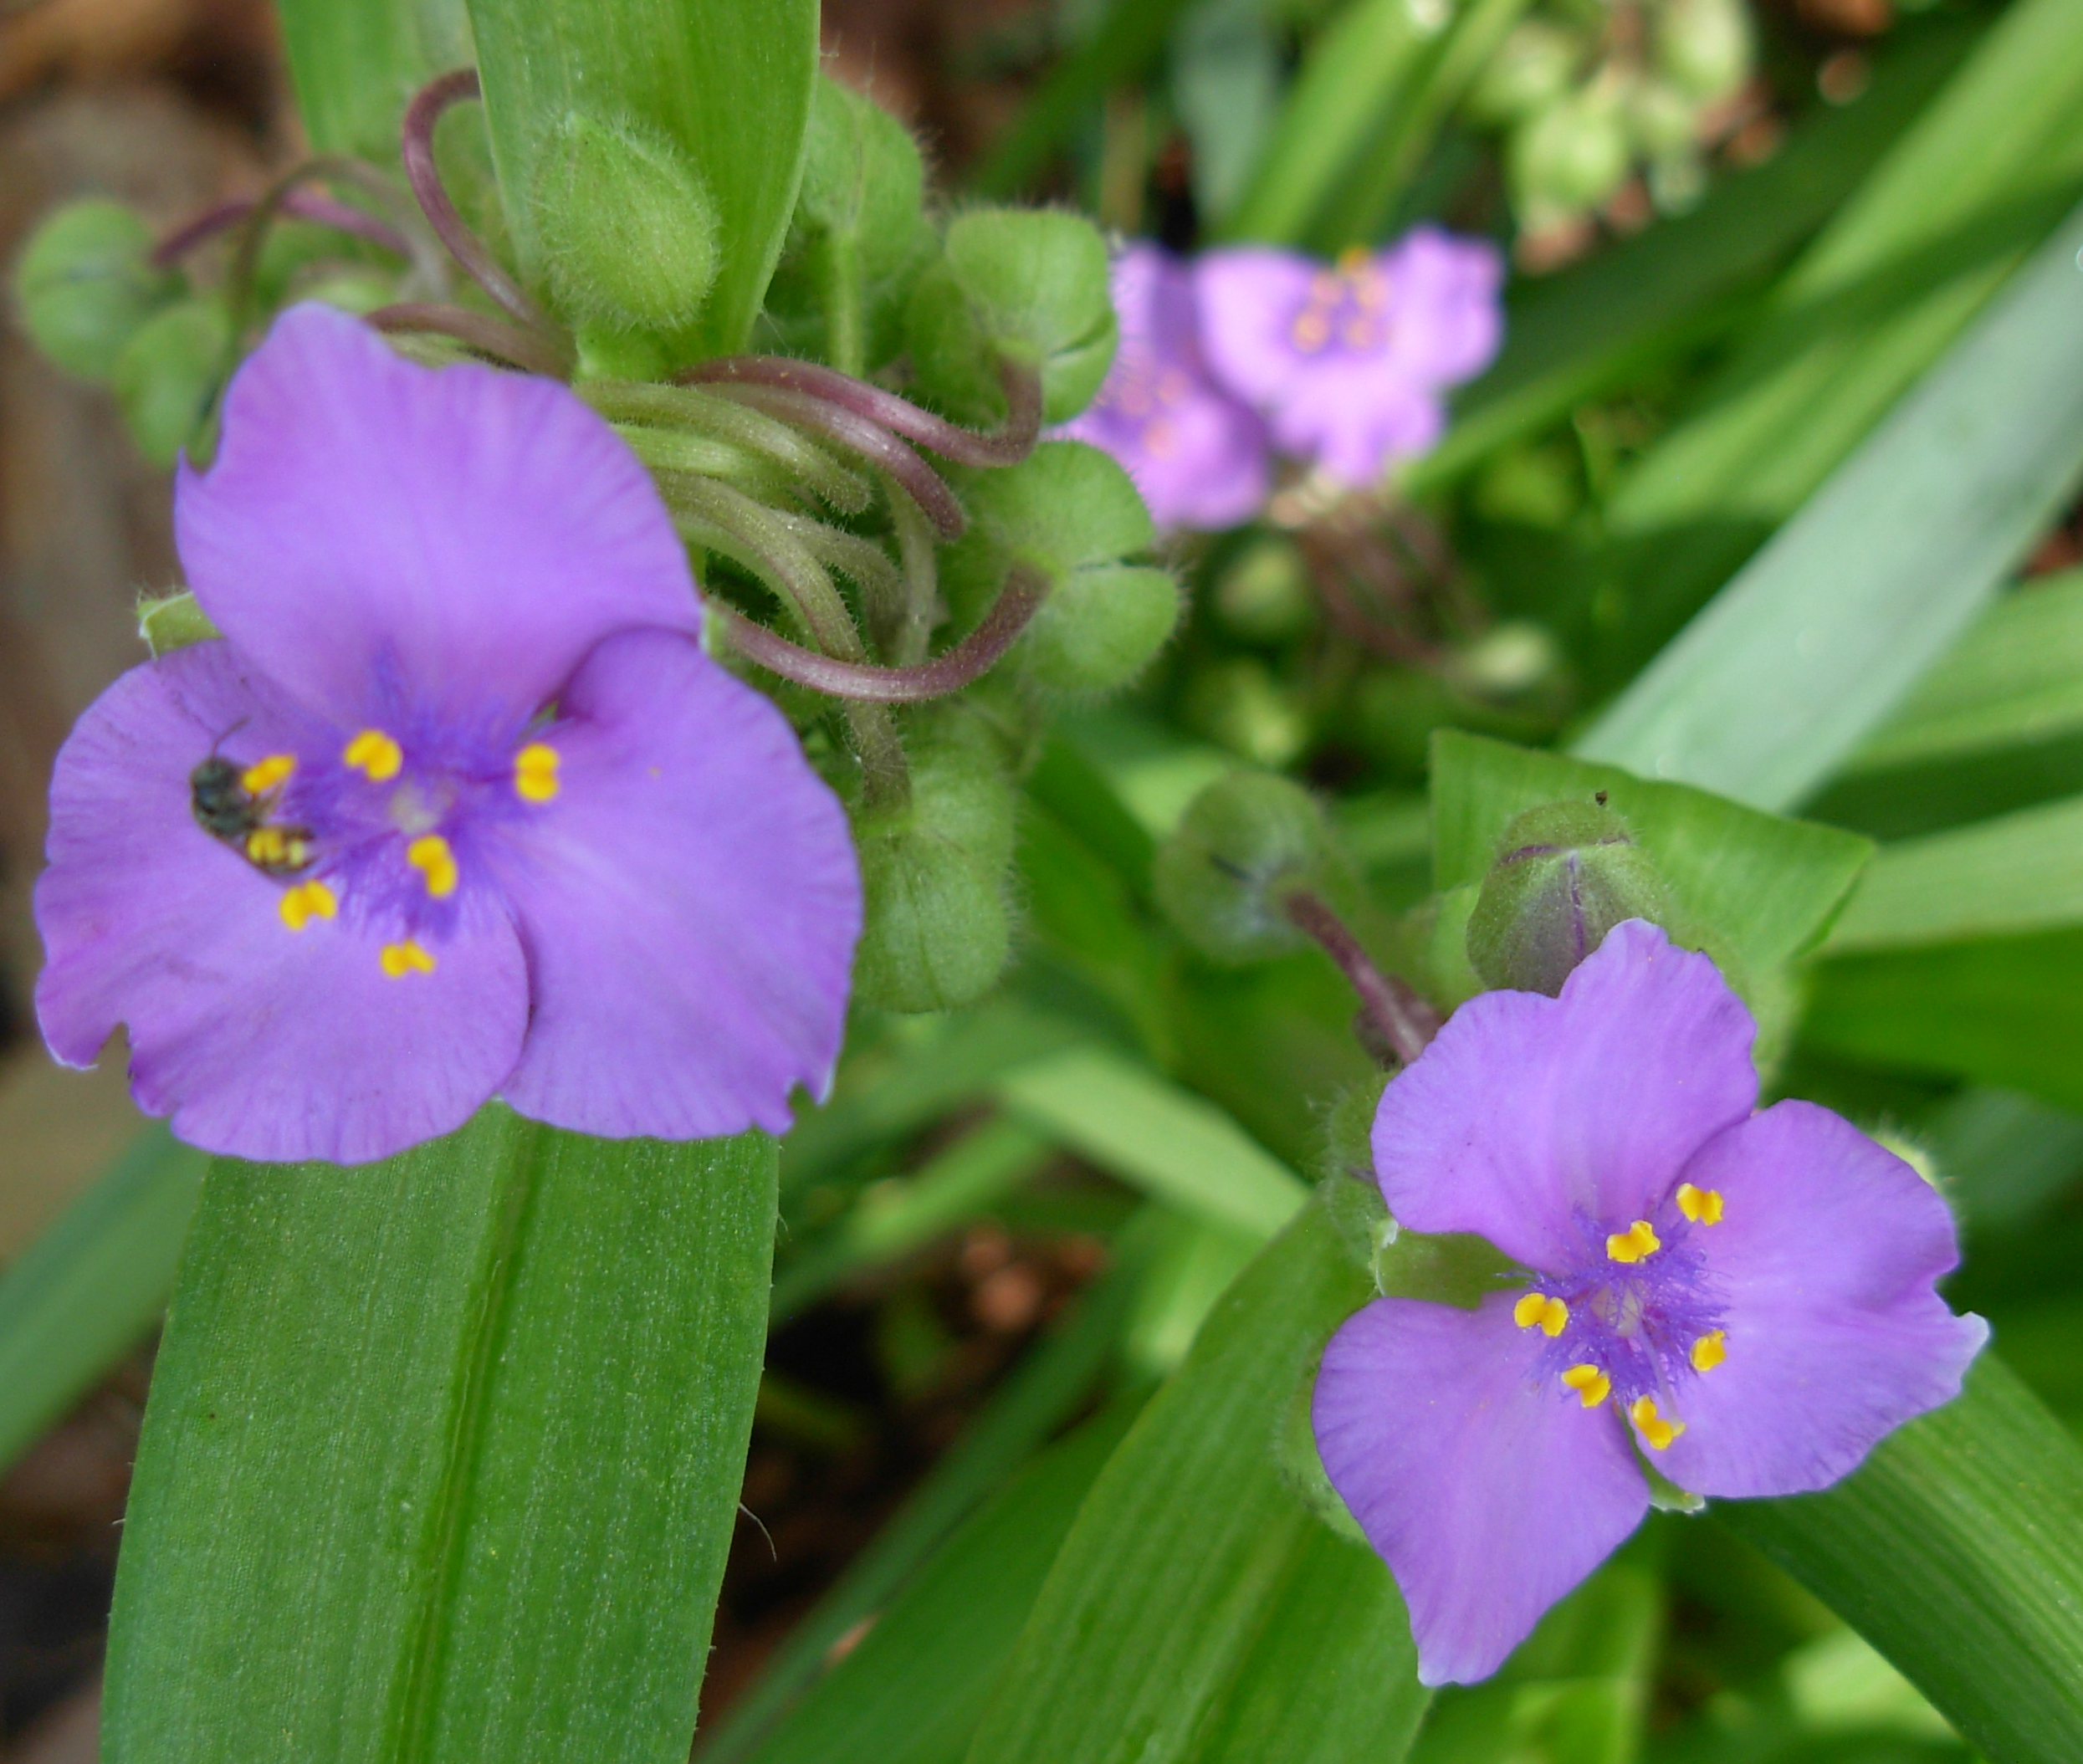
Coconut Palm
Spiderwort

Slide 14
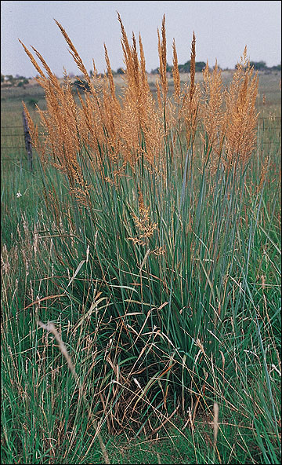
Corn
Indian Grass

