Slide 1
Acknowledgments:
Melissa Csikari
Kristine Grayson
Rebecca Orr
Sat Amagai
1
of 10

Slide 2
Ecology: Exploring Trophic Cascades with Rice
Brian Shmaefsky, Emily Nodine, Fernando Nieto, Kiersten Newtoff
Ecosystem and community level
“Exploring Trophic Cascades” click & learn on HHMI BioInteractive
Tie into food chains or agriculture
2
of 10

Slide 3
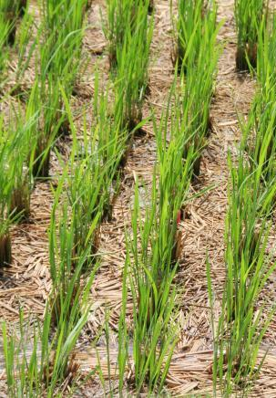
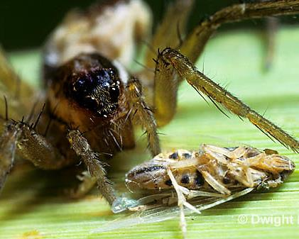
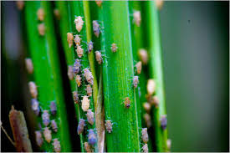
Ecology: Exploring Trophic Cascades with Rice
Pesticide resistance
Predator decline
GMOs & cultivars
Impact of fertilizer
3
of 10

Slide 4
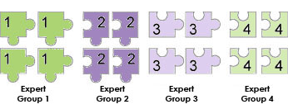
Ecology: Exploring Trophic Cascades with Rice
Jigsaw activity
How could integrated pest management practices be used to solve the issues associated with rice agriculture?
4
of 10

Slide 5
Physiology: Regulation of Sex Determination
Laura Pickell,
Deborah Taylor,
Christie Landry,
Jessica Allen
5
of 10

Slide 6
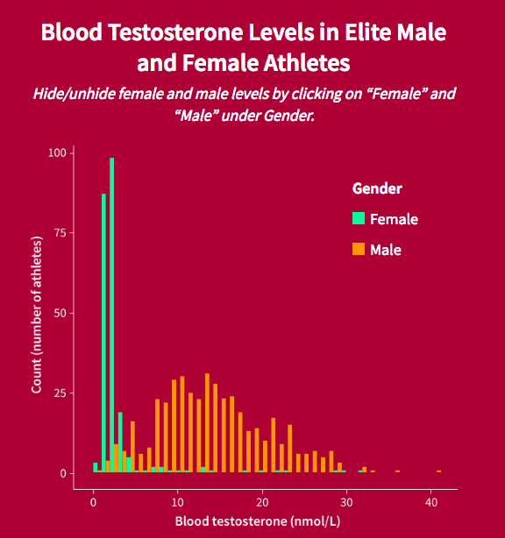
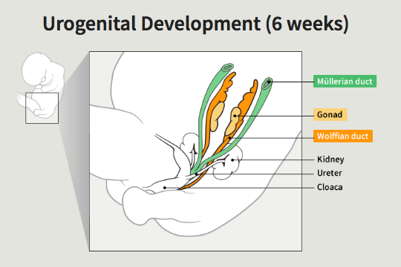
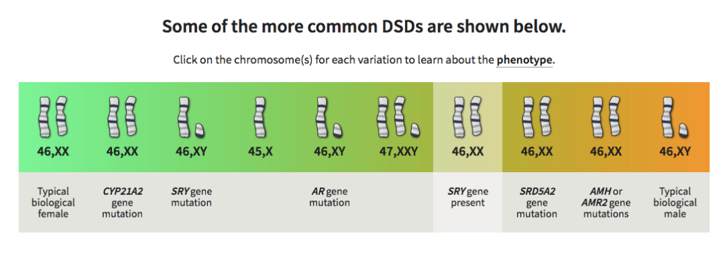
Physiology: Regulation of Sex Determination
“Sex Verification of Athletes.” BioInteractive, in Development.
6
of 10

Slide 7
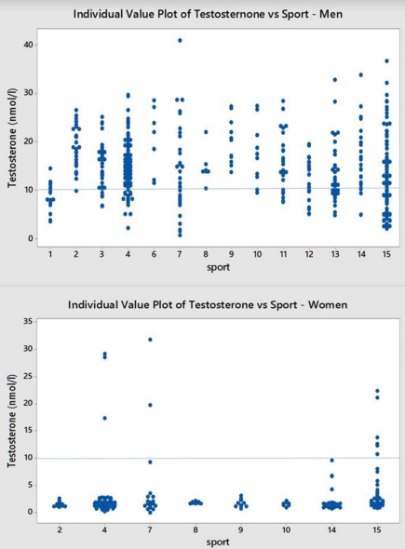
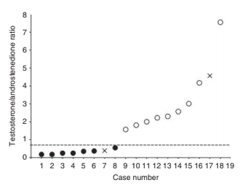
Testosterone Levels in 46, XY Females
Physiology: Regulation of Sex Determination
Niamh Phelan et al. Eur J Endocrinol. 2015; 172:6, 745-751. Sönksen et al. Clinical Diabetes and Endocrinology. 2018; 4:3.
7
of 10

Slide 8
Cell/Molec: Regulation of Gene Expression
OBESITY: A WICKED PROBLEM
Gary Laverty, Thomas J. Peters, Saumya Ramanathan, Juan S. Ramírez Lugo, Denise Signorelli
8
of 10

Slide 9
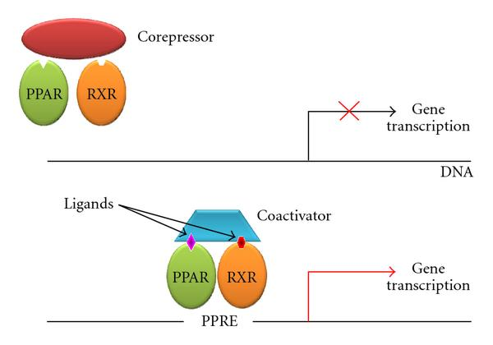
Cell/Molec: Regulation of Gene Expression
Leonardini et al., 2009
Auwerx et al., 2003
9
of 10

Slide 10
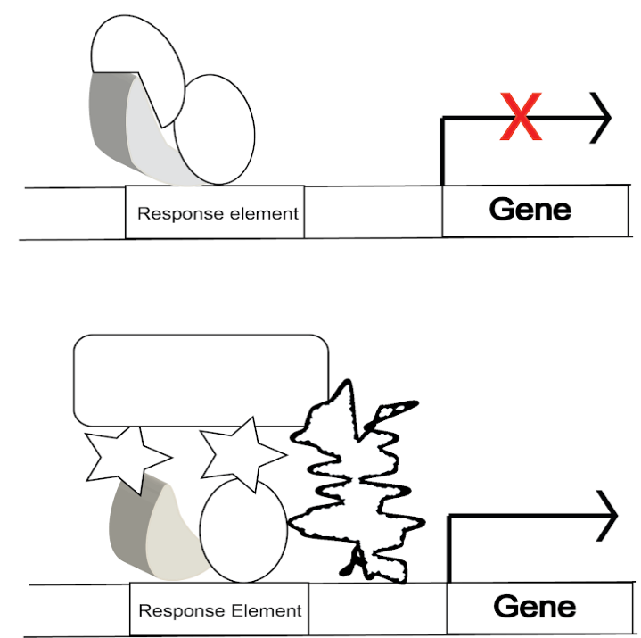
Cell/Molec: Regulation of Gene Expression
Student Coloring Activity
SCENARIO | GENE EXPRESSION (ON/OFF) | PHENOTYPE
Repressor bound
Ligand bound
Different Cell Type
Mutant DNA Response Element
10
of 10

