Slide 1
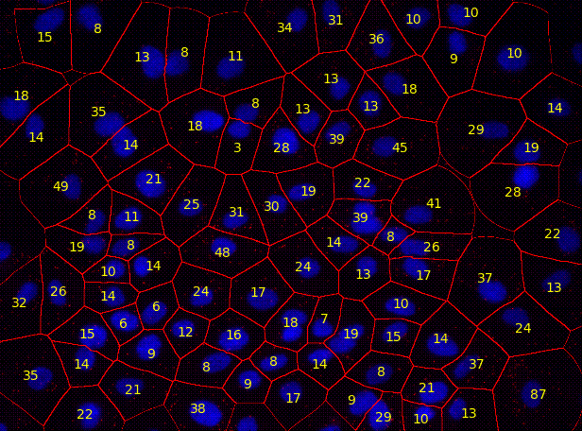
Cell Image Analysis, Part 2
David Julian University of Florida
ASCB Conference 2016

Slide 2
Student Learning Goals
Overall
Use basic bioimage informatics techniques to acquire quantitative data from images of cultured cells, and then use these data to test a hypothesis about the effect of a genetic mutation on cellular phenotypes.
Part 1
Analyze fluorescence emission images of cultured cells to determine the appearance, characteristics, and dimensions of some cellular features and then create a composite, color image.
Part 2
Use image analysis to count and measure the nuclei of control cells and cells with a mutation in a proto-oncogene.

Slide 3
Part 2 Learning Outcomes
Research Skills
Use the ImageJ or CellProfiler application to process images of cultured cells and determine the mean number and size of nuclei.
Use a spreadsheet application to summarize data and perform a t-test.
Learning Objectives
Explain why cancer can result from genetic mutations.
Provide an example of a cell-screening assay.
Describe how bioimage informatics can be used to screen cells for specific phenotypes.

Slide 4
Materials for the Activity
Image set
A549 cells imaged at low magnification.
Labeled with fluorescent dye for DNA.
Three treatment groups:
Control cells
Cells with targeted mutation 1 in gene for EGFR
Cells with targeted mutation 2 in gene for EGFR
Computer with either of two options:
ImageJ (or FIJI)
CellProfiler (Windows, Linux, or OS X)

Slide 5
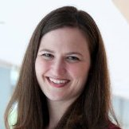
More About the Image Set
Control, Mutated EGFR Allele 1, Mutated EGFR Allele 2
Each set has 8 replicates, and 9 sites (fields) per replicate
Students would analyze the control cells and cells with one of the two EGFR mutations.
Images for all five dyes are available, but this exercise only uses the DNA channel.
Anne Carpenter, Imaging Platform Director, Broad Institute of MIT and Harvard

Slide 6
The Epidermal Growth Factor Receptor (EGFR)
Cell-surface receptor protein activated by binding to specific growth factors including epidermal growth factor, and transforming growth factor α (TGFα).
Part of the ErbB family of tyrosine kinase receptors.
Helps cells respond to signals that regulate normal growth and division.
Upon activation by a growth factor, autophosphorylates intracellular tyrosines, which activates signal transduction cascades that increase cell division and cause changes in cell phenotypes such as cell migration and adhesion.

Slide 7
Make a Prediction
Predict whether the mutation in EGFR will increase, decrease, or have no effect on the number of cells and the average nuclear size.

Slide 8
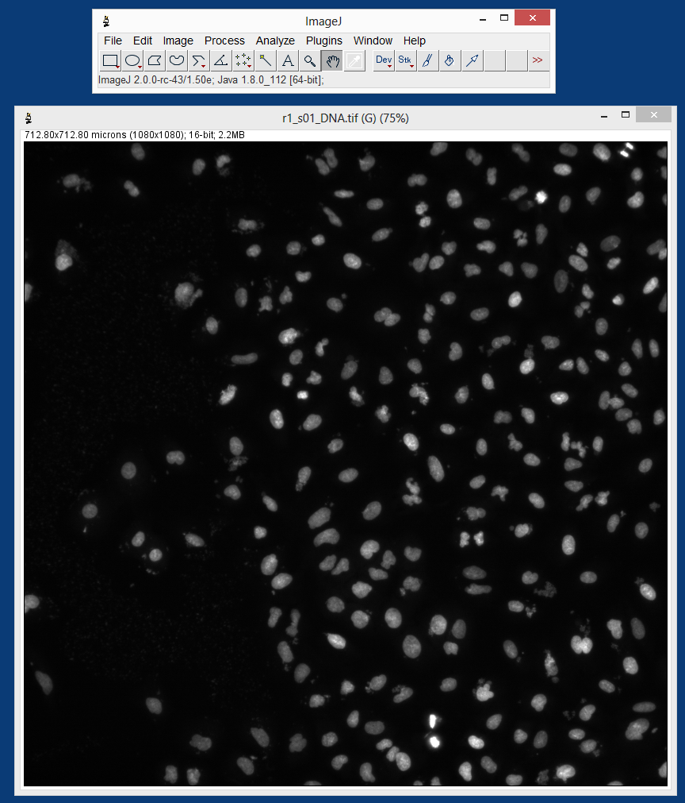
Notes:
Q2: Discuss the distribution of nuclei across the field of view. Are the nuclei randomly distributed? Are the nuclei separated from each other, or are any overlapping or touching? Do the nuclei all have the same shape and brightness?

Slide 9
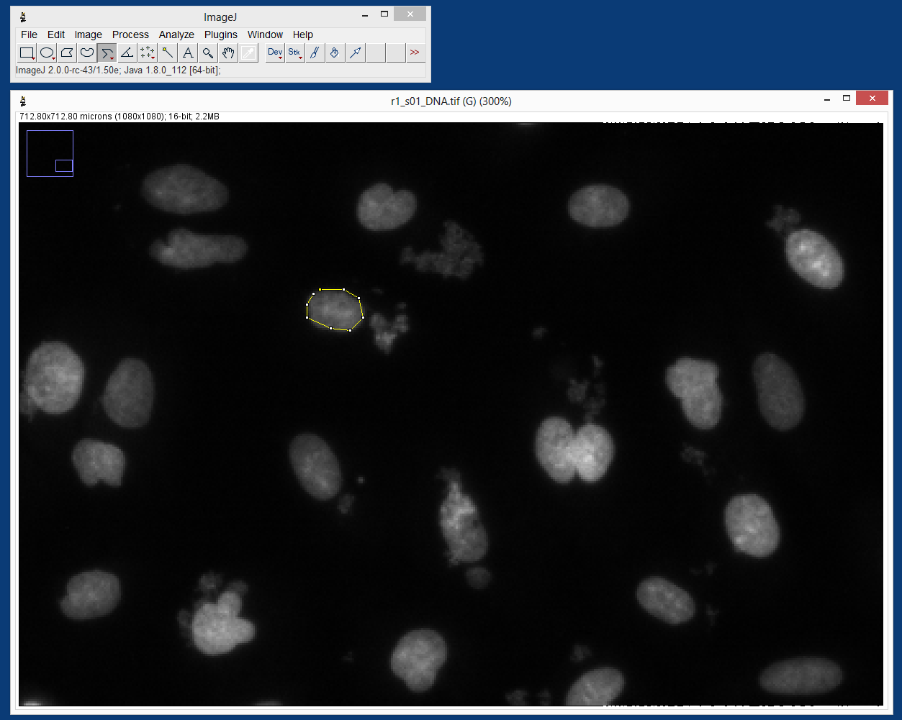
Notes:
Q3: What are the minimum and maximum areas of the nuclei you sampled?

Slide 10
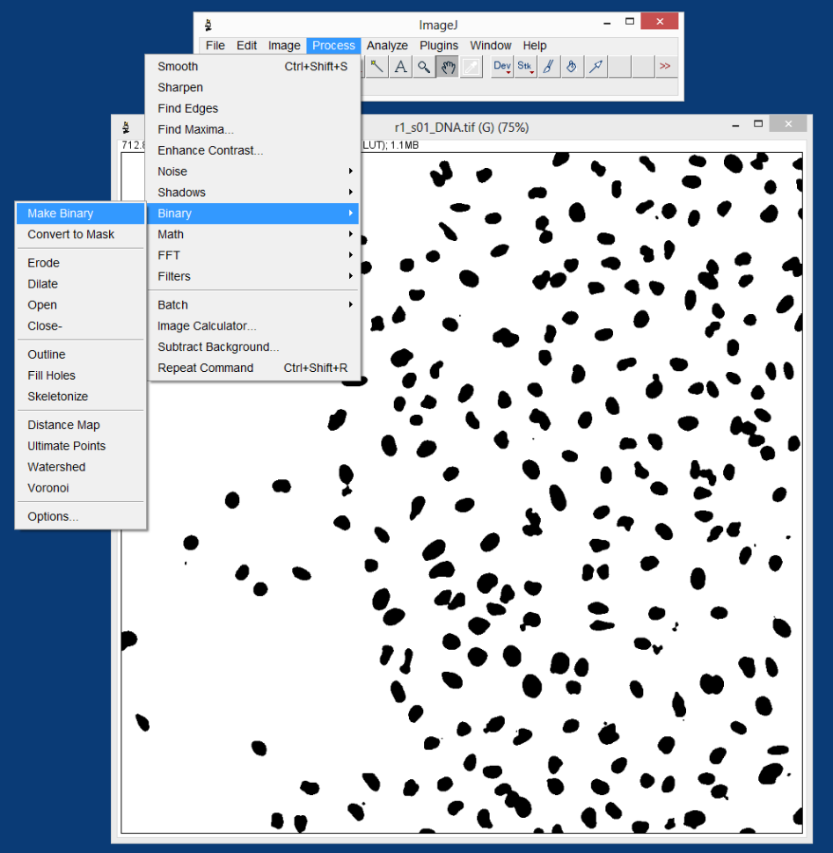

Slide 11
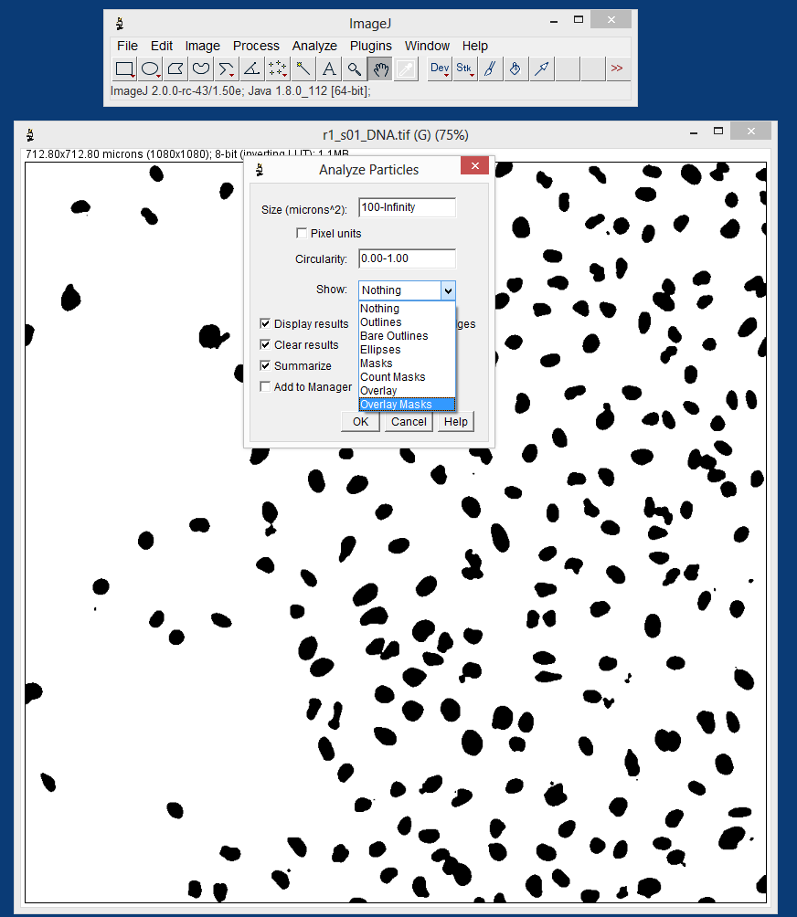

Slide 12
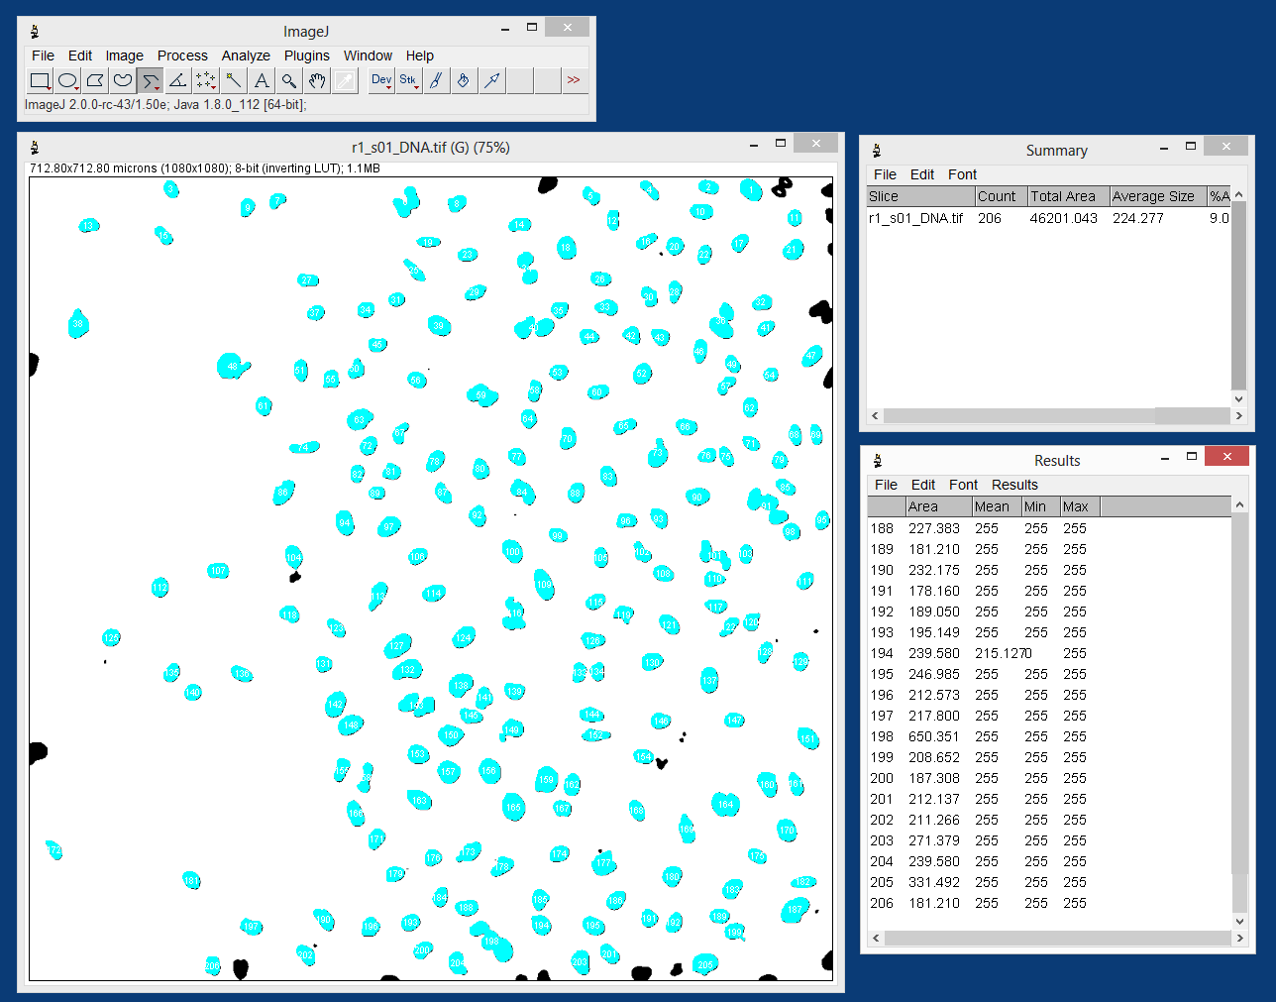
Notes:
Q4: What are likely reasons why the various black particles were not included?

Slide 13
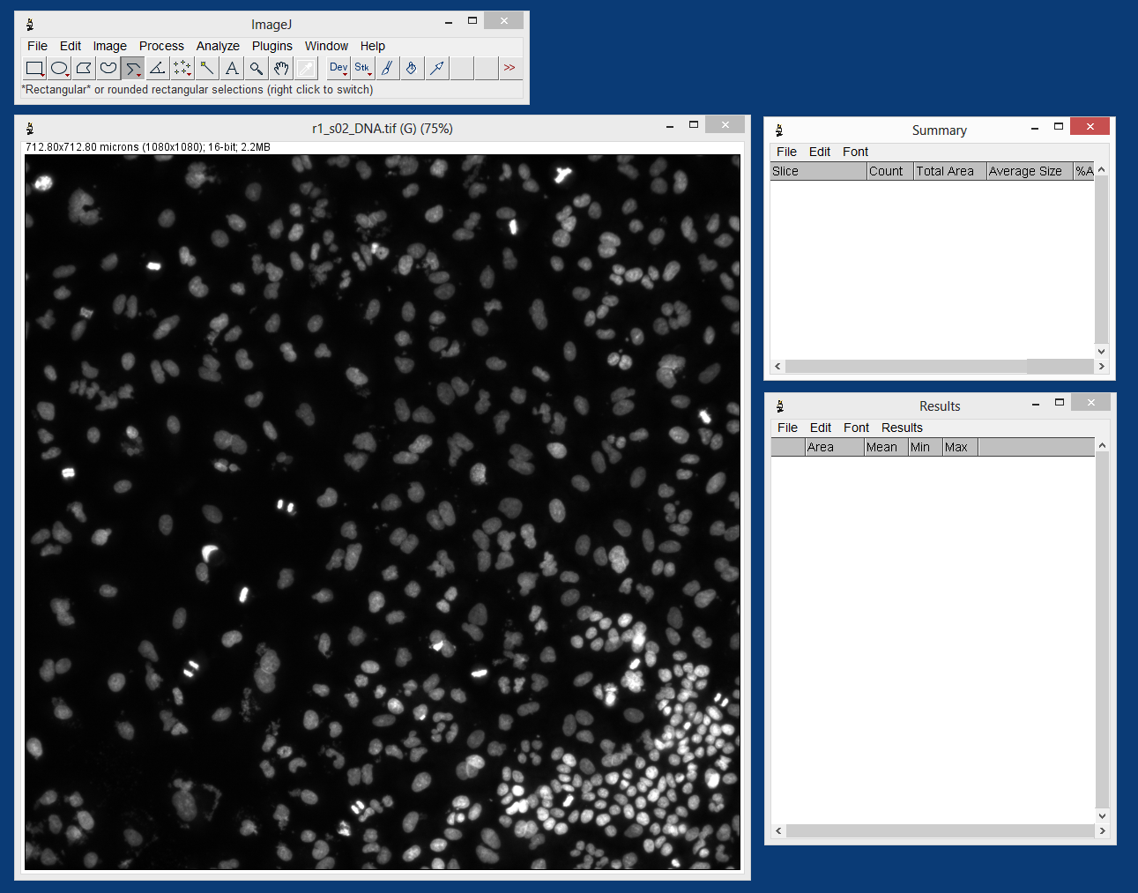

Slide 14
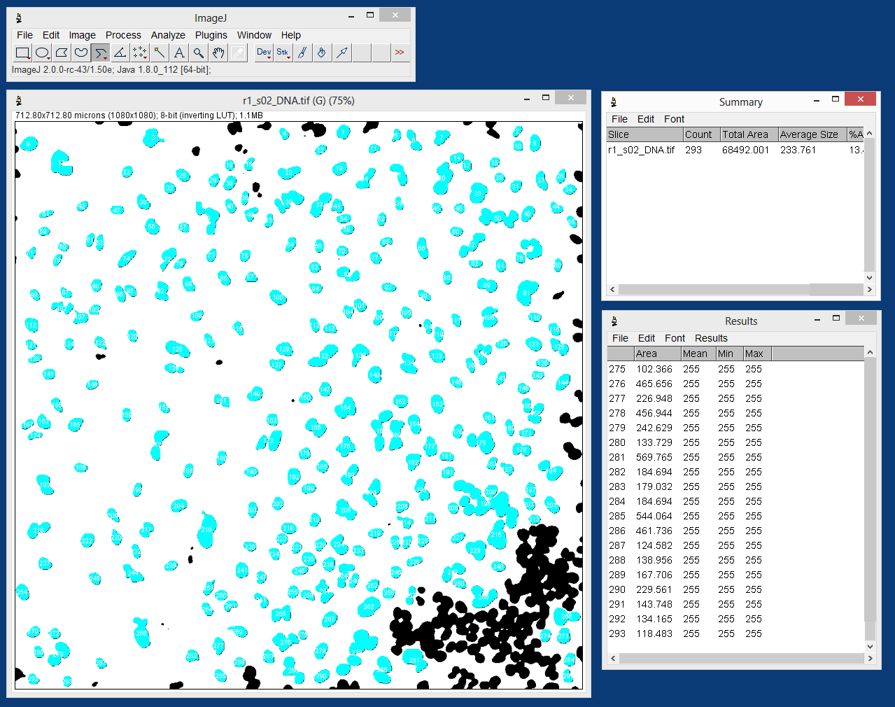
Notes:
Q5: Why did the automated analysis not count and measure the nuclei as accurately as in the previous image?

Slide 15
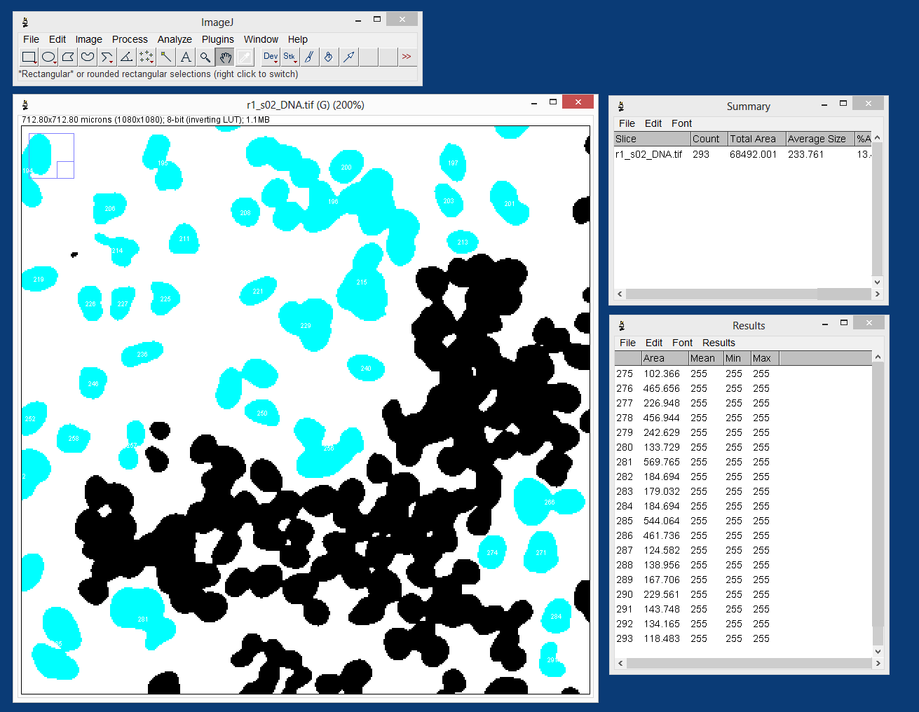
Notes:
Q4: What are likely reasons why the various black particles were not included?

Slide 16
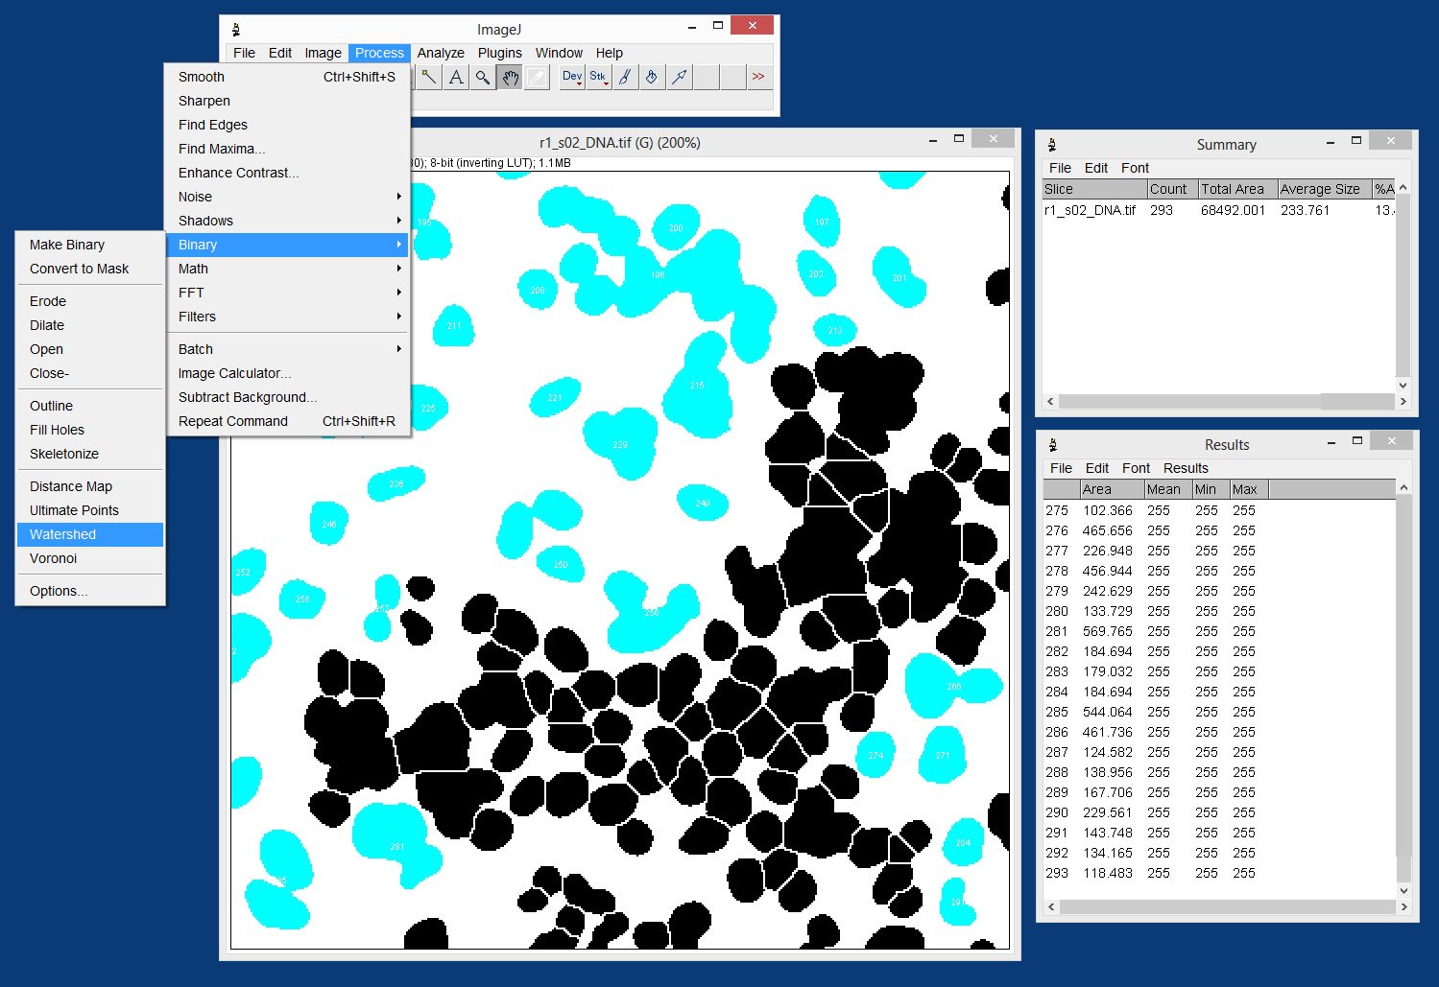
Notes:
Q6: Are there still black particles that you think should have been included?
Q7: What could you change to include more of the particles?

Slide 17
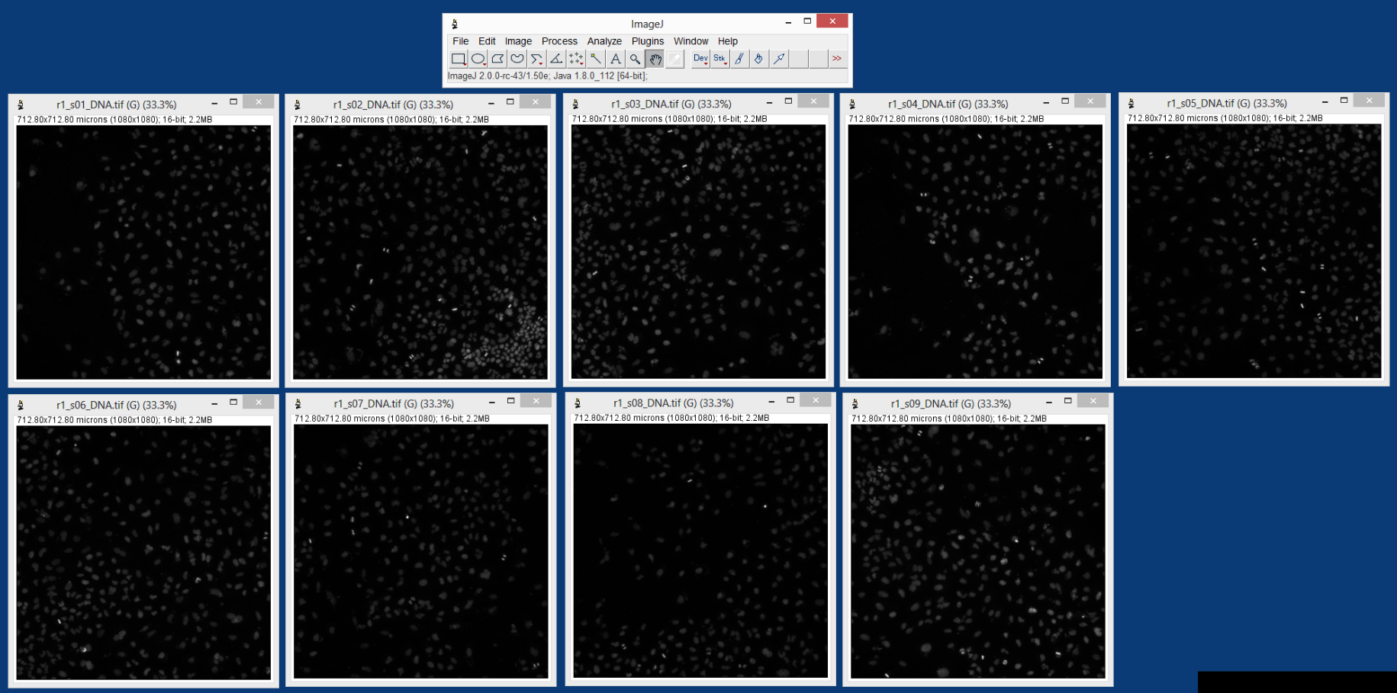

Slide 18
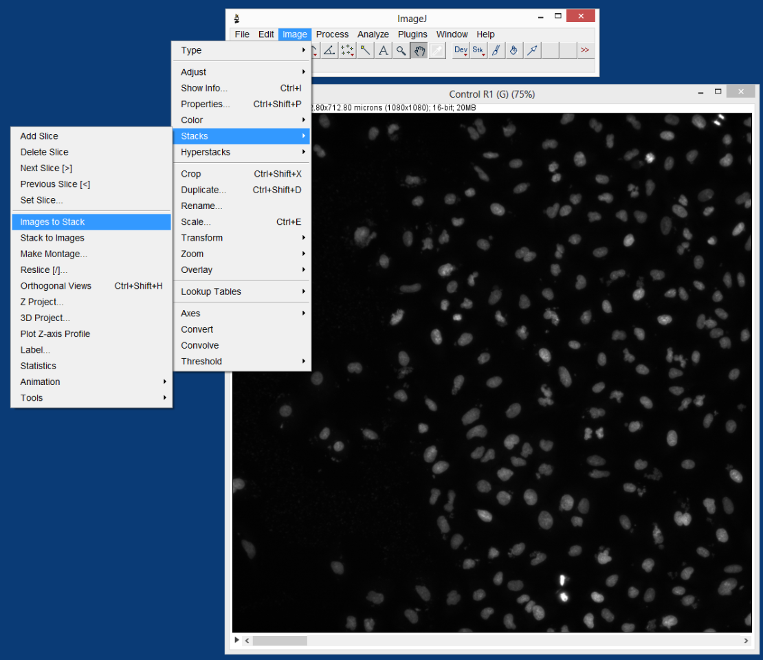

Slide 19
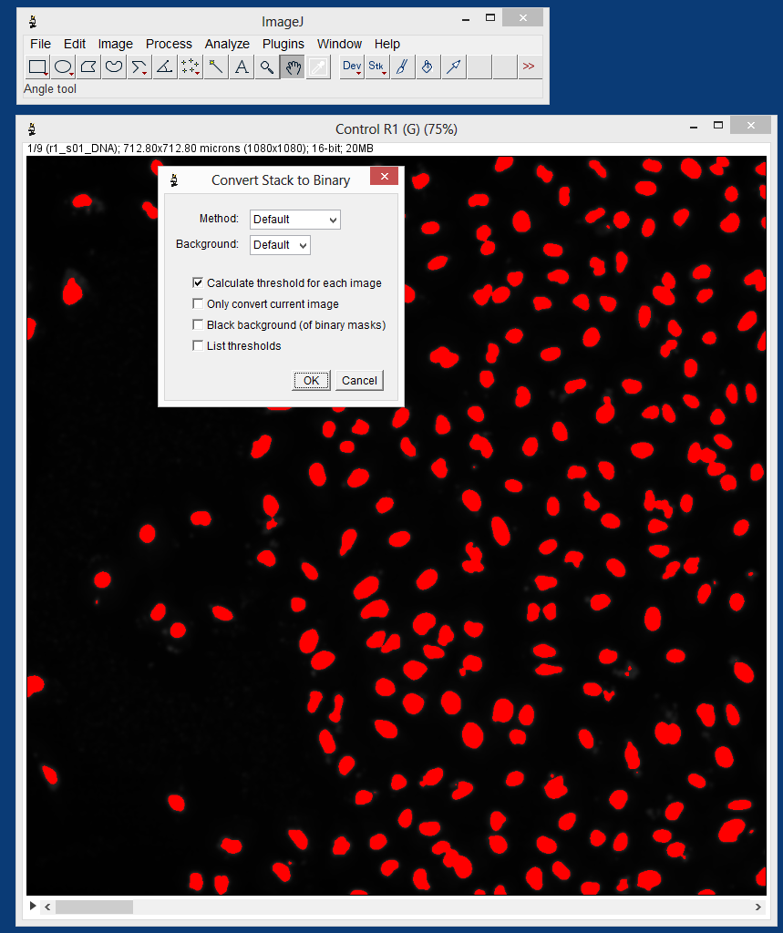

Slide 20
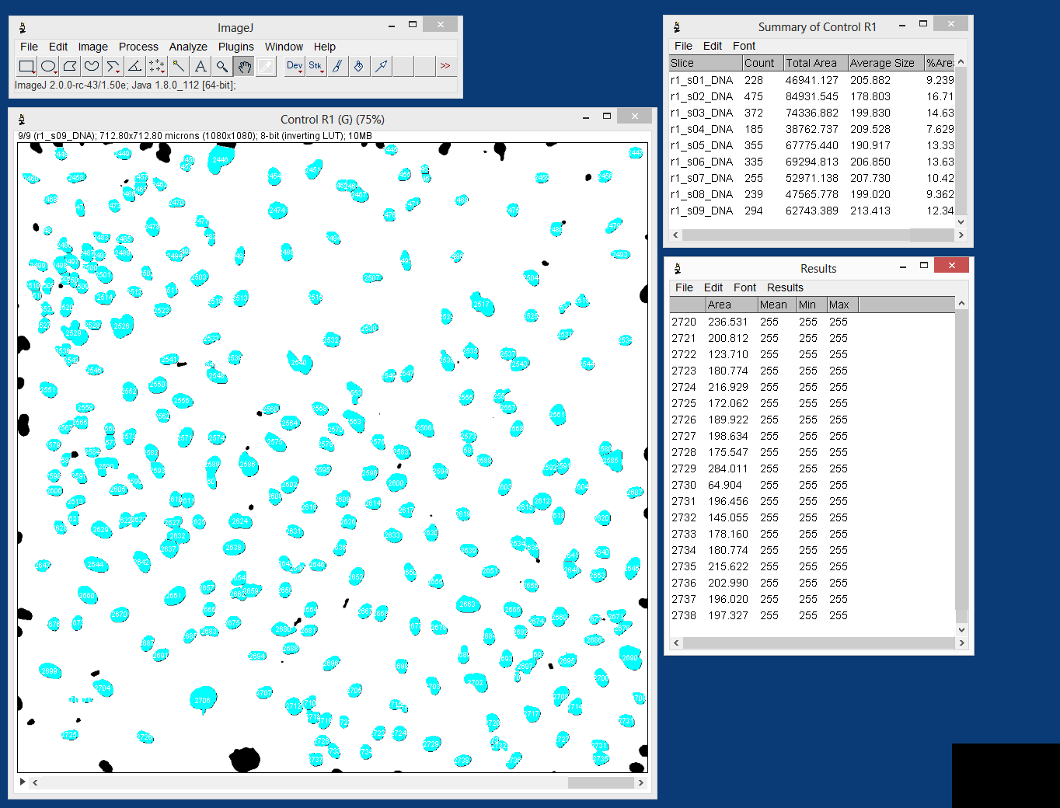

Slide 21
With your student hats on….
Can each of the nine sites (images) within each replicate be considered a replicate for the purposes of statistical analysis?
That is, if you determined the mean nuclei count for nine images for each of five replicates, do you have 45 replicate measurements or only five replicate measurements?

Slide 23
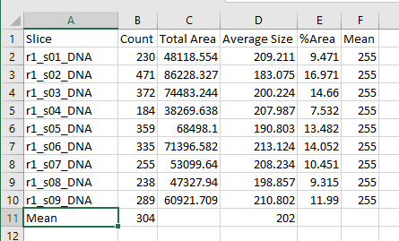
Students Determine Means for Each Replicate

Slide 24
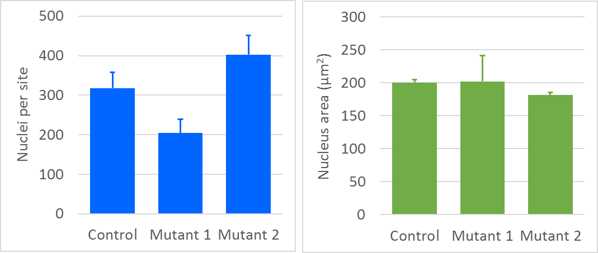
Students Conduct t-Test Between the Control and Their Mutant
t-Test P values
Count |  | Area
Ctrl vs. Mut1 | Ctrl vs. Mut2 | Ctrl vs. Mut1 | Ctrl vs. Mut2
0.000032 | 0.002029 | 0.917006 | 0.167079

Slide 25
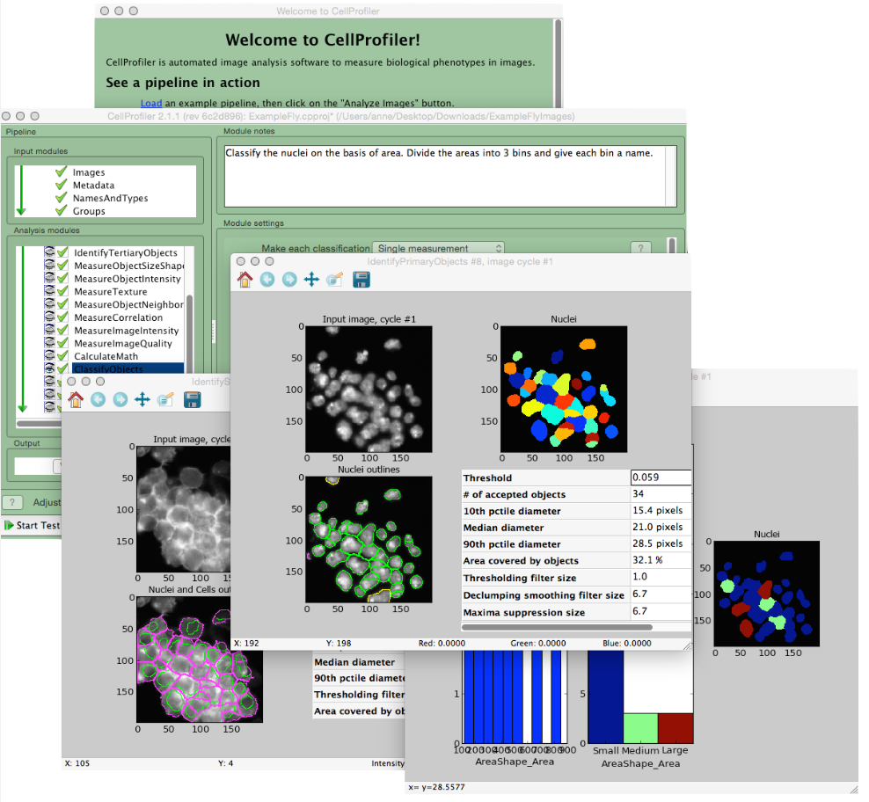
CellProfiler Option

Slide 26
Resources
ImageJ: https://imagej.nih.gov/ij/
Free, open-source, fast, versatile, widely-used biomedical image analysis software. Versions are available for most operating systems. Runs on almost any computer.
CellProfiler: http://cellprofiler.org/
Free, open-source, very powerful, modular image analysis software for image batch processing and data analysis. An intuitive interface that can handle many thousands of images, but processing takes time, so classroom use requires fast computers.
HHMI BioInteractive: https://www.hhmi.org/biointeractive
Rich, diverse multimedia resources to bring scientific discovery into the classroom.
X-Laboratory: http://x-laboratory.org/
Latest versions of this exercise, along with other cross-disciplinary laboratory exercises.

